Slide 1
Reproduce Research Result
Divyashree, Doddbele Aswatha Narayana
Mtknr : 23660613

Slide 2
A Hierarchical Probabilistic U-Net for Modeling Multi-Scale Ambiguities

Slide 3
Overview
Motivation
sPU-Net
Limitations
HPU-Net
Training
Results

Slide 4
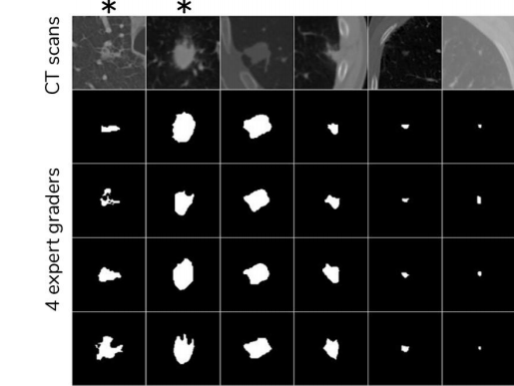
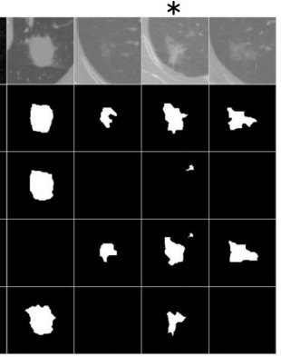
Motivation
CT Scan
4 expert graders
Source : Kohl, Simon AA, et al. "A hierarchical probabilistic u-net for modeling multi-scale ambiguities." arXiv preprint arXiv:1905.13077 (2019).
Notes:
Medical images can be ambiguous. On the left side you can see the lung CT scan images showing potential abnormalities, and to the right of it you see the annotation from 4 independent expert graders. We can observe that, they vary significantly.

Slide 5
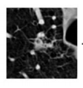

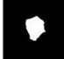
U-Net
Predicted Segmentation
Image
U-Net
Source : Kohl, Simon AA, et al. "A hierarchical probabilistic u-net for modeling multi-scale ambiguities." arXiv preprint arXiv:1905.13077 (2019).
Notes:
Semantic segmentation is usually approached in a deterministic fashion. That is, assumes one to one mapping between images and segmentations. And U-Net is one of the successful deterministic model. However, this does not account for the ambiguities in medical images.

Slide 6


Hierarchical Probabilistic U-Net (HPU-Net)
Image
U-Net + Conditional VAE
Predicted Samples
Source : Kohl, Simon AA, et al. "A hierarchical probabilistic u-net for modeling multi-scale ambiguities." arXiv preprint arXiv:1905.13077 (2019).
Notes:
So, they propose an HPU-Net, the objective of which is to model distributions of plausible segmentations given an image. They combine U-Net with conditional variational auto encoder.
As the HPU-NET is based on their previous work from the paper "probabilistic U-net for segmentation of ambiguous images".

Slide 7
Probabilistic U-Net (sPU-Net)
Sampling
Training
Notes:
sPU-Net:
Sampling
During inference, it uses a prior net, which is conditioned on the image to predict a distribution over a low-dimensional latent space. This prior distribution is modelled as an axis aligned Gaussian, with mean (mu)and variance (sigma).
Random samples are drawn from this prior distribution and are broadcasted to N channels (N=6), concatenated with the last activation map of U-net and passed through a combiner head (three 1 x 1 convolutions) so as to produce consistent segmentations for each such sample.

Slide 8
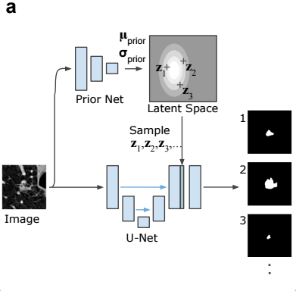
Probabilistic U-Net (sPU-Net)
Sampling
Source : Kohl, Simon, et al. "A probabilistic u-net for segmentation of ambiguous images." Advances in neural information processing systems 31 (2018).
Notes:
sPU-Net:
Sampling
During inference, it uses a prior net, which is conditioned on the image to predict a distribution over a low-dimensional latent space. This prior distribution is modelled as an axis aligned Gaussian, with mean (mu)and variance (sigma).
Random samples are drawn from this prior distribution and are broadcasted to N channels (N=6), concatenated with the last activation map of U-net and passed through a combiner head (three 1 x 1 convolutions) so as to produce consistent segmentations for each such sample.

Slide 9
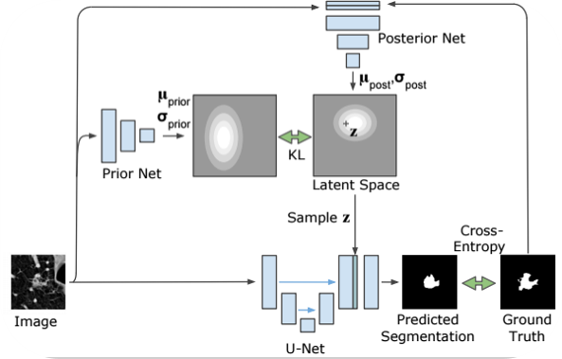
Probabilistic U-Net (sPU-Net)
Training
Source : Kohl, Simon, et al. "A probabilistic u-net for segmentation of ambiguous images." Advances in neural information processing systems 31 (2018).
Notes:
Training
During training alongside the prior net, a posterior net is added, which is conditioned on both the image and its ground truth. It predicts an axis aligned Gaussian with mean and variance over the a latent space. Random sample from the posterior distribution is concatenated with the last U-net activation map, passes through a combiner to obtain a prediction.
The loss is the pixel-wise cross-entropy between prediction and ground truth and a weighted KL term that pulls the posterior and prior towards each other. So that, over the dataset, the prior learns to cover the space of plausible segmentation variants for each image.

Slide 10
Limitations of sPU-Net
CT Scan
4 expert graders
Single global latent vector.
Coarse or blobby samples.
Does not scale well to multi-scale
ambiguities.
Samples
Source : Kohl, Simon, et al. "A probabilistic u-net for segmentation of ambiguous images." Advances in neural information processing systems 31 (2018).

Slide 11
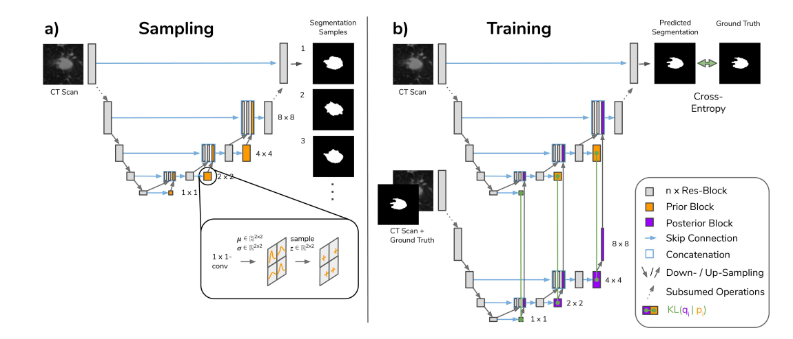
HPU-Net
Source : Kohl, Simon AA, et al. "A hierarchical probabilistic u-net for modeling multi-scale ambiguities." arXiv preprint arXiv:1905.13077 (2019).
Notes:
Sampling : In a conventional U-Net, the U-Net decoder’s features of every resolution are up-sampled and then concatenated with the features of the U-Net’s encoder from
the respective resolution above. In our proposed architecture, sampling uses a hierarchical conditional prior inside the U-Net decoder.
After inferring from the U-net encoder, at the bottom of the U, a Gaussian with mean and variance is predicted via 1 x 1 convolutions. which is then sampled and added to the decoder features. Followed by usual decoder steps- up sample, concatenate with the encoder feature. This process is repeated at every decoder scale.
Training:
Training uses a hierarchical posterior that mirrors the hierarchical prior inside the U-Net decoder. The posterior Q is modeled in form of a separate network.
For each decoder scale, the current decoder features together with the ground-truth mask 𝑌 are used to predict a Gaussian (mean and variance maps via 1×1 convolutions).
We sample the latent at that scale from this posterior and pass it through the decoder; the goal is to reconstruct the given segmentation Y.
The reconstruction loss is pixel-wise cross-entropy between the prediction and Y. In addition, at every scale we add a KL term that matches the posterior at that scale to the prior at that scale (conditioned on the coarser latents).
Together, this is the standard ELBO: reconstruction term plus a weighted sum of per-scale KL terms.
In practice, plain ELBO led to under-trained priors. So, we use GECO: enforce a target reconstruction level and use a Lagrange multiplier to balance reconstruction vs. KL over training.
Early on, GECO puts more pressure on reconstruction; once the target is reached, it gradually shifts pressure to the KL so the prior aligns with the posterior.
We also apply online hard-negative mining: during backprop, we keep only the worst pixels in the batch (the top-k percentile of errors, with k=2%) and stochastically pick that percentile.
This focuses learning on the most difficult pixels and stabilizes training.
At test time, the posterior is not used. We sample latents only from the learned prior and run the decoder to generate diverse, consistent segmentations.

Slide 12
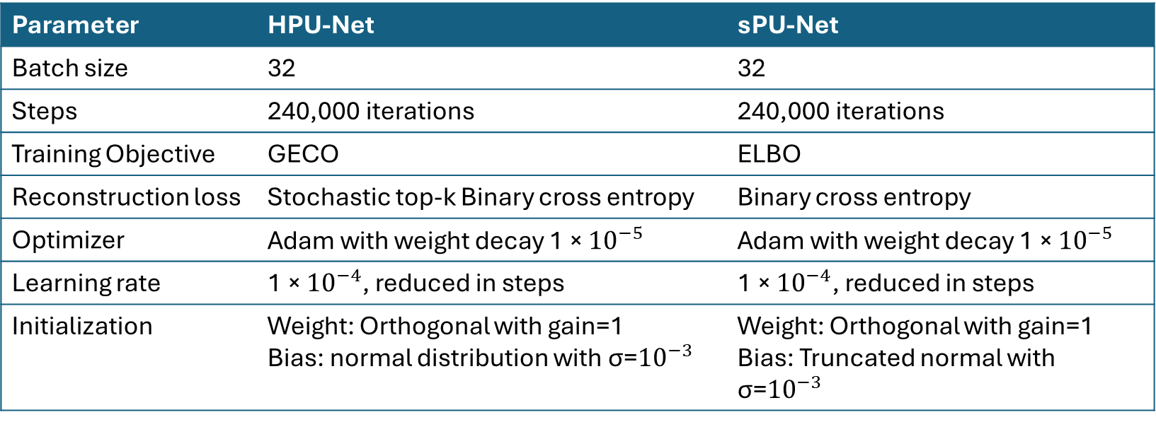
Training Parameters
Parameter | HPU-Net | sPU-Net
Batch size | 32 | 32
Steps | 240,000 iterations | 240,000 iterations
Training Objective | GECO | ELBO
Reconstruction loss | Stochastic top-k Binary cross entropy | Binary cross entropy
Optimizer | Adam with weight decay 1 × ${10}^{−5}$ | Adam with weight decay 1 × ${10}^{−5}$
Learning rate | 1 × ${10}^{−4}$, reduced in steps | 1 × ${10}^{−4}$, reduced in steps
Initialization | Weight: Orthogonal with gain=1 Bias: normal distribution with σ=${10}^{−3}$ | Weight: Orthogonal with gain=1 Bias: Truncated normal with σ=${10}^{−3}$

Slide 13
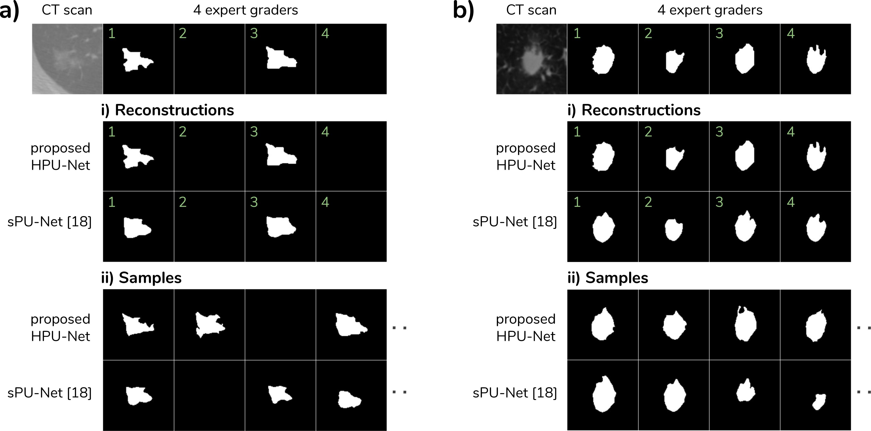
Results - original
Source : Kohl, Simon AA, et al. "A hierarchical probabilistic u-net for modeling multi-scale ambiguities." arXiv preprint arXiv:1905.13077 (2019).

Slide 14
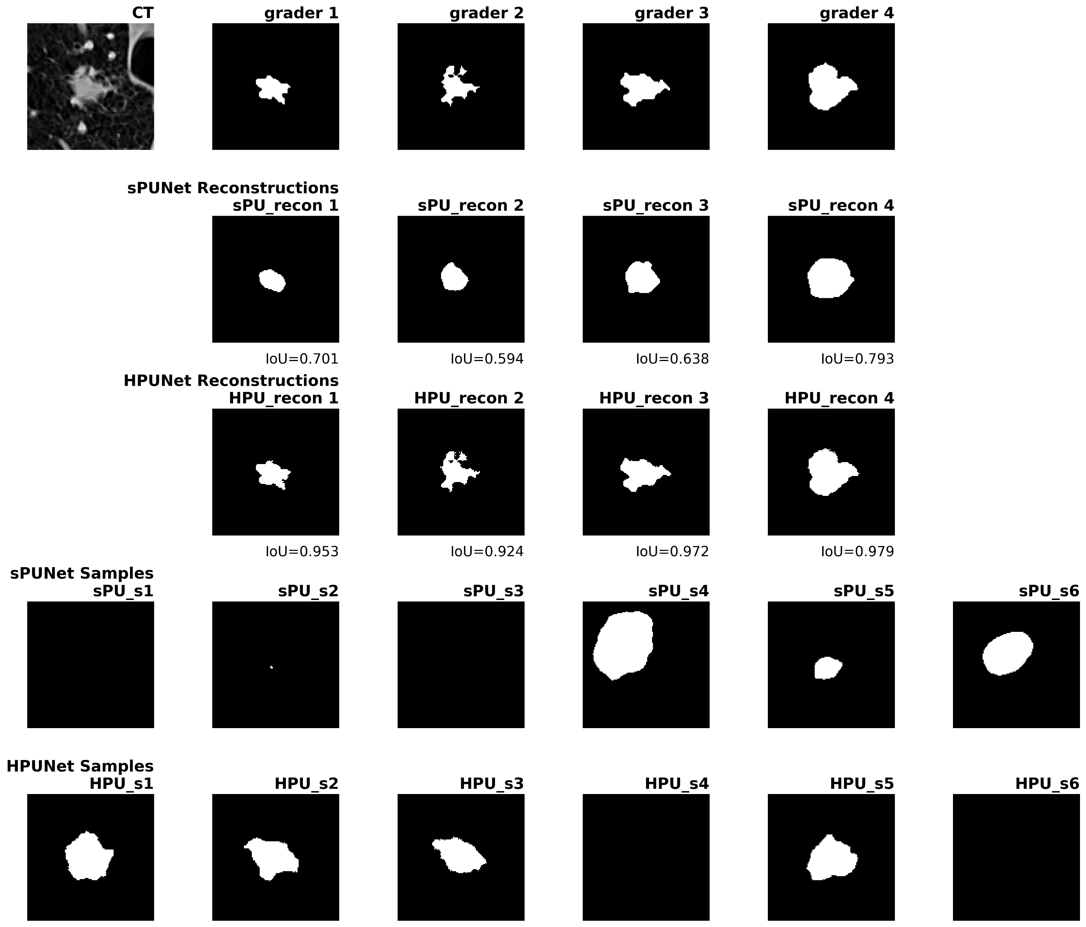
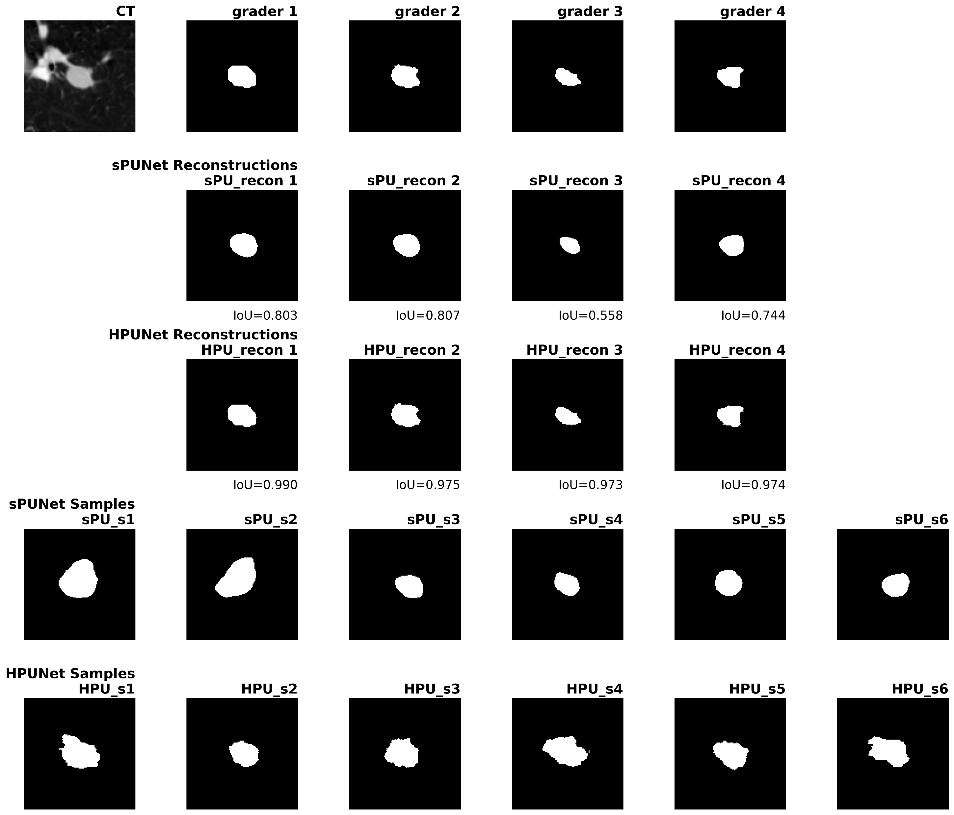
Results - reproduced
Notes:
I observed that the HPU-net with hierarchical latent sampling captured both the global structure and local fine details consistently well compared to the sPU-Net.

Slide 15
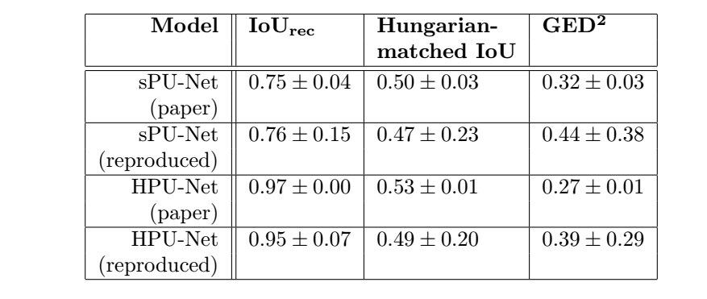
Performance metrics comparison

Slide 16

THANK YOU

Slide 17
Questions?

Slide 19
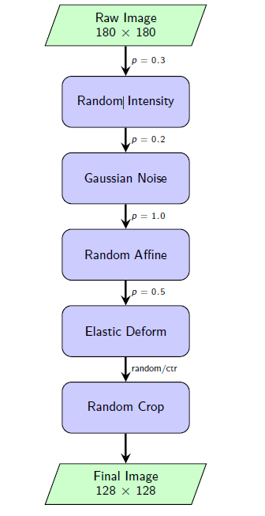
Data
LIDC 2D crop
Train images - 8843, Test images - 1980
Train masks – 35372, Test masks – 7920
Augmentation: Intensity: 30% chance, Noise: 20% chance, Affine: 100% chance (always), Elastic: 50% chance
We resampled the CT scans to 0.5mm x 0.5mm in-plane resolution and then cropped 2D images of size 180 x 180 pixels, centered on the abnormality position. The abnormality positions are those where at least one of the experts segmented an abnormality and we assumed that two masks from different graders correspond to the same abnormality if their tightest bounding boxes overlap. We only used those abnormaliies that were specified as a polygon (outline) in the XML files of the LIDC dataset, disregarding the ones that only have center of shape. That is, according to the LIDC paper we use the ones that are larger than 3mm, and filter out the others, that are clinically less relevant. We also filterd out each Dicom file whose absolute value in the XML element of SliceLocation differs from the absolute value of the last element in ImagePositionPatient.
This preprocessing results in 8843 images for training, 1993 for validation and 1980 for testing (corresponding to 530, 111 and 103 patients respectively).

Slide 20
Architecture
HPU-Net
8 scale U-Net, preactivated residual blocks
1 x 1 conv at the bottom
Down sampling – average pooling
Up sampling – nearest neighbor interpolation
Channels – 24 up to 192.
sPU-Net
5 scale U-Net
1 x 1 conv at the bottom
Down sampling – bilinear interpolation
Up sampling – bilinear interpolation
Channels – 32 up to 512.

Slide 21
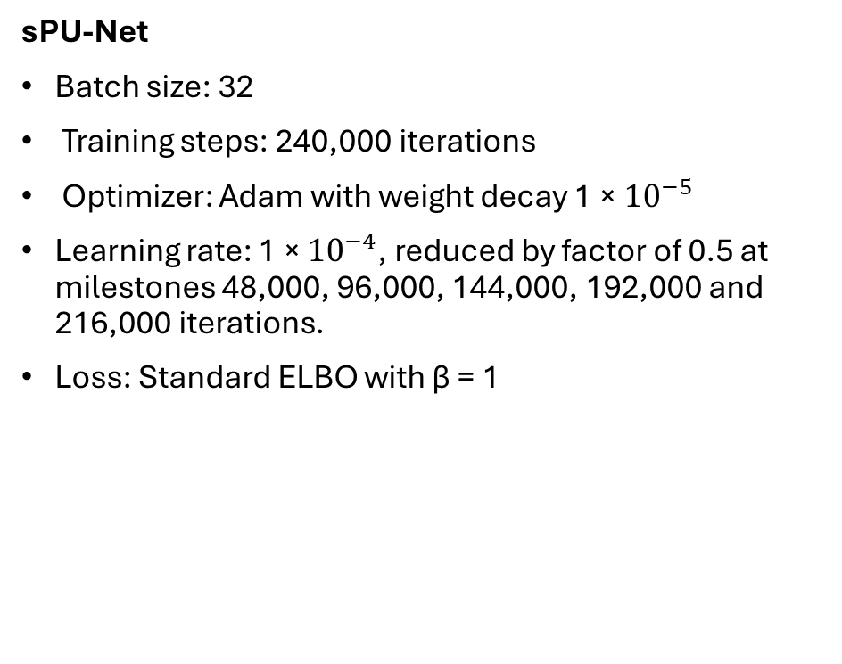
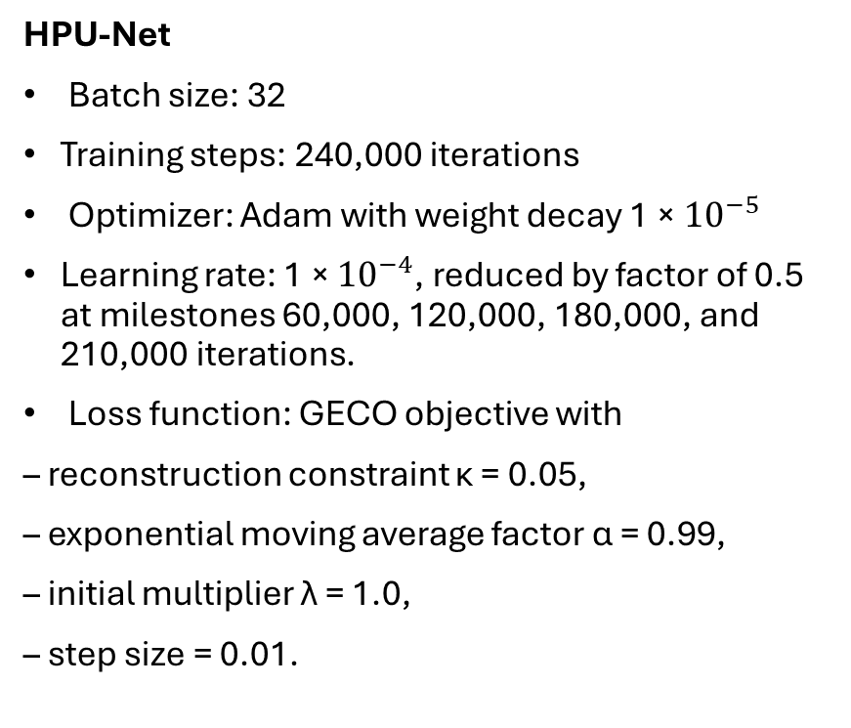
Training
HPU-Net
Batch size: 32
Training steps: 240,000 iterations
Optimizer: Adam with weight decay 1 × ${10}^{−5}$
Learning rate: 1 × ${10}^{−4}$, reduced by factor of 0.5 at milestones 60,000, 120,000, 180,000, and 210,000 iterations.
Loss function: GECO objective with
– reconstruction constraint κ = 0.05,
– exponential moving average factor α = 0.99,
– initial multiplier λ = 1.0,
– step size = 0.01.
sPU-Net
Batch size: 32
Training steps: 240,000 iterations
Optimizer: Adam with weight decay 1 × ${10}^{−5}$
Learning rate: 1 × ${10}^{−4}$, reduced by factor of 0.5 at milestones 48,000, 96,000, 144,000, 192,000 and 216,000 iterations.
Loss: Standard ELBO with β = 1

Slide 22
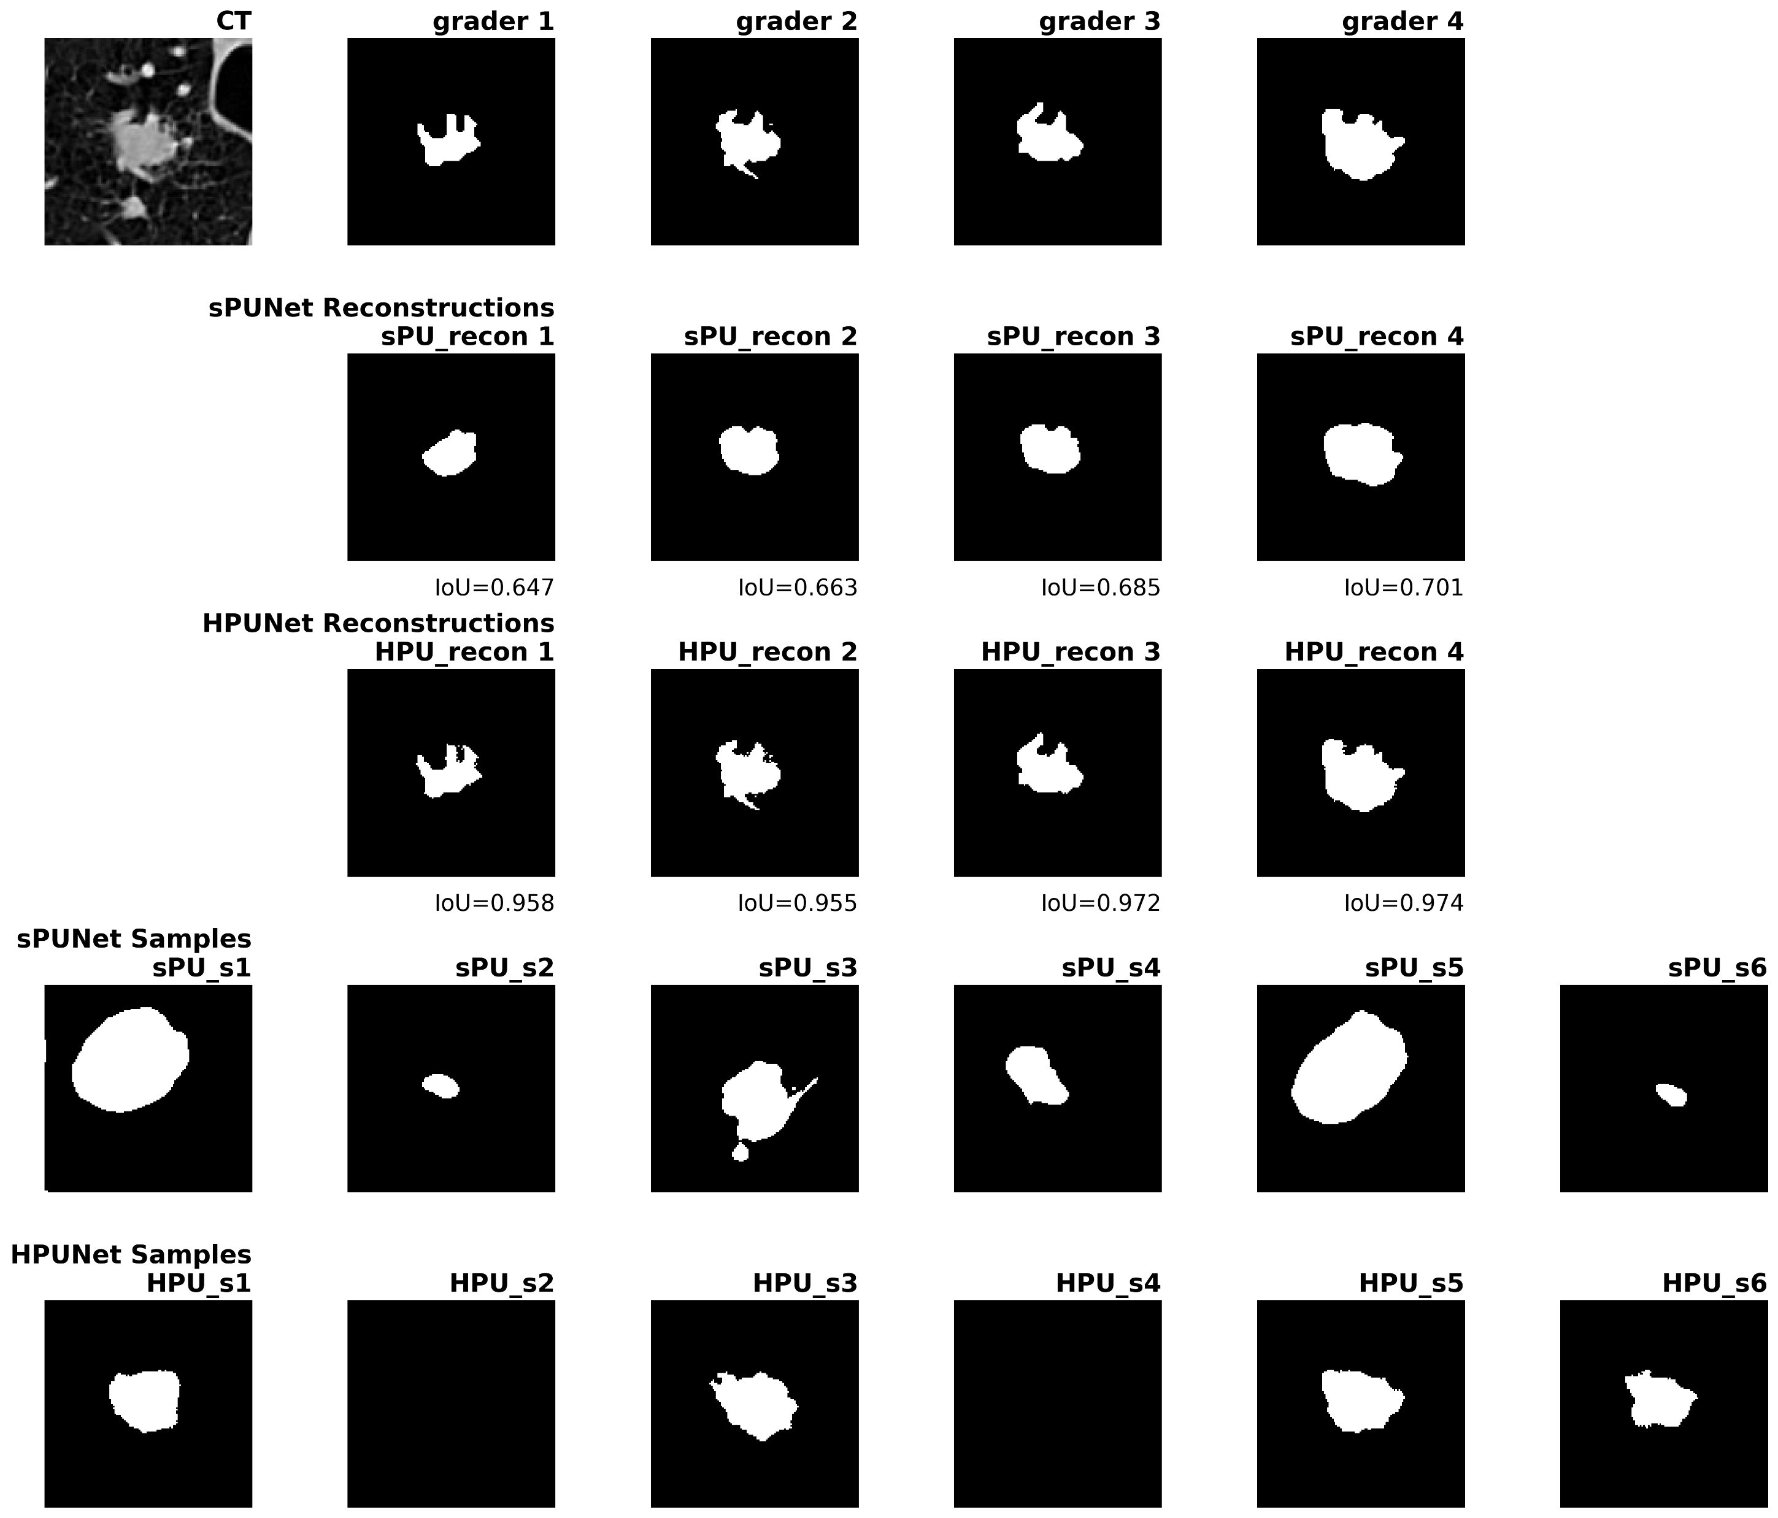
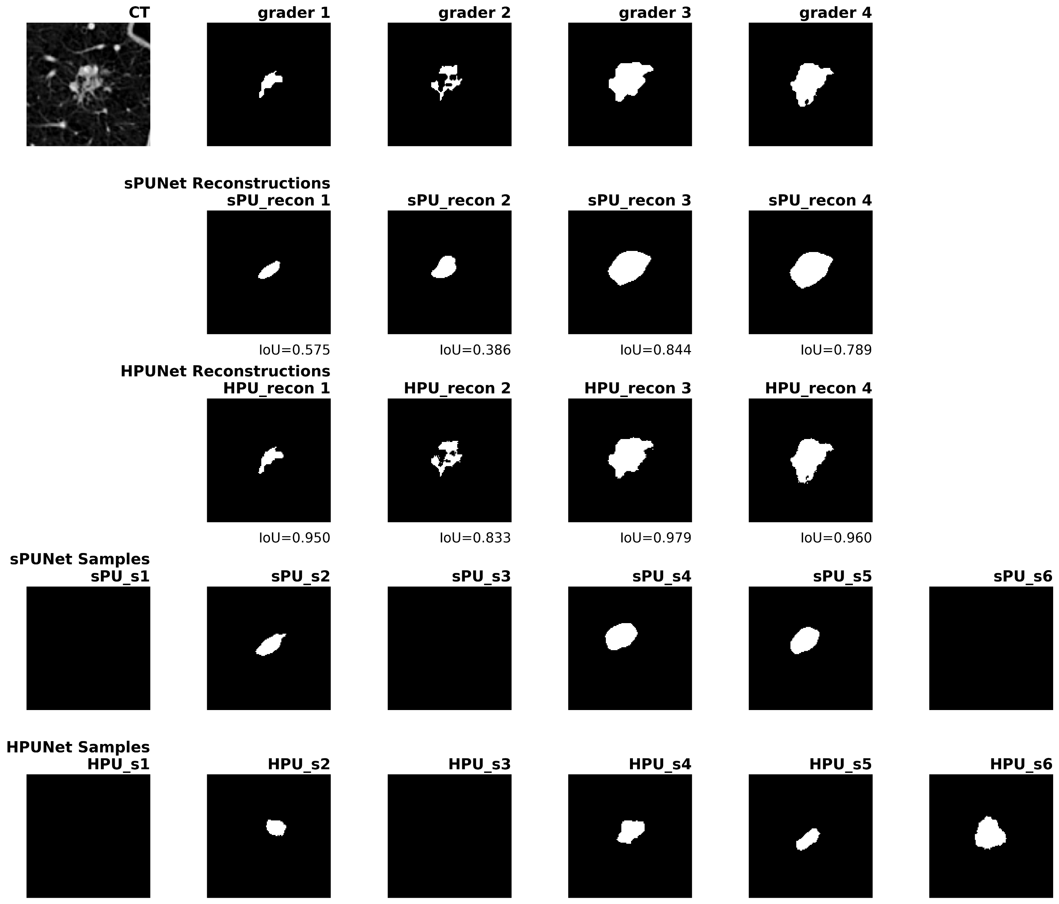
Results

Slide 23


Results

Slide 24

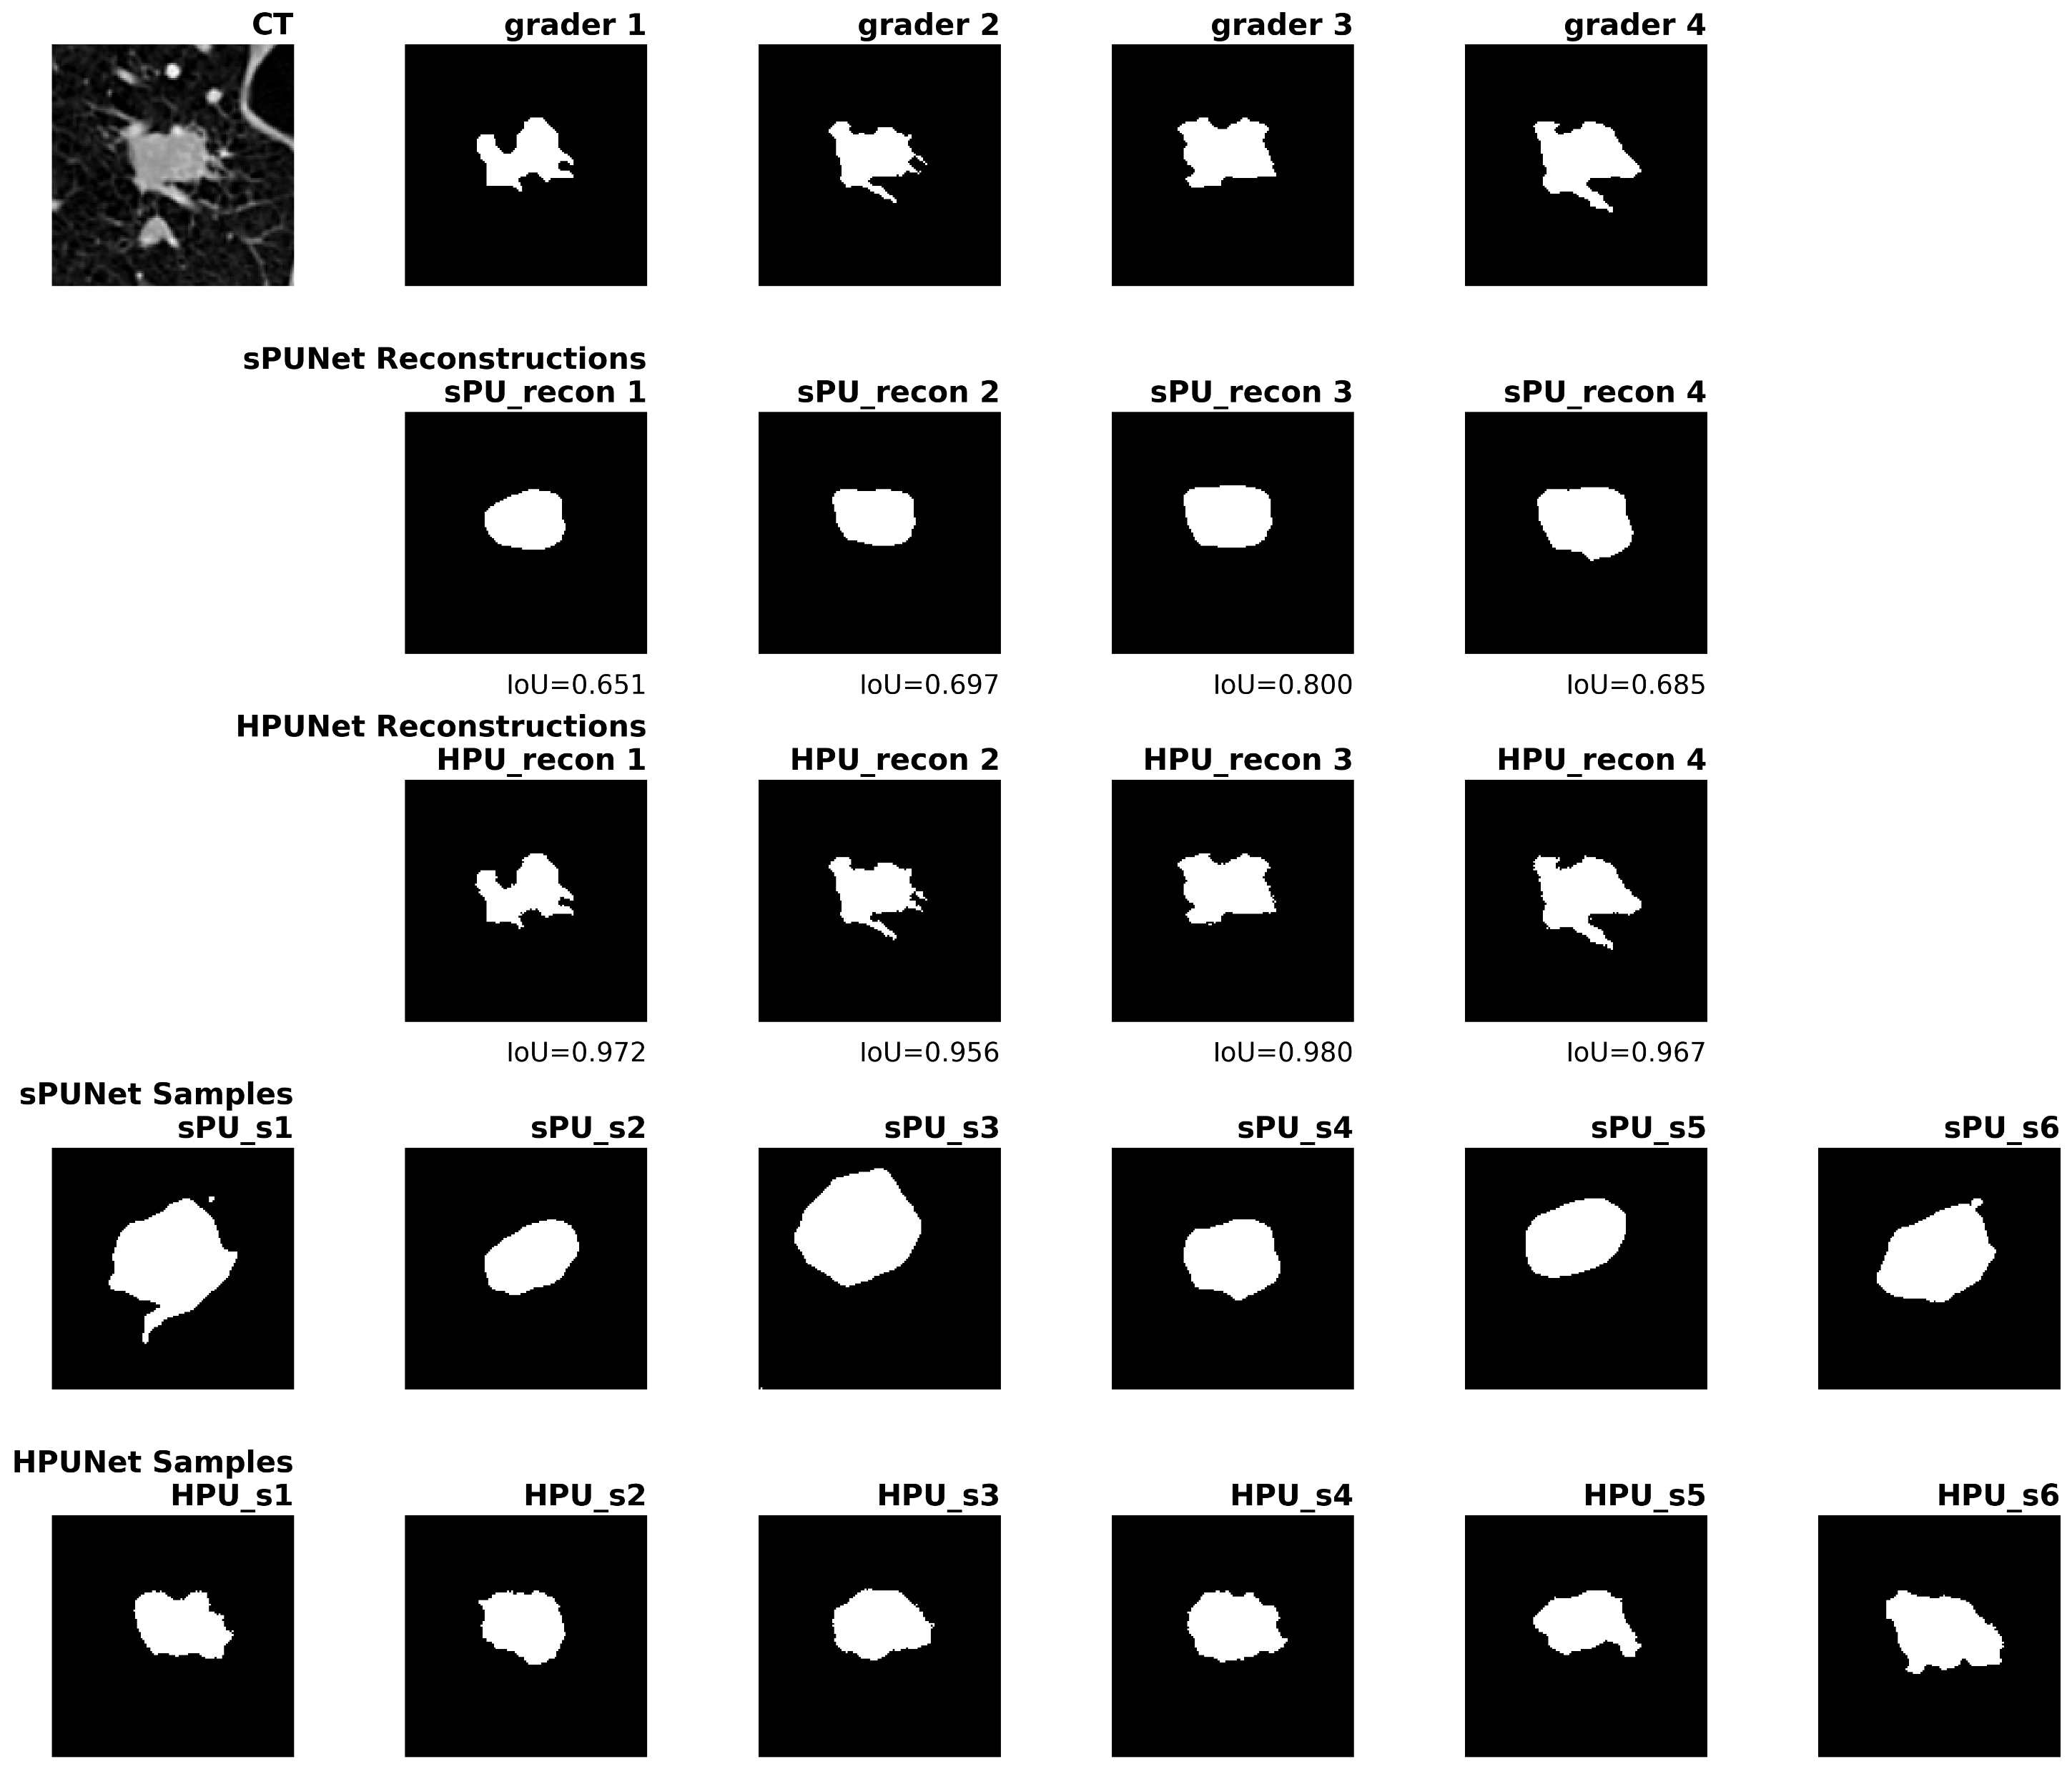
Results

Slide 25
Results

Slide 26
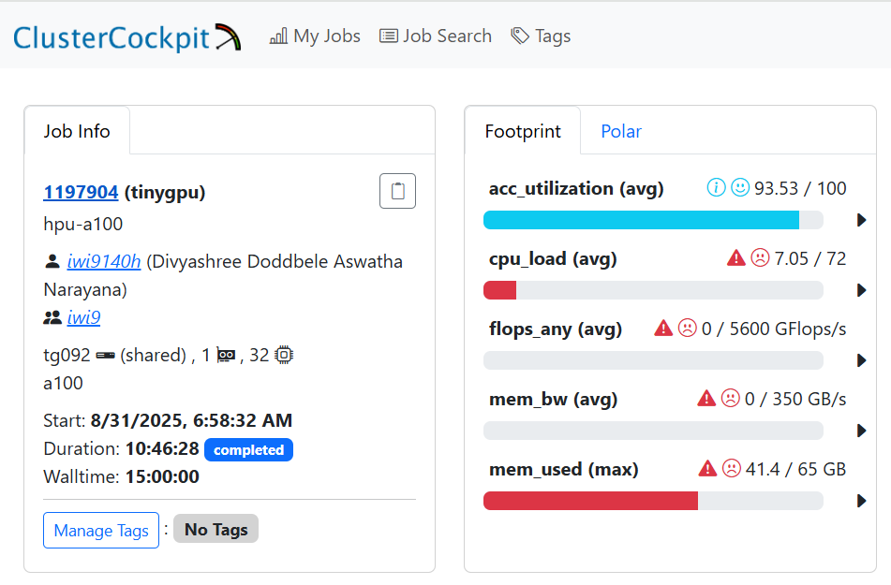
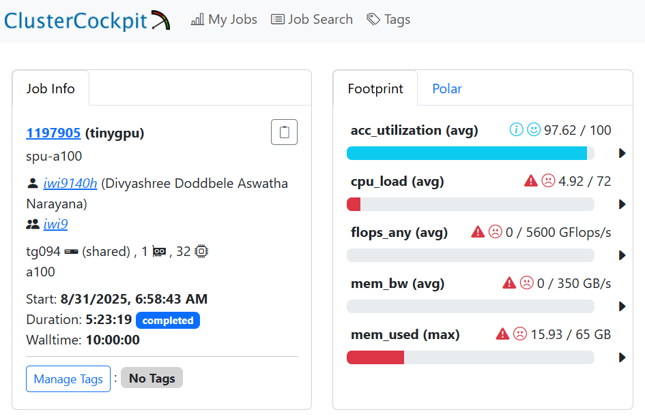
Runtime

Slide 27
sPU-Net
Graders
Samples

Slide 28
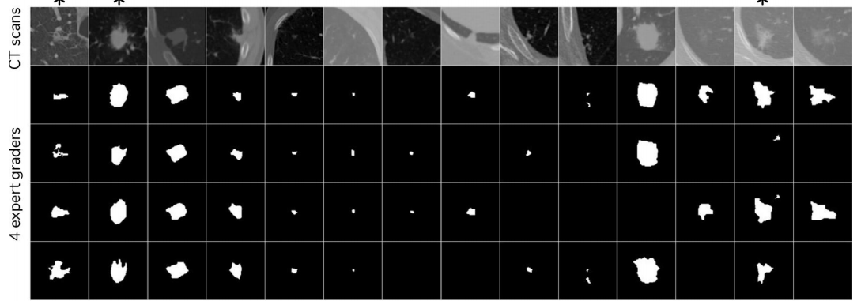
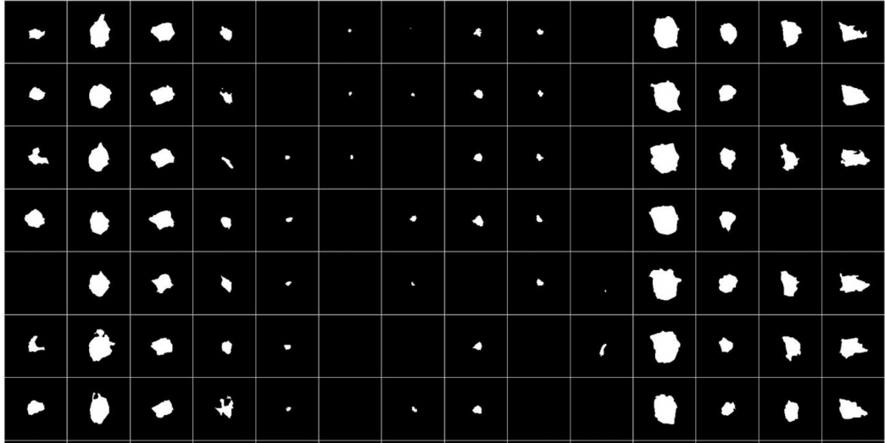
HPU-Net
Samples

Slide 29
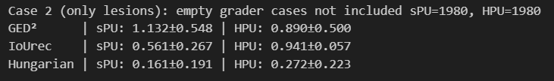
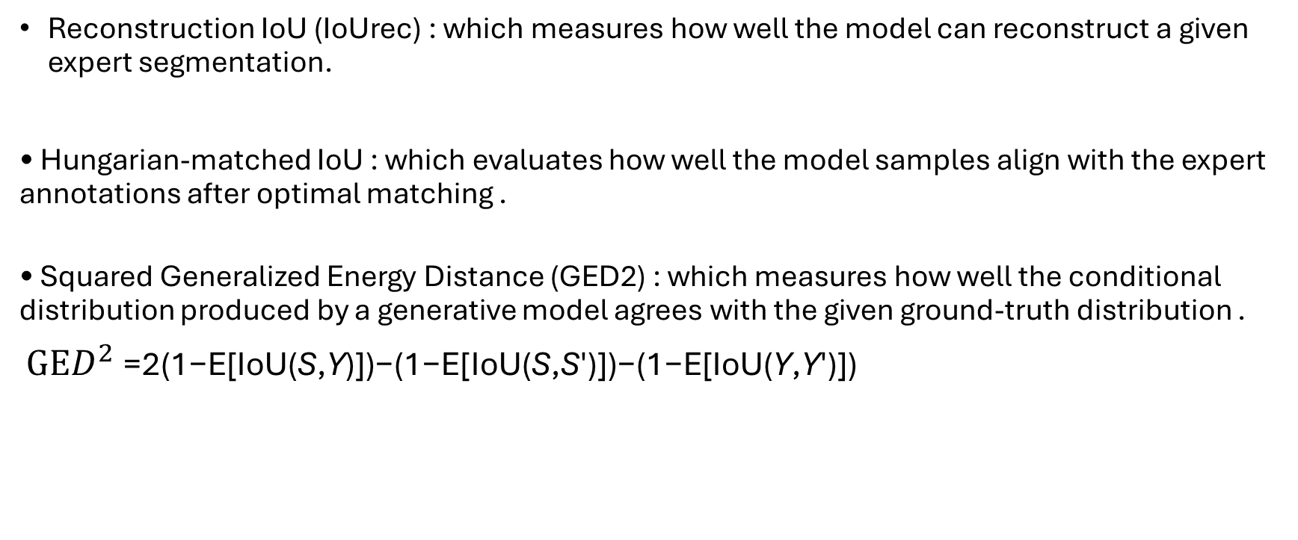
Metrics
Reconstruction IoU (IoUrec) : which measures how well the model can reconstruct a given expert segmentation.
• Hungarian-matched IoU : which evaluates how well the model samples align with the expert annotations after optimal matching .
• Squared Generalized Energy Distance (GED2) : which measures how well the conditional distribution produced by a generative model agrees with the given ground-truth distribution .
GE$D^{2}$=2(1−E[IoU(S,Y)])−(1−E[IoU(S,S′)])−(1−E[IoU(Y,Y′)])

Slide 30
Formulas – training objective
Training Objective
Elbo : Evidence lower bound
Geco : Generalized ELBO with Constrained Optimization.
Notes:
Training Objective :
Minimizing LELBO leads to sub-optimally converged priors ____ GECO. It adds in a constraint on the reconstruction term and thus dynamically balances it with the KL terms.
κ is chosen as the desired reconstruction loss value and the Lagrange multiplier λ is updated as a function of the exponential moving average of the reconstruction constraint.
This formulation initially puts high pressure on the reconstruction and once the desired κ is reached it increasingly moves the pressure over on the KL-term.
Online hard negative mining, with k = 0.02, only worst 2% pixels are back propagated. And sample from a Gumbel- Softmax distribution. Over Lrec per pixel.
Metrics (IOU recon) :
the IoU-metric, is calculated with respect to the stochastic foreground classes only.
Not globally across all the test set pixels as is regularly done in semantic segmentation challenges, but calculate it across the pixels of each image and then average across all test set images.
For the LIDC dataset, a correctly predicted absence as IoU = 1.

Slide 31

Formulas
Sampling
Training
Notes:
Sampling :
1. Sampling from the corresponding Gaussian distribution results in the spatial latents $Z_{i}$.
2. The hierarchical sampling results in a joint distribution for the prior that decomposes as follows.
Training :
modelling a variational posterior Q(.|X, Y ) that depends on both X and Y.

Slide 32
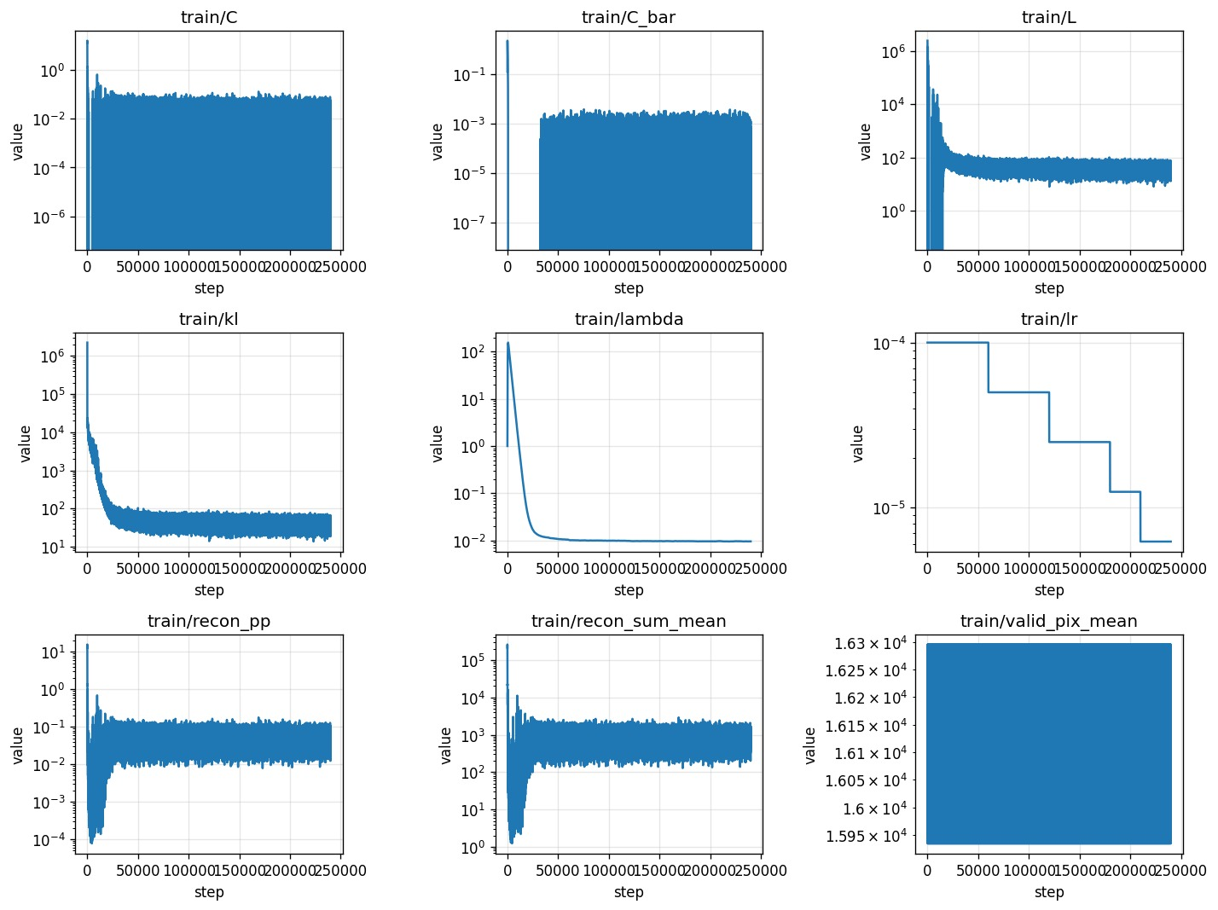
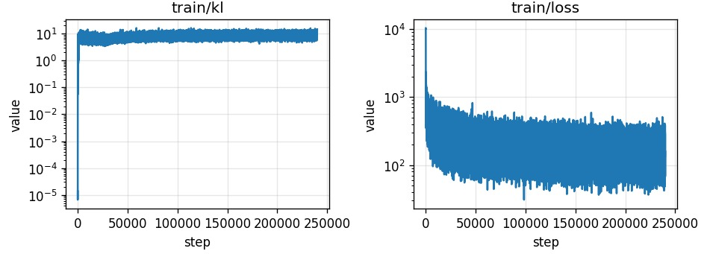
HPU-Net
sPU-Net

Slide 33
A Hierarchical Probabilistic U-Net for Modeling Multi-Scale Ambiguities
Source : Kohl, Simon AA, et al. "A hierarchical probabilistic u-net for modeling multi-scale ambiguities." arXiv preprint arXiv:1905.13077 (2019).

