Slide 1

RCB iPL
STRATEGY
BY DIVYA DESAI
July 2026

Slide 2


Problem Statement

Slide 3



In preparation for the 2017 Mega Player Auction, the management of the Royal Challengers Bangalore (RCB) aims to build a balanced, high-performing, and cost-efficient squad capable of consistently winning tournaments.
As a Sports Data Analyst, the objective is to evaluate players using historical performance metrics, consistency indicators, match impact, and auction pricing trends to identify players who deliver maximum value for money.
The analysis focuses on optimizing auction investments while ensuring the team secures reliable performers across batting, bowling, and all-rounder roles.

Slide 4


Introduction
&
Objectives

Slide 5

INTRODUCTION
IPL generates vast amounts of player and match data every season.
Data analytics helps teams make informed decisions for player selection and auction strategy.
This project uses SQL to analyze historical IPL data.
Evaluates batting, bowling, team, and venue performances.
Applies data cleaning, transformation, and analytical queries to extract meaningful insights.
Supports data-driven decision-making by identifying consistent and high-performing players.
OBJECTIVES
Identify top-performing IPL players
Assess consistency and match impact
Compare performance with auction price
Find undervalued high-impact players
Build a balanced squad within budget
Support data-driven auction decisions

Slide 6
DATABASE SCHEMA

Slide 7
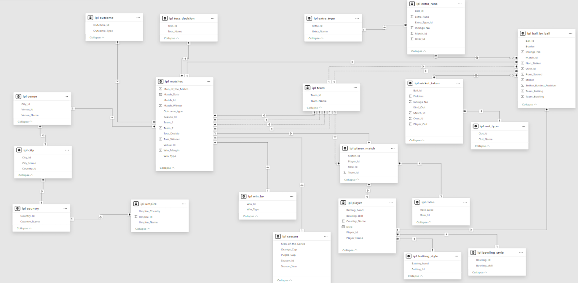

Slide 8
Methodology

Slide 9
Data Collection
Data Transformation
Joins
Grouping
Aggregation
Filtering
Imported IPL SQL database.
Data Analysis
Insights
&
Recommendations
Strike Rate
Average Run
Total Runs
Wickets
Venue Analysis
Season Analysis

Slide 10
KEY TABLES USED:

Slide 11
1. ball_by_ball 2. wicket_taken In-game performance data | 3. player 4. role 5. player_match Player profiles and match roles | 6. matches 7. season Match metadata and season stats
 | 8. team 9. venue 10. city Match context and geography

Slide 12
Key SQL Queries
&
Findings

Slide 13
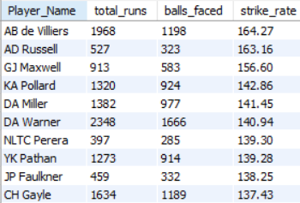
Key Findings
For the 2017 auction, RCB should prioritize AB de Villiers as a non-negotiable retention. DA Warner should be a primary target — his combination of volume and speed is unmatched. AD Russell could be a valuable lower-order finisher at a potentially lower price.

Slide 14
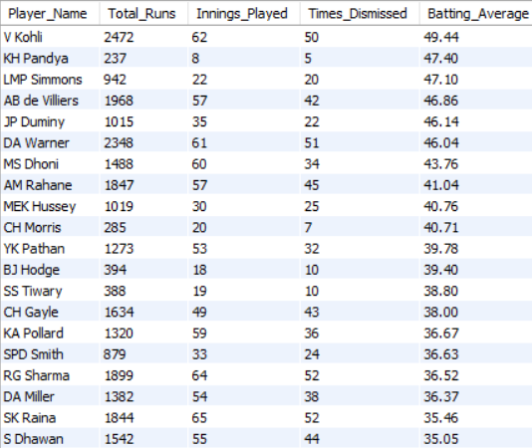
Key Findings
V Kohli and AB de Villiers should be RCB's two core retentions.
Both appear in top rankings across multiple batting metrics. No other players come close to their combination of volume, average, and strike rate.

Slide 15
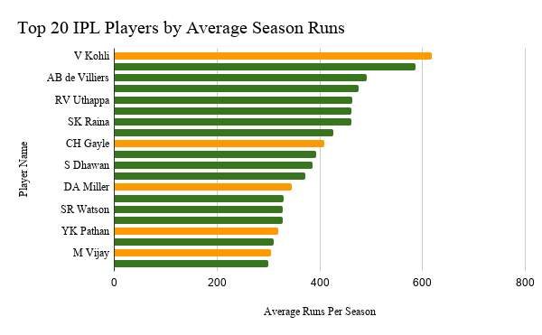
Key Findings
RCB should build their core squad around green-bar players — consistent performers who deliver every season.
Star players with orange bars can be added as match-winners, but the backbone should be reliability.

Slide 16
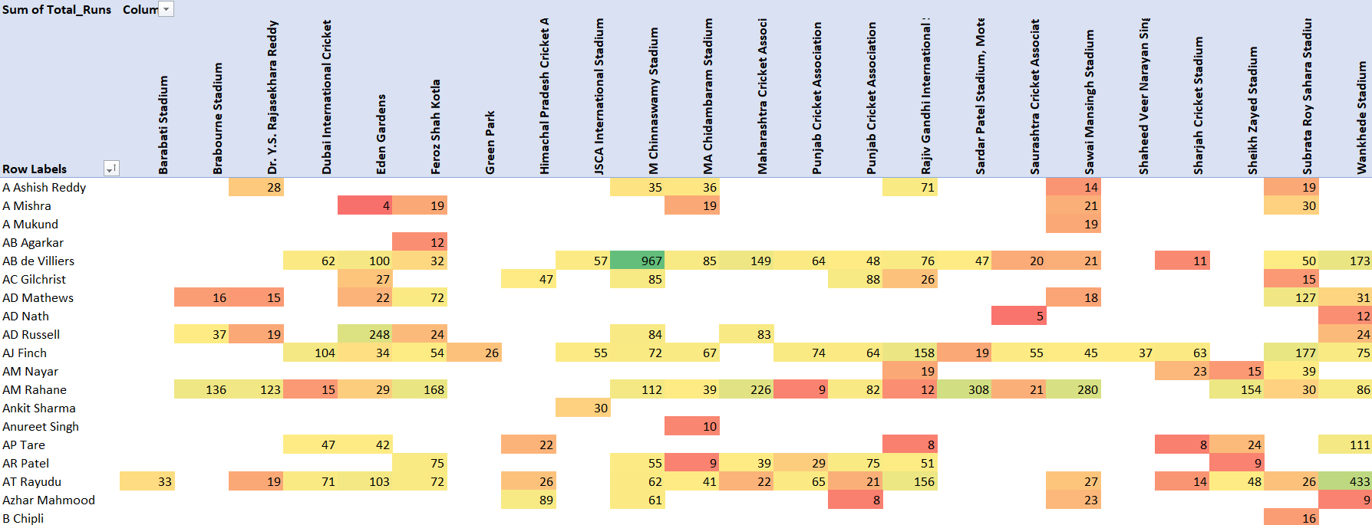
Key Findings
RCB should specifically prioritize players whose brightest green cells appear at Chinnaswamy Stadium and other venues where RCB frequently plays. A player who averages 50 runs at Chinnaswamy is worth more to RCB than one who averages 50 runs at venues RCB rarely visits.

Slide 17
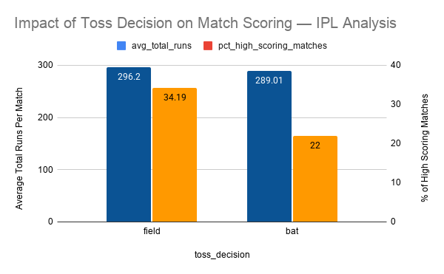
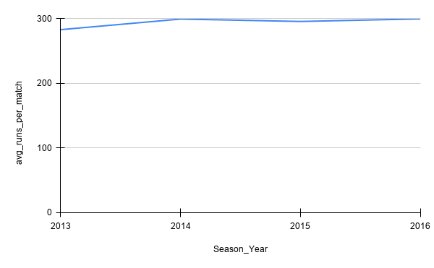
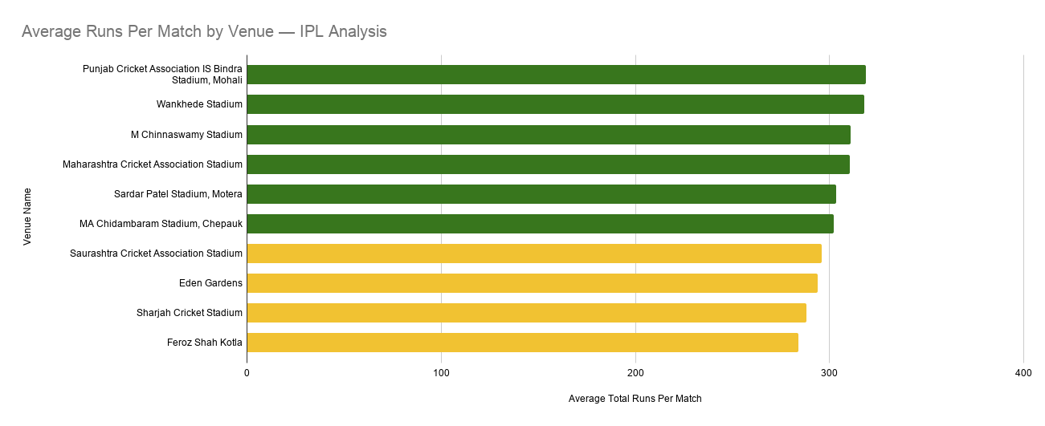
Key Findings
For RCB specifically these findings mean: First: they should prefer to field first after winning the toss, as data shows this leads to higher scoring and more exciting matches which suits their strong batting lineup. Second: at Chinnaswamy they need quality death-over bowlers since opposition teams will also score heavily. Third: for away matches at low-scoring venues like Kotla, they should add a spinner to their playing XI.

Slide 18
Recommendations

Slide 19
1. Data confirms Kohli and ABD are irreplaceable - retain both before auction day. | 2. DA Warner ranks in the top 10 across ALL batting metrics - the most complete auction target available | 3. Chinnaswamy is a double-edged sword. RCB must invest in death-over specialists to defend big totals at home
4. All-rounders like Raina and Jadeja deliver double value - one player fills two squad positions | 5. CV% analysis reveals consistent players win more league matches than unpredictable superstars - choose reliability over reputation | 6. Chinnaswamy is a double-edged sword. Data shows field-first at Chinnaswamy maximizes RCB's home advantage, Kohli (2264 runs) and ABD (967 runs) dominate at home to defend big totals at home

Slide 20
CONCLUSION
Successfully analyzed IPL historical data using SQL.
Identified top-performing players using multiple performance metrics.
Evaluated venue-wise and season-wise trends.
Generated data-driven insights for player selection.
Demonstrated how SQL can support sports analytics and decision-making.

Slide 21
THANK YOU!

