Slide 1


By: Chris Blankenship, Divya Shetty & Vanessa Vasquez
Notes:
All

Slide 2
Agenda
Objective
Questions
Data Cleanup & Exploration
Data Analysis
Discussion
Post Mortem
Q & A
Notes:
Vanessa

Slide 3
Decades of Music
Spotify Dataset 1921-2020

Slide 4

Music is always changing, and the changes are unpredictable.
~ Billy Sheeham
Notes:
Vanessa

Slide 5
Objective
Spotify Dataset 1921-2020
Notes:
Chris

Slide 6
Objective
Identifying music trends and characteristics over the past one hundred years.
Spotify Data extracted from Kaggle
Raw Data contained 174k+ tracks and 19 audio features
Data contains information on release by year and provides numerical ratings for different characteristics of music released.
Notes:
Chris

Slide 7
Null Hypothesis & Questions
Null Hypothesis:
There is no statistically significant relationship between the decades of song release and the number of songs released during that time period.
Question 1 :
Is there a statistically significant difference in Number of records released over the decades?
Alternate Hypothesis:
There is a statistically significant relation between the decade of song release and the number of songs released in any time period
Notes:
First: Chris
Explanation: Divya

Slide 8
Null Hypothesis & Questions
Null Hypothesis:
There is no correlation between levels of speechiness vs energy in Rolling Stones songs.
Question 2 :
Is there a correlation between the "Speechiness" and "Energy" of Rolling Stones songs over time?
Alternate Hypothesis:
There is a correlation between levels of speechiness vs energy in Rolling Stones songs - they travel similar paths.
Notes:
First: Chris
Explanation: Chris

Slide 9
Null Hypothesis & Questions
Null Hypothesis:
There is no correlation between levels of speechiness vs energy in all songs.
Question 3 :
Are energy and speechiness patterns in music correlated when looking at all songs released?
Alternate Hypothesis:
There is a correlation between levels of speechiness vs energy in all songs - they travel similar paths.
Notes:
First: Chris
Explanation: Vanessa
Are energy and speechiness patterns in music correlated when looking at all songs released?
Null Hypothesis:
There is no correlation between levels of speechiness vs energy in all songs
Alternate Hypothesis:
There is a correlation between levels of speechiness vs energy in all songs - they travel similar paths.

Slide 10
Data Cleanup & Exploration
Spotify Dataset 1921-2020

Slide 11
Data Cleanup & Exploration
Categorical:
Artists
Release Data
Name
Year
Numerical:
Acoustiness
Danceability
Energy
Duration (bps)
Instrumentalness
Valence
Popularity (1-100)
Tempo
Liveness
Speechiness
*Audio characteristics ranged from 0-1*
Notes:
Divya
Not all audio characteristics range from 0-1
Loudness is measured in Db (-60 to 0db)
Popularity measured from 1 – 100
According to Spotify developers' site, popularity is calculated by an algorithm and is based on the total number of downloads and plays the track has had and how recent those plays are.
While this is accurate for newer tracks, could be a bias on older tracks.

Slide 12
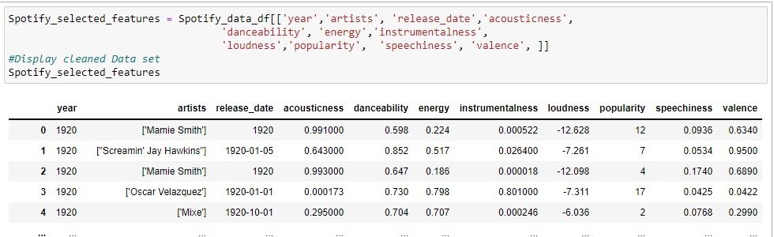
Data Cleanup & Exploration
Notes:
Divya
Pandas columns selection method is used to select and re-arrange key audio features.
Data frame did not have Null values
No data type conversion was needed.

Slide 13
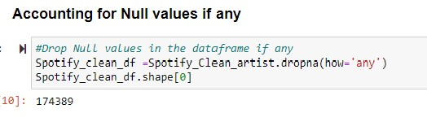
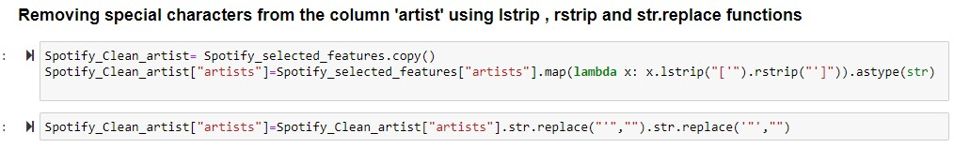
Data Cleanup & Exploration
Notes:
Divya
Pandas columns selection method is used to select and re-arrange key audio features.
Data frame did not have Null values
No data type conversion was needed.

Slide 14
Data Analysis
Notes:
Question 1: Divya
Question 2: Chris
Question 3: Vanessa

Slide 15
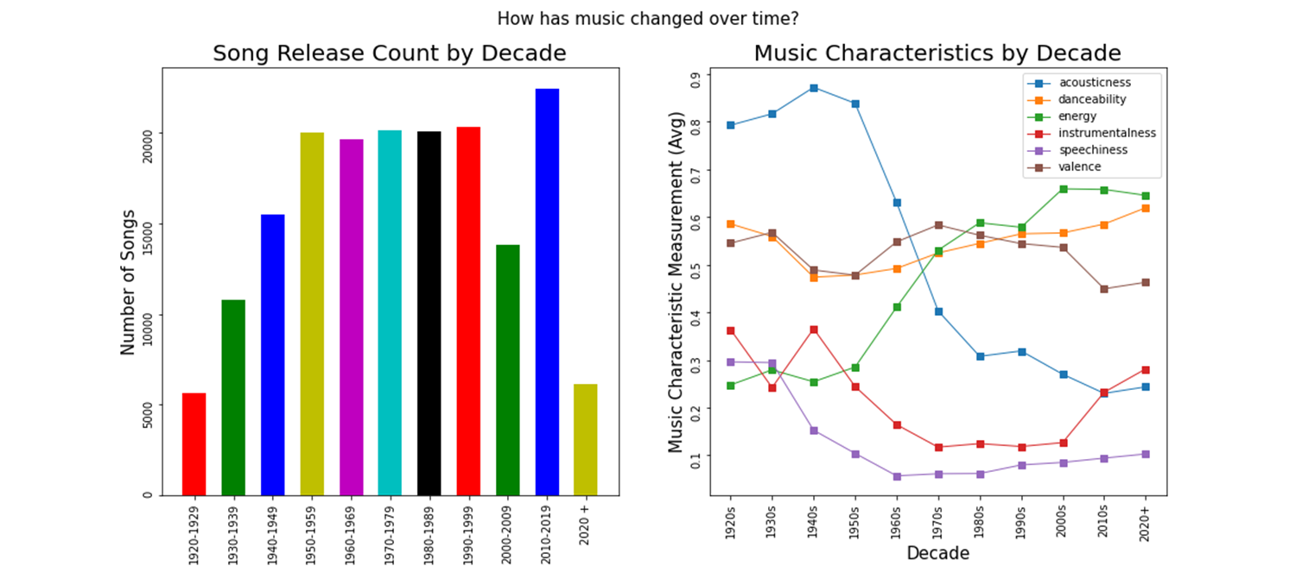
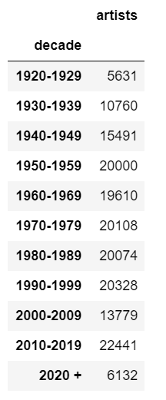
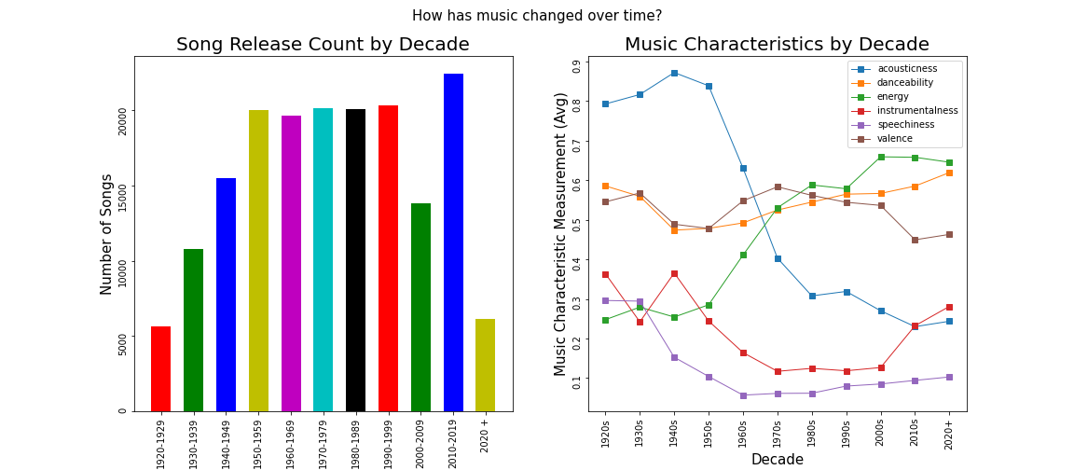
Is there a statistically significant difference in Number of records released over the decades?
Notes:
Divya
Is there a statistically significant difference in Number of records released over the decades?
Null Hypothesis:
There is no correlation between levels of speechiness vs energy in all songs
Alternate Hypothesis:
There is a correlation between levels of speechiness vs energy in all songs - they travel similar paths.

Slide 16
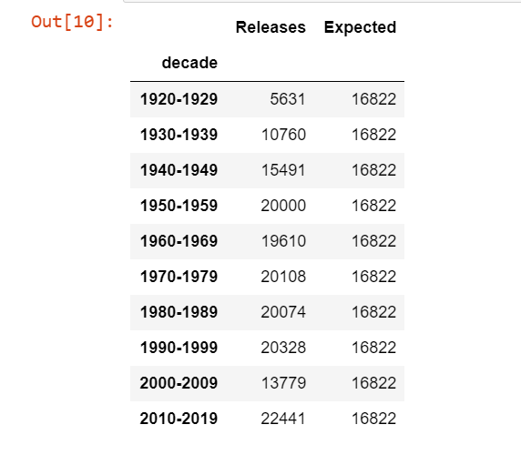
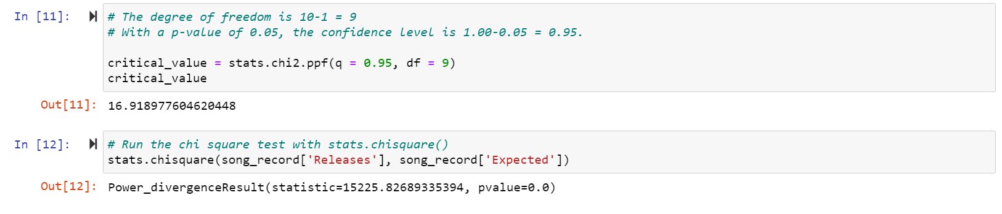
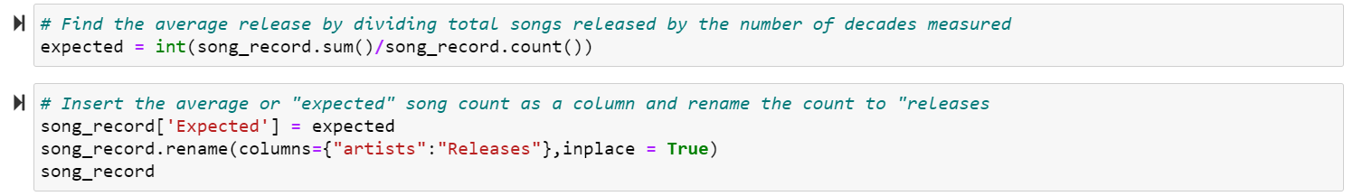
Use chi square test to measure categorical data sorted by decade
Notes:
Divya

Slide 17
Results from Question 1
Since the chi-square value of 15,225.82 at a confidence level of 95% exceeds the critical value of 16.91
With P-value 0.00 we would reject our null hypothesis that two characteristics are not correlated.
Notes:
Divya
, we conclude that the differences of number of records released per decade is statistically significant
Conclusion:
The decade of release was related to the number of songs during that time. Chi-Square yielded a value of 15,225 at 95% confidence level - higher than our critical value of 16.91 and P-value was 0.00.

Slide 18
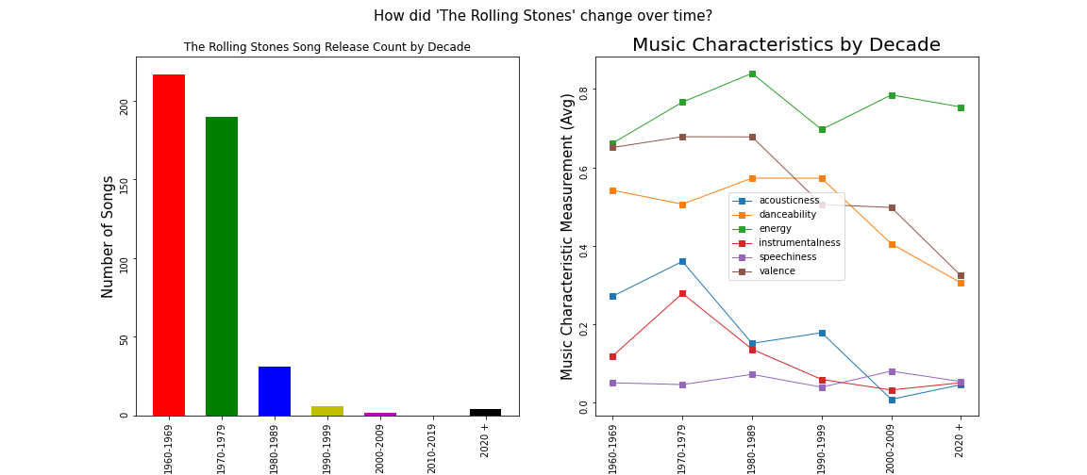
Is there a correlation between the "Speechiness" and "Energy" of Rolling Stones songs over time?
Notes:
Chris

Slide 19
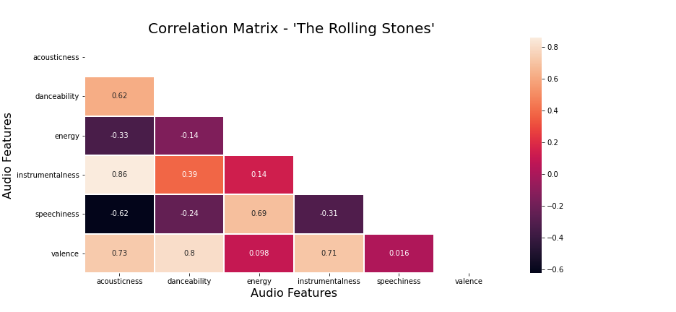
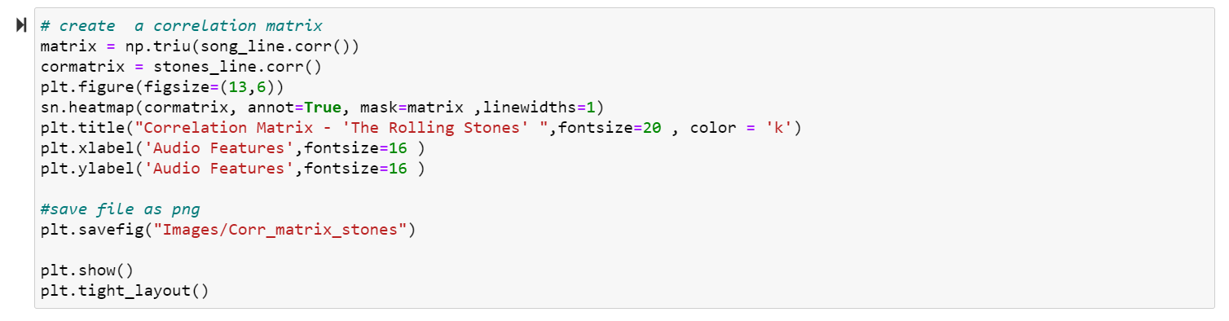
Correlation Matrix – ‘The Rolling Stones’
Notes:
Chris

Slide 20
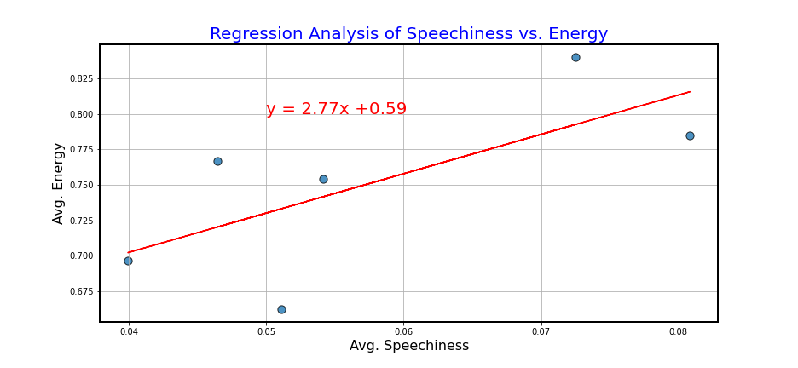
Regression Analysis of Speechiness vs Energy
Notes:
Chris

Slide 21
Results for Question 2
Regression analysis shows a Moderate positive correlation.
R value 0.48 shows that 48% of data is accounted
P-value 0.02 - reject our null hypothesis that two characteristics are not correlated.
Notes:
Chris
This means the two patterns are likely to travel together in Rolling Stones music
Conclusion:
A positive correlation coefficient of 0.69 is measured between the speechiness and energy of Rolling Stones music over time. This would indicate that the two patterns travel a similar trajectory.

Slide 22
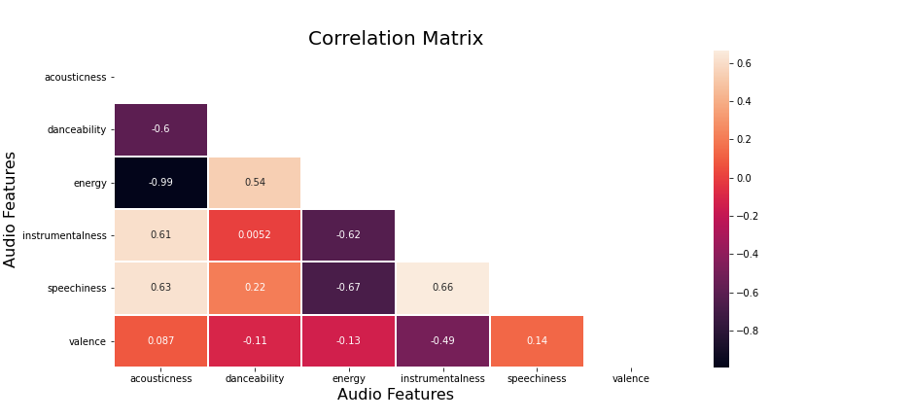
Correlation Matrix
Notes:
Vanessa

Slide 23
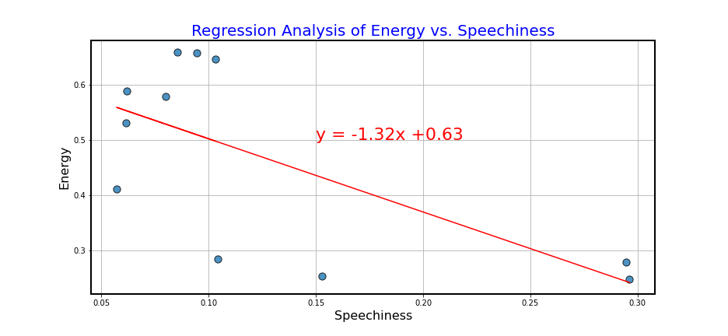
Regression Analysis of Speechiness vs Energy
Notes:
Vanessa

Slide 24
Results for Question 3
p value 0 shows that there is a statistically significant relationship between the two features
r value 0.45 shows that 45% of the data is accounted for and there is a moderate relationship between the two variables.
In our measure of all music releases, as Energy increases Speechiness decreases. This is the exact opposite pattern we saw in our previous measure of Rolling Stones songs only
Notes:
Vanessa
Conclusion:
A negative correlation coefficient of -0.67 is measured between the speechiness and energy of all music over time. This is almost the exact opposite of what we measured in the Rolling Stones music trends.

Slide 25
Overall Conclusion
Change over time
Release counts
Characteristics
However, change is not universal
Predict customer behavior
Forecast future song trends
Notes:
Chris

Slide 26

Post Mortem

Slide 27

Post Mortem
Rabbit hole
Data Cleanup
Adding Hypothesis
Notes:
Presenter: Vanessa
SettingWithCopyError :
Error was thrown due to chaining two indexing methods while setting a value.
Solution : Creating a copy of a data frame to avoid assigning values directly.
Loudness in db :
To plot loudness with other features, we have to normalize the data to fit the scale.

Slide 28
Addition Possible Questions
How does some of the audio characteristic impact popularity?
Who makes the most “Danceable” music? Identify top 10 danceable songs by artist
Notes:
Presenter: Vanessa
SettingWithCopyError :
Error was thrown due to chaining two indexing methods while setting a value.
Solution : Creating a copy of a data frame to avoid assigning values directly.
Loudness in db :
To plot loudness with other features, we have to normalize the data to fit the scale.

Slide 29
THANKS!
Any questions?

