Slide 1



Energy Consumption Trend Analysis with Power BI

Slide 2

Learning Objectives
Understand energy consumption patterns over time.
Learn to import, clean, and transform data using Power BI.
Create interactive visualizations and reports .
Derive actionable insights for energy efficiency.
GOAL
Source :
www.freepik.com/

Slide 3
Tools and Technology used
Power BI Desktop
Excel (Data Source)
DAX (Data Analysis Expressions)
Power Query

Slide 4
Methodology
Collected and imported energy consumption data.
Cleaned and transformed the dataset using Power Query.
Built a data model with relationships.
Created interactive dashboards using DAX and Power BI visuals.
Analyzed patterns and trends in energy usage.

Slide 5
Problem Statement:
In managing their organizations, energy usage is poorly monitored and tracked which leads to improper spending and worsens the environmental impact.

Slide 6
Solution:
Designed a Power BI dashboard that enables the visualization of energy consumption on both a monthly and yearly basis while also determining the periods of high consumption and spotting optimization opportunities.

Slide 7
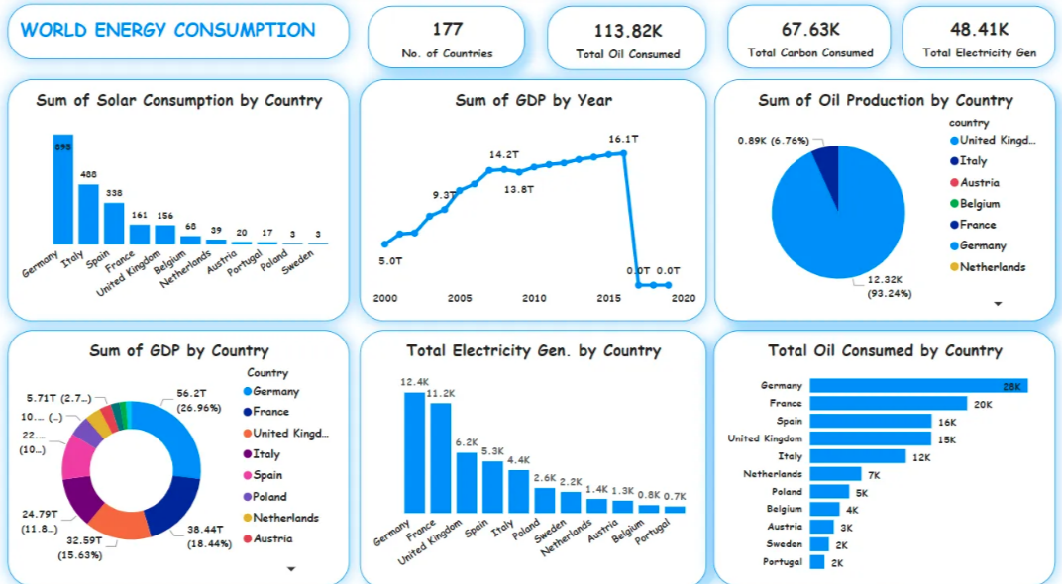
Screenshot of Output:

Slide 8
Conclusion:
The project especially aided in revealing new insights on the patterns of energy usage. Stakeholders can interactively visualize the data which allows them to make more informed decisions when it comes to minimizing costs and improving sustainability.

