Slide 1
Oceanographic: A Machine Learning-Driven Sonar Framework for Real-Time Coral Reef Habitat Prediction and Marine Ecosystem Monitoring
MLOps Presentation 2 — Data Collection and Model Training
Decision-support prototype | Synthetic data | Indian reef systems
Four regions: Lakshadweep | Gulf of Mannar | Gulf of Kutch | Andaman and Nicobar Islands
All observations in this prototype are synthetic. Models do not represent real-world conservation accuracy.
1
Notes:
Welcome. This presentation covers the data collection strategy and model training pipeline for the Oceanographic reef prediction framework. This is a machine learning prototype designed to classify reef health and assess restoration suitability from simulated marine sensor observations. I'll walk through how the data was generated, how it was processed and validated, how the models were trained, and what results were achieved on a synthetic benchmark dataset. Everything you see here is backed by actual code and evaluation files in the project repository.

Slide 2
Data Collection Strategy
Current prototype vs. proposed future deployment
Current: Synthetic Data Generation
Proposed Future: Real Field Collection
SYNTHETIC DATA — not real sensor readings
Acoustic Surveys
Why synthetic data was required:
Multi-beam sonar deployed from survey vessels
Measures bathymetric rugosity and backscatter
Real sonar hardware and calibrated marine sensor
Autonomous Underwater Vehicles (AUVs) for
arrays have not yet been deployed for this project.
deep transects and consistent coverage
Environmental Sensors
Expert-labelled field surveys take months to
Fixed buoy arrays for temperature, pH,
collect across four remote Indian reef regions.
dissolved oxygen, turbidity, salinity
Remotely Operated Vehicles (ROVs) for
Synthetic data lets the full MLOps pipeline be
depth-stratified profiles
built, tested, and validated before physical
hardware is available.
Biological Surveys
Expert diver transects for coral cover,
How it was generated:
bleaching extent, and disease prevalence
15,000 observations generated by src/data/generate_data.py
Photographic and video records for
Statistical rules from published Indian reef literature
systematic label assignment
(Hughes et al. 2017; Venkataraman et al. 2011)
Gaussian noise (scale=0.15) prevents perfect separability
Fixed random seed 42 — fully reproducible
Oceanographic Reef Prediction Framework
3
Notes:
No real sonar data or field surveys have been collected for this prototype. Real sonar hardware, environmental buoys, and biological survey teams have not yet been deployed. All 15,000 observations were generated using a documented Python script that applies statistical rules derived from published Indian reef literature. Gaussian noise prevents any single feature from being a perfect predictor. The key advantage is that the complete MLOps pipeline — validation, preprocessing, training, evaluation, serving — can be built and tested now, and then the synthetic generator simply gets replaced with a real ingestion module when field data becomes available. The proposed future collection plan involves multi-beam sonar from boats and AUVs, fixed environmental sensor buoys, and expert biological surveys conducted by trained marine biologists.

Slide 3
Data Sources and Feature Groups
21 columns across five categories — synthetic prototype
Geographic & Observation Metadata
Sonar-Derived Structural Features
Environmental Sensor Features
Reef-Condition Observations
Target Labels
timestamp
sonar_backscatter (dB)
water_temperature_c
coral_cover_percentage (%)
reef_health (4 classes)
latitude
rugosity_index
ph
bleaching_percentage (%)
restoration_suitability (3 classes)
longitude
hard_substrate_percentage (%)
salinity_ppt
disease_percentage (%)
region
acoustic_complexity_index
dissolved_oxygen_mg_l
turbidity_ntu
light_intensity (PAR)
current_speed_m_s
depth_m
4 reef regions in Indian waters
Sonar measures structure — NOT bleaching or coral cover
Physical oceanographic conditions
Biological survey observations
Supervised learning targets
Scientific limit: Sonar measures habitat structure (depth, backscatter, rugosity). It does NOT directly measure coral bleaching, coral cover, or water chemistry.
Oceanographic Reef Prediction Framework
4
Notes:
The dataset has 21 columns divided into five logical groups. Geographic metadata locates each observation in one of four Indian reef regions. Sonar-derived features describe the physical structure of the reef — rugosity, backscatter, hard substrate fraction, and acoustic complexity. These are habitat structure indicators only. An important scientific limit is that sonar cannot directly measure bleaching percentages, coral cover, or water chemistry. Environmental sensors capture the physical conditions of the water column — temperature, pH, dissolved oxygen, turbidity, salinity, light, and current. Reef-condition observations record what a diver or camera would see — coral cover, bleaching extent, and disease prevalence. Finally, we have two target label columns. In a real deployment, the sonar and sensor data would be collected continuously, while biological survey labels would require periodic expert annotation.

Slide 4
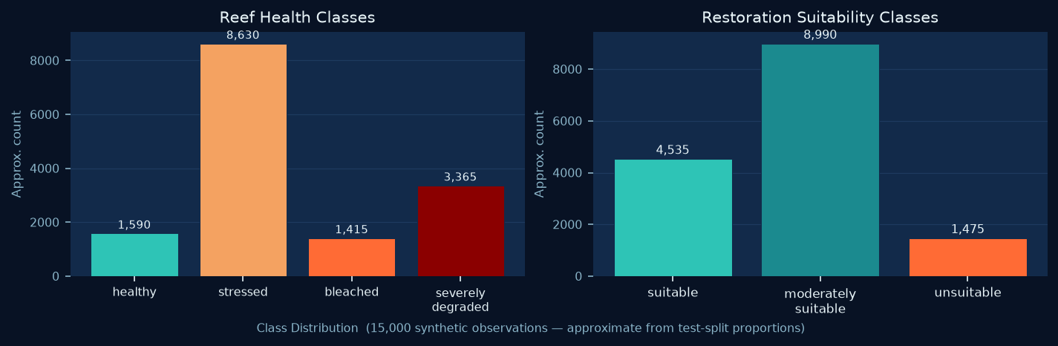
Dataset Description
15,000 synthetic observations — confirmed from data/raw/observations.csv
Dataset Statistics
Reef Health Classes (4)
Total observations
15,000
healthy
CSV columns
21
stressed
Training rows (80%)
12,000
Test rows (20%)
3,000
bleached
Missing values
0 (all required)
severely_degraded
Duplicate rows
None in generated data
Temporal range
2018-01-01 to 2024-12-31
Random seed
42 (reproducible)
Noise scale
0.15 (prevents perfect accuracy)
Restoration Suitability Classes (3)
CV folds
5 (stratified)
Reef regions
4 (Indian waters)
suitable
Health classes
4
moderately_suitable
Restoration classes
3
unsuitable
Numeric features
15
Categorical features
1 (region)
Derived features
6 (engineered)
Oceanographic Reef Prediction Framework
5
Notes:
The dataset has exactly 15,000 rows and 21 columns, confirmed from the CSV file. The 80/20 stratified split gives 12,000 training rows and 3,000 test rows. Stratification ensures that class proportions are preserved in both splits. There are no missing values because all fields are required in the Pandera schema — any row with a null value would be rejected at validation. The class distribution is not perfectly balanced. For reef health, the stressed class is by far the most common, followed by severely degraded, healthy, and bleached. For restoration suitability, moderately suitable is the majority class. This imbalance is handled during training using the class_weight=balanced setting, which automatically adjusts the loss function to give more weight to minority classes. The charts shown here are approximate distributions scaled from the test-set support counts in the evaluation JSON files.

Slide 5
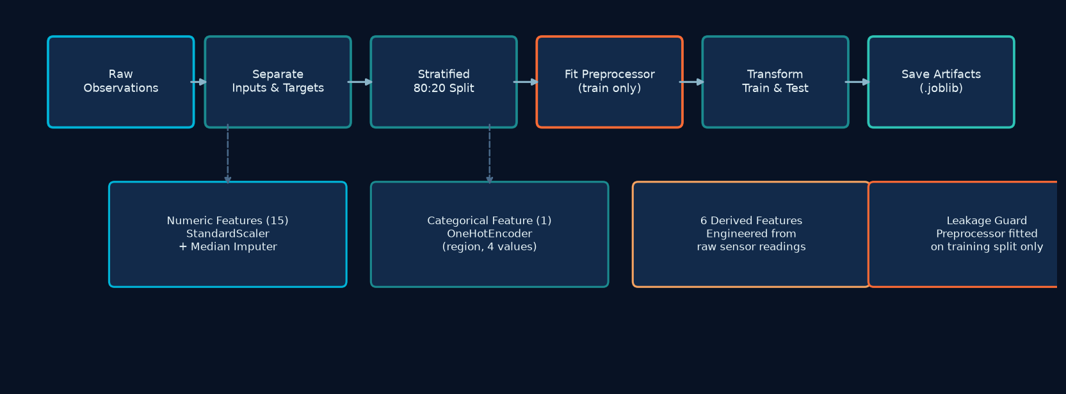
Preprocessing and Feature Transformation
Training-only preprocessor fitting — preventing test-data leakage
Numerical Pipeline (15 features)
Categorical Pipeline (1 feature: region)
1. SimpleImputer — median strategy (robust to skew)
1. SimpleImputer — most_frequent strategy
2. StandardScaler — zero mean, unit variance
2. OneHotEncoder — 4 region values
Handles: depth, temperature, pH, salinity, DO,
Lakshadweep, Gulf of Mannar,
turbidity, light, current, sonar, rugosity,
Gulf of Kutch, Andaman & Nicobar Islands
hard_substrate, ACI, coral cover, bleaching, disease
handle_unknown='ignore' for inference safety
Preprocessor fitted on training split ONLY — test data statistics never influence scaling parameters.
Oceanographic Reef Prediction Framework
7
Notes:
The preprocessing step converts raw feature columns into a numeric matrix that sklearn classifiers can consume. There are two separate pipelines: one for numeric features and one for the categorical region column. The critical design rule is that the ColumnTransformer is fitted only on the training split. If we fitted on the full dataset, the scaler would learn the mean and variance of test rows, which would constitute data leakage and inflate apparent test performance. Each task — health and restoration — gets its own fitted preprocessor saved as a .joblib file. These artifacts are used both during the DVC pipeline evaluation and at inference time in the FastAPI service. The preprocessor is always called in transform-only mode at inference time — never refit on production data. In addition to the 16 raw features, 6 derived features are computed before splitting: thermal stress index, oxygen stress index, acidity deviation, water quality index, substrate stability score, and structural complexity score.

Slide 6
Model Training Design
Three algorithms, two tasks, five-fold cross-validation — tracked in MLflow
Logistic Regression
Random Forest
XGBoost
Hyperparameters (params.yaml):
Hyperparameters (params.yaml):
Hyperparameters (params.yaml):
C = 1.0 (regularisation strength)
n_estimators = 200
n_estimators = 300
max_iter = 1000
max_depth = 12
max_depth = 6
class_weight = balanced
min_samples_leaf = 4
learning_rate = 0.05
solver = lbfgs (default)
class_weight = balanced
subsample = 0.8 | colsample_bytree = 0.8
Strong baseline for linearly separable features. Interpretable coefficients.
Handles non-linear interactions between sensor readings. Robust to noise.
Gradient boosting often outperforms RF on tabular data with mixed features.
Separate training for each task
Health and restoration are independent classifiers — not multi-output. Each trains on its own label column.
5-fold stratified cross-validation
CV macro-F1 is the primary selection metric. Winner is selected before evaluation on the held-out test set.
class_weight = balanced
Automatically adjusts loss function weights to compensate for class imbalance. All three algorithms apply this.
Fixed random seed = 42
All randomness (data splits, model initialisation, numpy) is seeded for full reproducibility.
MLflow experiment tracking
Every run logs: parameters, CV scores, test metrics, confusion matrix, feature importances, model artifact.
Oceanographic Reef Prediction Framework
8
Notes:
Three algorithms are trained for each classification task: Logistic Regression, Random Forest, and XGBoost. All hyperparameters are stored in params.yaml so they can be tracked and changed reproducibly via DVC. The two tasks are trained completely independently — health and restoration have separate preprocessors, separate training runs, and separate registered models. Class imbalance is handled by setting class_weight to balanced in all three algorithms. The primary selection metric is CV macro-F1, which averages F1 score equally across all classes regardless of their frequency. This matters because naive accuracy would favor the majority class. Five-fold cross-validation is used to estimate generalisation performance before any test data is touched. The model with the highest CV macro-F1 is selected, and only then evaluated on the held-out 3,000-row test set. MLflow tracks every experiment run — parameters, metrics, the trained model artifact, and confusion matrix — all stored in a local SQLite database at artifacts/mlruns.db.

Slide 7
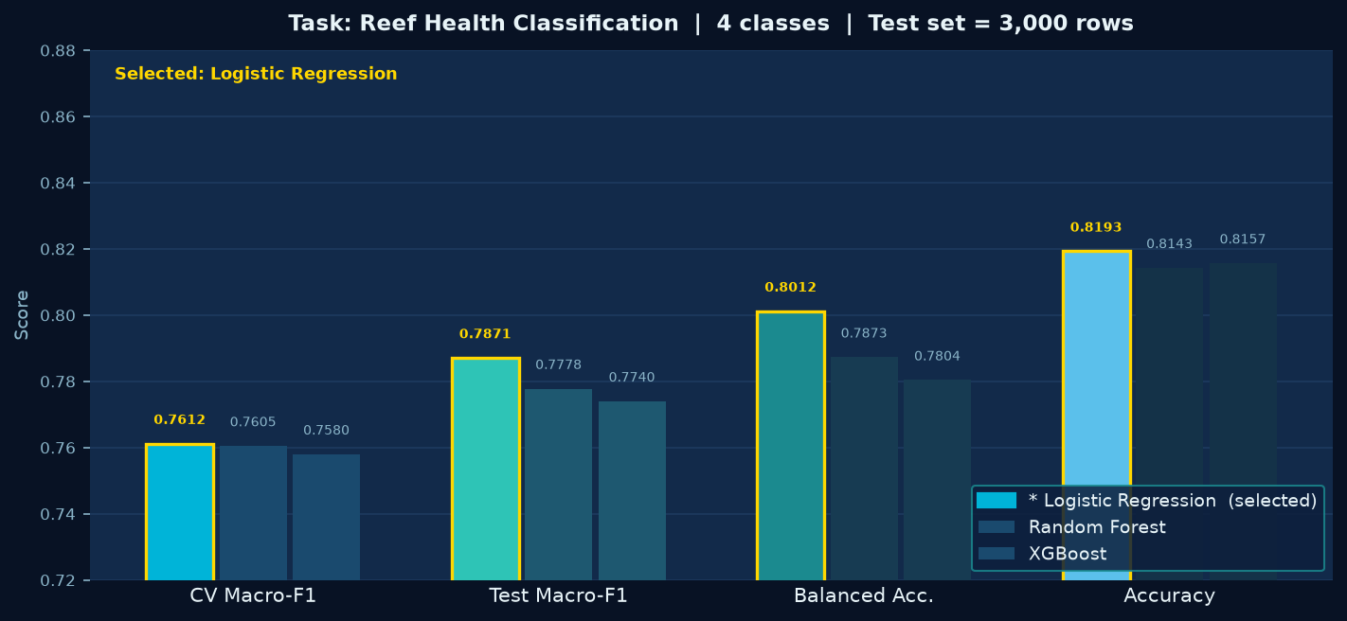
Reef-Health Model Comparison
Selected model: Logistic Regression (highest CV Macro-F1) — SYNTHETIC DATA
Selected: Logistic Regression
CV Macro-F1
0.7612 ± 0.009
Test Macro-F1
0.7871
Balanced Accuracy
0.8012
Overall Accuracy
0.8193
Per-class Test F1:
healthy
0.6962
stressed
0.8986
bleached
0.8830
severely_degraded
0.6708
Why Logistic Regression won: Although all three models achieved very similar CV macro-F1 (within 0.003 of each other), Logistic Regression scored highest at 0.7612 and also achieved the best test macro-F1 (0.7871) and balanced accuracy (0.8012).
SYNTHETIC DATA DISCLAIMER: These metrics reflect performance on synthetic observations only. They do not indicate real-world coral reef prediction accuracy.
Oceanographic Reef Prediction Framework
9
Notes:
For the reef health task, all three algorithms performed very similarly. Logistic Regression achieved the highest five-fold cross-validation macro-F1 of 0.7612, slightly ahead of Random Forest at 0.7605 and XGBoost at 0.7580. On the held-out test set, Logistic Regression also achieved the best macro-F1 of 0.7871 and balanced accuracy of 0.8012. The stressed class is the easiest to classify, with an F1 of about 0.90 across all models — this is the majority class and has the clearest feature signal. The healthy and severely degraded classes are harder, both scoring around 0.67 to 0.70 F1. This reflects overlapping feature ranges between adjacent ordinal health states, which is intentional in the synthetic data generator. It is critical to remember that these scores are on synthetic data with known statistical structure. Real reef data would likely produce different results due to genuine environmental complexity and labelling noise.

Slide 8
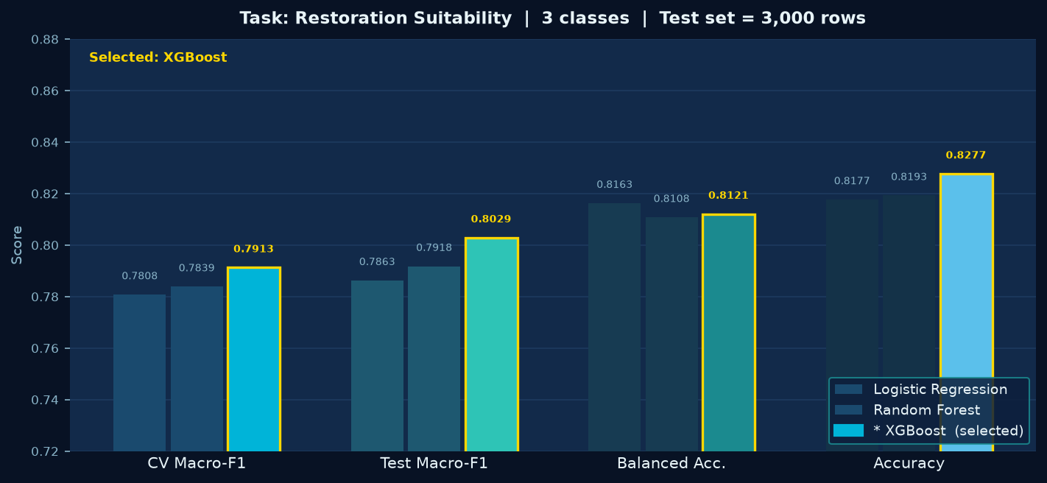
Restoration Suitability Model Comparison
Selected model: XGBoost (highest CV Macro-F1) — SYNTHETIC DATA
Selected: XGBoost
CV Macro-F1
0.7913 ± 0.008
Test Macro-F1
0.8029
Balanced Accuracy
0.8121
Overall Accuracy
0.8277
Per-class Test F1:
suitable
0.7204
mod. suitable
0.8884
unsuitable
0.8000
Why XGBoost won: XGBoost achieved CV macro-F1 of 0.7913, ahead of Random Forest (0.7839) and Logistic Regression (0.7808). It also produced the best test macro-F1 (0.8029) and accuracy (0.8277), capturing non-linear interactions between substrate and water quality.
SYNTHETIC DATA DISCLAIMER: These metrics reflect performance on synthetic observations only. They do not indicate real-world coral reef prediction accuracy.
Oceanographic Reef Prediction Framework
10
Notes:
For the restoration suitability task, XGBoost achieved the highest cross-validation macro-F1 of 0.7913, compared to 0.7839 for Random Forest and 0.7808 for Logistic Regression. On the test set, XGBoost also led with a macro-F1 of 0.8029 and accuracy of 0.8277. The moderately suitable class has the highest per-class F1 at 0.8884, which makes sense as it is the majority class. The suitable class is harder to classify at 0.7204, which reflects overlap with moderately suitable sites where most conditions are good but one or two factors are suboptimal. The unsuitable class achieves a solid 0.8000 F1, as the extreme conditions that make a site unsuitable are generally quite distinct. Comparing across the two tasks, XGBoost did better on restoration but not on health, suggesting the restoration decision depends more heavily on non-linear interactions — particularly between substrate quality, turbidity, and temperature — that boosted trees handle well.

Slide 9
Results, Limitations and Next Steps
Prototype performance on synthetic data — real-world validation required
Selected Models
Current Limitations
Next Steps
Reef Health
Logistic Regression
All 15,000 observations are synthetic.
Field data integration
CV Macro-F1
0.7612
Labels are generated by a known scoring
Deploy real sonar hardware and
Test Macro-F1
0.7871
function — real labels require expert
calibrated environmental sensors.
Test Accuracy
0.8193
biological field surveys.
Commission expert biological surveys
for ground-truth label annotation.
Restoration
XGBoost
Sonar features in this dataset are
Validation strategy
CV Macro-F1
0.7913
statistically simulated, not calibrated
from real acoustic hardware.
Hold out a geographically separate
Test Macro-F1
0.8029
reef region for external evaluation.
Test Accuracy
0.8277
Temporal cross-validation across
Metrics demonstrate prototype pipeline
survey years (2018–2024).
correctness, not real-world reef
prediction accuracy.
Model improvement
SHAP feature importance analysis
No temporal or regional hold-out splits
to identify key sensor drivers.
— spatial autocorrelation not yet modelled.
Hyperparameter search beyond
current params.yaml defaults.
No independent external validation set
from a separate reef system.
The pipeline is complete and test-verified. Replacing synthetic data with real calibrated field observations is the critical next milestone before any ecological conclusions can be drawn.
Oceanographic Reef Prediction Framework
12
Notes:
To summarise the training results: for reef health classification, Logistic Regression was selected with a test macro-F1 of 0.7871 and accuracy of 0.8193. For restoration suitability, XGBoost was selected with a test macro-F1 of 0.8029 and accuracy of 0.8277. Both models are registered in the MLflow model registry with the 'champion' alias. These are strong results for a classification prototype, but the critical limitation is that the data is entirely synthetic. The synthetic generator bakes in certain correlations by design, which means the models are learning the structure of the simulation rather than the complexity of real reef ecosystems. The next concrete steps are to deploy real hardware and collect labelled field data, and then to evaluate the models on a geographically separated hold-out reef to test for spatial generalisation. The complete MLOps infrastructure — the validation pipeline, drift monitoring, retraining governance, FastAPI inference service, and Streamlit dashboard — are already built and waiting for real data to flow through them.

