Slide 1
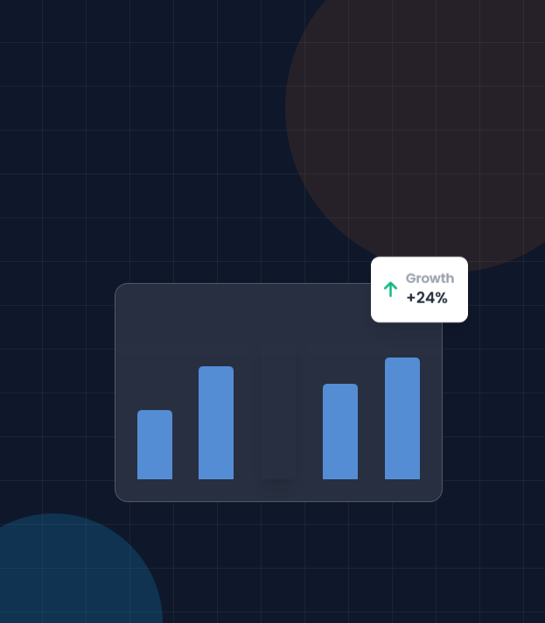



Food Delivery App
Data Analytics Capstone Project
Transforming raw transactional data into actionable business intelligence through advanced SQL analysis and interactive visualization.
SQL / MYSQL
Power BI
Data Analytics
By Divya Nirwan

Slide 2




Business Objective
Primary Goal
Analyze food delivery platform performance to drive data-driven decisions and optimize operational efficiency.
Revenue Optimization
Customer Behaviour
Deep dive into commission analysis, revenue streams, and profitability across different segments.
Identify retention patterns, high-value customer segments, and purchasing habits.
Partner Performance
Order Trends
Evaluate restaurant ratings, delivery partner efficiency, and vehicle utilization.
Analyze temporal patterns, peak hours, and reasons behind order cancellations.

Slide 3





Dataset Overview
Comprehensive relational database consisting of 5 interconnected tables
Core Table
Orders Table
Customers Table
Restaurants Table
Transactional data containing order IDs, dates, amounts, status (delivered/cancelled), and partner assignments.
Customer demographics including unique identifiers, names, cities, and registration details.
Restaurant profiles featuring names, city locations, average ratings, and cuisine categories.
Time Period
Delivery Partners
Ratings Table
The analysis covers multi-month transactional data to identify seasonal trends and growth patterns.
Logistics data linking partners to vehicle types (bike/scooter) and performance metrics.
Feedback loop data connecting orders to customer satisfaction scores and restaurant reviews.

Slide 4
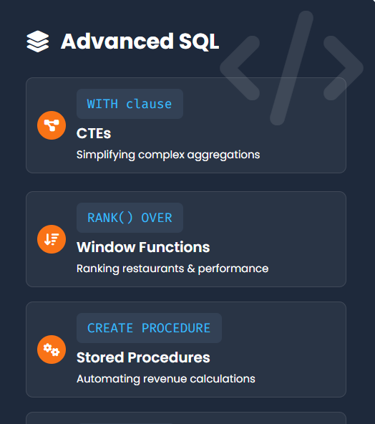


Tools & Technologies
Leveraging industry-standard tools for robust data processing and interactive visualization.
SQL (MySQL)
Data Engine
Used for data extraction, joins, filtering, and aggregation from relational databases. Executes complex queries to handle large transactional datasets and prepares data for analysis.
Power BI
Visualization
Developed interactive dashboards with dynamic filtering.
Visualizes KPIs, trends, and geospatial data for stakeholder reporting.
Power Query
Data transformation
Performed data cleaning and transformation including:
Removing duplicates & null values
Standardizing formats before loading into Power BI

Slide 5
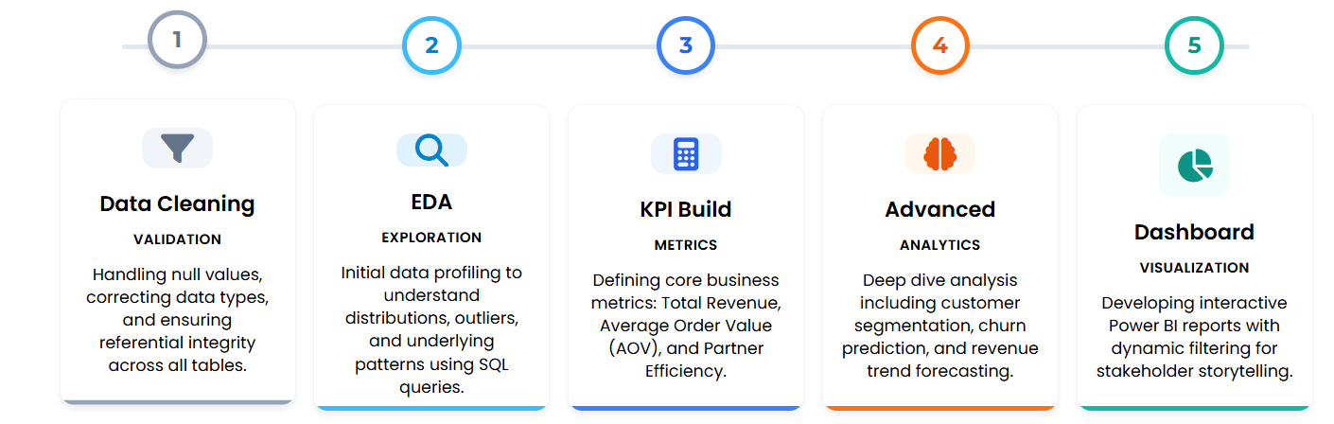
Data Analysis Approach
Systematic 5-phase framework from raw data to actionable insights

Slide 6


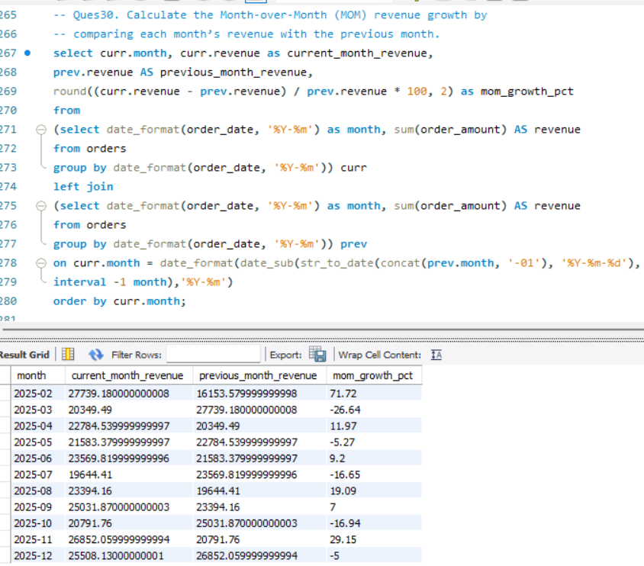
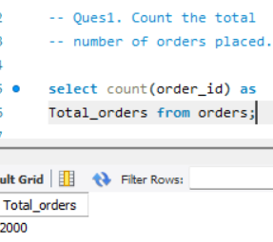
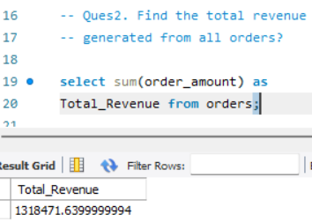

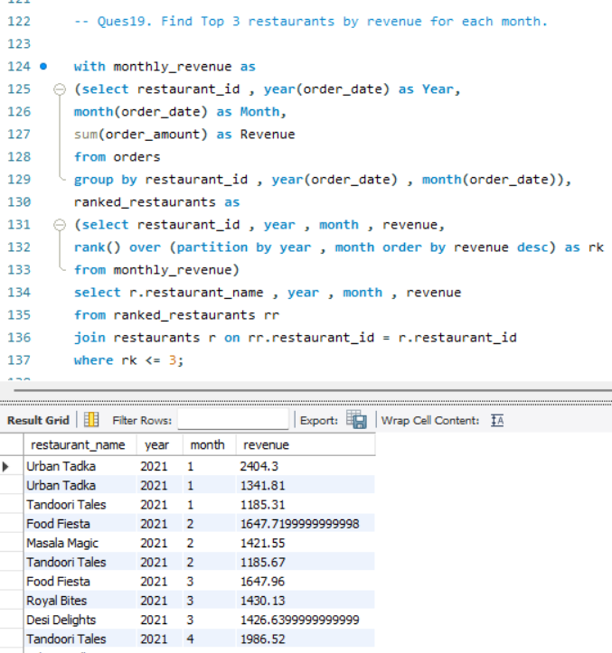
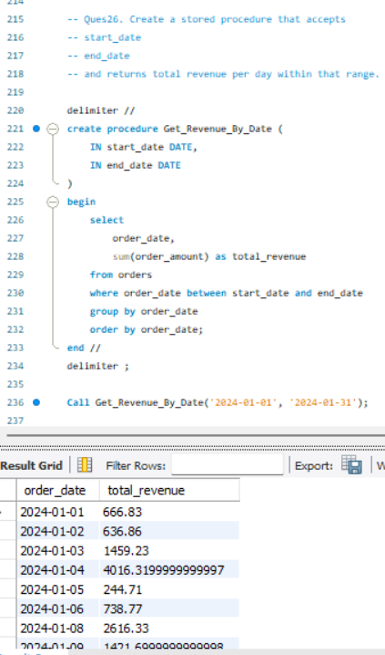
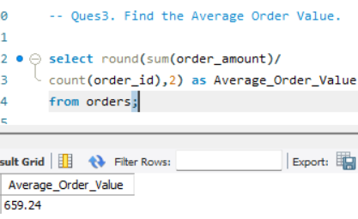


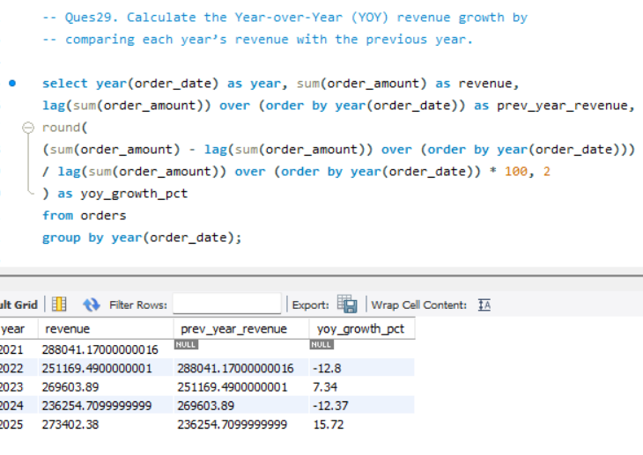
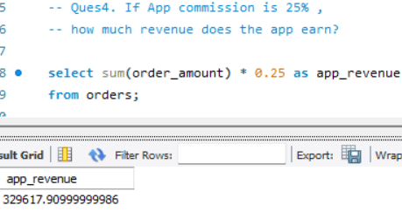
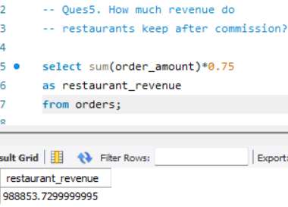
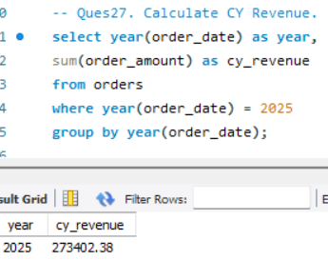
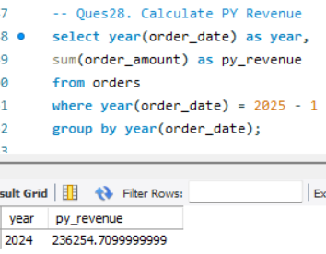
SQL Analysis & Code Logic
KPIs
Joins
Stored Procedure
CY and PY Revenue

Slide 7
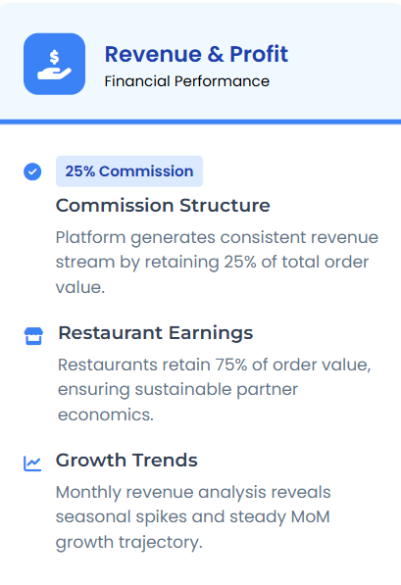
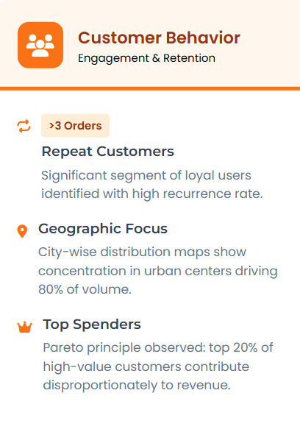
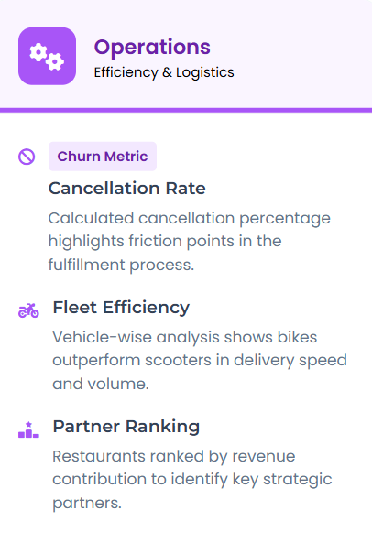
Key Insights Discovered
Critical business intelligence derived from SQL analysis

Slide 8

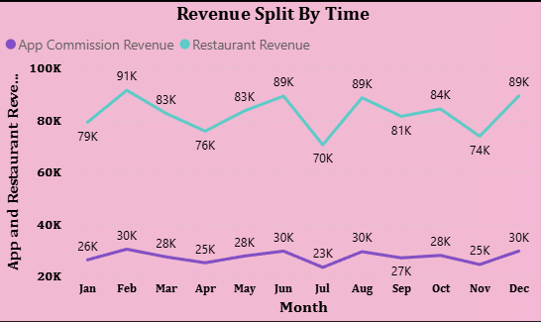
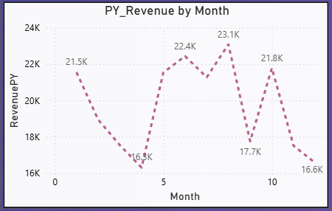

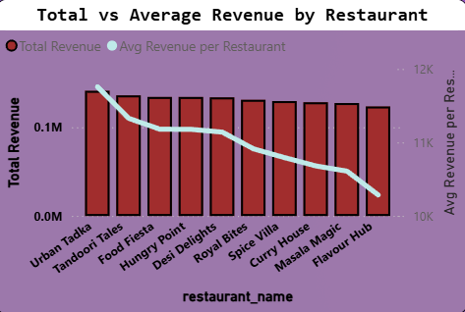
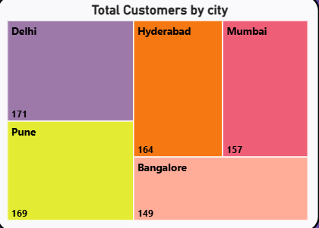
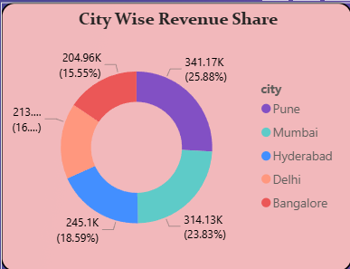
Power BI Dashboard Highlights

Slide 9



Business Recommendations
Data-driven strategic initiatives for sustainable growth
Revenue Growth
Operational Efficiency
Reducing friction & costs
Maximizing top-line performance
Strategic Restaurant Partnerships
Collaborate with top 20% performing restaurants (identified via SQL ranking) to create exclusive bundles and priority placement, driving higher AOV.
Reduce Cancellation Rate
Target the cancellation rate by optimizing order assignment algorithms to reduce driver wait times.
High-Value Loyalty Program
Implement a tiered rewards system for customers with >$500 lifetime spend. Data shows this segment retains 3x better than average.
Optimize Partner Allocation
Prioritize bike couriers for short-distance (<3km) orders in congested zones to improve delivery speed by 20%.
Dynamic Commission Modeling
Introduce flexible commission rates for new partners during peak hours to onboard more high-demand cuisines.
Goal: Cut cancellations by 50%

Slide 10




Conclusion & Impact
Delivering value through data-driven insights
Project Achievements
Skills Demonstrated
Deliverables & Milestones
Technical & Analytical
End-to-End Data Pipeline
Advanced SQL
CTEs & Subqueries
25+ Optimized SQL Queries
Stored Procedures
Window Functions
Interactive Power BI Dashboard
Data Cleaning
Actionable Business Report
Data Modelling
Power BI / DAX
Business Ready Solution
Full Stack Analysis

