Slide 1
Global active consumption forecast
Divya Kannan

Slide 2
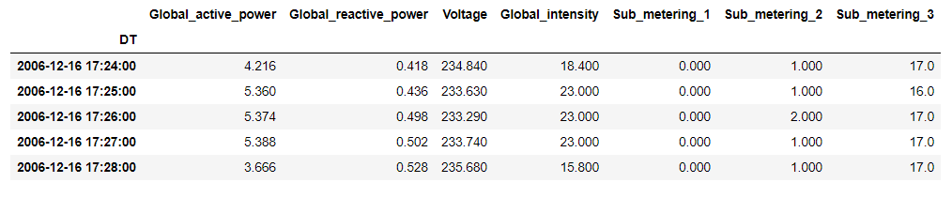
Dataset
Note:
Electricity consumption for a single household over four years
Readings were collected every minute
Missing values were filled with reading from previous day

Slide 3

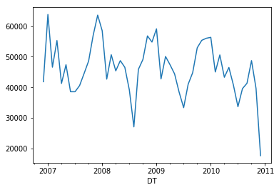
Global active power 2007 - 2010 (monthly)

Slide 4
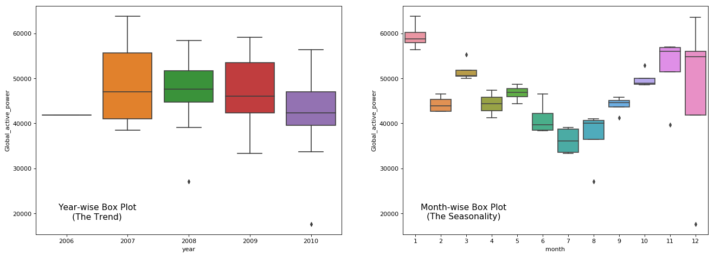
Trend over years
Seasonality over months

Slide 5
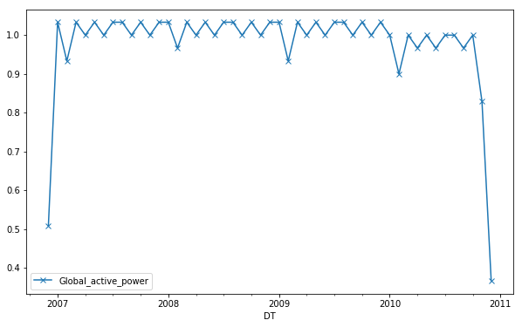
Count of observations (per month)

Slide 6
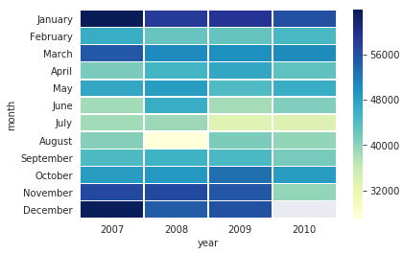
Heatmap

Slide 7
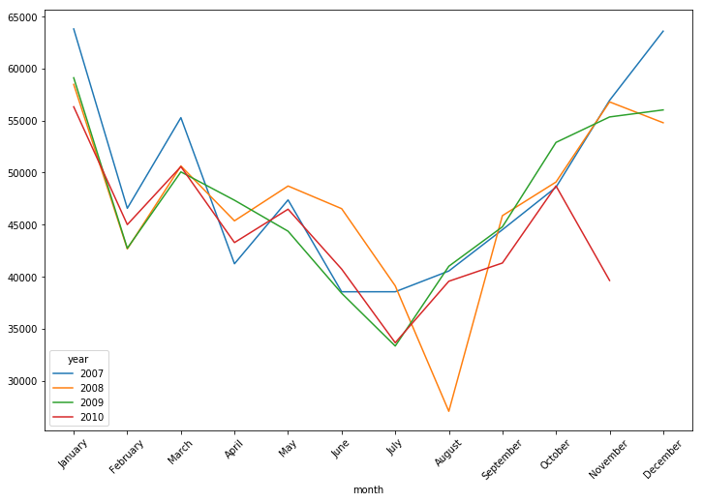
Year over Year consumption comparison

Slide 8
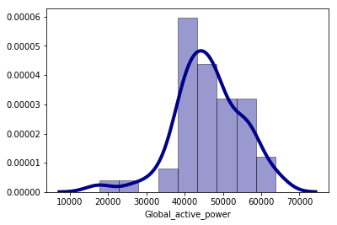
Density plot (over all years)

Slide 9
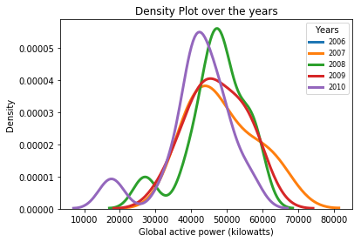
Density plot (over individual years)

Slide 10
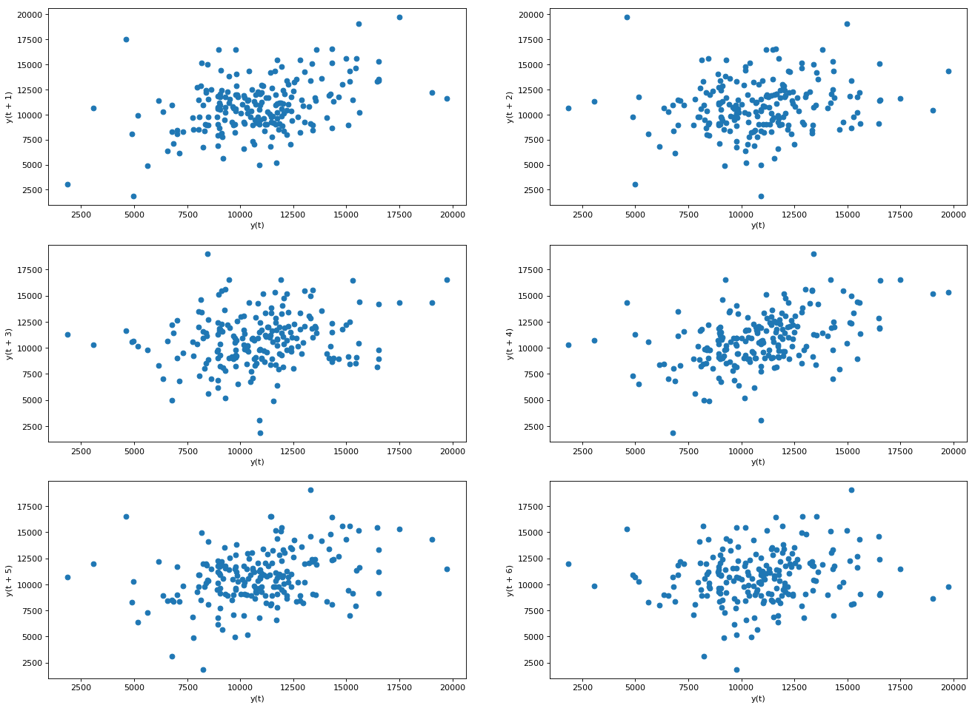
y(t) vs y(t+n) t: weekly sample

Slide 11
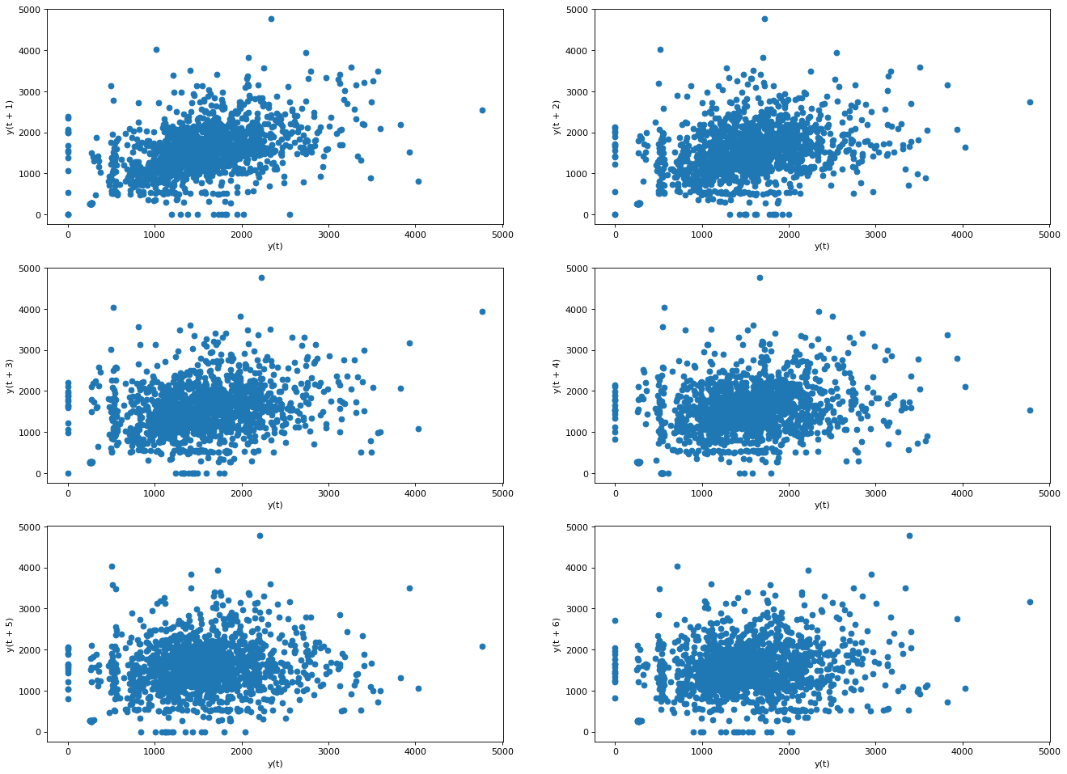
y(t) vs y(t+n) t: daily sample

Slide 12
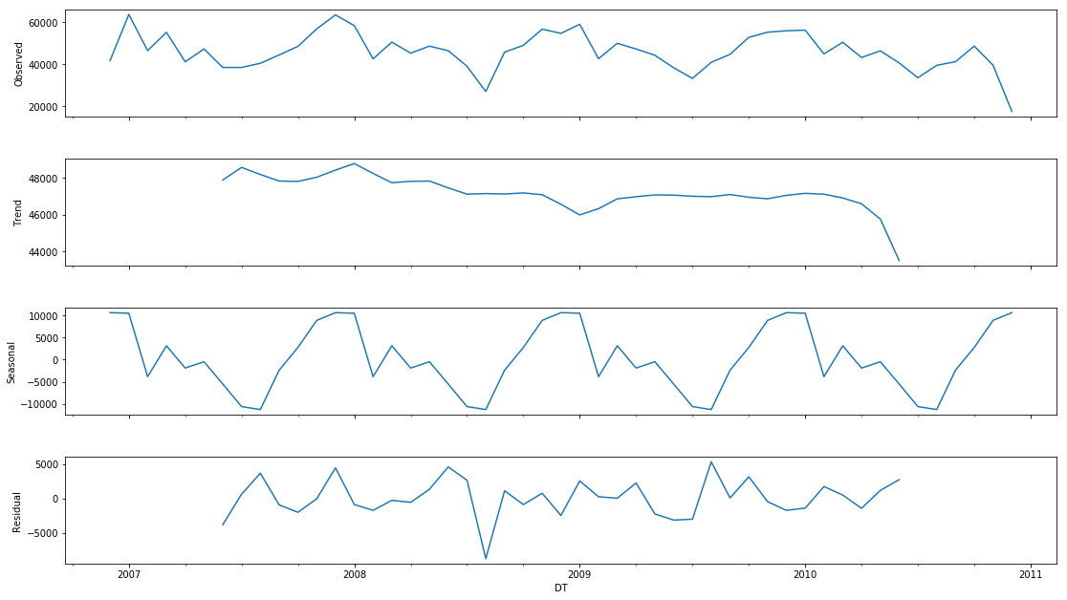
Time series: decomposition

Slide 13
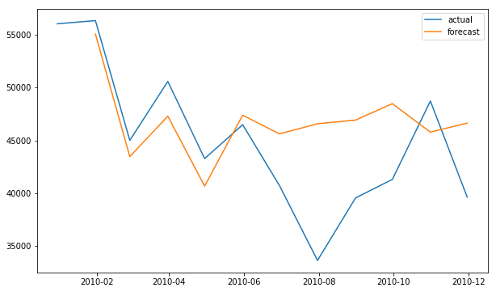
Forecast vs Actuals

