Slide 1

paper

Slide 2
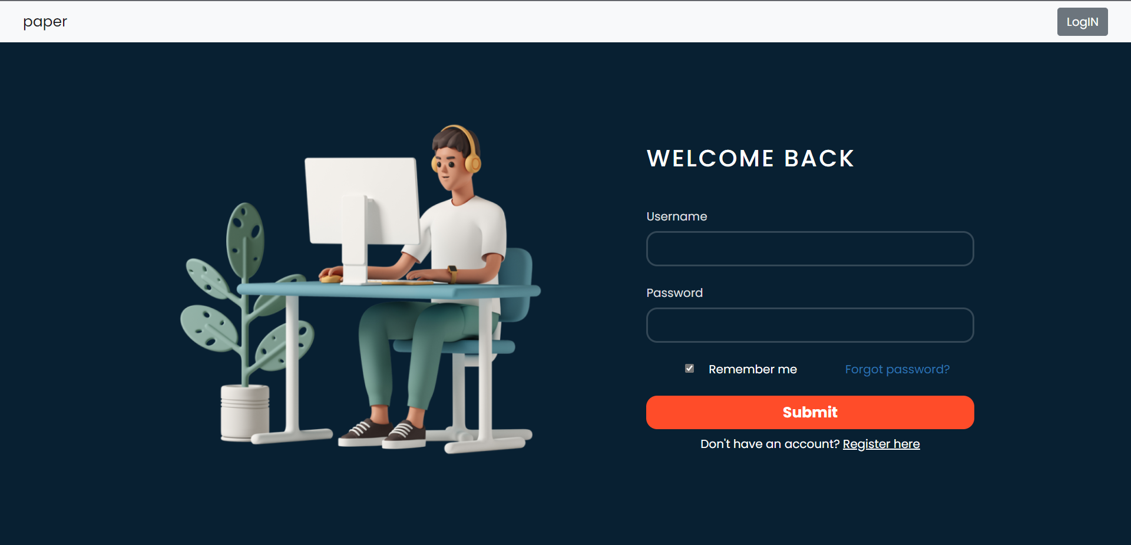
Login Page
Registered Users can Login from this page

Slide 3
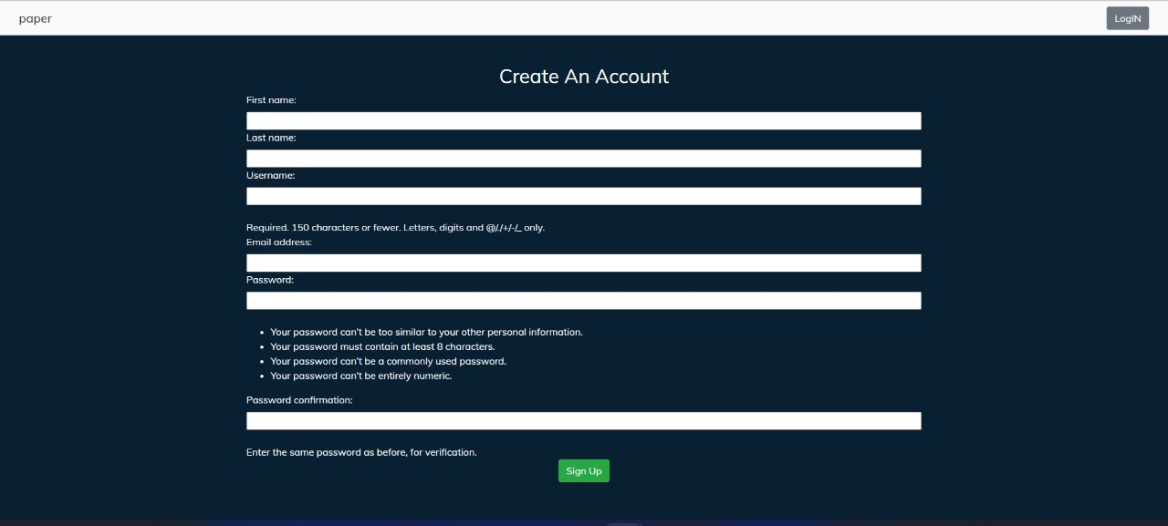
Registration Page
Unregistered Users can register from this page

Slide 4
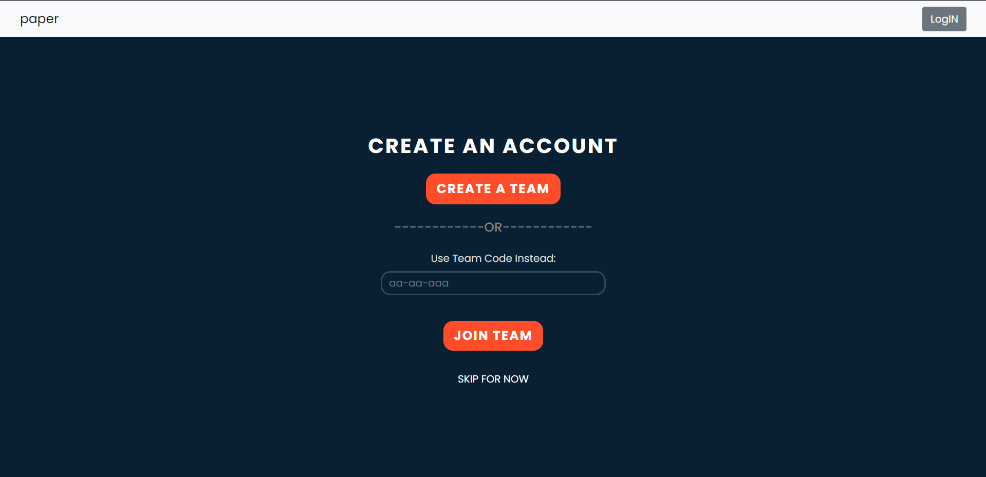
Register Team
New Users can either join an existing team using a team invite code or can create a new team.

Slide 5
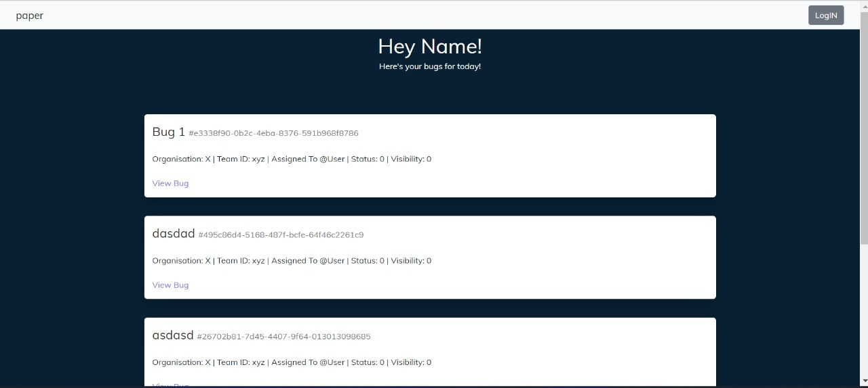
Bug Dashboard
All bugs are cascaded on this page and information related to severity, priority, assignment and resolution are displayed.

Slide 6
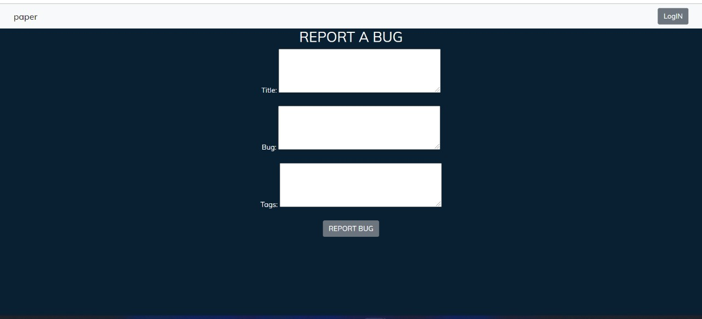
Bug Reporting
Bugs can be raised by both the users as well as by the development team of the concerned software.

Slide 7
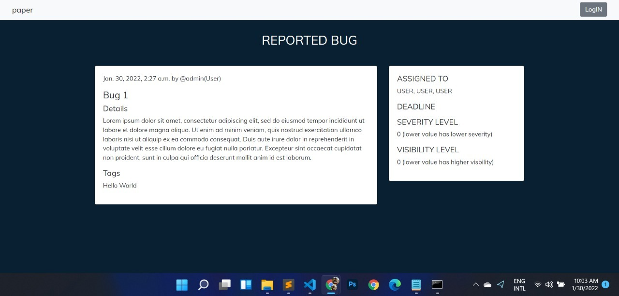
Reported Bug
The visibility of the bugs is restricted based on the employee’s role.
The members in higher roles can assign bugs to employees while those at lower levels can request assignment of a particular bug. They can also assign severity and priority values.

Slide 8
Yet to be done
https://www.figma.com/file/i6UpbHzIQr69b29lHlDaef/Untitled?node-id=5%3A124
Discussion thread page
Profile Page (with record of contributions)
User Facing Dashboard for Resolved Bugs
Database Models Used
Organization
Software
Team
User (outside, jr dev, sr dev, tech lead)

