Slide 1


Telangana Growth Analysis

Slide 2

CONTENTS
01
ABOUT TELANGANA
02
GOALS AND OBJECTIVES
03
PRILIMINARY RESEARCH
04
SECONDARY RESEARCH
05
RECOMMENDATIONS

Slide 3
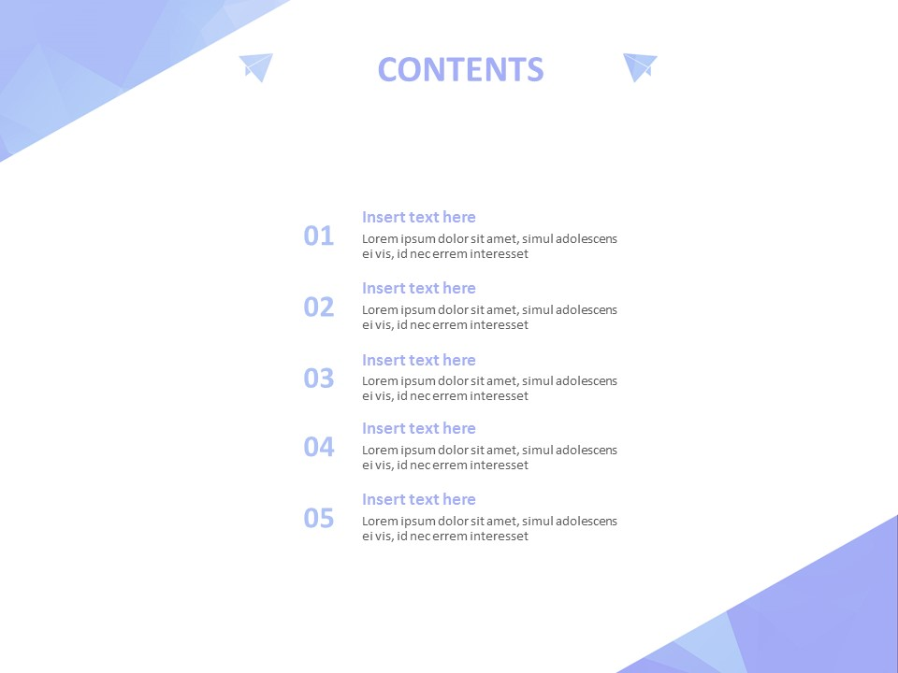
about Telangana
Telangana is one of the fastest-growing states in India. Service sector is the largest contributor to the Telangana's economy. Growth in services has largely been fueled by IT services.
Agriculture also form a backbone of Telangana's Economy. Two important rivers of India, the Godavari and Krishna, flow through the state, providing irrigation.
Several major manufacturing and services industries are in operation mainly around Hyderabad. Automobiles and auto components industry, spices, mines and minerals, textiles and apparels, pharmaceutical, horticulture, poultry farming are the main industries in Telangana.

Slide 4
GOALS AND OBJECTIVES
To Analyze trends and patterns in Stamp Registration, Transportation and Ts-Ipass Datasets
To identify growth opportunities and areas needing attention.
To find correlation among these departments and report the overall growth of the state through insights and relevant visuals such as shape maps.

Slide 5
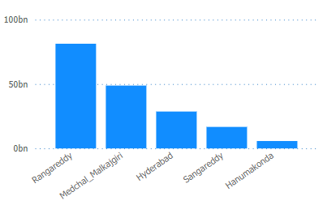
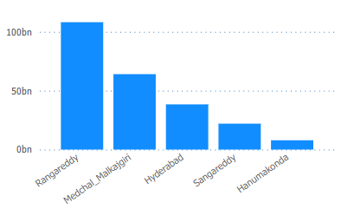
1. Top 5 districts that showed the highest document registration and E-stamp Registration revenue growth between FY 2019 and 2022.
Document Registration Revenue
Estamp Registration Revenue
Highlights:
Rangareddy has the highest Revenue in both document registration and E-stamp registration of 108 bn and 81 bn respectively, followed by Medchal_Malkajgiri (64 bn and 48.8 bn) and Hyderabad ( 38.3 bn and 28.6 bn)
The Top 5 states of highest document registration simultaneously maintains the top 5 position in e-stamp registration by performing well.

Slide 6
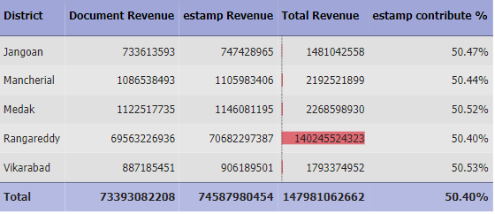
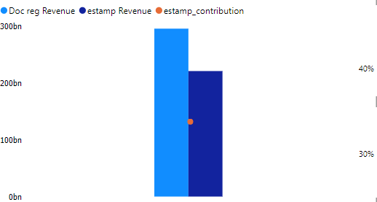
2. Top 5 districts where e-stamps revenue contributes significantly more to the revenue than the documents
Highlights:
Jangoan has the higher contribution of 50.47% to the revenue by e-stamp registration followed by Mancherial with 50.44% and Medak with 50.52%.
The total revenue generated from e-stamp registration is comparatively lower than the revenue generated from document registration by 34%
The total revenue of Rangareddy is higher than the others but the revenue by e-stamp registration is slightly lesser than top 3 districts.

Slide 7
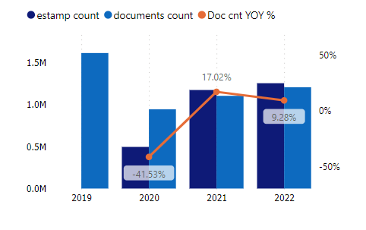
3. Alteration of e-Stamp challan count and document registration count pattern since the implementation of e-Stamp challan .
Highlights:
By introducing e-stamp registration, the document registration has drastically reduced by 41.5% from 1.6 M to 0.9 M for the year 2020. A slight increase can be seen in 2021 and 2022 by 17 % and 9.2% respectively.
Whereas E-stamp registration has increased tremendously in 2021 by 136.6% from 0.4 M to 1.17 M and 6.9% increase in 2022.
The revenue of 2019 is around 62 bn, by introducing e-stamp registration the revenue has gone up to 100 bn each in 2022.

Slide 8
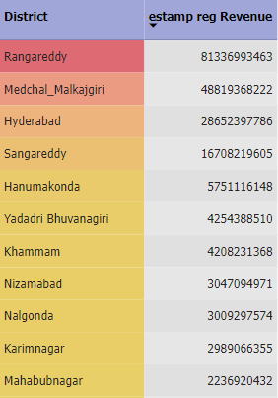
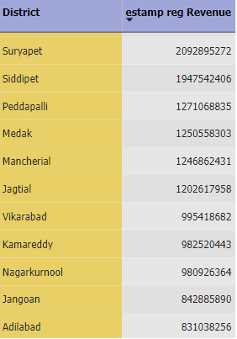
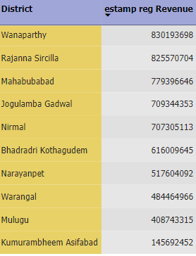
4. Categorize districts into three segments based on their stamp registration revenue generation during the fiscal year 2021 to 2022.
.
Highlights:
Rangareddy has the highest revenue from e-stamp registration of 81 bn, followed by Medchal_Malkajgiri of 48.8 bn and Hyderabad of 28.6 bn
Warangal has the lowest revenue of 4.8 bn, followed by Mulugu 4.0 bn and Kumurambheem Asifabad 1.4 bn

Slide 9
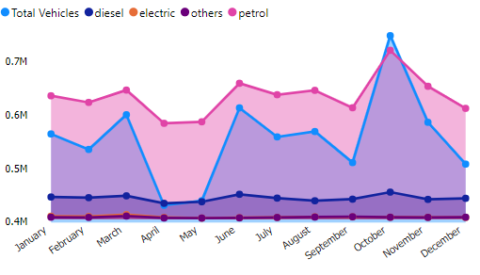
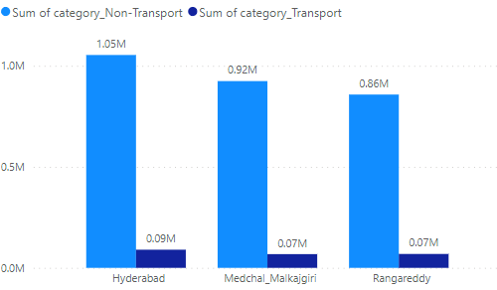
5. Correlation between vehicle sales and specific months or seasons in different districts.
Month wise vehicle sales by Fuel type
Top 3 districts of highest vehicle sales
Highlights:
October had the highest Total Vehicles Sales of 0.74M and was 73.85% higher than April, which had the lowest Total Vehicles at 0.43M followed by March and June 0.6M each.
October accounted for 11.23% of Total Vehicles sales
May and April are encountered with lowest vehicle sale.
In October, Hyderabad ,Medchal Malkajgiri, Rangareddy has the highest vehicle sales of 1.05M ,0.92M, 0.86M respectively among other districts.
Overall, petrol vehicles are selling higher than other fuel types

Slide 10
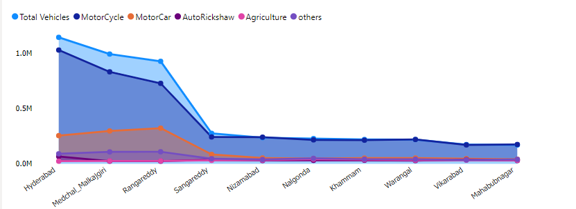
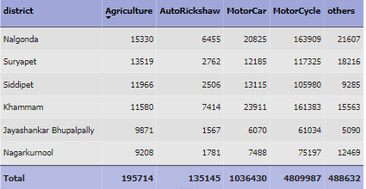
6. Distribution of vehicles vary by vehicle class (MotorCycle, MotorCar, AutoRickshaw, Agriculture) across different districts.
Districts of highest vehicle sales
Highlights:
Motor Cycle has been the predominant preference for all districts, particularly for Hyderabad, Medchal Maikajgiri, Rangareddy, Sangareddy.
Nalgonda, Suryapet, Siddipet are leading in agriculture vehicle sales as these districts are predominantly focuses on Agriculture rather than industry,

Slide 11
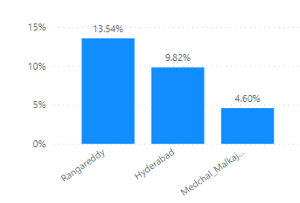
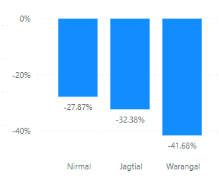
7. The top 3 and bottom 3 districts that have shown the highest and lowest vehicle sales growth during FY 2022 compared to FY 2021
Top 3 districts
Bottom 3 districts
Highlights:
Rangareddy, Hyderabad, Medchal Malkajgiri are the top 3 districts with higher vehicle sales of 13.54%, 9.82%, 4.60% during 2021 – 2022 respectively and these districts are also leading in both document and e-stamp registration revenue.
Nirmal, Jagtial, Warangal are the bottom 3 districts with lesser vehicle sales of -27.87%, -32.38%, -41.68% during 2021 – 2022 respectively

Slide 12
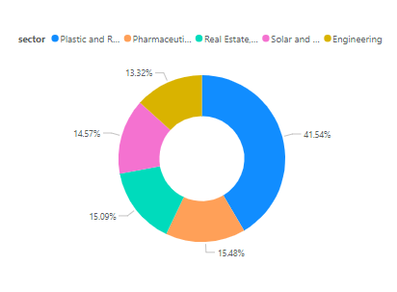
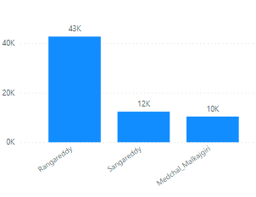
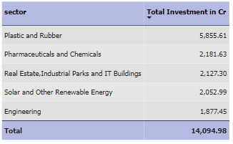
8. List down the top 5 sectors that have witnessed the most significant investments in FY 2022.
Highlights:
Plastic and rubber are the highly invested sector, followed by Pharmaceuticals and Chemicals and Real estate, Industrial parks and IT Buildings
Around 66% of total investments are in top 5 sectors, 34% of investments in remaining 15 sectors.
Rangareddy district significantly investing in Real estate, IT Buildings and Industrial Parks

Slide 13
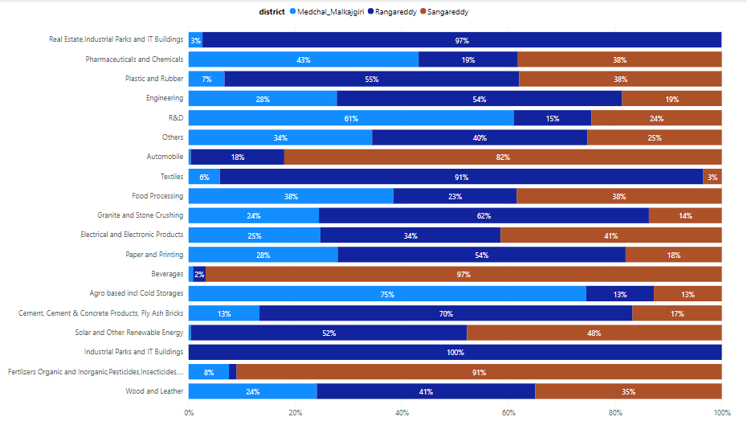
9. The top 3 districts that have attracted the most significant sector investments during FY 2019 to 2022
Highlights:
Rangareddy, Madchal Malkajigri, and Sangareddy are investing a substantial amount in multiple sectors.
Rangareddy predominantly investing in Real Estates, IT Buildings, Industrial park and Textile, Sangareddy in Fertilizers and Beverages.
Maximum investment by Madchal malkajigri is Agro based cold storages sector.

Slide 14
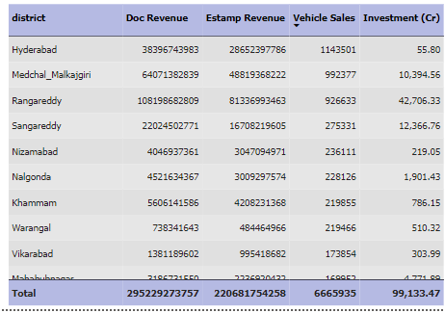
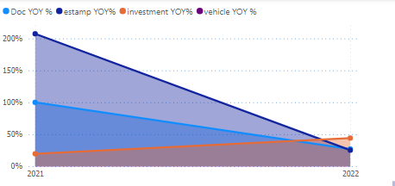
10. Relationship between district investments, vehicles sales and stamps revenue within the same district between FY 2021
and 2022
Highlights:
There is a significant relationship between Document registration and E- stamp registration as one increases the other increases.
The overall reveunue of document and e-stamp registration revenue has seen a significant fall from 2021 to 2022.
There aren’t any visible relations between vehicle sales and investments in different sectors.

Slide 15
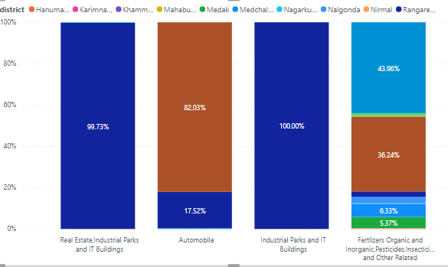
11. Particular sectors that have shown substantial investment in multiple districts between FY 2021 and 2022?
Highlights:
Rangareddy district is the major investor for Real Estate (4k Cr) , Industrial Park, IT Buildings (280 Cr).
In Automobile sector, 82% of investments are Sangareddy (1.2k Cr) and the remaining 18% by Rangareddy districts (275 Cr).
In Fertilizers, Pestisides, Insectisides sector, 44% investments are Yadadri Bhuvanagiri (25 Cr), 36% by Sangareddy (21 Cr) and the remaining 20% of investments are other 5 districts in small amounts.

Slide 16
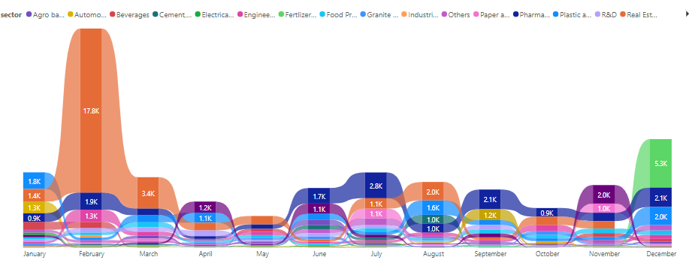
12. Identify any seasonal patterns or cyclicality in the investment trends for specific sectors? Do certain sectors experience higher investments during particular months?
Highlights:
In February, there is a significant increase in the investments in Real estate, Industrial Park, IT Buildings.
In June, there is a slight increase in the investments in Pharmaceuticals and Chemicals and gradually increases in July.
In April ,June and November, an increase in investment is seen in Solar and other renewable energy
In December, Fertilizers has a significant increase.

Slide 17
SECONDARY QUESTIONS
1. The top 5 districts to buy commercial properties in Telangana
Hyderabad, Capital of Telangana, an emerging IT and Tech hub, has various business opportunities, has higher registration revenue and vehicle sales
Rangareddy one of the highest vehicle sales and registration revenue, have investments in Real Estate, IT Building, Industrial Parks. Because of the close proximity of Rangareddy and Hyderabad, the development of Hyderabad can impact Rangareddy.
Sangareddy, have major investments in Automobile sector and has high revenue from registrations conforms the industrial and economic growth of Telangana
Medchal Malkajgiri is one of the district with highest registration revenue, vehicle sales and investments in Pharmaceutical and chemicals can contribute to the economic growth.
Yadadri Bhuvanagiri has major investments in Agro based cold storages and Pharmaceutical and chemicals can impact the economic growth of Telangana

Slide 18
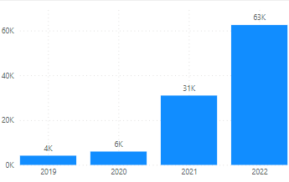
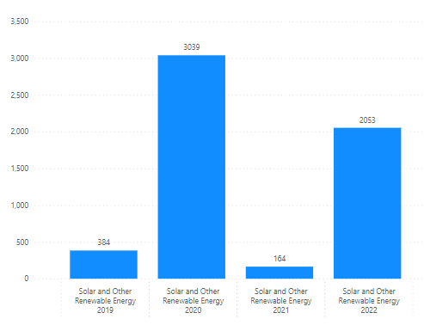
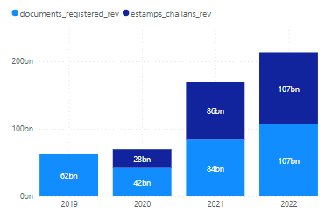
2. The significant policies or initiatives were put into effect to enhance economic growth, investments, and employment in Telangana by the current government.
Telangana electric vehicle and energy storage policy (2020 – 2030)
After the launch of this policy, the sales of electric vehicle has gone up to 63k and a significant amount of investment is made in Renewable Energy Sector
Electric vehicle sales
Investments
Ts-ipass (TELANGANA STATE INDUSTRIAL PROJECT APPROVAL AND SELF CERTIFICATION SYSTEM)
From our data FY2019 – FY2022, Telangana has gained over 10000 Cr as revenue which contributes to the industrial and economic development.
Rithu Bandhu
To promote agriculture productivity and income to the farmers besides breaking the vicious cycle of rural indebtedness adds up to the economic growth of the state.

Slide 19
RECOMMENDATIONS
Focus on infrastructure and promote investments in Rangareddy, Hyderabad and Madchal Malkajgiri as they are performing well and have potential to contribute more to the economic growth of Telangana.
As there is a promising potential in Electric vehicle, by monitoring and promoting the growth of sales especially in districts like Rangareddy, Hyderabad and Madchal Malkajgiri can have a greater impact on the development of Telangana.
Promote the use of E-stamps. The government can take initiative to educate public about the benefits and can provide convenient payment options.
Encouraging investments in sectors that have high potential, such as Pharmaceutical and Chemicals, Plastic and Rubber, Solar and other Renewable Energy.
Government can create employment opportunity by encouraging investments in Engineering, Food Processing, R$D and other top sectors.

