Slide 1
ENTERPRISE TECHNICAL BRIEFING · CONFIDENTIAL
Preckon
An AI-native construction operating system where every number can name the document, the drawing layer, or the person it came from.
TECHSME · CANADA · US · INDIA
20 MINUTES · LIVE WORKSPACE DEMO
Notes:
DO — Stand still. Do not touch the mouse.
SAY — "Twenty minutes. Nine on how this is built, five showing you the running system, and the last six on where the build actually stands — including what isn't finished. Stop me whenever you want."
CORE SLIDE. TIME 0:00–0:30

Slide 2
THE PROBLEM 01
The most consequential number your business produces is the least governed one.
A tender price commits the company for years. It is produced in two to six weeks, by one senior estimator, in spreadsheets, from marked-up PDFs — and when it is questioned in a post-tender meeting, the answer comes from memory.
CONCENTRATION
The method lives in one person's head. It leaves when they do.
OPACITY
No trail from a number back to the drawing it was measured off.
LATENCY
The cycle is longer than the bid window, so scope gets thinner.
Every other business-critical number you hold — payroll, ledger, inventory — sits in a system with an audit trail. The estimate does not.
Notes:
SAY — "Everything else that commits your company at this scale sits in a system with an audit trail. Payroll does. The ledger does. The estimate doesn't."
DO — Four clicks on this slide. Let each card land before you trigger the next.
CORE SLIDE. TIME 0:30–1:15

Slide 3
WHAT IT COSTS TODAY 02
The numbers behind a manual bid.
2–6
weeks for one bid, start to finish
1
person holds the method behind it
0
numbers with a trail back to the drawing
100s
pages of tender read by hand, every time
And the bid window does not move. So the estimator either narrows the scope they price properly, or pads the number to cover what they could not check. Both are expensive, and neither is visible until the job is running.
Notes:
SAY — "Two to six weeks. One person who holds the method. Zero numbers with a trail back to source. And a few hundred pages read by hand, every single time."
DO — Land hard on the zero. That is the one they have never been able to fix by hiring better estimators.
CORE SLIDE. TIME 1:15–1:50

Slide 4
WHERE EVERYONE ELSE STOPS 03
The preconstruction chain has five stages. Almost every tool owns one.
DOCUMENTS
TAKEOFF
BOQ
ESTIMATE
PROCUREMENT
Takeoff tools
Togal · Kreo · Beam
Estimating
CostX and peers
PM platforms
Procore · RDash
Preckon
Everyone sells a stage. The cost, the delay and the lost provenance are all in the joins between them.
SOLID = OWNS THE STAGE · MID-TONE = DOES IT, BUT MANUALLY · OUTLINE = DOESN'T REACH IT
Notes:
DO — One click per row. The Preckon row lands last and reads as a single unbroken span.
SAY — "PM platforms pick up after procurement — they manage what you have already produced. The join between the others is a person retyping into a spreadsheet, and that is exactly where the trail dies."
CORE SLIDE. TIME 1:50–2:35

Slide 5
HOW WE SOLVE IT 04 PAIN BY PAIN
Six things that hurt, and what the platform does about each.
THE PAIN TODAY
WHAT IT COSTS YOU
WHAT PRECKON DOES
Reading the tender by hand
Days before real work starts
Extracts requirements and clauses, and structures the bid
Measuring off drawings manually
The single longest task in the cycle
Reads PDF and CAD, measures elements, records a confidence
Rebuilding the bill in spreadsheets
The same rework on every bid
Generates the bill from those measurements, already structured
Chasing rates across email
Inconsistent pricing between bids
Prices from your rate library — every rate names its origin
No trail from number to drawing
Indefensible in a post-tender meeting
Every line carries its source region and who confirmed it
The programme built separately, late
Cost and schedule disagree
Derives the programme from the same bill, deterministically
Notes:
DO — Six clicks — one per row. Do NOT read the table. Say two rows out loud and let them read the rest.
SAY — "Six things that hurt. The middle column is what each one costs you today. The right-hand column is the part we actually built."
Row five is the one to say out loud — no trail from number to drawing. It is the pain the whole architecture exists to fix.
CORE SLIDE. TIME 2:35–3:30

Slide 6
THE SINGLE CLAIM 05
Every number on screen can tell you where it came from.
Which page of which document. Which layer of which drawing. Or which person typed it, and when they signed for it.
That is the product. The speed is a consequence of it, not the point of it.
Notes:
DO — Say the headline, then stop for two full seconds before you click.
YOUR ANCHOR. Every architecture slide later exists to make this survive an audit. Never cut this one.
CORE SLIDE. TIME 3:30–4:00

Slide 7
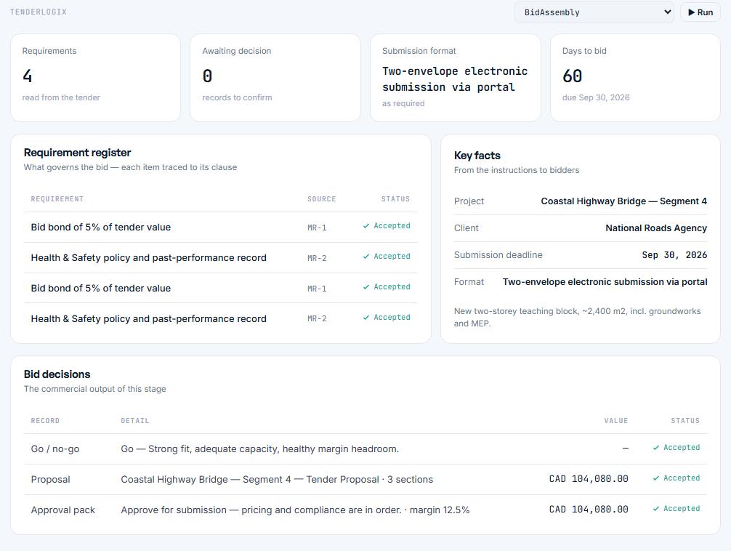
THE PRODUCT 06 TENDER INTAKE
TENDERLOGIX · LIVE WORKSPACE
It reads the tender first.
Requirements pulled out of the package and tracked as objects — not highlighter marks on a PDF.
The submission format, the deadline and the days remaining are read from the documents, then held as project facts every later stage can use.
Bid decisions — margin, resourcing, health and safety record — sit against the requirements that drove them.
Notes:
SAY — "This is the real workspace, not a mock-up. Four requirements pulled straight out of the package. Two-envelope electronic submission. Sixty days left — read from the tender, not typed in by somebody."
DO — CUT THIS SLIDE if you are demoing live. The product tour (slides 7–13) and the demo do the same job.
OPTIONAL — product tour.

Slide 8
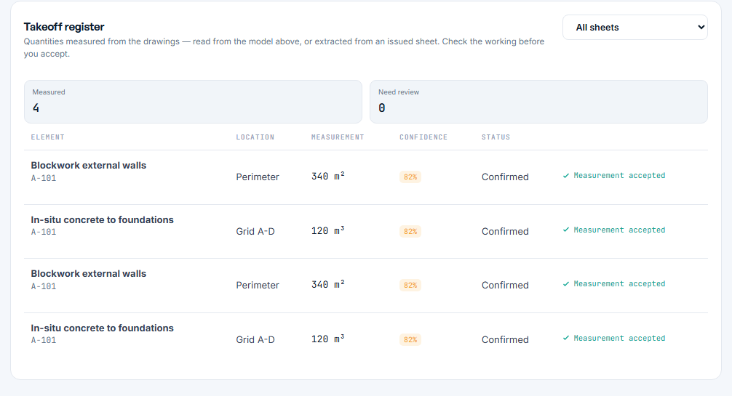
THE PRODUCT 07 DRAWINGS TO QUANTITIES
It measures, and it shows its working.
DRAWLOGIX · TAKEOFF REGISTER
Every measurement names the element, the sheet it came off and the location on it — A-101, Grid A–D.
And every one carries a confidence figure. The low ones are the ones you look at; that is the whole point of showing it.
Nothing here is committed. Each row waits on a person to accept the measure.
Notes:
SAY — "Every measurement names its element, its sheet and its location on that sheet. And it tells you how confident it is. Eighty-two per cent is not a failure — it is the software saying 'check this one first'."
OPTIONAL — product tour. Cut if demoing live.

Slide 9
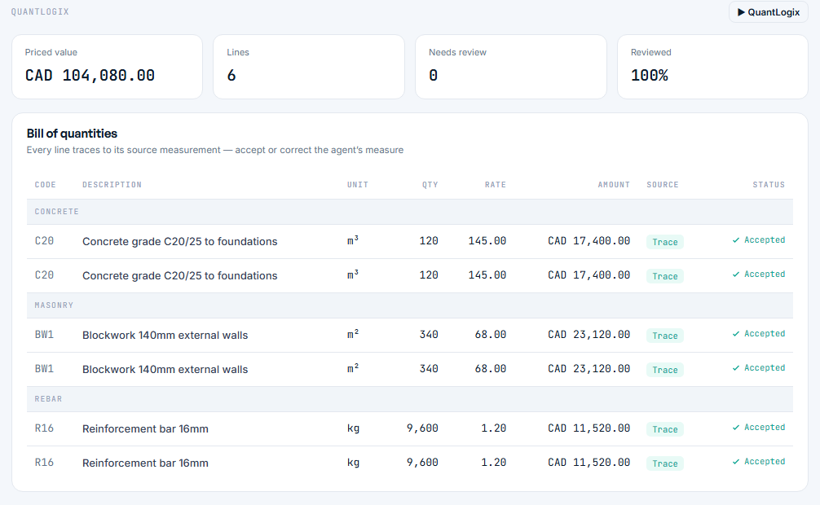
THE PRODUCT 08 THE BILL OF QUANTITIES
Every line has a Trace button.
QUANTLOGIX · PRICED BILL WITH PROVENANCE
This is the screen the whole product is built around.
A priced bill, grouped by division, units normalised. And on every single line, a button that answers the question estimators normally answer from memory.
Press it and you land on the measurement, the sheet and the layer that produced that quantity.
Notes:
SAY — "Look at the column on the right. Every line says Trace, and every line says Accepted — by a person. Those two columns together are the product."
DO — If you cut the rest of the product tour, keep this slide.
OPTIONAL — but the strongest of the seven. Keep if you keep only one.

Slide 10
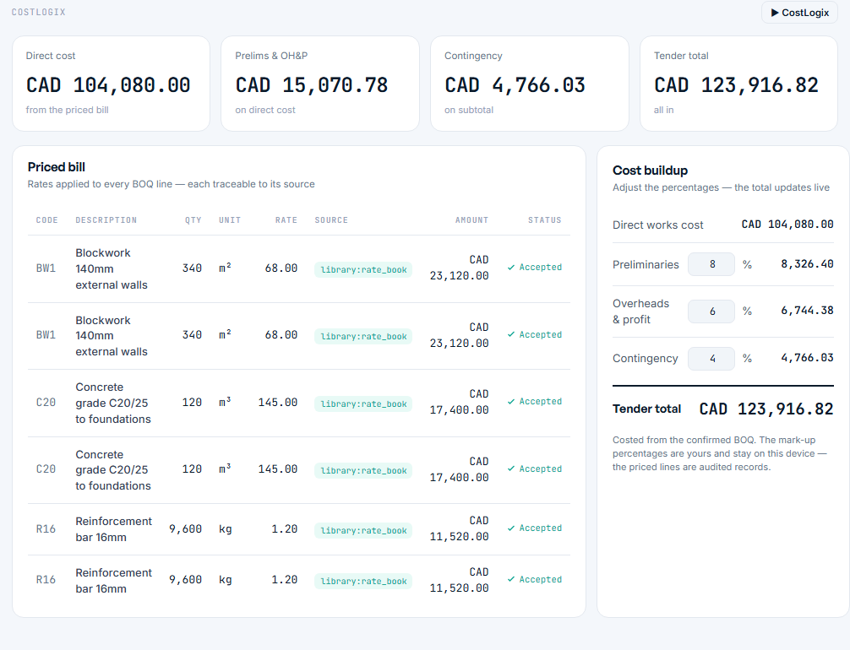
THE PRODUCT 09 THE ESTIMATE
COSTLOGIX · ESTIMATE BUILD-UP
The build-up, not just the total.
Priced bill, overheads, contingency, tender total — each one adjustable, each one showing what it did to the number above it.
Rate times quantity equals amount, on every line. And each rate says where it came from: your rate book, history, or a person who typed it.
There is no third category where a number simply appears.
Notes:
SAY — "A hundred and four thousand of priced work. Fifteen thousand of overhead. Four seven six six of contingency. A hundred and twenty-three nine sixteen as the tender total — and every one of those four numbers can be opened up."
OPTIONAL — product tour.

Slide 11
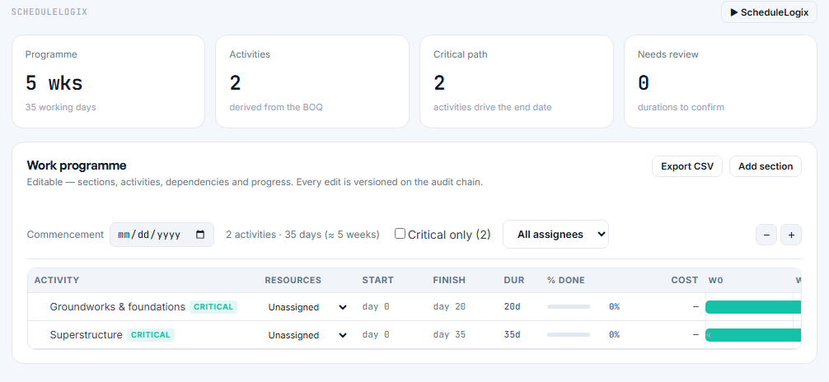
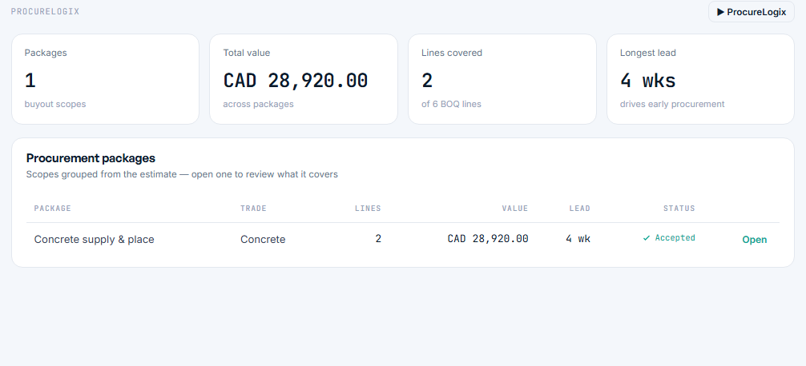
THE PRODUCT 10 PROGRAMME AND PROCUREMENT
Both fall out of the same bill.
SCHEDULELOGIX · DERIVED PROGRAMME
PROCURELOGIX · PACKAGES FROM THE BILL
The programme is a real critical-path calculation, not a Gantt chart somebody drew. The procurement packages are grouped out of bill lines you already accepted — so the package, the quantity and the price cannot disagree with each other.
Notes:
SAY — "Neither of these was typed in. The programme is calculated. The packages are grouped out of bill lines you already accepted. Which means the package, the quantity and the price physically cannot drift apart."
OPTIONAL — product tour.

Slide 12
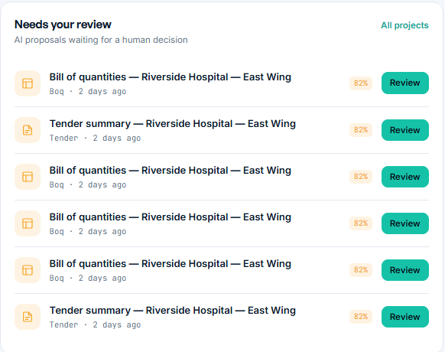
THE PRODUCT 11 AGENTS PROPOSE, HUMANS DISPOSE
Nothing on this screen was committed by software.
PRECKON CORE · REVIEW QUEUE
Every row is a proposal waiting on a person. Each shows what produced it, what it is about, and how confident it is.
Confirming is a permission — held by a named person, checked at one enforced point in the code.
And each confirmation lands on a tamper-evident chain, against that name and that time.
Notes:
SAY — "AI proposals waiting for a human decision. That subtitle is not marketing — it is a structural property. The assistants have four calls available and none of them writes a business record."
KEEP THIS ONE even if you cut the rest of the tour. It carries the governance argument visually, which is worth more than the architecture slide alone.

Slide 13
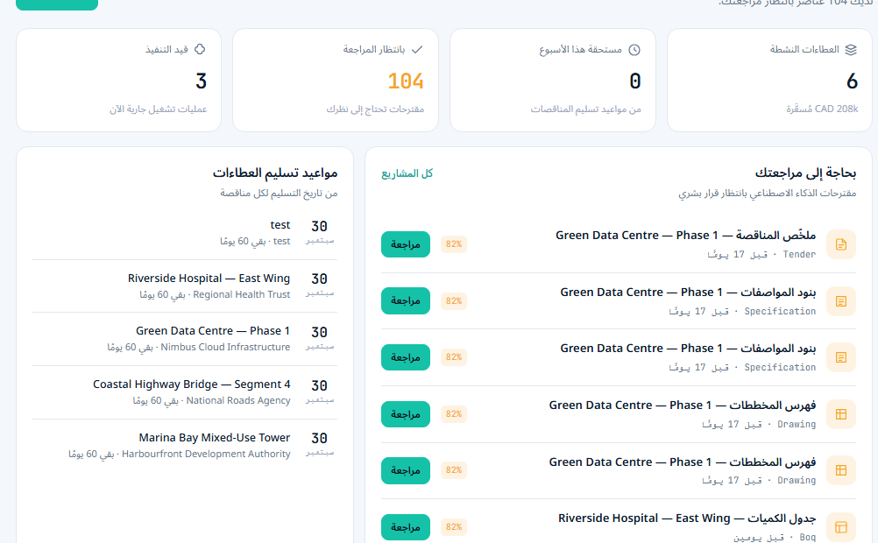
THE PRODUCT 12 ONE WORKSPACE, ANY LANGUAGE
Not a translated copy. The same workspace.
THE SAME TENANT, SWITCHED TO ARABIC
Right-to-left layout, localised numerals, the same records, the same audit chain, the same permissions.
For a GCC or a bilingual delivery team this is usually the difference between a platform people adopt and one that lives with a single power user.
Notes:
DO — Say one line and move. This slide sells itself and does not need explaining.
SAY — "Same workspace. Not a translated copy of it."
OPTIONAL — but very strong for GCC-facing partners.

Slide 14
WHAT YOU GET 13 BEFORE AND AFTER
Six advantages, stated as changes rather than adjectives.
TODAY
WITH PRECKON
A bid takes two to six weeks
The same bid runs in hours, and the estimator spends their time judging rather than measuring
The method lives in one person's head
The method lives in the system, and survives the person leaving
A number cannot be traced
Every quantity names its drawing, sheet and layer
Corrections quietly break things downstream
A correction marks everything downstream stale and tells you what to re-run
Bid capacity is capped by estimator headcount
Capacity is capped by opportunity, not by hiring
A post-tender challenge is answered from memory
It is answered from a tamper-evident chain, in front of the client
Notes:
DO — Six clicks. Read the left column flat and the right column with weight — the contrast does the work.
ROW FIVE is the commercial argument. Bidding more without hiring proportionally is the sentence a CFO repeats afterwards.
Substitute measured pilot figures here the moment you have them. Anything from a real bid beats anything on this slide.
CORE SLIDE. TIME 3:30–4:20

Slide 15
LIVE WORKSPACE
Five minutes on the running system.
app.preckon.com — a real tenant, real documents, nothing pre-rendered
BEAT 01 · 60S
Propose
Open a live bid. Run a stage. The assistants read the tender and the drawings and produce proposals — nothing is committed.
BEAT 02 · 60S
Dispose
The review queue. Confirm one, reject one. The bid advances because a human decided, not because a card was dragged.
BEAT 03 · 120S
Correct
They pick a bill line. Trace it to the drawing layer. Then disagree with it — and watch the downstream go stale.
BEAT 04 · 60S
Verify
Trace view, then Verify audit chain, live. Then switch the workspace to Arabic and leave it for a beat.
Notes:
DO — Leave this slide up while you switch to the browser. It is the frame they hold while you drive.
SAY — "Pick any line you like. I'd rather you chose it than I did."
BEAT 03 IS THE PEAK. Let them choose the line, then stop talking while they read the trace. If a quantity looks wrong, say 'Good, that's exactly the case this is built for' and correct it live.
CORE SLIDE. TIME 4:20–9:20

Slide 16
ARCHITECTURE 14 TWO PLANES
The commercial model is data. The product plane never learns your contract.
HOST PLANE — CONTROL
Where the product is defined
TENANT PLANE — WORK
Where the project lives
Feature → Edition → Pricing → Subscription → resolved entitlements. Tenant provisioning, billing, platform operations.
32 tables · hash-chained audit · operated by TechSME
Projects, documents, drawings, records, review queues, the audit chain. Consumes exactly one thing from the host: resolved entitlements.
84 tables · 90 API routes · deployed
Because the split is that clean, a tenant can be given its own deployment target, its own region, or its own brand without touching product code — and pricing can change without a release.
Notes:
SAY — "The only thing that crosses between them is a resolved entitlement set. Your tenant database holds no commercial terms at all — it doesn't know what it costs."
CORE SLIDE. TIME 9:20–10:15

Slide 17
ARCHITECTURE 15 DOMAIN-NEUTRAL KERNEL
The core knows nothing about construction.
CONSTRUCTION PACK — SHIPPED
8 modules · 18 record types · 20 assistants · 14 workflows · 34 deterministic engines
THE PROOF IT IS REAL
A second pack — underwriting — runs on the same unmodified kernel. Construction is loaded, not hard-coded.
It knows one interface: DomainPack. A vertical is data — one file satisfying the contract, plus a line in the registry.
A pack declares its modules, record types and schemas, assistants with typed I/O, workflows as DAGs, a lifecycle state machine, roles and permissions.
THE ABI — FOUR CALLS, NOTHING ELSE
emitArtifact · readArtifacts enqueueJob / onJobResult · requestReview
Notes:
SAY — "An assistant can do exactly four things. Create a typed record. Read records it's allowed to read. Queue a job. Ask a human to review something. There is no fifth call — it cannot write to a table, approve anything, or reach the network."
This is the extensibility and the moat argument in one slide. Expand here if you are running short.
CORE SLIDE. TIME 10:15–11:10

Slide 18
ARCHITECTURE 16 THE CHAIN OF RECORD
Every output is a typed record that carries its own parentage.
WHAT PRODUCED IT
The assistant, the model alias, the prompt version, the run.
WHAT IT DERIVED FROM
The upstream records, the document page, the drawing region.
WHO CONFIRMED IT
The named person, the timestamp, the entry on the audit chain.
AND THE PART NOBODY ELSE DOES
Correct a confirmed record and the system keeps its version, records your disagreement against your name, and marks every downstream record stale — then tells you precisely what needs re-running. Not the correction. The consequences of the correction.
Notes:
SAY — "Every estimating tool ever built lets you correct a number. Not one of them tells you what else just became wrong."
CORE SLIDE. TIME 11:10–12:05

Slide 19
GOVERNANCE 17 AGENTS PROPOSE, HUMANS DISPOSE
AI does not own authoritative business state.
AI PRODUCES
Proposals, extracted facts, classifications, draft records, explanations — each with confidence and provenance attached.
Architecture principle P-02, locked as ADR-003. Not a setting. Not a policy document. A structural property of the ABI.
AI CANNOT COMMIT
A bill change. A schedule baseline. A contract value. A drawing revision. An approval. Any authoritative transaction.
Confirming is a permission, held by a person, checked at a choke point. Every confirmation lands on the tamper-evident audit chain against a name and a time.
Notes:
SAY — "Not 'we've configured it not to'. It structurally cannot. So the failure mode here is a bad proposal that somebody rejects — not a bad commit nobody noticed."
STRONGEST SLIDE FOR A RISK-AVERSE CTO. Never cut.
CORE SLIDE. TIME 12:05–12:50

Slide 20
GOVERNANCE 18 THE AI FABRIC
No module ever calls a model.
MODEL INDEPENDENCE
Code references aliases — preckon-reasoning — never a vendor. Swapping providers is a registry change.
1
Deterministic software
DEFAULT
2
Exact and semantic cache
BEFORE INFERENCE
POLICY BEATS CAPABILITY
A restricted document does not leave its approved boundary because an external model happens to be better at the task.
3
Structured retrieval
BEFORE LONG CONTEXT
4
Small private model
CLASSIFICATION
5
Private reasoning model
EXTRACTION
EVERY CALL HAS ECONOMICS
Attributed per attempt to tenant, project, user, module, route, tokens and cost. AI spend is a product KPI, not an invoice surprise.
6
Frontier model
ESCALATION ONLY
Notes:
SAY — "A frontier model is the sixth thing we try, not the first. Most of what looks like AI in here is thirty-four deterministic engines doing arithmetic."
DO — Six clicks down the ladder, then three for the panels. If short on time, click once to reveal the whole ladder — select all six in the animation pane and set them to With Previous.
Retires three objections at once: accuracy, cost and sovereignty.
CORE SLIDE. TIME 12:50–13:50

Slide 21
GOVERNANCE 19 TRUST FOUNDATIONS
A log says what happened. A chain proves nobody changed it since.
AUDIT
Hash-chained
Append-only, tamper-evident, and verifiable from the interface — one button, in front of the customer.
ISOLATION
One choke point
Every tenant-scoped query passes a single enforced path. A cross-tenant read returning zero rows is asserted in the test suite.
PROVENANCE
On every derived value
Source, version, rule and model recorded at the moment of derivation, not reconstructed later.
DURABILITY
State in the database
Jobs, gates and re-plans are durable rows, not in-memory queues. A restart resumes; it does not lose the run.
Notes:
SAY — "A log tells you what the application says happened. A hash chain tells you whether anyone changed the record since. In a claim, that's the whole difference."
CORE SLIDE. TIME 13:50–14:15

Slide 22
INTEGRATION 20 THE SURFACE
Integration is a product capability, not a services engagement.
FILES IN
Read once, hashed
PDF · DWG · DXF · IFC · Excel · CSV · P6 XER · images. Ingested once, content-hashed, and processed revision-aware so a re-issue costs a diff, not a re-read.
SYSTEMS
Both directions
ERP and accounting · Autodesk and other CDEs · Primavera · document platforms · email. Connectors are built against a published SDK.
API
90 routes, typed
Stable global object IDs, JSON schemas, idempotent commands, optimistic concurrency, and asynchronous jobs for anything heavy.
EVENTS
Outbox, then webhook
DrawingRevised · QuantityChanged · BOQChanged · CostImpactDetected · SubmittalAffected. Your systems react rather than poll.
Every export is also how the modules talk to each other internally — which is the reason it has to be complete rather than a retention feature bolted on at the end. Honest gap: P6 import, calendars and baselines are specified but not yet built. The critical-path engine underneath them is real and running.
Notes:
SAY — "Four surfaces. Files, systems, the API, and events. The one I'd point at is events — your systems get told when a quantity changes, rather than polling us and hoping."
DO — VOLUNTEER THE P6 GAP. An integration slide that admits its weakest connector is worth more than one that lists forty logos.
CORE SLIDE. TIME 14:15–15:05

Slide 23
INTEGRATION 21 HOW ADOPTION ACTUALLY GOES
Nothing gets switched off in month one.
PHASE A · NOW
Coexist
Preckon reads and writes against what you already run. It adds a layer and takes nothing away. This is where a pilot lives.
PHASE B
Reduce dependency
Takeoff, the bill, tender workflow, document control and commercial workflows move across natively — one at a time, on evidence.
PHASE C
Native
Preckon becomes the system of work from design through handover, while open exchange with consultants and owners is retained permanently.
Phase A has to earn Phase B. That is a commercial commitment, not just an architectural one.
Notes:
DO — Thirty seconds. This defuses the migration objection before the ask — it is not a slide to explore.
CORE SLIDE. TIME 15:05–15:35

Slide 24
DEPLOYMENT 22 FOUR SHAPES, ONE CODEBASE
SHAPE 01
Preckon SaaS
Multi-tenant, managed. Fastest to value, standard terms.
SHAPE 02
Dedicated cloud
Your region, your isolation boundary, our operations.
SHAPE 03
Private AI
Inference inside your boundary. No document reaches an external provider.
SHAPE 04
Sovereign AI
Full on-premise, model serving included, for regulated and state work.
There is no enterprise fork. The same domain model, identity model, API contracts, audit model and AI governance operate across all four. The deployment shape is configuration and hosting — never a second codebase to maintain, and never a second product to certify.
Proven today: SaaS and dedicated cloud. Supported by the architecture but not yet delivered to a customer: private and sovereign.
Notes:
SAY — "Shapes three and four are why the AI fabric exists in the form it does. If a module could call a provider directly, sovereign deployment would be a rewrite."
DO — Say the maturity line out loud. Never imply a reference customer you don't have.
CORE SLIDE. TIME 15:35–16:20

Slide 25
THE BROADER PLAY 23 WHY THIS IS BIGGER THAN A BID
Four things the same foundation makes possible.
HORIZON 1
Beyond the bid
The same chain carries on past award — change control, field capture, quality, handover. The record you built to win the job becomes the record you run it from.
HORIZON 2
Beyond one project
A typed graph across every project: rate history, productivity, which risks actually materialised. Your own portfolio becomes the benchmark you price against.
HORIZON 3
Beyond construction
The kernel is domain-neutral. Construction is one pack; underwriting already runs on the same core. A vertical is data, not a rewrite.
HORIZON 4
Beyond one company
Open exchange stays permanent. Consultants, owners and subcontractors keep their own tools — the chain does not require everyone to adopt it.
The moat is not the construction pack. It is that the pack is data, sitting on a kernel that could carry another industry.
Notes:
SAY — "Horizon three is the one to sit on with a strategic partner. We didn't build a construction app. We built a kernel and loaded construction into it — and there's a second pack running on that same core today to prove it."
If the partner has verticals of their own, this is the slide where you stop and ask which one they'd want to see running on it.
CORE SLIDE. TIME 16:20–17:05

Slide 26
WHERE THE BUILD ACTUALLY IS 24
DocLogix
93%
132 features. 97 done, 15 partial, 20 missing.
ProcureLogix
92%
CostLogix
88%
NarrativeLogix
83%
Measured against the blueprints as written — 13,074 lines of specification across ten documents. Not against a roadmap we could move.
QuantLogix
82%
TenderLogix
81%
ScheduleLogix
77%
Platform / Core
72%
HOW IT IS COUNTED
Done means built, tested and deployed. Partial counts as a half. Missing counts as zero. Every row verified against the codebase and the deployed production database.
DrawLogix
72%
All modules
79%
Notes:
SAY — "Seventy-nine per cent, and I want to be careful with that number, because a percentage can be made to say almost anything. Partial counts as a half. Missing counts as a zero."
DrawLogix is lowest and also the strongest thing in the demo — because it has the most ambitious spec. Say that; it shows the measure is honest, not flattering.
CORE SLIDE. TIME 17:05–17:50

Slide 27
EVIDENCE 25 COUNTED, NOT ASSERTED
84
database tables, deployed
90
API routes
982
tests passing, 46 files
34
deterministic engines
24
schema migrations
20
assistants, typed I/O
18
record types
14
workflows
12
architecture decision records
31
live sheets in production
These were queried from the repository and the running production database on the morning of this briefing. Any of them can be re-run in front of you.
Notes:
DO — Do not read the grid. Say the last sentence only.
SAY — "If any of them matter to your diligence, we'll run the query in front of you rather than send you a spreadsheet."
Safe to compress if running long. TIME 17:50–18:20

Slide 28
THE GAPS 26 TOLD TO YOU, NOT FOUND BY YOU
ENTERPRISE REQUIREMENT
STATE
NOTE
Sixteen open P0s. These are the eight you would have found.
SSO — SAML / OIDC
NOT BUILT
Deal blocker. Named in the platform spec.
MFA
NOT BUILT
Deal blocker.
Encryption at rest + KMS
NOT BUILT
Specified, not yet implemented.
CI running the suite
0 RUNS
Six workflow files exist; none has executed.
You will find every one of these in a diligence pass. We would rather you heard them from us, in the room, than from a consultant in week six.
Staging environment
NONE
Changes are validated in production.
Backup with tested restore
NONE
An untested restore is not a backup.
Retrieval / RAG
PARTIAL
Wired for DocLogix; no embeddings yet.
The trust foundations underneath — audit chain, tenant isolation, provenance, durable jobs — are built and tested. What is missing is the enterprise operations layer around them. A known, bounded, unglamorous list.
AI policy enforcement
REPORT-ONLY
Recording on every call; enforcement behind a flag.
Notes:
SAY — "There are sixteen open P0s. These eight are the ones that matter to you specifically. And notice what they are, and what they aren't — none of them is 'the chain doesn't work'. They're the operations layer."
DO — CRITICAL — the public website still shows SSO, encryption at rest and row-level security as live. They are not. Correct it yourself before anyone raises it: 'our marketing site is ahead of the build on three of these and we're fixing the copy.'
DO — IF ASKED — the deployed database is MySQL, so tenant isolation is enforced in the repository layer rather than by Postgres row-level security. Deliberate, tested and documented.
NEVER CUT. This slide is why the meeting works. TIME 18:20–19:10

Slide 29
THE ASK 27
Three things, six weeks, one live tender.
01
One real bid, end to end. One project, one estimating team, six weeks — measured against a bid you have already priced, so the comparison is yours and not ours.
02
A golden set. One design set paired with its final priced bill, which we hold as a regression fixture. Accuracy stops being a claim the moment it has a fixture behind it.
03
A named security counterpart. Someone on your side who closes that P0 list with us inside the same six weeks — SSO, MFA, CI, staging, backups.
WHAT WE ARE NOT ASKING FOR
A migration. A system to be switched off. A commitment beyond the pilot. Or a decision today.
Notes:
SAY — "The third one tells you how serious we are. We're not asking you to wait while we build SSO. We're asking you to close that list with us."
THE GOLDEN SET IS THE HIGHEST-LEVERAGE ASK IN THE DECK. A design set paired with its final priced bill is the most valuable thing a construction AI company can be given. Ask directly; do not soften it.
CORE SLIDE. TIME 19:10–19:40

Slide 30
CLOSE 28
Twenty minutes. From an empty project to a priced bill, a programme, a technical submission and a register of what is still outstanding.
But the number of minutes was never the argument.
Every number you saw today can name where it came from. A page of a tender, a layer of a drawing, or a person who typed it and signed for it.
That is the whole product. The rest is speed.
Notes:
DO — No animation here on purpose. Say the last three lines slowly, then stop talking. Do not offer next steps. Let them ask the first question.
If the silence runs past ten seconds, the only line that works is: 'What would you want to test first?'
CORE SLIDE. TIME 19:40–20:00

