Slide 1

Every number knows where it came from.
TECHSME · CANADA · US · INDIA
APP.PRECKON.COM
Notes:
DO — Stand still. Say the line on the slide, then nothing for two seconds.
SAY — "Preckon. Every number knows where it came from. That's the whole product — I'll spend the next fifteen minutes proving it."
TIME 0:00–0:20

Slide 2

ONE TENDER, PRICED BY HAND
2–6
weeks per bid
1
person holds the method
100s
pages read by hand
0
numbers you can trace
And the bid window does not move.
Notes:
SAY — "Two to six weeks. One person who holds the method. A few hundred pages read by hand. And zero numbers you can trace back to the drawing they came off."
DO — Four clicks. Land hard on the zero, then click once more for the line.
TIME 0:20–1:00

Slide 3
WHAT THE INDUSTRY ACTUALLY COMPLAINS ABOUT
Fifteen pain points.
Fifteen symptoms. One cause — the chain breaks at every handover.
INFORMATION & DESIGN
COMMERCIAL
DELIVERY & OPERATIONS
01
Drawing and document versions
03
Slow estimation and tendering
06
Procurement and supply delays
02
Manual take-offs and BOQ
05
Change orders hard to manage
07
Material wastage and stock
04
Design changes and rework
13
Budget overruns, weak cost control
09
Manual progress reporting
08
Poor coordination between parties
12
No basis for forecast or risk
11
Many projects at once
10
Fragmented data, slow decisions
14
Schedule overruns
15
Planning measured in months
Notes:
DO — Three clicks — one per column. Do NOT read fifteen items aloud. The filled card in each column is the one to say out loud; let them read the rest.
SAY — "These are not our list. They came out of talking to construction clients, and every one of them is somebody's actual week."
THE THREE HIGHLIGHTED CARDS are the ones Preckon answers most directly — manual take-offs, slow tendering, and planning measured in months. They line up with the three highlighted advantages later.
FULL WORDING, for reference:
1 Document and drawing version management challenges
2 Manual quantity take-offs (QTO) and BOQ preparation
3 Time-consuming cost estimation and tendering
4 Frequent design changes and rework
5 Change order management difficulties
6 Delayed procurement and supply chain disruptions
7 Material wastage and inventory issues
8 Poor coordination between architects, engineers, contractors and clients
9 Manual progress reporting and project tracking
10 Delayed decision-making due to fragmented data
11 Difficulty managing multiple projects simultaneously
12 Lack of data-driven insights for forecasting and risk management
13 Budget overruns and poor cost control
14 Project delays and schedule overruns
15 Planning time measured in months
NOTE ON ITEM 15: in the source list this was written as 'Reduced project planning time (months to days)', which is a benefit rather than a pain. It is flipped here to state the problem; the benefit form is advantage 13.
TIME 1:00–1:45

Slide 4
FIVE STAGES · WHO OWNS WHAT
DOCUMENTS
TAKEOFF
BOQ
ESTIMATE
PROCUREMENT
Takeoff tools
Estimating
PM platforms
Preckon
The cost is in the joins.
Notes:
SAY — "Almost every tool owns one of these five. The joins between them are a person retyping into a spreadsheet — and that's where the trail dies."
DO — One click per row. Preckon lands last, as one unbroken span.
TIME 1:00–1:45

Slide 5
ONE RECORD, EIGHT STAGES
Tender
Drawings
Specs
BOQ
Estimate
Programme
Procurement
Submission
Nothing is retyped between them. Each stage reads what the last one confirmed.
Notes:
SAY — "Eight stages, one record. The word that matters is chain, not suite. A suite is products that share a login."
DO — Eight quick clicks — let it build left to right like a conveyor.
TIME 1:45–2:20

Slide 6
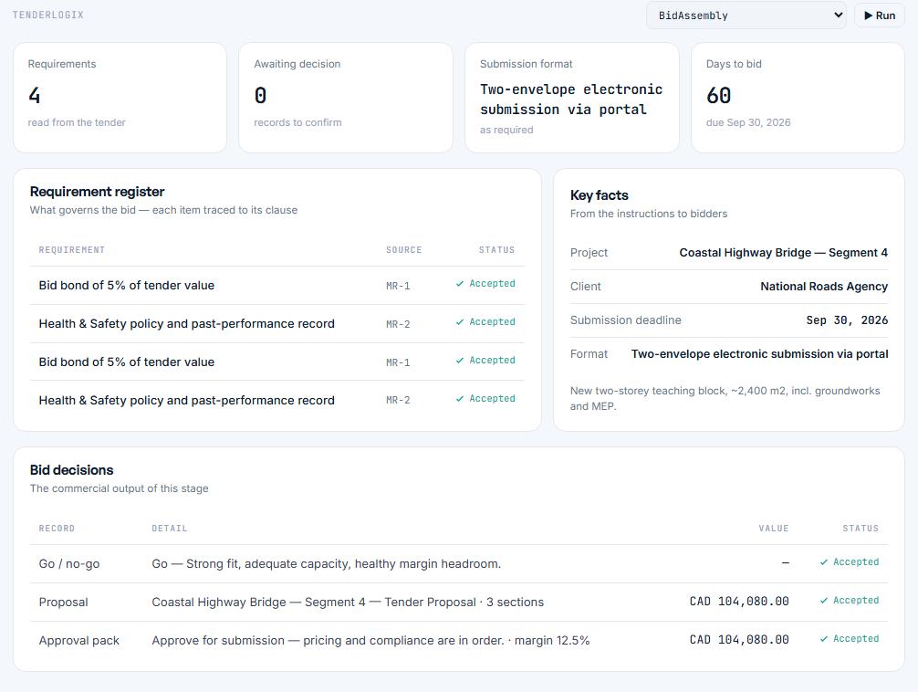
TENDERLOGIX
It reads the tender.
Notes:
SAY — "Four requirements pulled straight out of the package. Two-envelope submission. Sixty days left — read from the documents, not typed in."
DO — One click brings the screen up, one brings the line. Then be quiet and let them read it.
Cut this slide if you are demoing live.

Slide 7
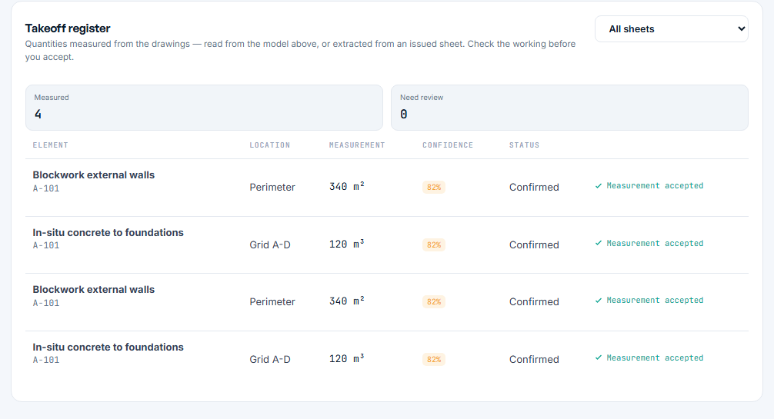
DRAWLOGIX
It measures, and shows its working.
Notes:
SAY — "Every measurement names its element, its sheet and its grid reference. And it tells you how confident it is. Eighty-two per cent means check this one first."
DO — One click brings the screen up, one brings the line. Then be quiet and let them read it.
Cut this slide if you are demoing live.

Slide 8
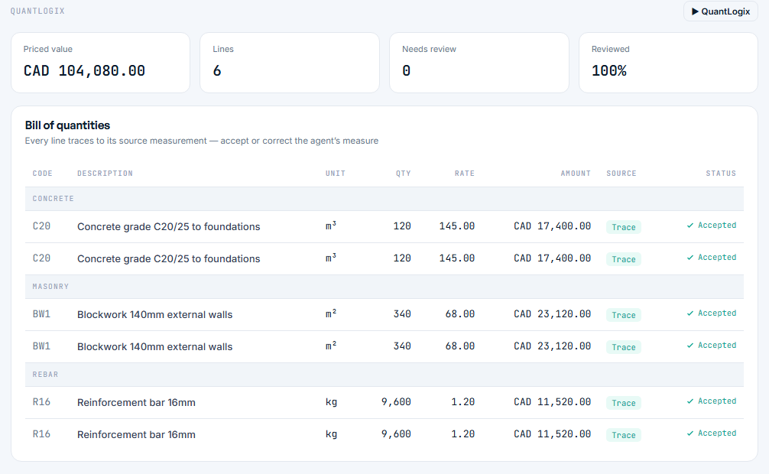
QUANTLOGIX
Every line has a Trace button.
Notes:
SAY — "Look at the right-hand columns. Trace, and Accepted — by a person. Those two columns together are the entire product."
DO — One click brings the screen up, one brings the line. Then be quiet and let them read it.
Cut this slide if you are demoing live.

Slide 9
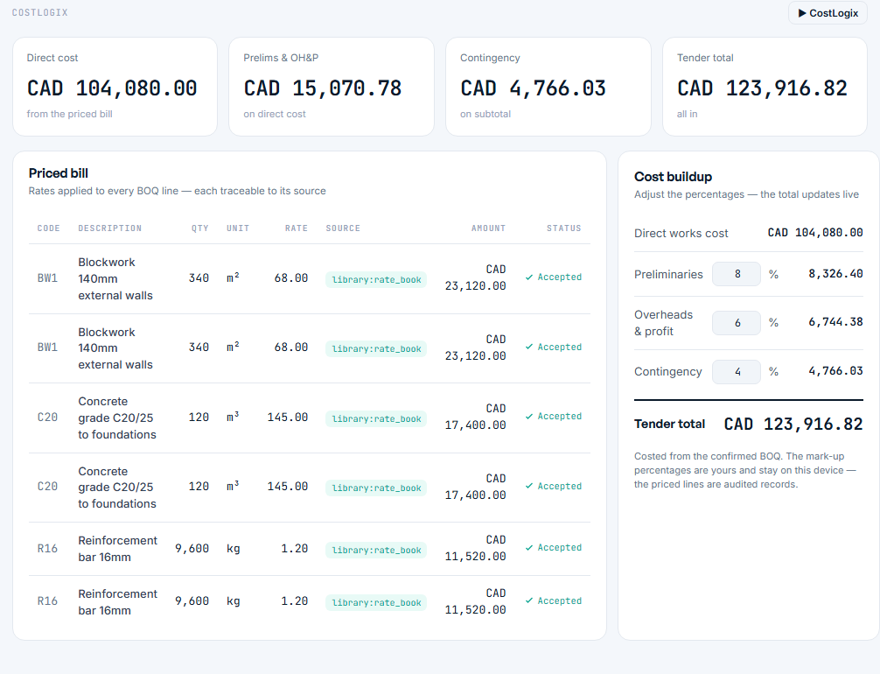
COSTLOGIX
The build-up, not just the total.
Notes:
SAY — "A hundred and four thousand priced. Fifteen thousand overhead. Four seven six six contingency. A hundred and twenty-three nine sixteen total — and every one opens up."
DO — One click brings the screen up, one brings the line. Then be quiet and let them read it.
Cut this slide if you are demoing live.

Slide 10
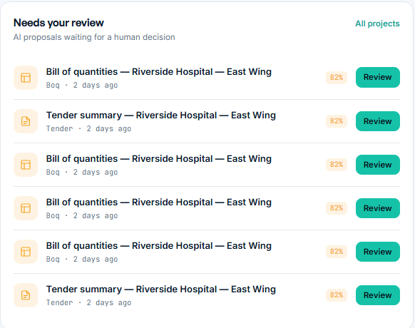
PRECKON CORE
Nothing here was committed by software.
Notes:
SAY — "AI proposals waiting for a human decision. That subtitle is a structural property, not a marketing line."
DO — One click brings the screen up, one brings the line. Then be quiet and let them read it.
Cut this slide if you are demoing live.

Slide 11
SAME BID, BOTH WAYS
ESTIMATOR DAYS PER BID
Manual
15 days
With Preckon
4 days
11 days back, on every bid.
The estimator stops measuring and starts judging — which is the part you were paying them for.
Notes:
SAY — "Fifteen estimator-days becomes four. And the four that remain are review and judgement, not measuring."
DO — FOUR DAYS IS DELIBERATELY CONSERVATIVE. Our own website says hours. Quote the conservative number in the room and let the pilot beat it.
TIME 2:20–3:00

Slide 12
WHAT CHANGES WHEN THE CHAIN IS JOINED UP
Fourteen advantages.
Weeks to hours. Months to days. And every number still names its source.
PRODUCE THE NUMBERS
KEEP THEM TRUE
RUN THE WORK
01
AI take-off and BOQ — weeks to hours
03
One source of truth, versioned
05
Integrated procurement and materials
02
Estimates and tenders in days
04
A design change updates everything
06
Real-time dashboards
11
Higher accuracy, fewer errors
07
Live budget and variance control
09
One platform for every party
13
Planning: months to days
08
AI forecasting and risk signals
10
Multi-project workspace
12
End-to-end digital lifecycle
14
Productivity and scale
Notes:
DO — Three clicks. Same rule — the filled card per column is the one you say; let them read the rest. The kicker line is the one to say slowly.
SAY — "Same three groupings as the pain slide, in the same order. Produce the numbers. Keep them true as things change. Then run the work off them."
THE THREE HIGHLIGHTED CARDS answer the three highlighted pains directly. If someone asks 'which of these actually matter', point at those and say the rest follow from them.
FULL WORDING, for reference:
1 AI-powered QTO and BOQ generation — take-offs and BOQ from weeks to hours
2 Faster cost estimation and tendering — estimates and tender documents in days instead of weeks
3 Automated document and drawing management — single source of truth with version control
4 Smart design change management — instantly update quantities, costs and documentation when designs change
5 Integrated procurement and material management
6 Real-time project monitoring through live dashboards
7 Better cost and budget control — monitor budgets, detect variances
8 AI-driven forecasting and risk analysis — identify risks and cost impacts early
9 Centralized collaboration — architects, engineers, contractors, consultants and clients on one platform
10 Multi-project management from a unified workspace
11 Higher accuracy and reduced manual errors
12 End-to-end digital construction lifecycle, tender through delivery
13 Significant time savings — pre-construction and planning from months to days
14 Improved productivity and scalability at any project size
DO — HONESTY CHECK before you present this slide. Items 5, 6 and 10 lean on parts of the platform that are not fully built: procurement stops at package grouping (RFQ, quotes and commitments are not started), and post-award cost control is not started. If someone asks whether all fourteen are live today, say which are roadmap. The build-state slide covers you — but only if you do not oversell here.
TIME 4:20–5:05

Slide 13
THE ARITHMETIC
Put your own numbers in.
LEVER 1
INPUTS — REPLACE WITH YOURS
$264k
saved a year in estimating effort 440 estimator-days returned
Bids per year
Estimator days per bid
Cost per estimator-day
Average contract value
Win rate
40
15
$600
$8M
20%
LEVER 2
+10
more bids a year with the same team ≈ 2 extra wins at a 20% rate
LEVER 3
$80k
one 1% pricing error avoided on one $8M job is worth more than the licence
Notes:
SAY — "I'm not going to show you a case study, because we don't have one yet and you'd see through it. Here's the arithmetic instead — put your own numbers in the left-hand box and the three levers on the right recalculate."
DO — THE INPUTS ARE ILLUSTRATIVE. Edit them in PowerPoint before the meeting if you know the client's real figures — a deck showing THEIR numbers is worth ten showing ours.
Lever 3 is the one that lands with a commercial director. One avoided pricing error on one job pays for the platform several times over. Say it plainly.
TIME 3:00–4:00

Slide 14
PAYBACK
Under three months.
2.7 months
to cover a year of platform cost from estimating effort alone.
Levers 2 and 3 are not in this chart. Neither is a single won bid.
Notes:
SAY — "Effort saving alone covers a year of platform cost in under three months. And that line does not include a single extra bid won, or a single pricing error caught."
DO — The chart is a real PowerPoint chart — right-click, Edit Data, and put the client's figures in during the meeting if they give them to you. That moment does more than the rest of the deck.
$60k platform cost is a placeholder. Set it to the real proposed number.
TIME 4:00–4:50

Slide 15
HOW A NUMBER BECOMES REAL
Documents & drawings
The assistant proposes
A person confirms
The record is committed
Hash-chained audit
AI CANNOT PASS THIS
The assistant has four calls. None of them writes a business record.
Notes:
SAY — "Documents in. The assistant proposes. A person confirms. Only then is anything committed — and it lands on a hash-chained trail. The AI cannot get past step three. Not configured not to. Structurally cannot."
STRONGEST SLIDE FOR A RISK-AVERSE ROOM. Never cut it.
TIME 4:50–5:40

Slide 16
WHAT ACTUALLY RUNS
A frontier model is the sixth thing we try.
Deterministic engines
34
deterministic engines do the arithmetic before any model is asked
Cache
Structured retrieval
Small private model
Private reasoning model
Frontier model
Notes:
SAY — "Most of what looks like AI in this product is thirty-four deterministic engines doing arithmetic. Critical path. Measurement. Reconciling the bill. A frontier model is the sixth thing we try, not the first."
This retires three objections at once: accuracy, cost and data sovereignty. The bars are illustrative of share of work, not measured telemetry.
TIME 5:40–6:20

Slide 17
IT FITS WHAT YOU ALREADY RUN
IN
OUT
PDF
BOQ export
DWG · DXF
Preckon
90 typed API routes
Domain events, not polling
Read once · content-hashed
Connector SDK
Estimate
IFC
Programme
Excel
Packages
P6 XER
Audit trail
ERP
Webhooks
Notes:
SAY — "Nothing gets switched off. We read what you already produce, and we emit events your systems can react to rather than poll for."
DO — VOLUNTEER THE GAP: P6 import, calendars and baselines are specified but not built yet. The critical-path engine underneath them is real.
TIME 6:20–7:00

Slide 18
WHERE IT RUNS
SaaS
Multi-tenant, managed
PROVEN TODAY
Dedicated cloud
Your region
PROVEN TODAY
Private AI
Inference in your boundary
ARCHITECTURE READY
Sovereign
On-premise, models included
ARCHITECTURE READY
One codebase. The deployment shape is configuration, not a fork.
Notes:
SAY — "Four shapes, one codebase. And I'll be straight about maturity — the first two are proven in what's running today. The second two are supported by the architecture and have not been delivered to a customer yet."
Never imply a reference customer you do not have.
TIME 7:00–7:40

Slide 19
BUILT, MEASURED AGAINST THE SPEC
79%
of 132 specified features are built, tested and deployed
84
tables
90
API routes
982
tests passing
97 done · 15 partial · 20 missing
Partial counts as a half. Missing counts as zero. Verified against the codebase and the deployed database.
34
engines
20
assistants
12
ADRs
Not built yet: SSO · MFA · encryption at rest · CI · staging · tested restore
Notes:
SAY — "Seventy-nine per cent, measured against the specification as written — not against a roadmap we could quietly move."
DO — READ THE AMBER BAR OUT LOUD. Sixteen open P0s and those are the six that matter to an enterprise buyer. You will be found out in diligence otherwise.
DO — Our own website still lists SSO and encryption at rest as live. They are not. Say so before anyone raises it.
NEVER CUT. This slide is what makes the rest believable. TIME 7:40–8:40

Slide 20
WHAT WE'RE ASKING FOR
One bid. Six weeks.
01
A live tender
One project, one team, measured against a bid you have already priced
02
A golden set
One design set with its final priced bill — we test against it, in front of you
03
A security counterpart
Someone who closes the gap list with us in the same six weeks
Not asking for: a migration, anything switched off, or a decision today.
Notes:
SAY — "Three things. Six weeks. One live tender. And the third one tells you how serious we are — we're not asking you to wait while we build single sign-on. We're asking you to close that list with us."
THE GOLDEN SET IS THE HIGHEST-LEVERAGE ASK. A design set paired with its final priced bill is the most valuable thing anyone can give us. Ask directly.
TIME 8:40–9:30

Slide 21
Every number can name where it came from.
That is the whole product. The rest is speed.
APP.PRECKON.COM
Notes:
DO — No animation here on purpose. Say the two lines slowly, then stop talking. Do not offer next steps. Let them ask the first question.
If the silence runs past ten seconds: 'What would you want to test first?' Nothing else.
TIME 9:30–10:00

