Slide 1
Employee Data Analysis using Excel
STUDENT NAME: Divya.M
REGISTER NO: 312209473,asunm1353312209473
DEPARTMENT: B.com Bank Management
COLLEGE: Anna Adarsh College For women

Slide 2
PROJECT TITLE
Employee Performance Analysis using Excel

Slide 3


AGENDA
Problem Statement
Project Overview
End Users
Our Solution and Proposition
Dataset Description
Modelling Approach
Results and Discussion
Conclusion
3/21/2024 Annual Review

Slide 4

PROBLEM STATEMENT
Inconsistent evaluation method lead to biased performance assessment
Lack of clear goals and expectations hinders accurate performance measurement
Insufficient data and analytics make it difficult to identify areas for improvement
Ineffective feedback mechanisms fail to drive employee growth and development
Absence of standardized performance metrics limits comparability and benchmarking

Slide 5

PROJECT OVERVIEW
.
This project aims to develop a comprehensive framework for evaluating employee performance. The scope includes analysing job responsibilities ,goals and key performance indicators. A combination of quantitative and qualitative approaches well be used to assess performance. The expected outcome is accurate performance assessments and targeted development plans . This will enable data-driven decision-making to enhance organizational efficiency

Slide 6
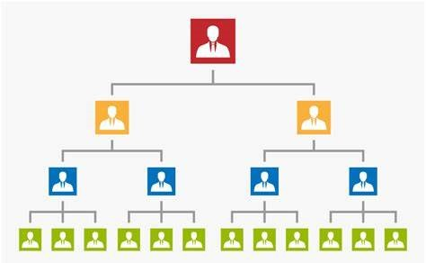

WHO ARE THE END USERS?

Slide 7

OUR SOLUTION AND ITS VALUE PROPOSITION
Conditional formatting-missing
Filter-remove
Formula-performance
Pivot-summary
Graph-data visualization

Slide 8
Dataset Description
Employee dataset from Kaggle
26-Features
We selected 9-Features
  Employee ID
  Employee name
  Employee type
  Performance level
  Gender
  Employee rating number

Slide 9

THE "WOW" IN OUR SOLUTION
Using this formula we have measured the performance level of employees working in an organisation
Performance level = ifs(z8>=5,”VERY HIGH”,Z8>=4,”HIGH”,Z8>=3,”MED”,TRUE,”LOW’)
3/21/2024 Annual Review
9

Slide 10
MODELLING
Data collection
  Download the employee dataset from Kaggle
  After the download an excel sheet will open
  In that sheet we have employee data details which has 26-features
Features collection
  We are selecting 9-features for our project
  In that features we have employee ID , employee name , employee type , gender , performance level , employee rating
Data cleaning
  In this method , we clear the empty rows or columns in the sheet
  By selecting the empty row and clear using conditional formatting tool
10

Slide 11
MODELLING
Performance level
  Here we calculate the performance of the employee
  By using the formula we can calculate the performance
  Using IF formula :IF(z8>=5,”VERY HIGH”,Z8=>4,”HIGH”,Z8>=3,”MED”,TRUE,”LOW”)
Pivot table
  After creating the performance level , click on pivot table icon
  In that application will appear as row , column , fields
  Select the required item and click ok
  Then using the details create a graph
Summary
  Using this method , we can know the performance level of the employees through graph

Slide 12
RESULTS
12

Slide 13
conclusion
Effective employee performance analysis is circular for driving organizational success. By implementing a standardized evaluation framework , leveraging data analytics and forecasting a culture of constructive feedback. Accurate performance assessments enable informed decision-making , target development initiatives and improved employee engagement . A well-designed performance analysis system is important for achieving strategic objective , enhancing productivity and sustaining competitive advantage

