Slide 1
QUICKCART E-COMMERCE WEB APP
Team:
Divya S.L- 1SU19CI011
Hruthwik- 1SU19CI012
University: Srinivas University
Branch: CTIS 7th
Guide: Daniel Selvaraj

Slide 2
Agenda
Abstract
Introduction
Domain
Problem statement
Technology
Software requirement
Proposed system
Architecture
Description of work
Module Description
Conclusion
References

Slide 3
Abstract
The main objective of this Quickcart E-Commerce Web Application is that Users can buy products and commodities using this web app.
This web app is fully architected in Azure Cloud.
In this project the vendor can upload products into the website. We are deploying a web application in Azure Function which is applicable to build a serverless environment
Azure Web app for frontend deployment. Azure App service for backend deployment. Azure active directory for Identity management. Azure SQL Server for database. Azure Key vault. CORS, logic app, Blob storage.

Slide 4
Introduction
This project is a web based shopping system for an existing shop.
The project objective is to deliver the online shopping application into android platform.
Online shopping is the process whereby consumers directly buy goods or services from a seller in real-time, without an intermediary service, over the Internet.
It is a form of electronic commerce.
This project is an attempt to provide the advantages of online shopping to customers of a real shop.

Slide 5

Domain

Slide 6
Problem Statement
delay in displaying the results
non user friendly interfaces that are hard to use
Busy schedule
User must go to shop and select products.
It is difficult to identify the required product.
Description of the product limited.
Not in reach of distant users.

Slide 7

Technology

Slide 8
Software Requirement
Front-End: Angular 13
Backend: Dotnet core 3.1
DB: Azure SQL Server.
Blob Store: Azure Storage Account.

Slide 9
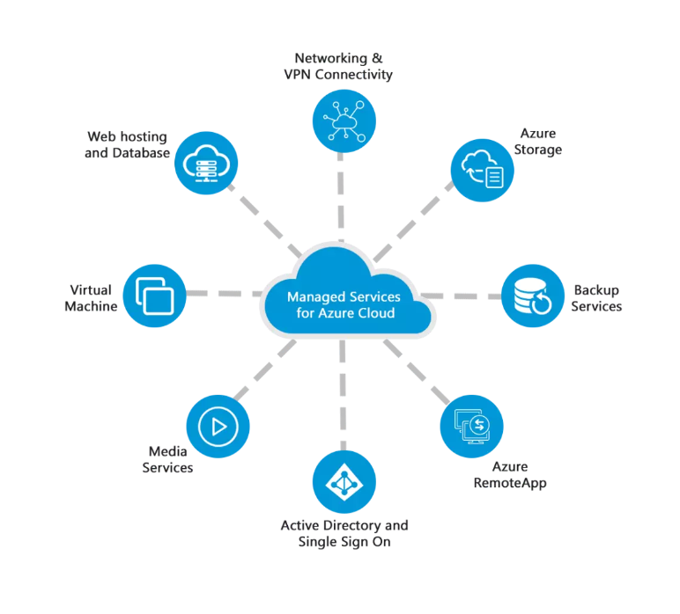
Technology

Slide 10
Existing System
Limeroad: website inspires customers to purchase stylish clothes.
Crafts Villa: was the idea of the powerful duo Manoj and Monica Gupta. This internet marketplace is a haven for everyone interested in crafts
Snapdeal: Is a well-known Indian internet retail website.

Slide 11
Proposed System
To develop an easy to use web based interface where users can search for products.
view a complete description of the products and order the products.
A user can view the complete specification of the product along with various images and also view the customer reviews of the product.
They can also write their own reviews.

Slide 12
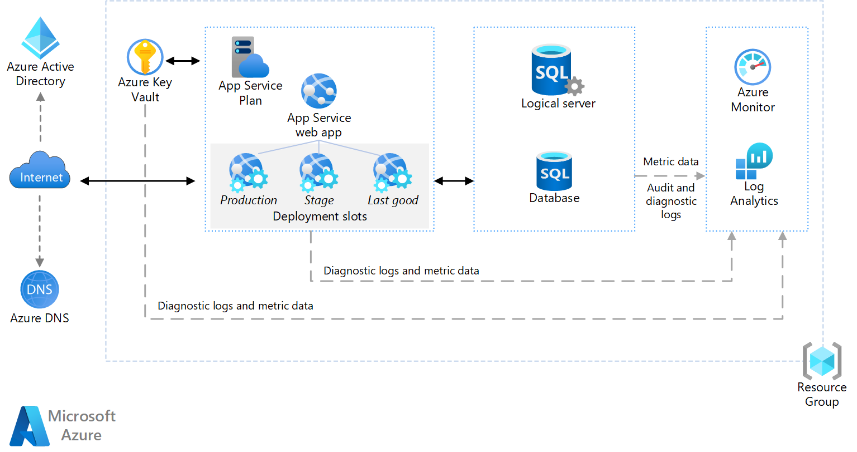
Architecture

Slide 13
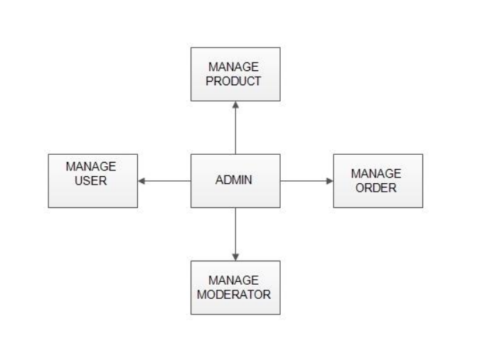
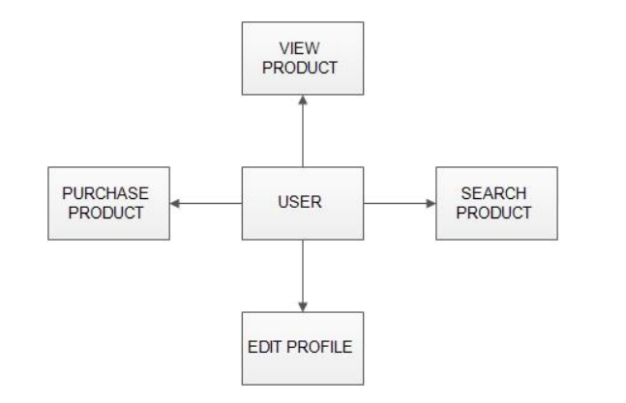
Module Description
User Module
Admin Module

Slide 14
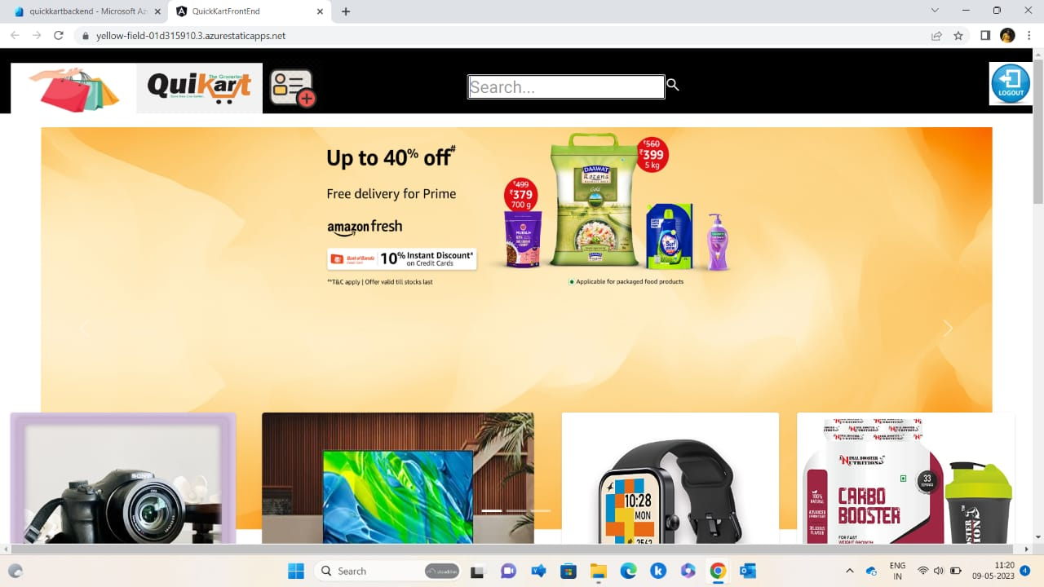
Description of work

Slide 15
Conclusion
The ‘Online Shopping’ is designed to provide a web based application that would make searching, viewing and selection of a product easier.
The search engine provides an easy And convenient way to search for products where a user can Search for a product interactively and the search engine would refine the products available based on the user’s input.
The user can then view the complete specification of each product. They can also view the product reviews and also write their own reviews.

Slide 16


