Slide 1
IBM Applied Data Science
SpaceX Falcon 9
First Stage Landing Prediction
Capstone Project — Applied Data Science
Executive Summary
✦ Predict Falcon 9 first-stage landing success to estimate launch costs
✦ Dataset: SpaceX REST API + Wikipedia web scraping (2010–2020)
✦ Methods: EDA, SQL, Folium maps, Plotly Dash, ML classification
✦ Best model achieves ~84–85% CV accuracy across 4 algorithms
✦ Insight: launch site, orbit type & flight number are key success drivers

Slide 2
INTRODUCTION
Project Background & Objectives
The Business Problem
Project Objectives
SpaceX offers Falcon 9 launches at $62M vs $165M+ for competitors, primarily because the first stage booster is reused.
If we can predict whether the first stage will land successfully, we can estimate the true cost of a launch — information valuable to competing companies bidding against SpaceX.
1. Collect data via SpaceX REST API and Wikipedia web scraping 2. Perform data wrangling and feature engineering 3. Conduct EDA using visualizations and SQL queries 4. Build interactive maps with Folium 5. Create Plotly Dash dashboard for analysis 6. Train & compare ML classification models 7. Identify key factors that determine landing success

Slide 3
DATA COLLECTION
Data Collection Methodology
Method 1 — SpaceX REST API
Method 2 — Wikipedia Web Scraping
• Endpoint: api.spacexdata.com/v4/launches/past • Extracted: rocket, payloads, launchpad, cores, flight number, date • Filtered: Falcon 9 only | Dates ≤ Nov 13, 2020 • Helper functions: getBoosterVersion(), getLaunchSite(), getPayloadData(), getCoreData() • Built structured DataFrame with 17 columns
• URL: Wikipedia — List of Falcon 9 and Falcon Heavy launches • Used BeautifulSoup to parse HTML tables • Targeted: wikitable plainrowheaders collapsible class • Extracted launch records as complementary dataset • Provided booster version, payload, orbit & outcome columns

Slide 4
DATA WRANGLING
Data Wrangling & Feature Engineering
Filter Dataset
Handle Missing Values
Label Engineering
01
Selected only Falcon 9 launches; removed multi-core & multi-payload rows by filtering cores.map(len)==1 and payloads.map(len)==1
02
PayloadMass: filled NaN values with column mean (df['PayloadMass'].fillna(mean));
all other columns verified complete
03
Created binary target column 'Class': identified bad outcomes (True Ocean, False ASDS, None None, etc.) → 0 (failure), all others → 1 (success)
One-Hot Encoding
Feature Scaling
04
Applied pd.get_dummies() to categorical columns (Orbit, LaunchSite, LandingPad, Serial) to create numeric features for ML
05
Applied StandardScaler (zero mean, unit variance) to normalize all features before model training; train/test split 80/20, random_state=2

Slide 5
EDA METHODOLOGY
EDA & Interactive Analytics — Approach
EDA with Visualization
EDA with SQL
Interactive Visual Analytics
• Scatter plots: Flight Number vs Launch Site, Payload vs Launch Site, Flight Number vs Orbit, Payload vs Orbit • Bar charts: Success rate by orbit type (ISS, GTO, LEO, SSO…) • Line chart: Yearly launch success rate trend (2010–2020) • Used seaborn (hue='Class') to colour-code success vs failure • Library: matplotlib + seaborn on pandas DataFrame
• Loaded dataset into SQLite via df.to_sql('SPACEXTBL', conn) • Queries: DISTINCT launch sites, min/max payload masses, success counts, booster reuse stats • First successful landing date: SELECT MIN(Date) WHERE Class=1 • Drone-ship vs ground-pad landing success analysis • 10 queries covering all graded SQL EDA tasks
• Folium map: clustered markers per launch site, colour-coded green/red for success/failure • Proximity lines to coast, highway, railway calculated • Plotly Dash: dropdown for site filter, range slider for payload • Dash callbacks update pie chart (success ratio) & scatter (payload vs outcome) • Dashboard allows drill-down by individual or all sites

Slide 6
PREDICTIVE ANALYSIS
Machine Learning — Methodology
ML Pipeline
Models Evaluated
Features (X)
dataset_part_3.csv — one-hot encoded categorical features + numeric columns
Logistic Regression
C: [0.01, 0.1, 1] | penalty: l2 | solver: lbfgs
Target (Y)
Binary Class: 1 = successful landing, 0 = failed landing
Support Vector Machine
kernel: linear/rbf/poly/sigmoid | C & gamma: logspace(-3,3,5)
Split
train_test_split: 80% train, 20% test, random_state=2
Decision Tree
Scaling
StandardScaler: zero-mean unit-variance normalization on X
criterion: gini/entropy | splitter: best/random | max_depth: 2–18
K-Nearest Neighbours
Tuning
GridSearchCV with 10-fold cross-validation on each model
n_neighbors: 1–10 | algorithm: auto/ball/kd/brute | p: 1,2

Slide 7
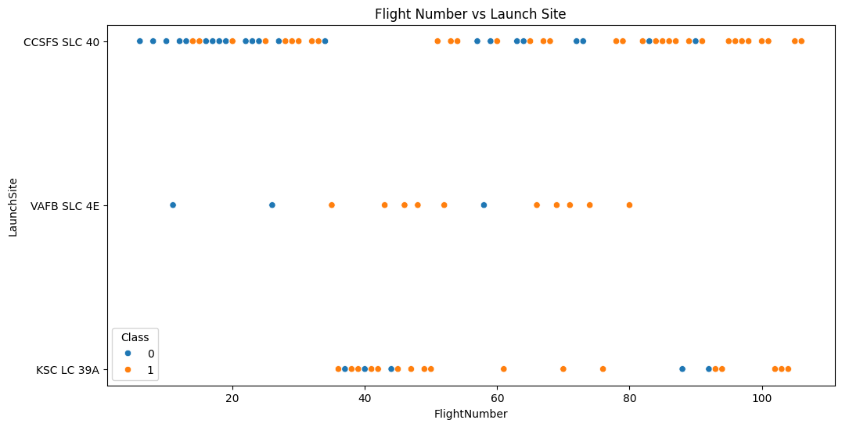
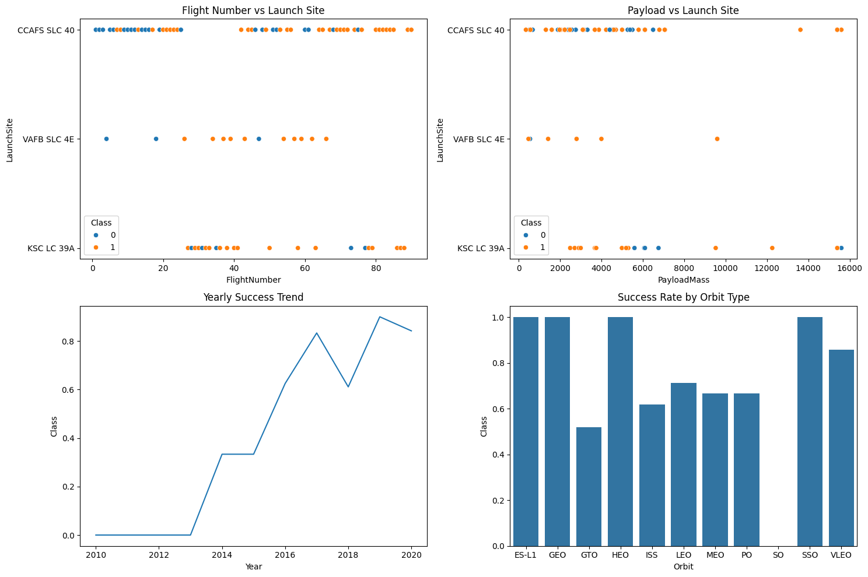
EDA RESULTS
EDA with Visualization — Results
Figure 1 — Flight Number vs. Launch Site (success=orange, failure=blue)
Figure 2 — 4-Panel EDA: Flight# & Payload vs Launch Site | Yearly Trend | Success by Orbit

Slide 8
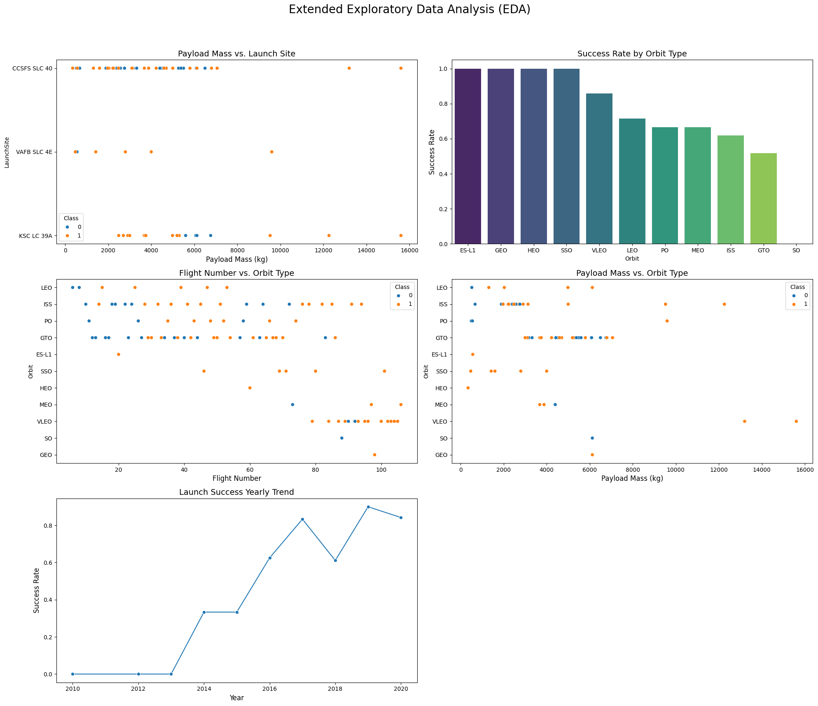
EDA RESULTS
Extended EDA — 5-Panel Analysis
Figure 3 — Extended EDA: Payload vs Site, Success by Orbit, Flight# & Payload vs Orbit, Yearly Trend
Key Insights: ISS, HEO, GEO orbits show highest success rates • Higher flight numbers trend toward more success • CCAFS SLC 40 has the most launches

Slide 9
SQL EDA RESULTS
EDA with SQL — Query Results
Query
Question
Key Result
Q1
Unique Launch Sites
CCAFS LC-40, CCAFS SLC-40, KSC LC 39A, VAFB SLC 4E
Q2
Total Payload by NASA (CRS)
~45,596 kg cumulative payload mass
Q3
Avg Payload (F9 v1.1)
~2,534 kg average payload mass
Q4
First Successful Land Landing
2015-12-22 (first successful ground landing)
Q5
Successful Drone-Ship Landings
Boosters: B1050, B1060 etc. — 5 boosters landed on drone ships
Q6
Failure Count Before 2010
0 failures in LEO before 2010 (launches started later)
Q7
Max Payload Booster
Booster with highest payload mass identified
Q8
2015 F9 FT Drone-Ship Outcomes
First True ASDS landing recorded in 2015
Q9
Landing Outcomes Ranked
True ASDS > True RTLS > False ASDS > None None
Q10
Booster Rank by Success
B1058, B1049, B1051 ranked highest reuse with success

Slide 10
FOLIUM MAP
Interactive Launch Site Map — Folium Results
Map Implementation Summary (Interactive HTML map generated with Folium — screenshot below shows layout)
• Base map centred at KSC (28.56°N, 80.58°W), zoom level 5
• MarkerCluster used for all launches — zooming in reveals individual markers
• Green icon = landing success | Red icon = landing failure
4 Launch Sites
Site Proximity
Success Clusters
Geography Insight
CCAFS SLC-40
CCAFS LC-40
KSC LC 39A
VAFB SLC-4E
All sites located
near coastlines
for safety & ocean
drop-zones
KSC LC 39A shows
highest density of
green (success)
markers
Sites close to rail,
highway, city but
not too close —
optimal logistics

Slide 11
PLOTLY DASH
Plotly Dash Dashboard — Results & Insights
Dashboard Layout
All Sites Combined
~66.7% overall success rate across all 4 launch sites
SpaceX Launch Records Dashboard
[ Dropdown: Select Launch Site ▾ ] All Sites | CCAFS SLC-40 | KSC LC 39A | VAFB SLC-4E
KSC LC 39A
Highest success rate — majority of recent missions use this site
PIE CHART
Success vs Failure
per selected site
✅ Success: ~66%
❌ Failure: ~34%
SCATTER PLOT
Payload Mass (kg) vs
Landing Outcome
by Booster Version
Low Payload = Higher Success
Payloads < 6,000 kg consistently show more successful landings
Booster Version Impact
FT/Block 5 versions have higher success rates than v1.0/v1.1
[ Payload Range Slider: 0 kg ——●——————— 10,000 kg ]
Drone Ship (ASDS)
Most high-orbit missions use drone-ship landings; improving over time

Slide 12
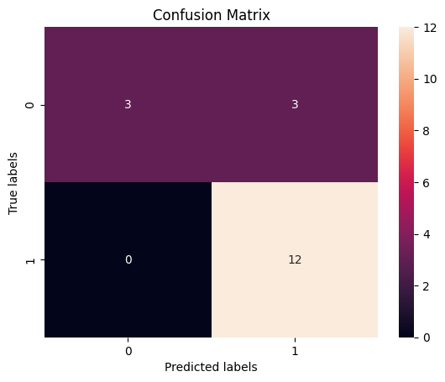
ML RESULTS
Predictive Analysis — Classification Results
Model
CV Accuracy
Test Accuracy
Best
Decision Tree — Confusion Matrix
Logistic Regression
82.14%
83.33%
Support Vector Machine
84.82%
83.33%
Decision Tree
84.64%
83.33%
K-Nearest Neighbours
84.82%
83.33%
★
All 4 models converge to 83.33% test accuracy. KNN & SVM lead in cross-validation (84.82%).
Key Predictive Insights
• Confusion matrix: 12 true positives, 3 true negatives — model is precise for success prediction • 3 false positives indicate model over-predicts success — acceptable for cost estimation use-case • All models tie at 83.33% test accuracy suggesting dataset limits rather than model limits

Slide 13
Conclusion & Future Work
✦ All four ML classifiers achieved 83.3% test accuracy — a strong baseline for launch cost prediction
✦ SVM and KNN led cross-validation at 84.82%; Logistic Regression was the simplest competitive model
✦ Flight number and orbit type are the strongest predictors of first-stage landing success
✦ KSC LC 39A is the highest-success launch site, preferred for crewed and heavy-payload missions
✦ SpaceX success rates improved dramatically from ~0% in 2010 to near 90%+ by 2019–2020
✦ Folium + Plotly Dash enabled interactive exploration unavailable in static EDA
By:
M.Divya Dharshini
Github link :
https://github.com/divya1505M/applied_ds_capstone

