Slide 1
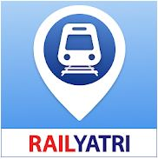
RAILYATHRI

Slide 2
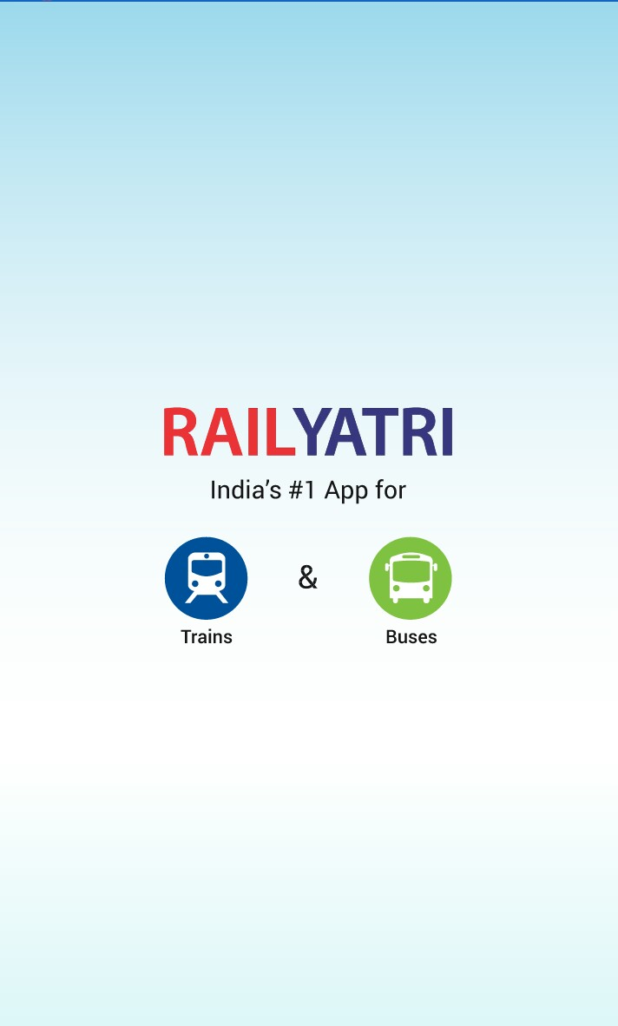
Released on December 4th, 2013
Latest Version : 3.8.0.2
10M+ Downloads
4.4 star rating
Download Size : 11MB
Official Partner App of IRCTC

Slide 3
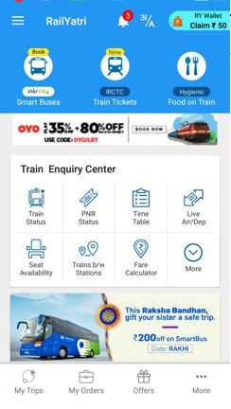
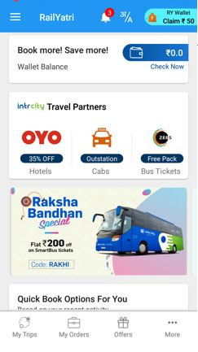
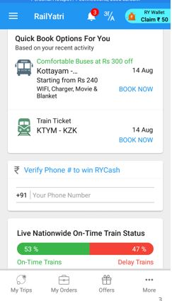


Slide 4
FEATURES

Slide 5

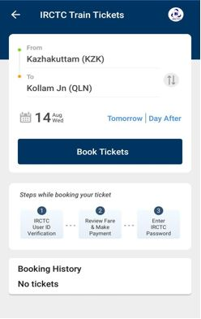
Train Ticket Booking
Steps involved in booking tickets
IRCTC User ID verification
Review Fare and make payment
Enter IRCTC Password

Slide 6
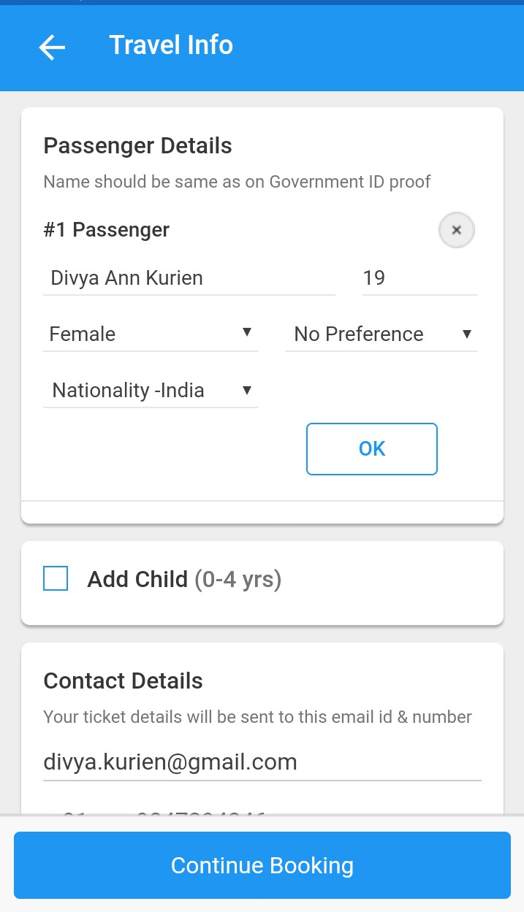
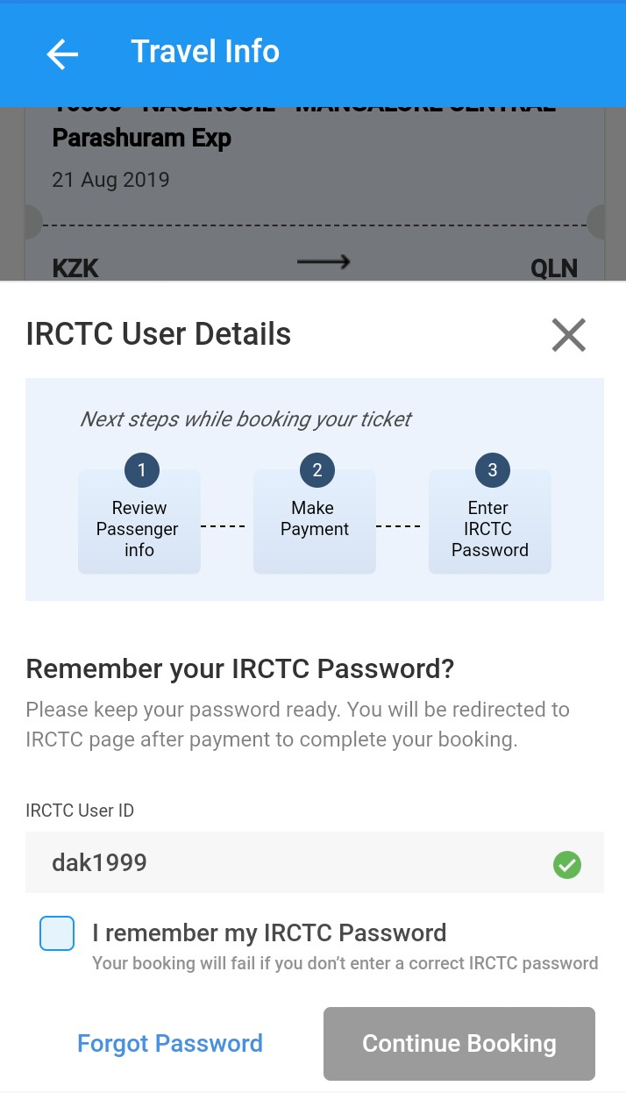
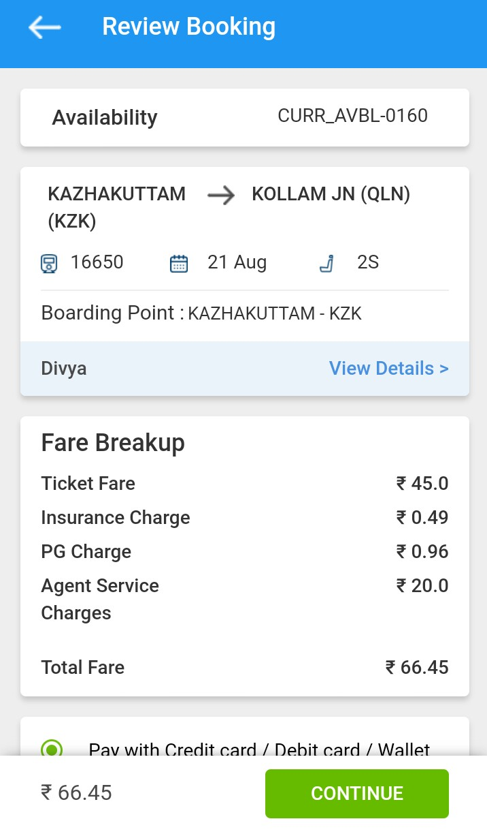
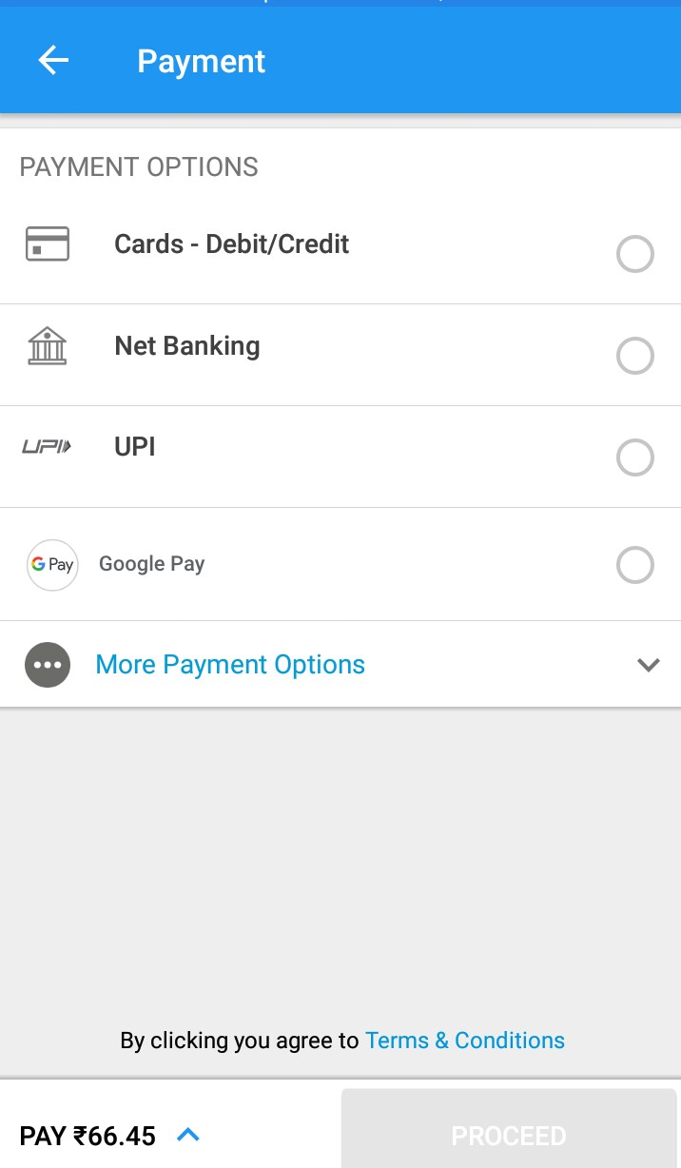

Slide 7
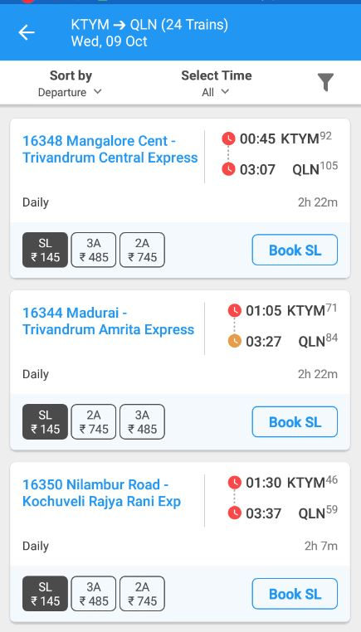

Slide 8

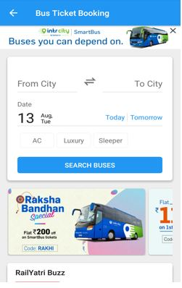
Book Bus tickets

Slide 9

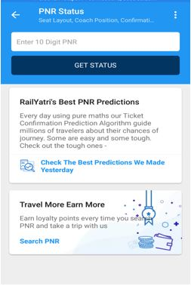
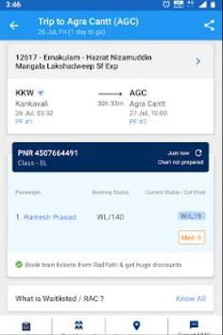
PNR status information with Confirmation Probability

Slide 10

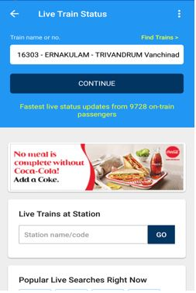
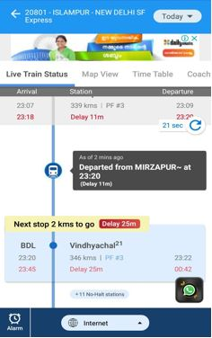
GPS Based Live Tracking

Slide 11

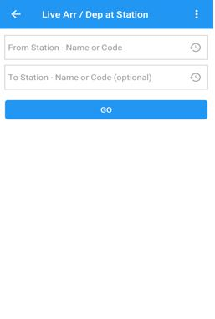
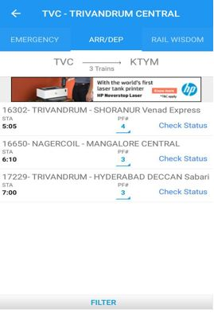
Live Arrival/Departure

Slide 12

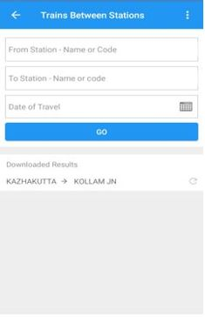
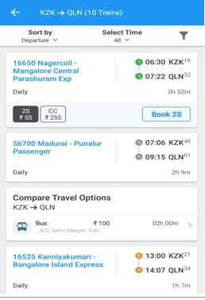
Trains between Stations

Slide 13

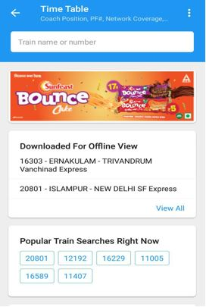
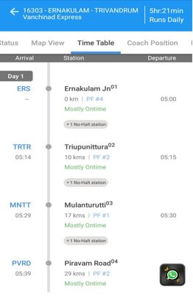
Time Table

Slide 14

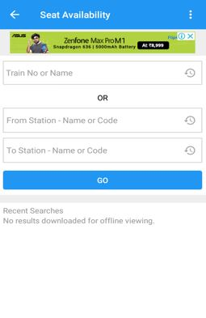
Seat Availability

Slide 15
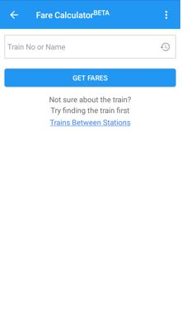
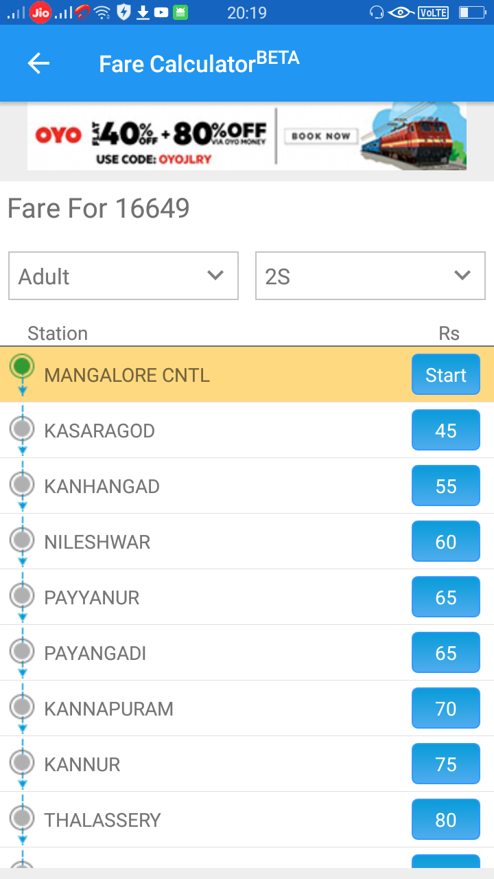
Fare Calculator
Fares from a starting location
Filter options

Slide 16

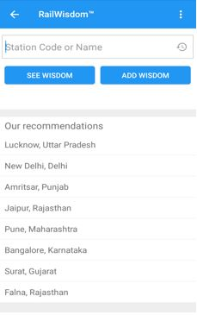
Rail Wisdom

Slide 17

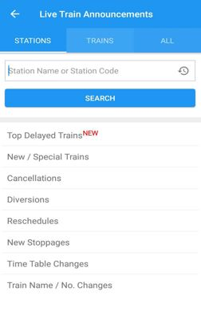
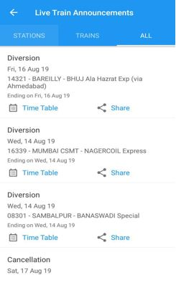
Live train Announcements

Slide 18

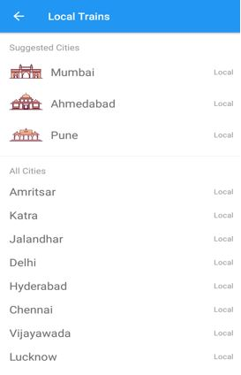
Local Trains

Slide 19
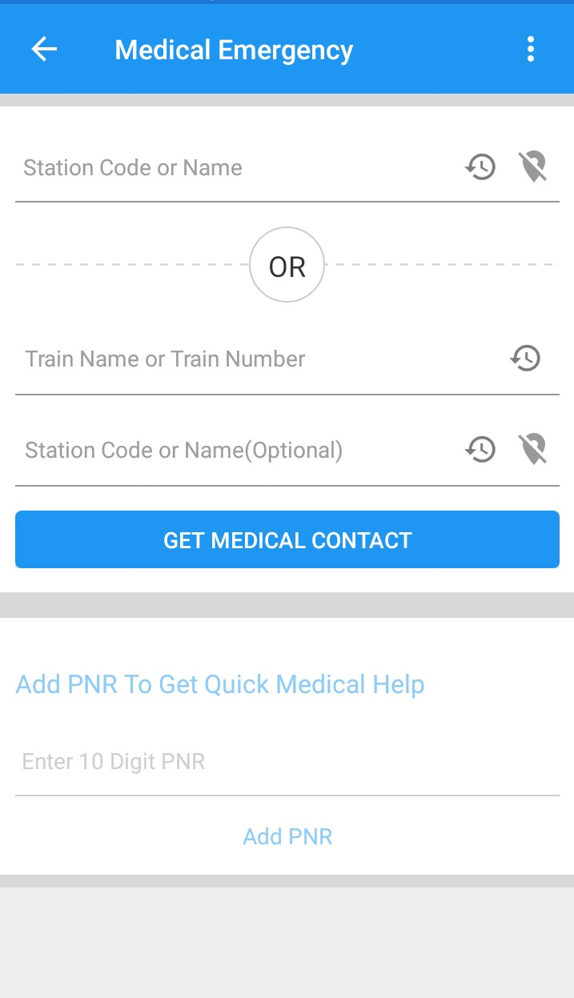
Medical Emergency

Slide 20

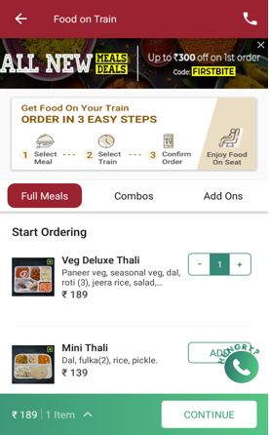
Order Food

Slide 21
Pros
Meets all the travel requirements of users .
Live location more precise & real time – data collected in a crowd sourced manner.
Uses Machine learning algorithms to predict ETA.
Available in 9 languages.
You can avoid the delayed trains by studying the running time statistics of the trains between two stations.
View past and upcoming trips.

Slide 22
Continued…
Train Schedule can be viewed in offline mode.
Get to know the latest news by RY bulletin.
Most of the features are interlinked, which makes it easier to use the app.
Provides discounts on bookings for users.
Low battery and Data consumption.

Slide 23
We can know fares beforehand.

Slide 24
Cons
UI is not very user-friendly.
Too many ads are annoying to the users.
For features like coach position , no data is available.

Slide 25
USER REVIEWS

