Slide 1
Analysis of MOOCs
Sanat Goel
Arqam Patel
Divya Gupta
Sudesh Kumari
Group 4
MTH208
Prof : Dr. Dootika Vats

Slide 2
What is a MOOC ?
MOOC stands for Massive Open Online Course
These are free Internet based Distance learning Programmes, made for people all over the globe.
MOOCs have a increasing importance in today society especially after the pandemic, because it provides access to quality educational resources at affordable prices.
Some of the major sites that host these MOOCs include
Coursera
EdX
NPTEL

Slide 3
A Comparison of the Platforms
NPTEL
Monthly traffic:
4.6 million
Registered users:
18.2 million
No. of courses:
2400
No. of universities:
31
Coursera
Monthly traffic:
54.9 million
Registered Users:
113 million
No. of courses:
13500
No. of universities:
151
edX
Monthly traffic:
14.1 million
Registered users:
110 million
No. of courses:
5300
No. of universities:
160

Slide 4
Problem Statement
Dr. Dootika Vats is launching a MOOC for MTH208™.
She wants to find the secret sauce for making it a hit.
So she has hired the students of Group 4 Consulting Ltd, and we are going to help her decide what is the optimum choice in terms of platform, duration of the online course, etc. to achieve the best result.

Slide 5


Datasets:
Coursera 3580 courses from 210 universities
edX 2848 courses from 202 entities
NPTEL 2568 courses from 31 universities

Slide 6
What is our motivation
Analysis by difficulty

Slide 7
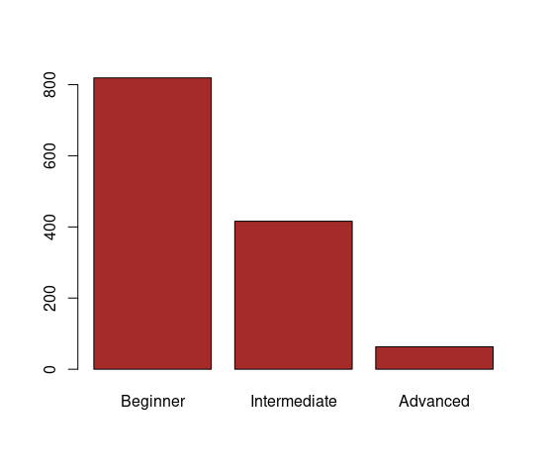
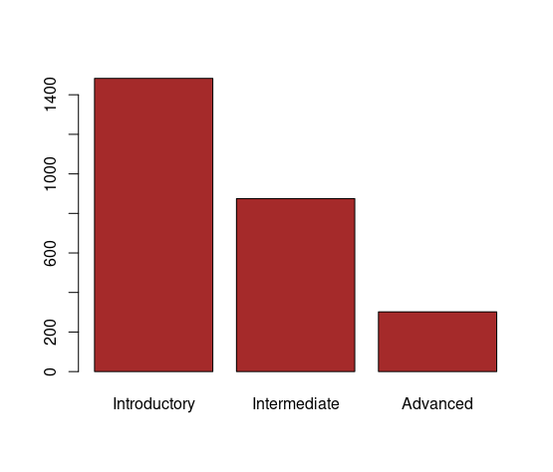
Coursera
EdX

Slide 8
There are very few courses of Advanced level compared to Beginner or Intermediate levels.
This suggests two possible conclusions:
The core base of MOOC platforms are beginners; rather than advanced learners.
MOOCs are not a good way to acquire Advanced skills.
Both these hypothesis will have to be tested further !!

Slide 9
Locations of Universities offering courses

Slide 10
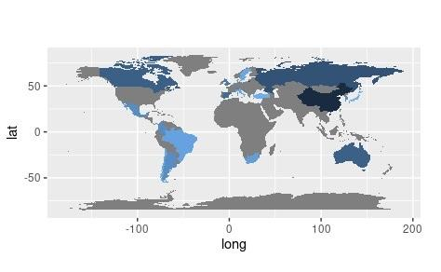
What is our jmotivation

Slide 11
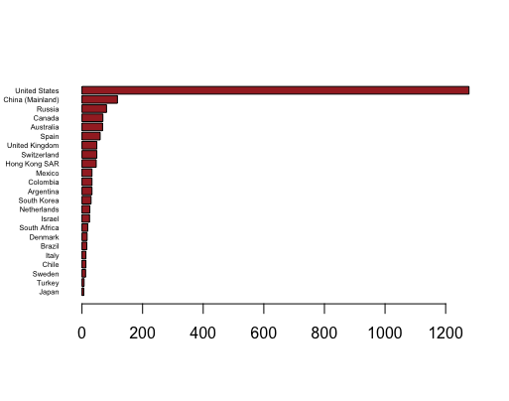

Slide 12
The countries with the most university offered MOOCs on Coursera are:
USA (1277)
China(117)
Russia (81)
Canada (69)
Australia (68)
Spain (60)

Slide 13

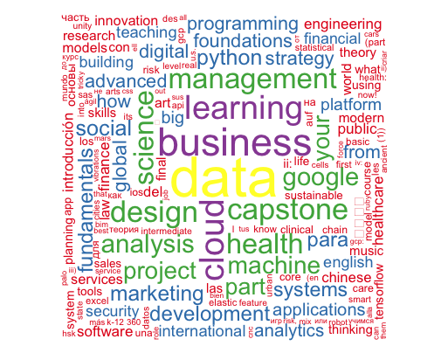
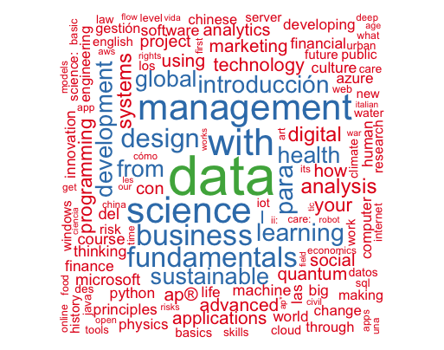
A Comparison of the Platforms
NPTEL
Coursera
edX

Slide 14
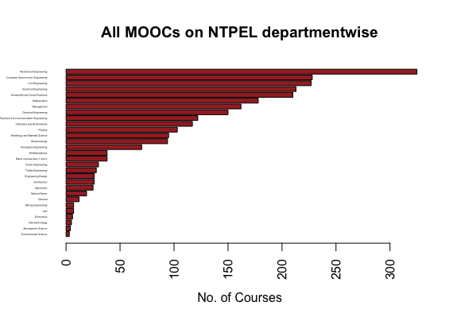
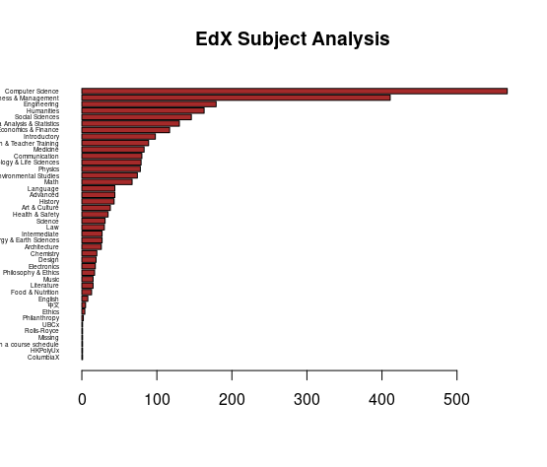

Slide 15
MOOCs on NPTEL are more related to core engineering topics like Mechanical, Electrical, Electronics, etc.
Where as MOOCs on EdX, are more software related, and it also have some courses that are missing from NPTEL, like art, history, culture, law, languages, etc.

Slide 16
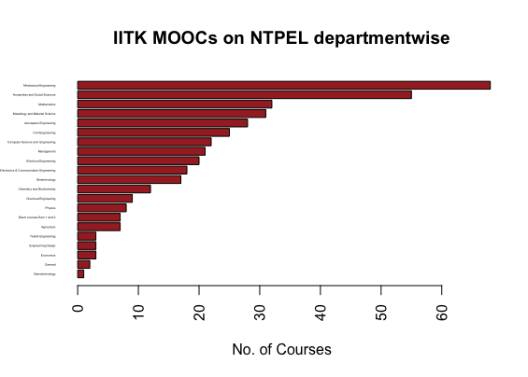

Slide 17
As we can see the highest courses are from Mechanical Engineering, and the other top contributor include Electrical and Electronics, Computer Science, Mathematics.
One thing that is common among these departments is that these departments are really old and very well established in top IITs

Slide 18
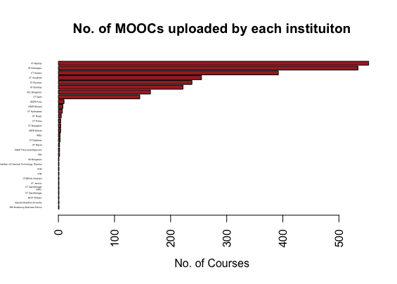

Slide 19
Something really interesting that we found during our analysis is that although alot of institution are there contributing on NPTEL, but the majority content is is provided only by IISC Banglore and top 7 IITs ( i.e IIT Kanpur, IIT Madras, IIT Kharagpur, IIT Bombay, IIT Delhi, IIT Roorkee and IIT Guwahati)

Slide 20
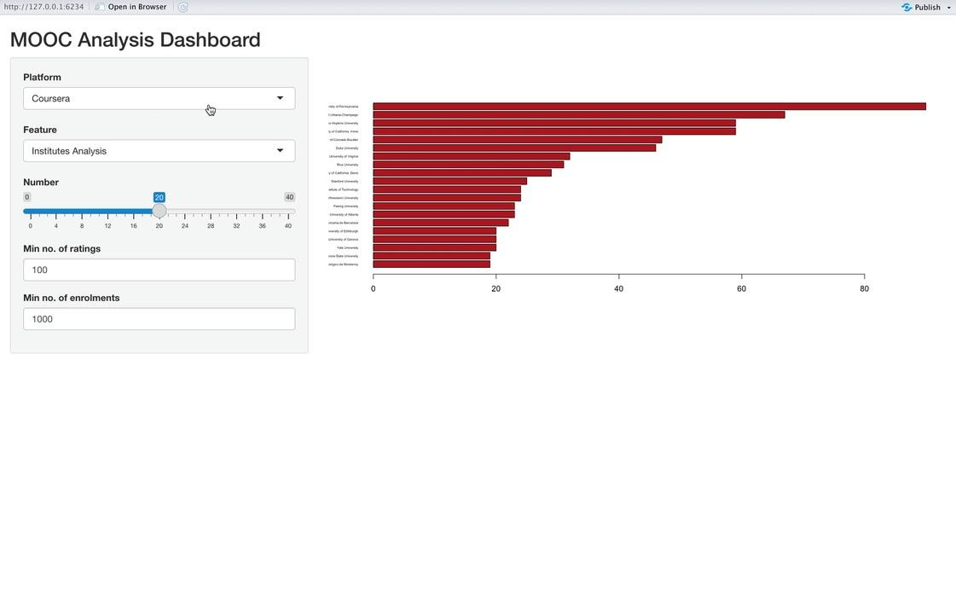

Slide 21
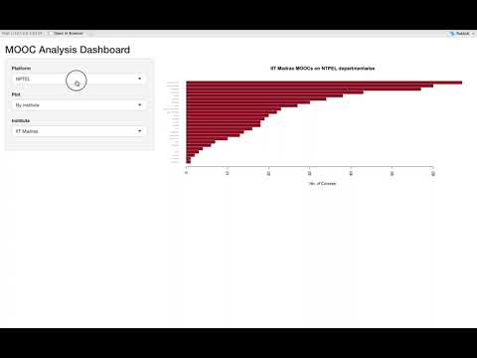


Slide 22
Limitations
The data scraped from the different platforms had different parameters, making any comparative analysis difficult. For example, we were able to get numeric course duration, rating and enrolments data from Coursera while we only got price, duration data from edX.
In some cases, multiple universities collaborated on a single MOOC, and in such cases we only considered the university named first.
Further, the data was quite cluttered; for example some courses listed duration in terms of modules rather than weeks. Some prices were in rupees, some in USD.
Lack of time data about courses meant we could not explore some interesting questions like COVID effect on MOOCs.

Slide 23
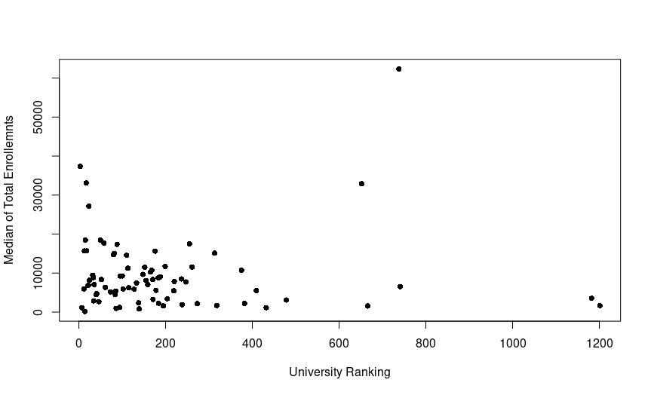
University rankings vs Median enrolments

Slide 24
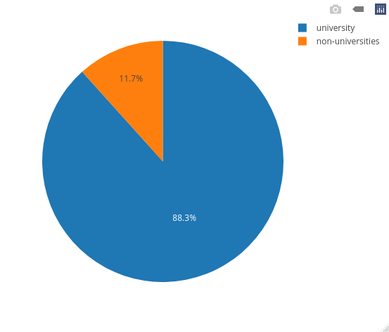
aaeee
FROM COURSERA DATASET -:

Slide 25
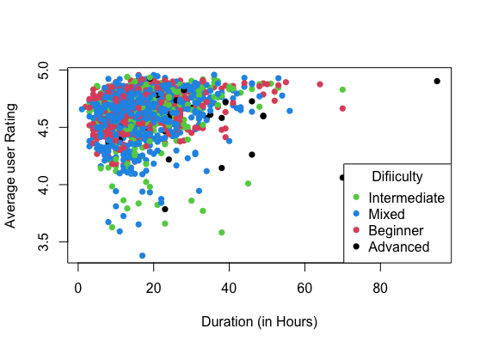
Average user rating vs Duration in hours

Slide 26
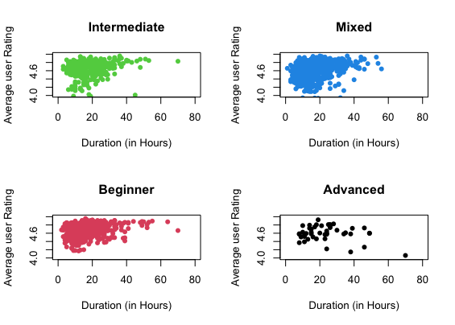
Rating vs Duration (by difficulty)

Slide 27
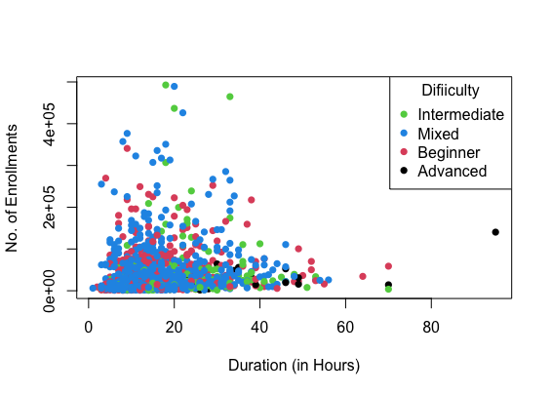
Enrolments vs Duration

Slide 28
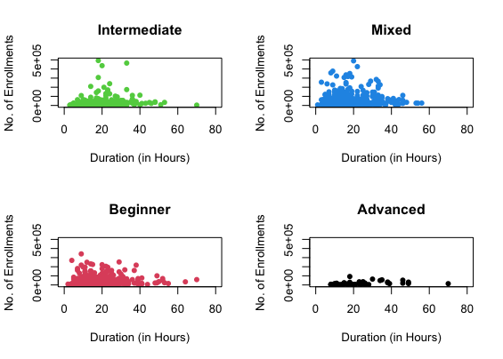

Slide 29
Data Sources
NPTEL website
Coursera Algolia API
edX Algolia API
QS World Rankings 2022

Slide 30
Thank you.

