Slide 1
AI Health Dashboard
Chronic Disease Risk Prediction & Recommendations
-Divya Mevada

Slide 2
Problem Statement
Chronic diseases like diabetes, heart disease, and hypertension are leading causes of death. Traditional systems lack personalized, continuous monitoring.

Slide 3
Objective
- Predict chronic disease risk
- Provide AI-based health tips
- Visualize and track health data over time

Slide 4
Solution Overview
- Flask Web App with login
- ML Model for disease risk
- Gemini AI Chatbot
- Chart.js/Plotly Dashboard
- Health history tracking

Slide 5
Technologies Used
Backend: Python, Flask, MySQL
ML: scikit-learn, joblib
Frontend: HTML, CSS, Bootstrap, Chart.js
AI: Google Gemini API

Slide 6
Key Features
✅ Health Prediction
💬 Gemini Chatbot
📊 Health Dashboard
📜 Health History
🔐 Authentication

Slide 7
ML Model Insights
Inputs: Age, BMI, BP, Glucose, Insulin, Pregnancies
Output: 0 = Low Risk, 1 = High Risk
Evaluation: Accuracy, Precision, Recall, F1

Slide 8
Dashboard Insights
📈 Radar Chart: Normalized factors
📉 Line Charts: Trends in Glucose, BMI, BP
🥧 Pie Chart: Risk distribution (optional)

Slide 9
AI Assistant
Learns from last 5 entries
Personalized & emoji-rich messages
Responds with username & context

Slide 10
Security
🔐 Hashed passwords
📁 Session-based login/logout
🔄 Admin retraining option

Slide 11
Deployment
LAN-Ready: Works offline (except Gemini)
Hosted on localhost or lab server

Slide 12
Future Enhancements
- Add heart/cancer models
- PDF medical report upload
- Admin/doctor dashboards
- Fitbit API integration
- Multilingual chatbot

Slide 13
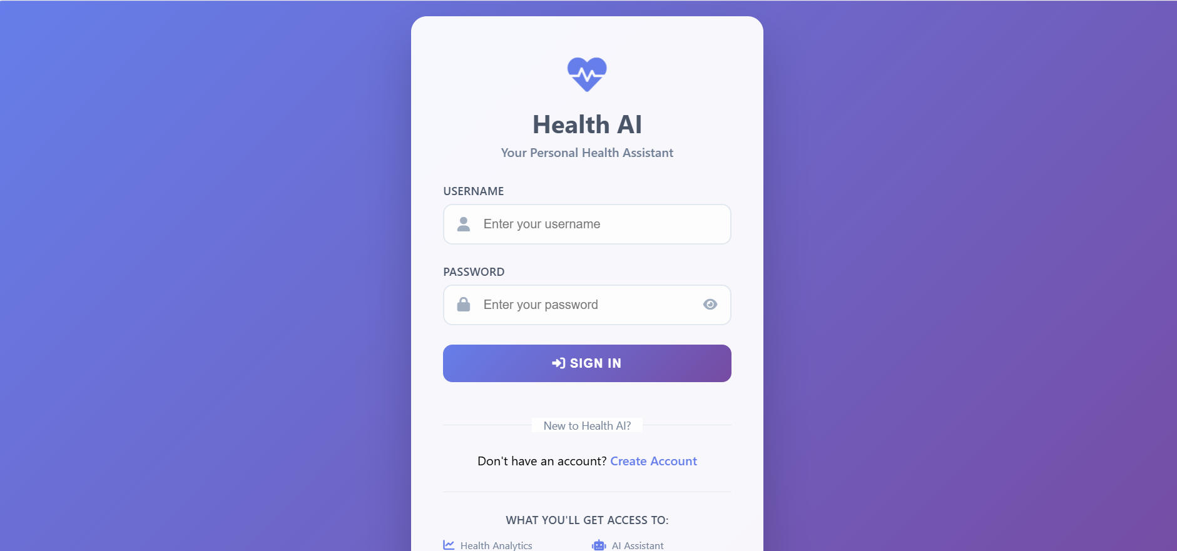
USER INTERFACE

Slide 14
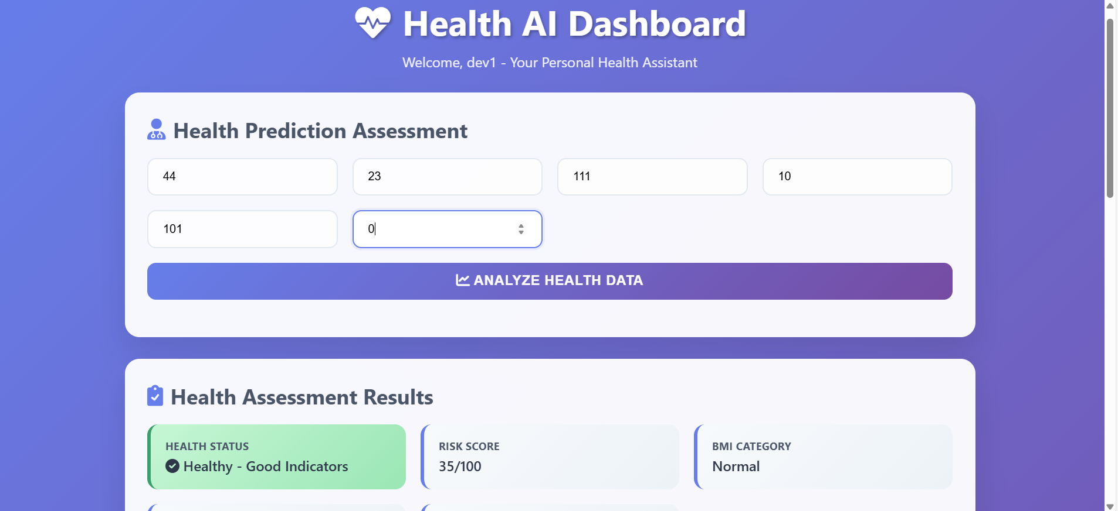

Slide 15
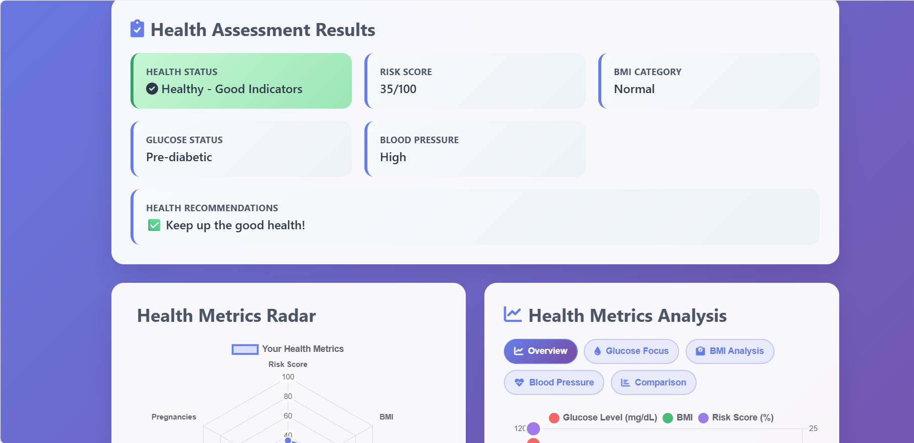

Slide 16
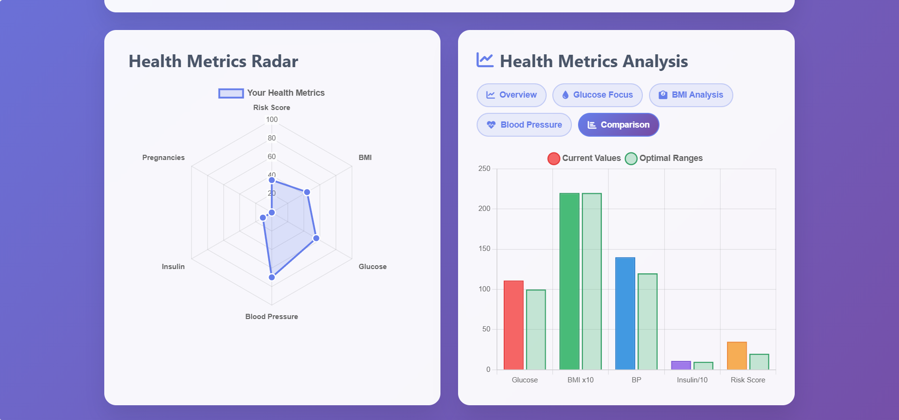

Slide 17
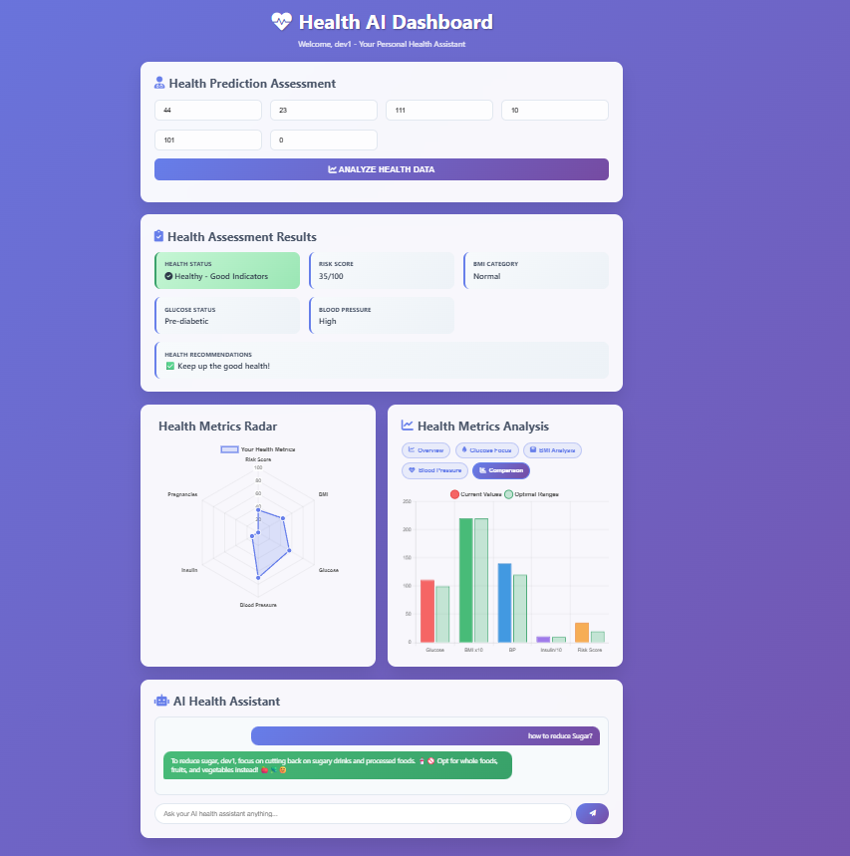

Slide 18
Github Link:
https://github.com/divya25-mevada/AI-Health-Dashboard

