Slide 1
E-Auction Application
By,
Divya Bharathi M

Slide 2



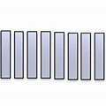
Architecture Overview
<interface>
CommandDispatcher
<interface>
CommandHandler
<interface>
EventSourcingHandler
<interface>
EventStore
Eauction Command API
COMMANDS
AddProductCommand
BidProductCommand
UpdateBidProductCommand
DeleteProductCommand
AggregateRoot
ProductAggregate
<interface>
EventPublisher
<interface>
EventStoreRepository
HTTP
Event Store/
Write Database
QUERIES
FindBidsByProductQuery
HTTP
<interface>
EventConsumer
<interface>
EventHandler
MySQL
Eauction
Query API
<interface>
QueryDispatcher
<interface>
QueryHandler
<interface>
EventHandler
Buyer Entity
Read Database

Slide 3
Mediator Pattern
Behavioral Design Pattern
Promotes loose coupling by preventing objects from referring to each other explicitly
Simplifies communication between objects by introducing a single object known as mediator that manages the distribution of messages amount other objects.

Slide 4
Command Dispatching
<<Mediator>> CommandDispatcher
registerHandler(Class<T> type, CommandHandlerMethod<T> handler) send(BaseCommand command)
<<Colleague>> CommandHandler
handle(AddProductCommand command) handle(BidProductCommand command) handle(UpdateBidProductCommand command) handle(DeleteProductCommand command)
<<ConcreteColleague>> ProductCommandHandler
handle(AddProductCommand command) handle(BidProductCommand command) handle(UpdateBidProductCommand command) handle(DeleteProductCommand command)
<<ConcreteMediator>> AccountCommandDispatcher
registerHandler(Class<T> type, CommandHandlerMethod<T> handler) send(BaseCommand command)

Slide 5
Git Lab Link
The below is the URL for GitLab,
https://git03.iiht.tech/divya2606/eauction/

Slide 6
Cloud Specifications
Replaced MySQL with AWS RDS
Deployed frontend React code to AWS S3
  http://div-eauction-react-app.s3-website.ap-south-1.amazonaws.com/
Deployed backend code to AWS EBS
  http://productquery-env.eba-jtmebmmu.ap-south-1.elasticbeanstalk.com/api/v1/productLookup/addProductDB

Slide 7
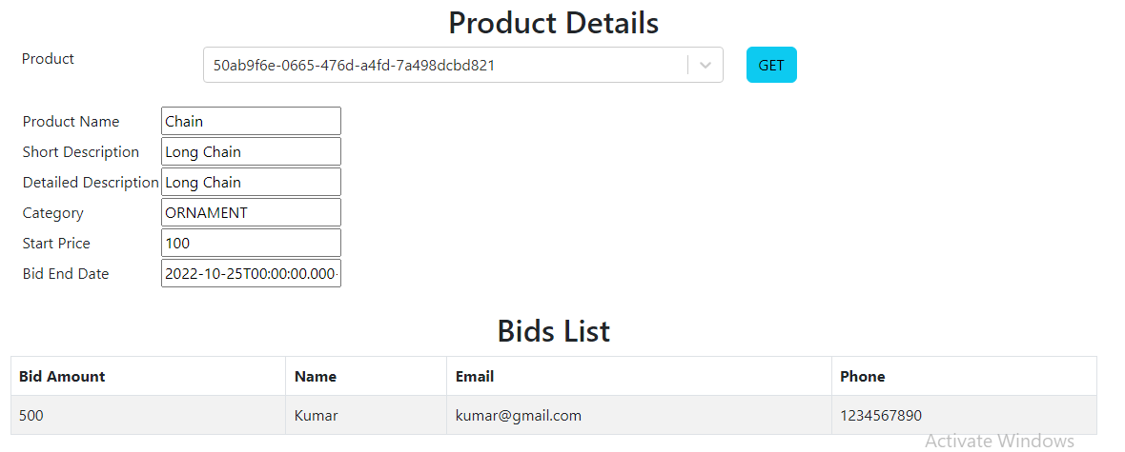
Screenshot of Product Details with bids

Slide 8
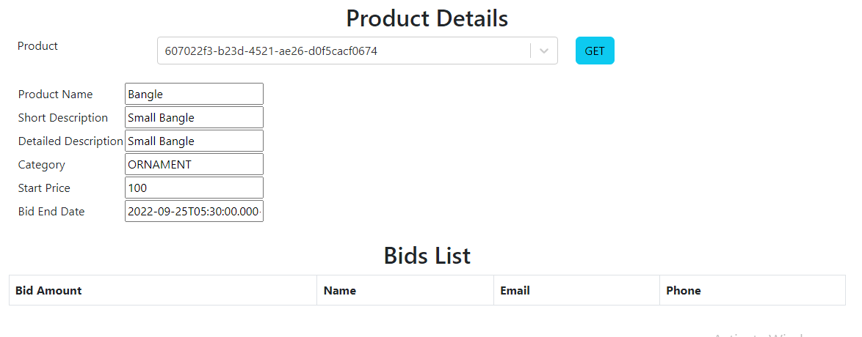
Screenshot of Product Details without bids

Slide 9
Thank You

