Slide 1
Vertical Solutions
January 2013

Slide 2
Vertical Profiles
Key Verticals Government – (FIPS/PIV, CAC, FICAM)
Aviation/Seaports/ Critical Infrastructure (TSA/TWIC)
Banking/Financial/Insurance – (FSA, PCI, MAR)
Energy (NERC)
Petrochem (CFATS)
Healthcare (HIPAA)
Pharma (21-CFR)
Higher Education
Notes:
The SAFE prospect profile & why

Slide 3
SAFE for Aviation
Market Drivers
Operations: Safety Operational efficiency Regulatory compliance Changing technologies | Security: Ensure high security Exceed TSA, TSC requirements Manage data privacy and background checks Leverage existing investments | Finance: Construction/ renovation projects Increase airlines/vendors on-site Constant need for additional revenue sources Budget pressures | Customers: Reputation is key Customer satisfaction
SAFE Benefits
Real-time policy adherence, correction and compliance reporting Efficiencies in card management via automated workflows Self-service portal for employees and tenants Efficient processes, accurate data, scalable infrastructure that increases productivity for airport staff Works with existing physical security infrastructure – no rip & replace

Slide 4

SAFE for Aviation Value Proposition
Quantum Secure’s SAFE suite of products provides a supervisory management system layer to automate manual workflows and processes, enabling airport authorities to manage facility access of users and groups through role-based access control.
SAFE provides:
Employee/employer and customer profile management
Key card/pass permit/parking pass management
Airside Vehicle Operators Permit (AVOP) management
AVOP tickets/infractions/suspensions management
Correspondence/letter management
Reporting/auditing/exception handling
Role-based physical access control
SAFE provides the back-end repository, business rules and Web GUI for the permit/pass office and for gaining access to external TSA systems.

Slide 5
SAFE for Life Sciences
Market Drivers
Compliance: HIPAA, FDA, DEA, HIPAA, DoD Data centers, laboratories, pharmacies | Loss of Assets & Theft: Essential medical equipment missing High-value assets stolen or damaged Restricted access to drugs and controlled substances | Fraud: Billing Time and attendance Inventory | Threat: Workplace stress Potential for violence Bioterrorism target Criminal threat Contamination
SAFE Benefits
Cost reductions in employee/ contractor on- and off-boarding, change management (lost cards, temporary cards, access changes, disabling cards for vacation, etc.) Departmental productivity regained and wait times eliminated by automated processes and integrated self-service Automated, rules-based monitoring, enforcement and reporting of compliance requirements

Slide 6

SAFE for Life Sciences Value Proposition
Quantum Secure’s SAFE suite of products provides a single interface to manage all identities, roles and related area access across a global telecommunications security infrastructure.
SAFE offers telecommunications-specific features such as:
Automatic access assignments, limiting hours and areas, requirement of special approvals
Self-service portal for employees and contractors to manage access
The ability to configure access groups/zones to business needs – across facilities and PACS
Assignment of secure area stewardship to business owners
Use of workflow and emails to streamline processes
SAFE provides the back-end repository, business rules and Web GUI for the security office, employees and trusted and un-trusted identities, increasing operational efficiencies and providing real-time compliance reporting.

Slide 7
SAFE for Telecommunications
Market Drivers
Operations: Massive regional and/or global footprint Disparate physical security systems Data center/co-location management issues Regulatory compliance | Security: Management of “trusted” and “un-trusted” identities across employees, vendors and third-parties Consolidation and standardization Theft and data breaches Budget pressures | Customers: Equipment maintenance Outages and emergency access
SAFE Benefits
Automate card holder administration and role/location-based provisioning Global efficiencies in card management Real-time policy compliance Flexibility to grow via merger and acquisition Lower total cost of ownership Works with existing physical security infrastructure – no rip & replace

Slide 8
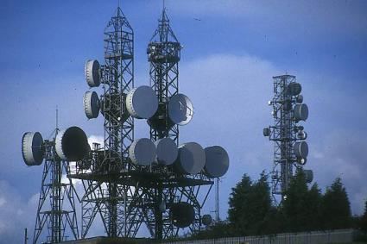
SAFE for Telecommunications Value Proposition
Quantum Secure’s SAFE suite of products provides a single interface to manage all identities, roles and related area access across a global telecommunications security infrastructure.
SAFE offers telecommunications-specific features such as:
Automatic access assignments, limiting hours and areas, requirement of special approvals
Self-service portal for employees and contractors to manage access
The ability to configure access groups/zones to business needs – across facilities and PACS
Assignment of secure area stewardship to business owners
Use of workflow and emails to streamline processes
SAFE provides the back-end repository, business rules and Web GUI for the security office, employees and trusted and un-trusted identities, increasing operational efficiencies and providing real-time compliance reporting.

Slide 9
SAFE for Petro/Chemical
Market Drivers
Operations: Political and physically hostile environments Employee safety across massive physical infrastructure Growth in regulatory and environmental restrictions | Security: Ensure high security and safety Consolidation and standardization Leverage existing investments | Finance: Corporate governance Budget pressures: exploration is very expensive Downsizing within the industry | Customers: Reputation
SAFE Benefits
Automate card holder administration and role/location-based provisioning Global efficiencies in card management Real-time policy compliance Flexibility to grow via merger and acquisition Lower total cost of ownership Works with existing physical security infrastructure – no rip & replace

Slide 10

SAFE for Petro/Chemical Value Proposition
Quantum Secure’s SAFE suite of products provides a single interface to manage all identities, roles and related area access across a global telecommunications security infrastructure.
SAFE offers telecommunications-specific features such as:
Automatic access assignments, limiting hours and areas, requirement of special approvals
Self-service portal for employees and contractors to manage access
The ability to configure access groups/zones to business needs – across facilities and PACS
Assignment of secure area stewardship to business owners
Use of workflow and emails to streamline processes
SAFE provides the back-end repository, business rules and Web GUI for the security office, employees and trusted and un-trusted identities, increasing operational efficiencies and providing real-time compliance reporting.

Slide 11
SAFE for High Technology
Market Drivers
Operations: Disparate systems Rapid expansion of enterprise ecosystem Operational efficiency Regulatory compliance | Security: Protect both physical and information-based assets Overlap between information and physical security functions Consolidation and standardization Leverage existing investments | Finance: Corporate governance Budget pressures | Customers: Reputation: security as a selling point
SAFE Benefits
Multiple cards and card formats tied to one identity and physical access privileges globally Seamless smartcard issuance and management System and processes to establish authority, responsibility and related access Flexibility to grow via merger and acquisition Lower total cost of ownership Works with existing physical security infrastructure – no rip & replace

Slide 12
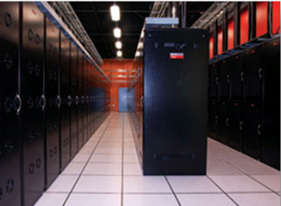
SAFE for High Technology Value Proposition
Quantum Secure’s SAFE suite of products provides an enterprise management layer for high-technology organizations, working with existing physical security infrastructures, integrating with corporate and IT systems and solving critical pain points associated with global compliance and card access management.
SAFE interfaces with key systems including:
Physical Access Control Systems (PACS)
Biometric systems such as iris or fingerprint scanners
Corporate IT/HR systems
Vendor profile management systems
Visitor management systems
Disaster recovery and emergency notification systems
SAFE provides the back-end repository, business rules and Web GUI for the security office, employees and trusted and un-trusted identities, increasing operational efficiencies and providing real-time compliance reporting.

Slide 13
SAFE for Education/Universities
Market Drivers
Operations: Multiple profiles Operational efficiency Regulatory compliance Newer technologies | Security: Ensure high security Consolidation and standardization Leverage existing investments | Finance: Corporate governance Budget pressures Mergers and acquisitions | Customers: Competition Reputation Customer satisfaction
SAFE Benefits
Role-based assignment of access Seamless smartcard issuance and management Automated, rules-based monitoring, enforcement and reporting of compliance requirements Assuring compliance with regulatory security requirements such as FERPA and HIPAA Works with existing physical security infrastructure – no rip & replace

Slide 14

SAFE for Education/Universities Value Proposition
Quantum Secure’s SAFE suite of products provides automates manual workflows and processes, enabling higher-education security professionals to manage facility access of users and groups through role-based access control.
SAFE provides:
Accurate verification and automated provisioning/de-provisioning of faculty, staff, students, researcher, vendor, affiliates and alumni
Controlled access to facilities, restricted areas, physical assets within banner systems and PACS
A reduction in physical security vulnerabilities by synchronizing changes to identities
A common repository for physical security audits & reports
SAFE allows public and private universities, multi-campus institutions, research and medical colleges to improve student services, enhance operational visibility and manage student life-cycles.

Slide 15
SAFE for Government
Market Drivers
Operations: Regulatory compliance: HSPD-12 Common identification standard for federal employees and contractors Operational efficiency Back-end attribute exchange | Security: Regular visitors and variance in quality of IDs used to enter restricted areas Increase government efficiency, reduce identity fraud, and protect personal privacy Consolidation and standardization Leverage existing investments
SAFE Benefits
Facilitates usage of HSPD-12-compliant cards across entire physical security infrastructure Elimination of manual data entry for PIV attributes = lower operational costs Real-time certificate validation Database integrity ensured Centralized security policies

Slide 16
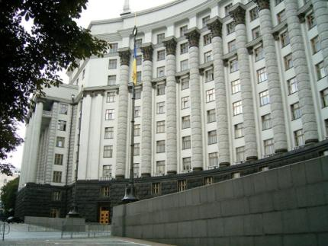
SAFE for Education/Universities Value Proposition
Quantum Secure’s SAFE suite of products automates manual workflows and processes, enabling government authorities to manage users and groups through role-based access control.
SAFE provides:
The ability to enroll, verify, authorize and provision cardholders into virtually any existing PACS environment
The enforcement of business rules for automatically granting and revoking access privileges per HSPD-12 guidelines
Real-time synchronization of PIV Identity attributes to manage additions/ changes/terminations/ certificate expiration
Support for a wide variety of card types, including CAC, FRAC, MAC and TWIC
SAFE provides the back-end repository, business rules and Web GUI for the security office, employees and compliance regulators, increasing operational efficiencies and providing real-time reporting.

Slide 17
Quantum Secure Customer Deployments
January 2013

Slide 18

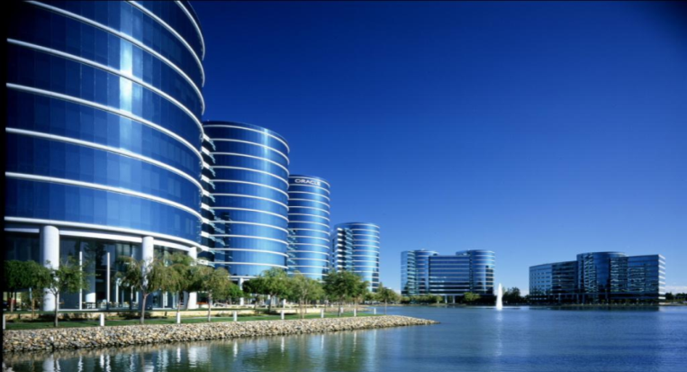
SAFE Deployment - Oracle Corporation
Background:
Services customers in 140+ countries
Over 2100 Facilities
4 PACS brands; 12 PACS servers
130,000+ employees, contractors and vendors, third parties
Requirements:
Centralize physical access grants, revoke and management across diverse PACS
Establish a flexible and scalable common policy based platform for physical Identity and Access Management: Operational agility, compliant provisioning / terminations and rules based approval workflows
Centralize web badging: consolidate global SOCs
Compliance automation: Audit, attestation and real-time reporting
Reduce TCO (total cost of ownership) and overall operational cost
SAFE Benefits:
Avoided $8M of capital expense for PACS rip-replace due to M&A
Integrate and interoperate all disparate PACS into a common platform
Fully automated access provisioning / termination process globally – automated rules and workflows for access rights management
Real-time policy compliance
Operational cost savings year over year

Slide 19


SAFE Deployment - British Telecom
Background:
British Telecom is a global provider of telecommunications infrastructure and services
7000+ facilities/sites throughout the world
200,000+ employees, contractors and vendors
Requirements:
Needed automate card holder administration & role/location based provision by integrating PeopleSoft HRMS/Oracle IdM & PACS (both legacy and updated)
Elimination in manual interventions needed for cardholder administration, visitor management and metal key management
Centralized smartcard badge issuance for logical and physical access
Temporary and ‘un-trusted’ (pool) card management
Self-service physical security portal - both trusted vendors and identities
Flexibility to grow - mergers & acquisitions
Reduce TCO (Total Cost of Ownership)
SAFE Benefits:
Cost Savings of £200K/year by automating manual security operations
Cost Savings of £750K/year by eliminating custom development & Maintenance Cost
Seamless smartcard issuance and management
Real-time policy compliance
Efficiencies in card management
No manual processing – all automated
No rip & replace

Slide 20

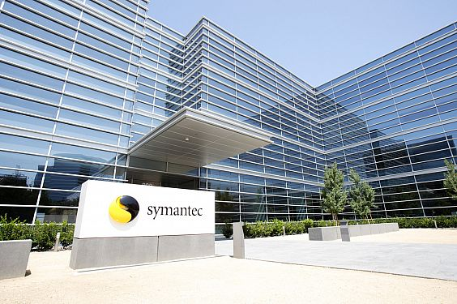
SAFE Deployment – Symantec Corporation
Background:
Global security management company
Facilities in 40+ countries
19 data centers, multiple PACS
40,000+ employees, contractors and vendors
Requirements:
Needed automated card holder administration & reporting across various PACS for Sarbanes Oxley (SOX) compliance
Ensure multiple cards and card formats can be tied to one identity and physical access privileges globally
Elimination in manual interventions needed across multiple PACS – GE, Lenel, visitor management systems, disaster recovery, case management
Eight-week deployment timeframe
Reduce TCO (Total Cost of Ownership)
Streamlined enrolment and badge issuance processes for visitors
SAFE Benefits:
$2.5M cost savings over 3 years
Real-time policy compliance
Reduced manual interventions
Fewer SME required to operate security infrastructure
Reduced from 15 to 8 people
No rip & replace of existing hardware/ software

Slide 21

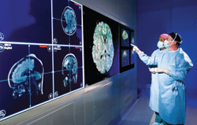
SAFE Deployment – Cincinnati Children’s Hospital
Background:
Cincinnati Children's Hospital Medical Center is a leader in pediatric healthcare, research and medical education
15 patient care sites throughout the region
15,000+ medical staff, employees, contractors and vendors
Requirements:
Needed automate card holder administration & role/location based provision by integrating PeopleSoft HRMS & PACS
Elimination in manual interventions needed for cardholder administration, visitor management, hard key management, parking reports
Self-service physical security portal
Reduce TCO (Total Cost of Ownership)
SAFE Benefits:
One-click audit & reporting
Real-time policy compliance
Efficiencies in card management
No manual processing – all automated
No rip & replace

Slide 22

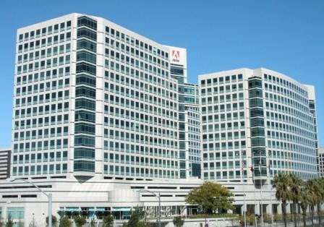
SAFE Deployment - Adobe
Background:
American computer software company founded in 1982
Creates multimedia and creativity software products, and into Internet application software development
In-house designed system for managing identities related to physical access
Requirements:
Automation of key manual processes related to access credential issuance and access privilege assignment
Streamlining compliance initiatives
Integration and automation of various disparate systems
Eliminating data entry mistakes and improving auditing capabilities
User-friendly security operations and policies
Reduce TCO (Total Cost of Ownership)
Improving customer satisfaction and overall levels of security
SAFE Benefits:
Automation of manual, labor-intensive tasks
Average processing time for employee badging reduced by 62%
Average time-access changes to be granted in PACS from 4 minutes to half a minute
A saving of 36 hours per month of labor in processing new employee badges

Slide 23



SAFE Deployment – the Irvine Company
Background:
140-year-old real estate company
400 office buildings, 40 retail centers, 90 apartment communities, two hotels, five marinas, three golf clubs
Multiple PACS
Requirements:
Multi-tenant delegated administration system
Different access levels/profiles per tenant
Change requests managed within five minutes
Notification to stakeholders within one minute
Alerting mode and one-minute response (via mail, pager, mobile)
Real-time reports on tenant-specific portal
Physical access usage history
Ability to view reports related to their employees
Physical access event correlation and interpretation, and alerting
SAFE Benefits:
Cost avoidance – SaaS
On-boarding card provisioning from days to minutes
Delegated administration – fully automated, labor savings
No rip & replace

Slide 24
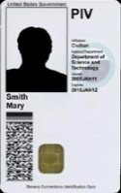

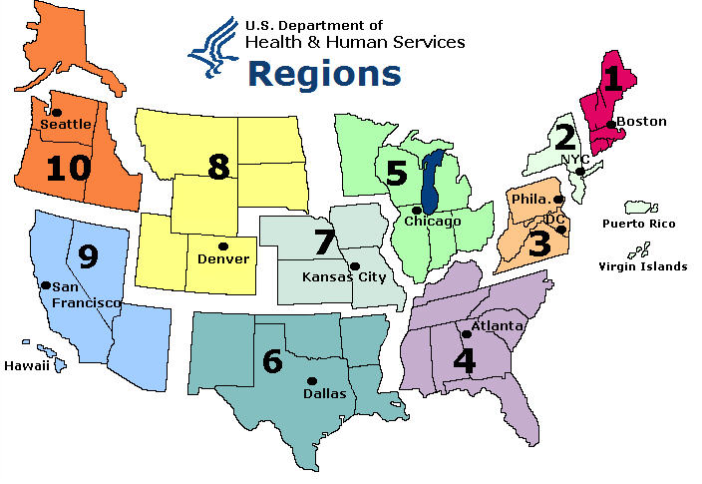
SAFE Deployment – US Department of HHS
Background:
Large federal agency managing
FDA, NIH, CDC, IHS, HRSA, ….
100,000+ employees, contractors and vendors
Requirements:
Real-Time integration with Enterprise Identity Management to eliminate manual forms, and maintain data integrity
Compliance with Federal Badging Initiatives (HSPD12)
Consistency of photographs across all PACS Enforcement of business rules for automatically granting and revoking access privileges per HSPD-12 guidelines
Satisfy Multiple Stakeholders, Multiple Agencies within HHS
SAFE Benefits:
Facilitates HSPD-12 compliance
Elimination of manual data entry for PIV attributes = lower operational cost
Real-time certificate validation
Database integrity ensured
Centralized security policies

Slide 25

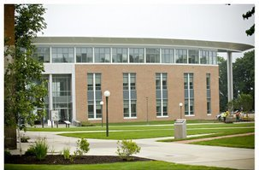
SAFE Deployment – Roger Williams University
Background:
Established in 1956 and located on 140 acres of land
Private liberal arts college, currently ranked in the Top 10 of comprehensive colleges in the North
3,800 undergraduate and 850 graduate students enrolled in 36 liberal arts majors and five professional schools
Multiple disparate systems
Requirements:
Automating the process of managing security for personal and property
Integration of ERP systems with PACS
Delegation of authority regarding access related to identities to particular departments in the organization
Automating key physical security processes
Reduction in the Physical Access Management Team’s day-to-day efforts
Effective execution of badging and metal key management processes
SAFE Benefits:
Integration of ERP systems with PACS
Automation of 40% of security operations
Elimination of up to 95% of errors in badging and access management
Significant reduction in cost
Effective management of identity access to university buildings and facilities

Slide 26

SAFE Deployment - GTAA
Background:
Canada’s biggest & busiest airport
Handling 30 million+ passengers/year
80,000 identities under management
Pass/Permit Control Office (PPCO) administers 33,000 active personnel
Serves 175 clients/day (over 43,000 per year)
Requirements:
Reduce long processing times
Poor customer service
Workers (tenant employees) leaving the airport before getting on the job
Increase security compliance
Difficult/costly to enforce consistent security controls
Automate manual processes
Average delay for a PPCO appointment was four weeks
SAFE Benefits:
Time for on-boarding IDs went from 577 min down to 72 min
Price per ID processing went from $49/card to $35/card
Average wait times reduced from 560 minutes to 20 minutes, a 96% reduction
Faster processing = better client service
Single-source data = high physical security controls
Reliable reporting = effective business operations

Slide 27

SAFE Deployment – Aspen Airport
Background:
County-owned public-use airport
44,000 square foot single-floor terminal facility, including six rental car operations, a year-round guest services operation, a restaurant and gift shop concessions.
Largely seasonal employee base and a small airport badging staff
Requirements:
Simplified provisioning of all personnel into their airport identity management system
Seamless integration of disparate biometric devices into one user interface
Incorporation of Biometric Airport Security Identification Consortium (BASIC) practices
Manage the issuance of pre-encoded proximity cards for different types of badge layouts
Integration with centralized billing system
Provide central repository for capturing, storing and managing documents
SAFE Benefits:
Streamlined security operations
Huge reductions in operating costs
Future-proofing of the physical security infrastructure
Simplification of badging operations through automation
Reliable and accurate reporting on pass office operations
Real-time compliance with the TSA security directives

Slide 28

SAFE Deployment – San Francisco International Airport
Background:
Category X airport that handles over 40-million passengers each year
Tenth largest in the United States and one of the world’s 30-busiest airports
Multiple departments within the airport – Aviation Security, Airfield Operations, Security Operations Center etc.
Requirements:
Management of entire badging process
A system that could work across multiple departments and systems within the airport
Automating manual processes related to background checks, access credential issuance and access privilege assignment
Issuance of multi-technology, highly secure badges for use with multiple PACS and biometric access devices
Provisioning of biographic and biometric information onto the badge contact-less chip
Dynamically driven enrollment processes appropriate to each applicant
Electronic, workflow-driven processes for assignment of metal keys and other access devices to identities
Integration with computer-based training systems for real-time validation of training credentials
SAFE Benefits:
Streamlined security operations
Improved level of customer services
Simplification of compliance needs
Real-time compliance with current TSA security directives
Reduction in data entry errors
Optimization of the management of TSA-regulated badging processes

Slide 29


SAFE Deployment – Empire State Building
Background:
Inability to securely manage thousands of visitors for their 300 tenants
High visitor processing time causing long wait times and delay
Requirements:
Deployed SAFE and connected to the base building GE Diamond II system for validation of tenants’ status when pre-registering a visitor
All visitors are given a bar-code pass and must badge in through base building turnstiles
All visitors are checked against the watch list
All visitors are auditable in terms of their access to the building and allowed to access only pertinent elevator banks
Tenants use self-service portal to manage their employee’s status for base building access and visitor invitation authorization
SAFE Benefits:
Securely manage both tenants’ physical access and visitors’ access to the premises using one solution
Reduce operating expenses by allowing tenants’ administrators to manage their employee access and pre-register visitors

Slide 30


SAFE Deployment – Juniper Networks
Background:
Uses SAFE Physical Identity and Access Mgmt to securely on-board identities from HRMS to PACS
Wanted to securely manage all types of identities including visitors using the same solution
Requirements:
Self-service process for managing access requests for employees
Centralized web-based badging and managing access for individual regions
Allow visitors to do an unmanned check-in at the lobby
Automate synching of PeopleSoft records with CCure
Common repository for security audits & reports
Track packages delivered to employees within the organization
Linking SAFE with ElectroStatic Discharge (ESD) Training system/database
Integration with Emergency Notification System - SendWordNow
SAFE Benefits:
High ROI by leveraging one solution to manage all types of identities and using the same visitor management solution to track packages
Reduced operational expenses by allowing visitors to do self check-in

