Slide 1

Welcome
To
Elitser IT Solutions
Fotopass Presentation
Visitor Management System

Slide 2
Objective Of The Fotopass
The Objective of the Fotopass is to capture the photographs, personal and official details of all visitors and stored in computerized system for reference at any point of time

Slide 3
Need for a Enterprise wide System
Security has become a paramount concern for every organisation today.
Modernisation of a security department revolves only around Proximity Cards, CCD Cameras etc but data analysis and mining operations are normally ignored.
Most of the systems are manual and hence analyzing the data and generating any intelligence out of it is very difficult.
Normally there is no comprehensive effort on computerisation of a Security Department.

Slide 4
Advantages of the Computerised System
Very user-friendly, still a stringent security system.
Intranet based system operational on any OS
Ability to print visitor ID with Photograph
Bar-code interface for faster check-ins and check-outs.
Online alert generation.
Powerful Data Snuffer Algorithms to control suspicious patterns.

Slide 5
Reasons for Security Lapses
Every organisation designs its security policy based on needs and perceived security threats.
In a manual system there are many chances that these policies are not implemented effectively.
ESM Office is that powerful tool which helps in ensuring that all the security policies are implemented to a fullest extent.

Slide 6
Issues in Manual System
Pass creation takes time
Photograph can not be captured
As photograph is not available, the same pass can be passed to other persons.
Pre-Approval before issuing a pass is not possible automatically
Prior appointment is not possible
In case of any mishap, retrieving the pass details including Photograph is not possible
Recording exit time is time consuming

Slide 7
Features of the Proposed System
Visitor pass with Visitor’s Details, Official Details & photograph
Option not to print the Pass or even reprint the Pass
Auto Sign out using Bar code etc.
Scheduling appointments for employees
Meeting Room / Conference Hall booking
Confirmation option for unscheduled / scheduled visitors through Application

Slide 8
Features - Contd..
Online scheduled appointments list
Centralized database management
Multiple Entrance point (gate) support
Common Instructions on the pass
Authorised users can access the application
Retrieval of the past visitors data based on different criteria.
Returnable/ Non-Returnable Material gate passes can be issued.
Key management
Employee ID card can be issued.

Slide 9
Benefits of the Proposed System
An immense value addition to visitor service
Easy retrieval of photographs and details across departments and floors.
Ease of installation and use.
Zero maintenance.
Temporary Visitor passes for any period of time for regular visitors such as Courier boys, canteen persons etc.,
Ease in verification of visitors using the photograph which is available on-line.
Reports date wise, visitor wise, department wise, floor wise, employee wise and simple query based reports.
Print outs clearly indicating area allowed to which the Visitors should access

Slide 10
Reports
All Master Reports
Visitor Reports
Area Wise Visited Reports
Gate Pass Reports
Search Visitor by Photo
Vehicle Reports
Visitor Movement Reports
Valid and Expired Passes Report
Key Transaction reportsmbers and view the results online

Slide 11
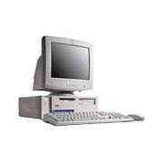
System Requirements
A Pentium IV
512MB RAM, 80 GB HDD
16MB AGP
Intel 10/100 LAN Card,
52X CDROM Drive, Multimedia
15” Color Monitor
USB port enabled
For backups CD writer.
LaserJet Printer
Digital Web Camera
Barcode Reader

Slide 12
Software Requirements
MSDE for Stand alone system
MS-SQL Server for Networked version
Windows XP to be provided by client.

Slide 13
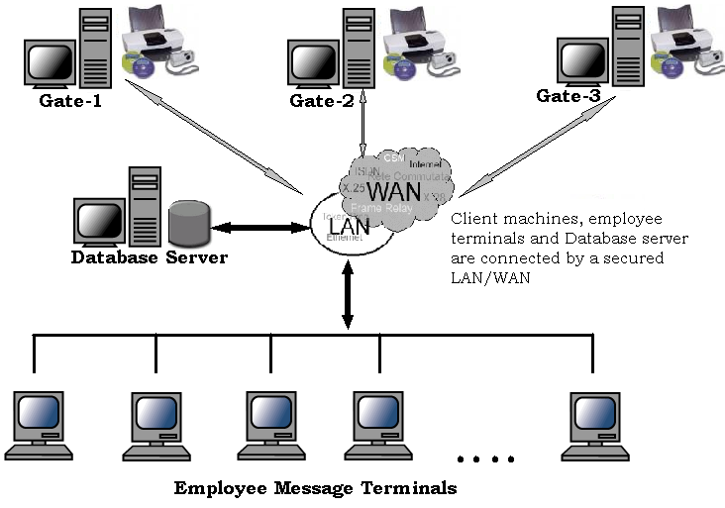
Proposed Solution Architecture

Slide 14
Components of Visitor Pass Control System
Entry Pass Creation with Photo ID and Printing
D
a
t
a
b
a
s
e
S
e
r
v
e
r
Data Analysis Services
Online Alert Generation & Monitoring system
FotoPass Messenger within premise Control System
Data Sniffer and Alert Generation

Slide 15
System Operations (Alert)
Entry
Take the details and
photograph of visitor
Print the visitor Pass
Issue him a Visitors
Pass.
No Check Out
G
F
Check Out Terminal
Security Reception
I
Restricted Visitor Reject
E
Control Console
Create Appointment
H
Database Server
D
A
B
C

Slide 16
System Architecture
Control Console
Appointment
Creation
Module
S E C U R I T Y
S E R V E R
Databases
General
Contractors
Vehicle Pass
Intranet Appointment Program
Visitor ID Generation
Alert Generation
Statistical Analysis
Visitor Pass Terminal
Digital Camera
Time Stamping
&
Check Out
Visitor Pass Generation & Printing Module
Data Validation
Alert Generation
&
Resolve Logic
Visitor Pass Printing Module
With Barcode
Statistical Analysis and Reporting Module
Alert Generation
Archival Data Retrieval

Slide 17
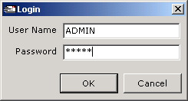
Login Screen

Slide 18
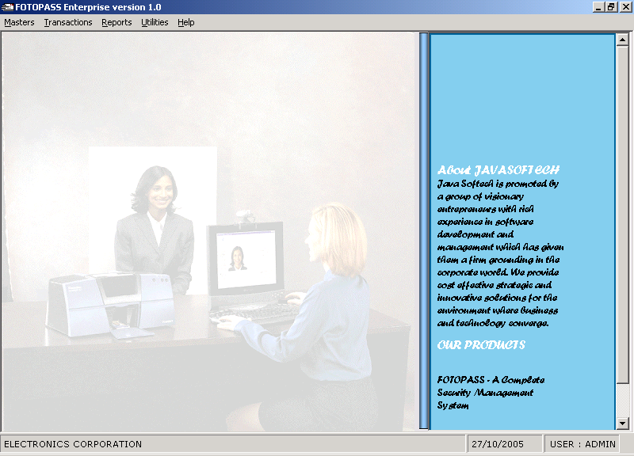
Application View

Slide 19
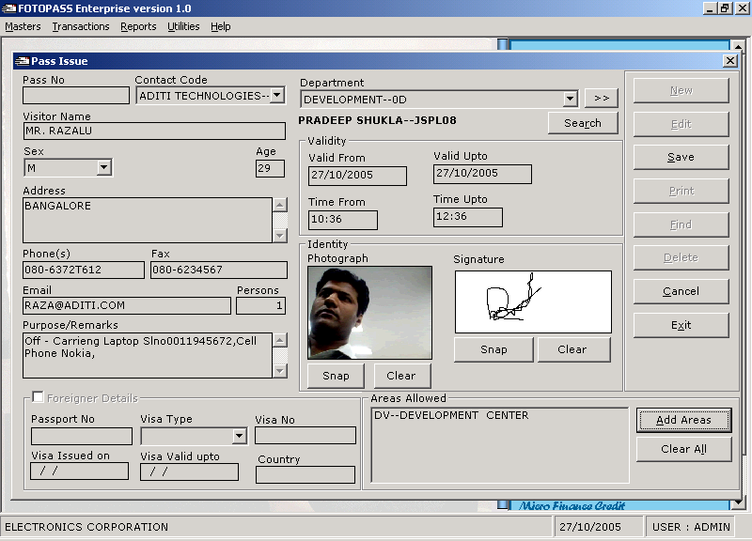
Process Of Generating Instant Pass

Slide 20
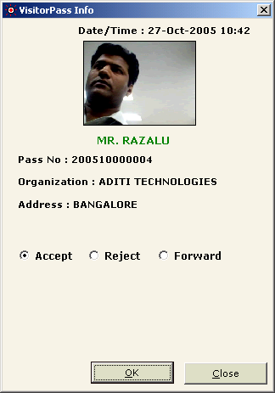
Notification On Client/Emp Machine For Accept/Reject/Forward the Pass

Slide 21
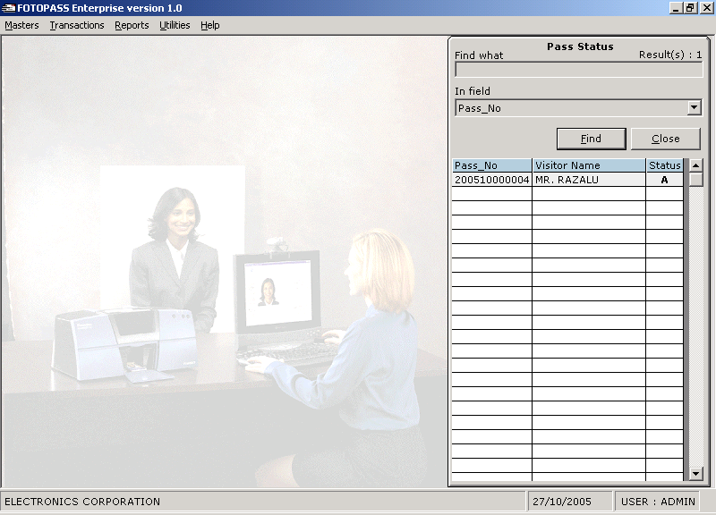
Pass status checking at issuing counter

Slide 22
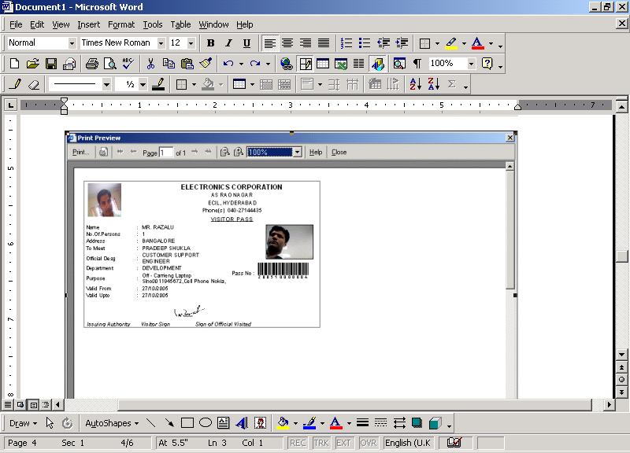
Preview Of Sample Pass

Slide 23
Thank you

