Slide 1
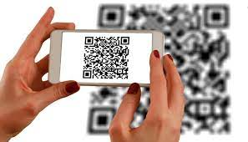
ScanKaro (Online Scan Menu and Payment Method)
Team Guide:
Ms. Sandhya Avasthi
Team Members:
Divya(1803210050)
Hrithik Gupta(1803210065)

Slide 2
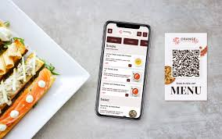
Index
Problem Statement
Motivation
Objective
Scope of Project
Previous Related Work
Software and Hardware Requirements
Proposed Methods
Deliverables
Stakeholders
Gantt Chart
Conclusion
References

Slide 3

Problem Statement

Slide 4
Motivation
I personally do not like waiting for long in the store or to have to call the store to place an order especially during the peak lunch or dinner hours. Due to covid-19 no one wants to touch the menu (which is of paper) as everyone is coming and touching it. So we think that now menu is in our pocket(in the app inside mobile)
This is basically for small shops where shopkeeper have many orders. But they are not able to manage it.

Slide 5
Objective
This project helps the customer to maintain social distancing.
This project helps to maintain time as no one will be in queue to order dishes.
This project also helps the user in predicting which food is the best and which is not by checking the review.

Slide 6
Scope Of The Project
Menu request: The first step is to scan the QR code from the table in the Smart dining with the customer using his smartphone. This step is accomplished by scanning the QR code and requesting access to the menu that is available in the restaurant to the manager/admin section.
Ordered food: This step is to order the customer's food according to his needs from the menu that was open before him. This order goes to the Manager/Admin section
Food list: The customer has no direct connection to the kitchen, but the manager has. At this stage, the list of the ordered food is transferred from the manager/admin section to the kitchen section.
Food delivery: At this point, the Smart Robot and the customer interact. This step is completed by delivering the food from the kitchen to the ordered customer.
Billing: This is the second last stage. At this stage, the manager/admin generates a bill according to the customer's food and gives it to the customer.
Payment :This is the final stage of the architecture. This step can be considered as the response of the eighth stage. At this point the customer is paying the bill.
Menu Confirmation : This phase can be considered as a continuation of the first step. This step is to make the manager/admin menu accessible to the customer in response to the customer's request. As a result, the menu becomes visible to the customer and moves onto the next step.
Order confirmation: This phase can be regarded as a continuation of the third stage. At this stage the confirmation response is what the customer ordered from the menu.
Food Hand over: This is a small step. At this stage the cooked food from the kitchen is handed over to the "Smart Robot" section according to the customer's order. Smart Robot is a fascinating feature of Smart Dining System.

Slide 7
Related Previous Work
1.One2 Menu
Overview: One2 Menu is an online menu builder for restaurants. It also offers a contactless menu building service that promises to create contactless menus for restaurant owners in less than 30 minutes. The contactless menus use both QR codes and smartphone tap features on table cards that direct diners to a restaurant’s online menu. It’s both safe and easy to use for diners, while also providing owners an easy way to update and change menus, as well as create an easy-to-use online menu for those browsing their website or social media profiles. It also auto-updates a restaurant’s Google My Business account every time a menu is updated, has language translation, and natively integrates into existing websites.
Pricing: $99 – $299 per month

Slide 8
2. MyMenu
Overview: MyMenu provides the tools to create a simple QR-code powered digital menu for restaurants – and at no cost to help the restaurant industry reopen safe and stop the spread of COVID-19. Its contactless menu offering can also be added into its existing suite of online menu and ordering systems to create a unified experience. Restaurants have the ability to create an online menu that can be integrated into their website, allow diners to place orders from home or in the restaurant, and pay for their order in a smartphone’s web browser or iOS/Android app. These additional features are not included in the free offering.
Pricing: Free

Slide 9
Software and Hardware requirements
Software:
VS Code
Windows 10(64 bit)
Android Studio, etc.
Hardware:
Laptop (Processor- 8th Gen Intel Core i5, RAM- 8GB)
Camera, etc.

Slide 10
Proposed Method
This step is completed when the customer scans the QR code with his/her smartphone.
The second stage is completed by scanning the QR code and making the customer access the food menu on his smartphone and ordering the customer's food.
At this point, the "waiter" delivers the food according to the customer's order.
At the final stage, the manager/admin generates the bill and the customer pays the bill.

Slide 11
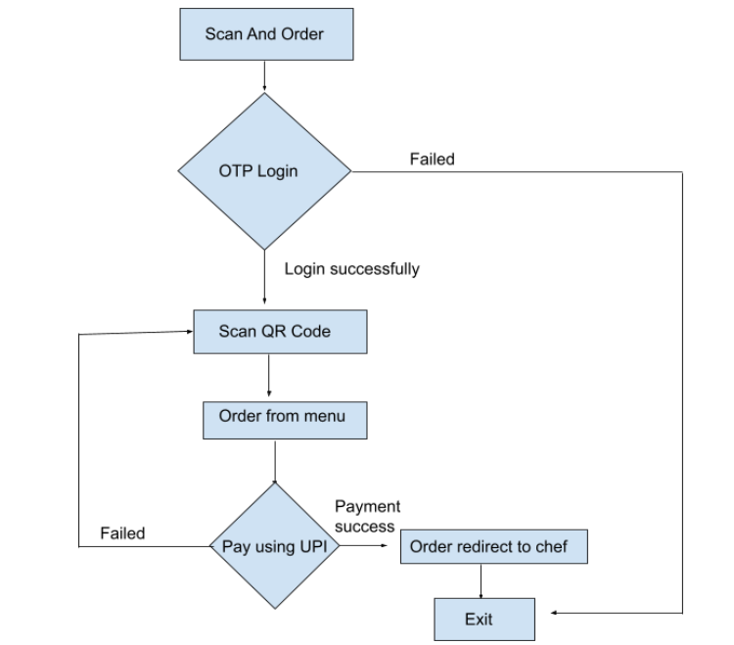
Flow Chart

Slide 12
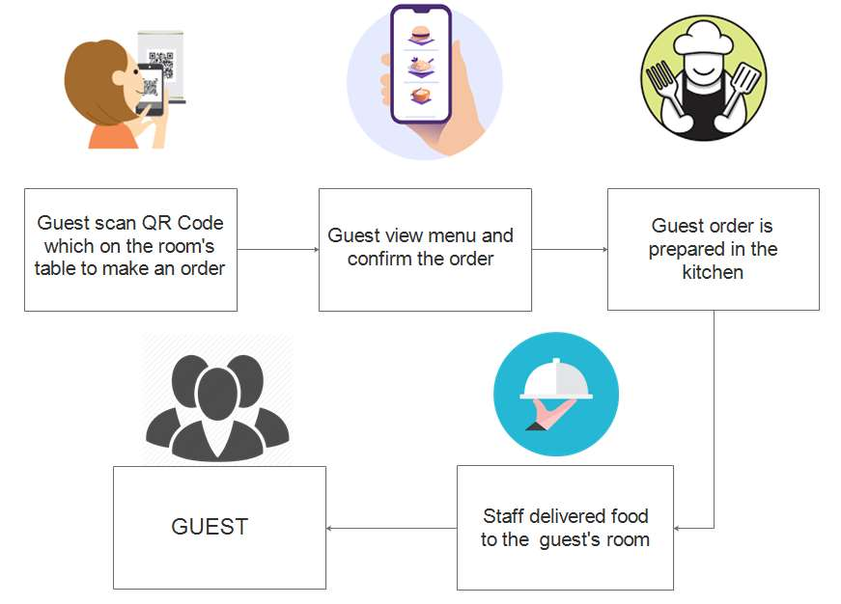
Architectural Diagram

Slide 13
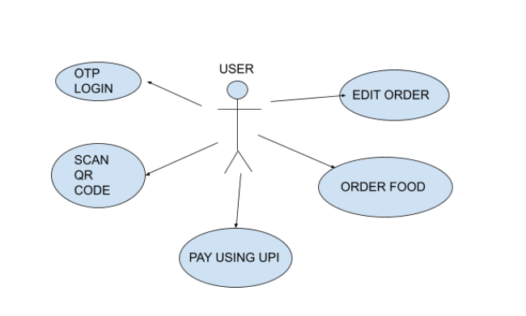
Use Case Diagram

Slide 14
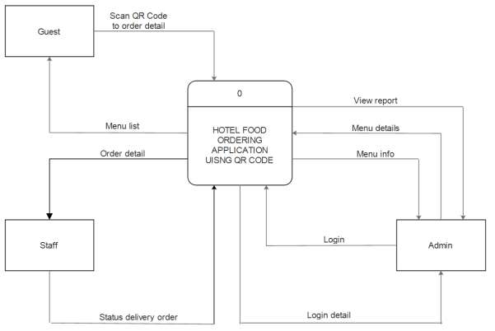
Context Diagram

Slide 15
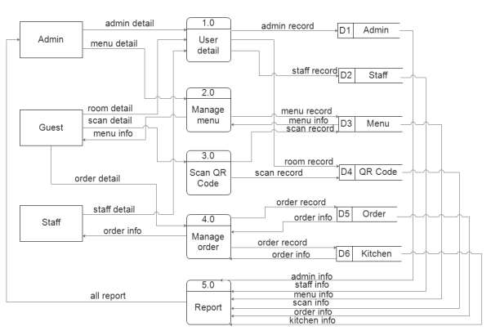
DFD 0-level

Slide 16
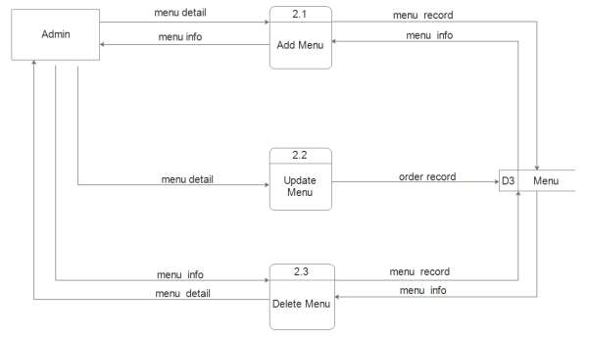
DFD 1-level

Slide 17
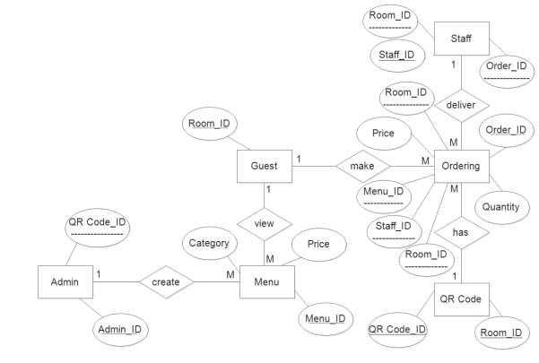
Entity Relationship Diagram

Slide 18
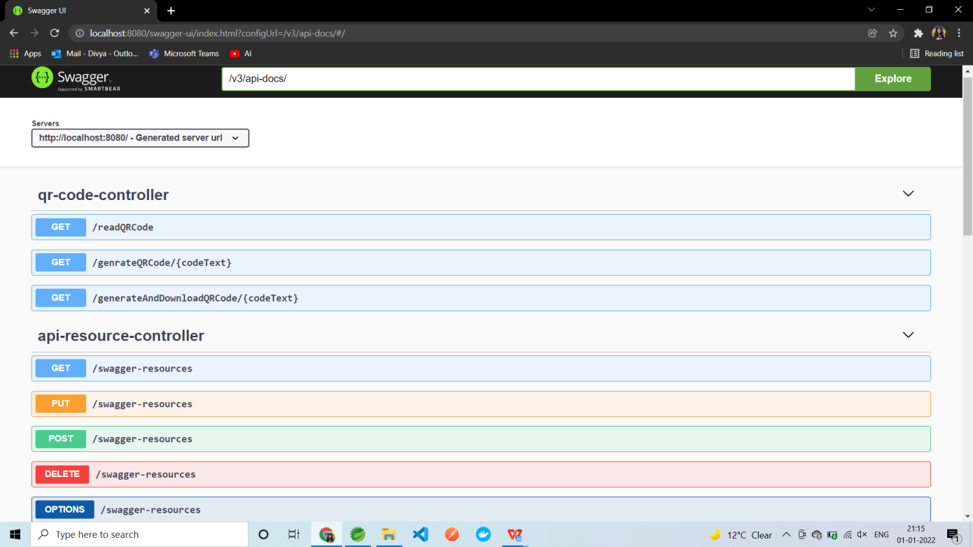
Screenshot of Implementation

Slide 19
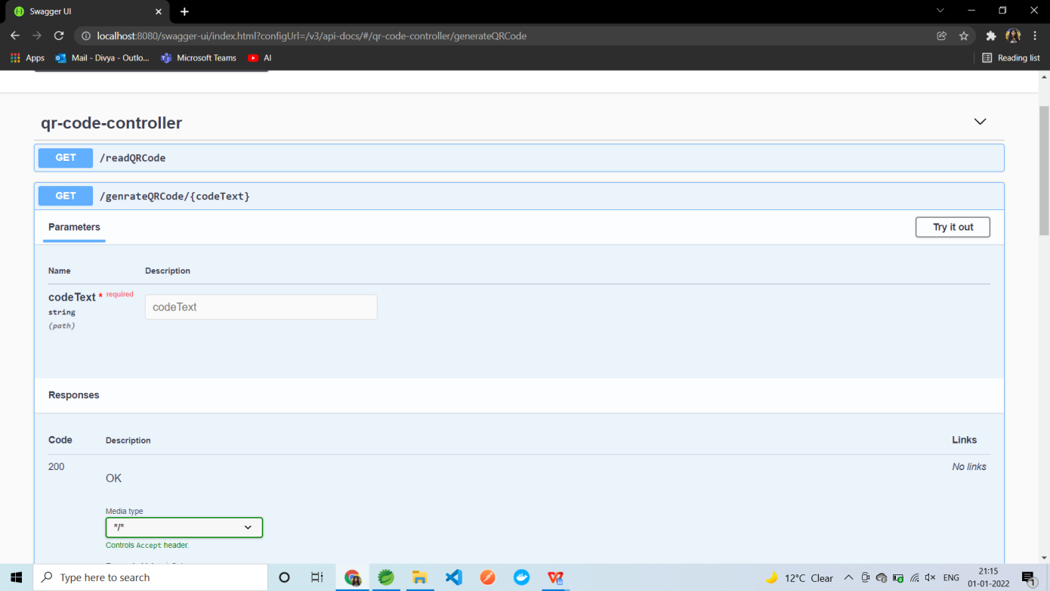
Screenshot of Implementation

Slide 20
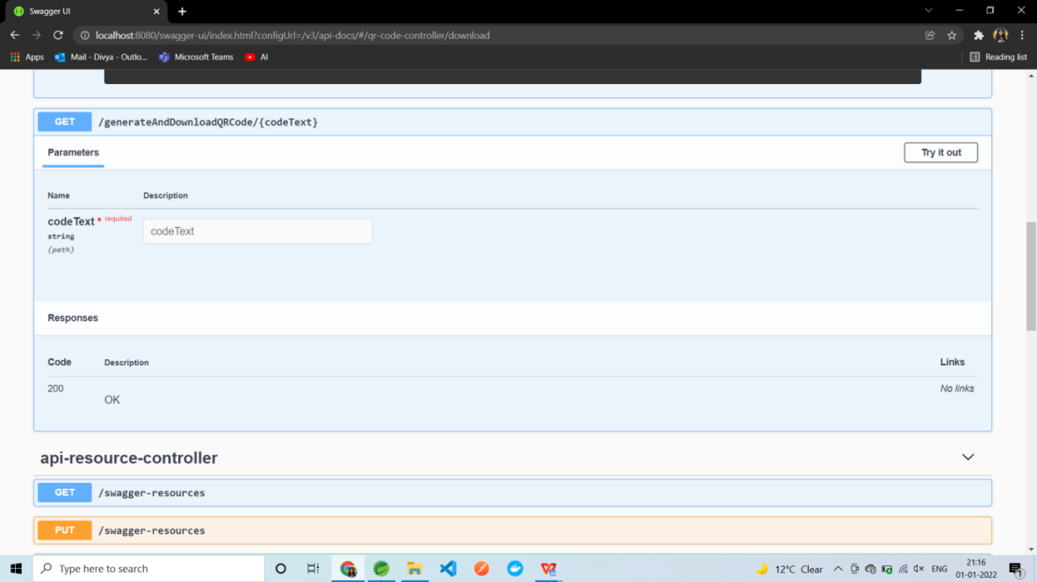
Screenshot of Implementation

Slide 21
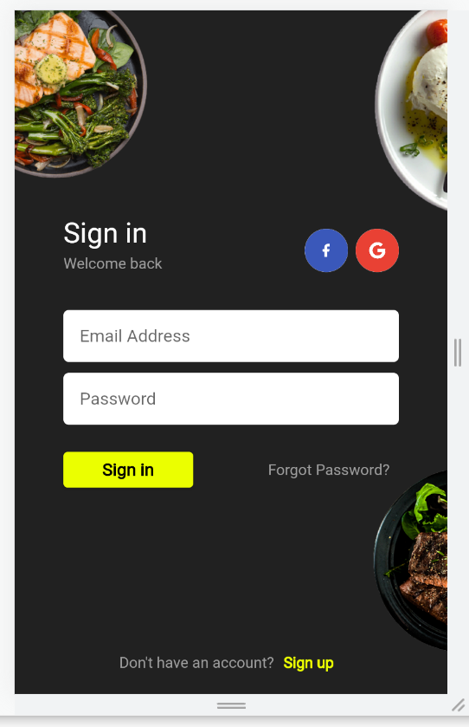
Screenshot of Frontend

Slide 22
Deliverables
Easy to access
Open the scanner app on your phone, then follow the instructions that appear. The exact process will depend on your app, but you'll usually be required to place the device directly above the document, then use the device's camera to scan the menu QR code.
Touch free software
The advancement in technology has greatly influenced business transactions. The adoption of digital technology has led to automation in the hospitality industry. Businesses in the hospitality industry such as restaurants can be improved with the help of digital systems. The competition in the restaurant business has increased with the advancements in food ordering techniques. This project aims to automate the food ordering and billing process in the restaurant as well as to improve the dining experience of customers. Here we discuss the design & implementation of the Smart Dining ordering system in real-time with customer's feedback for restaurants. The system on the user’s table will have all the details of his account as well as the menu. The order details from the customer’s table are updated and subsequently

Slide 23
Stakeholders
People of our country who don’t want to wait.
Restaurants and small shops.
Shopkeepers.

Slide 24
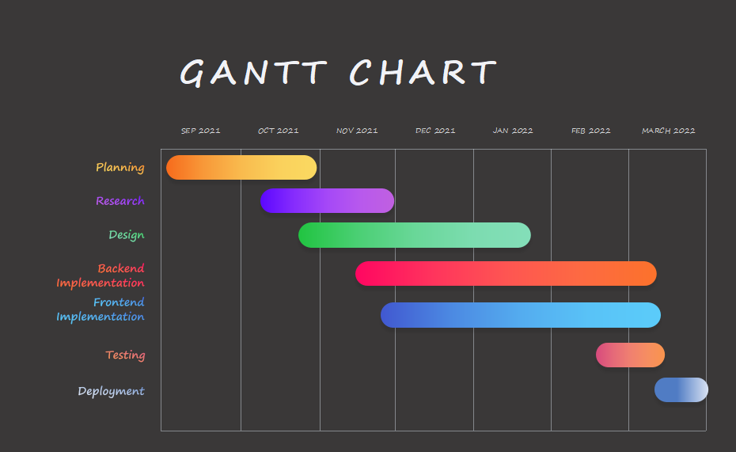

Slide 25
Conclusion
“No queues, No paperwork, Enjoy healthy food”

Slide 26
References
The advancement in technology has greatly influenced the business transactions. The adoption of digital technology has led to automation in the hospitality industry. Businesses in the hospitality industry such as restaurants can be improved with the help of digital systems.
Link :- https://jespublication.com/upload/2020-110568.pdf
Time saving and cost optimizations are essential for a restaurant to run effectively. Reduction in time by a few seconds for each table can speed up order processing, increase efficiency and boost profits. The food ordering system, till a few years ago, was a completely manual process where a waiter used to note down orders from the customers using pen and paper, take the orders to the kitchen, bring the food and make the bill.
Link :- http://ijarest.com/papers/finished_papers/150322164132.pdf

Slide 27
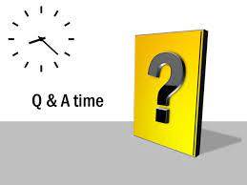
Question and Answers Time

Slide 28


