Slide 1



AI College Timetable
& Resource Scheduler
M
T
W
T
F
A CSP-based conflict-free timetable generator with role-based portals, room allocation and a Gemini-powered chat assistant
FOUNDATION OF ARTIFICIAL INTELLIGENCE PROJECT
Mentor : Dr. Mrs. Theepa Karthisai
Team Members
DIVYA SHREE G - 240701129
JAI SHURIYA J -240701200
Computer Science and Engineering
Rajalakshmi Engineering College
Batch: 2024 -2028
0 conflicts

Slide 2

Abstract
Why manual timetabling fails, and what we built
Building a college timetable by hand means juggling teachers, rooms, labs and batches so that nothing clashes. It is slow, error-prone and hard to change.
We model timetabling as a Constraint Satisfaction Problem and solve it with backtracking search, MRV ordering, forward checking and domain pruning. The engine guarantees no teacher, room or batch double-booking, matches labs and classrooms, respects room capacity and leaves every batch a daily break.
Around the engine we built Student, Faculty and Admin portals, best-fit room ranking, an event-request approval workflow and a chat assistant where Gemini only translates language while MongoDB supplies every fact.
24
94
Active teachers
6 subjects
Campus rooms
classrooms + labs
116
0
Sessions / week
69 theory, 48 lab
Conflicts
teacher / room / batch
Keywords: CSP, backtracking, MRV, forward checking, FastAPI, MongoDB, React, Gemini

Slide 3
Literature Survey
Foundations for the CSP engine and the grounded chat assistant
# | Reference | Contribution | Relevance to our work
1 | Russell & Norvig, Artificial Intelligence: A Modern Approach (CSP chapter) | Formalises CSPs, backtracking, MRV and forward checking | Theoretical basis of our solver
2 | Even, Itai & Shamir (1976), On the Complexity of Timetable and Multicommodity Flow Problems, SIAM J. Computing | Shows timetabling is NP-complete | Why we need heuristics, not brute force
3 | Mackworth (1977), Consistency in Networks of Relations, Artificial Intelligence 8(1) | Introduces constraint propagation and arc consistency | Domain pruning before search
4 | Haralick & Elliott (1980), Increasing Tree Search Efficiency for Constraint Satisfaction Problems, Artificial Intelligence 14(3) | Forward checking and fail-first variable ordering | MRV and early wipe-out detection
5 | Lewis (2008), A Survey of Metaheuristic-Based Techniques for University Timetabling Problems, OR Spectrum 30(1) | Reviews GA, simulated annealing and tabu search | Alternatives; CSP keeps hard constraints exact
6 | Lewis et al. (2020), Retrieval-Augmented Generation for Knowledge-Intensive NLP Tasks, NeurIPS | Grounds LLM answers in retrieved data | Chat: database gives facts, Gemini phrases them

Slide 4









System Architecture
React UI, FastAPI services, MongoDB and intelligence modules
React 18 + Vite
Tailwind CSS + MUI
React Router (protected routes)
AuthContext / ThemeContext
TimetableTable grid
ChatWidget
Role dashboards
FastAPI Backend
auth (JWT, bcrypt)
timetable
rooms
events
admin
chat
Pydantic models
MongoDB (Motor)
schedule, rooms, users, events
Student
REST + JWT
CSP Engine
backtracking + MRV + forward checking
Room Allocation
best-fit ranking
Faculty
Gemini API
intent + phrasing only
Admin
Request flow
UI action -> JWT check -> route -> service / CSP -> MongoDB -> JSON -> UI

Slide 5
CSP Engine: How the Timetable is Solved
Variables, domains and constraints, then search
1
Build variables
one per (batch, session); lab = one 2-period block
search tree
Start
2
Prune domains
drop rooms failing capacity, lab/theory type, late lab starts
X
lab
skip
3
Pick with MRV
variable with fewest legal values goes first (labs early)
X
ok
4
Backtrack + forward check
try (day, period, room); undo on dead end
dead end: undo, try next
all placed: solved
Hard constraints
No teacher / room / batch double-booking
Labs in lab rooms, theory in classrooms
Room capacity >= batch size
Each batch keeps at least 1 free period per day
Soft: preferred teacher, block, morning slots
5
Verify
independent scan: 0 teacher / room / batch clashes
6
Enrich
add times, duration and "Why this slot?" text

Slide 6

Modules
Three role portals on top of four core services
Student
Faculty
Admin
Select and lock faculty + section preferences
Personalised weekly / today timetable
Free Room Finder
Personal teaching schedule
Event / workshop room request
Track request status
Run CSP, generate alternatives
Approve or reject events
Workload analytics, conflicts, calendar, preference resets
CSP Engine
Room Allocation
Auth + Preferences
AI Chat Pipeline
engine.py: variables, pruning, MRV, verification
Best-fit ranking by capacity, type, e-board, block
JWT, bcrypt, one-time preference lock
Gemini intent -> MongoDB query -> Gemini answer

Slide 7
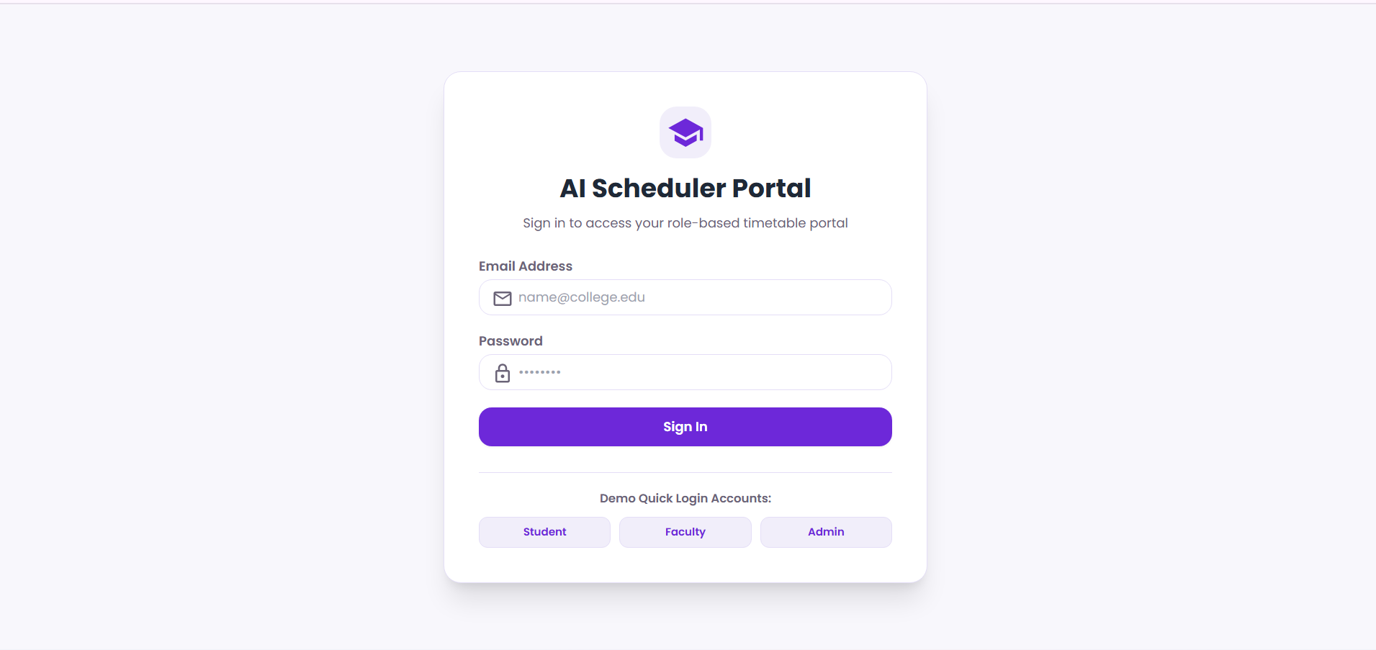
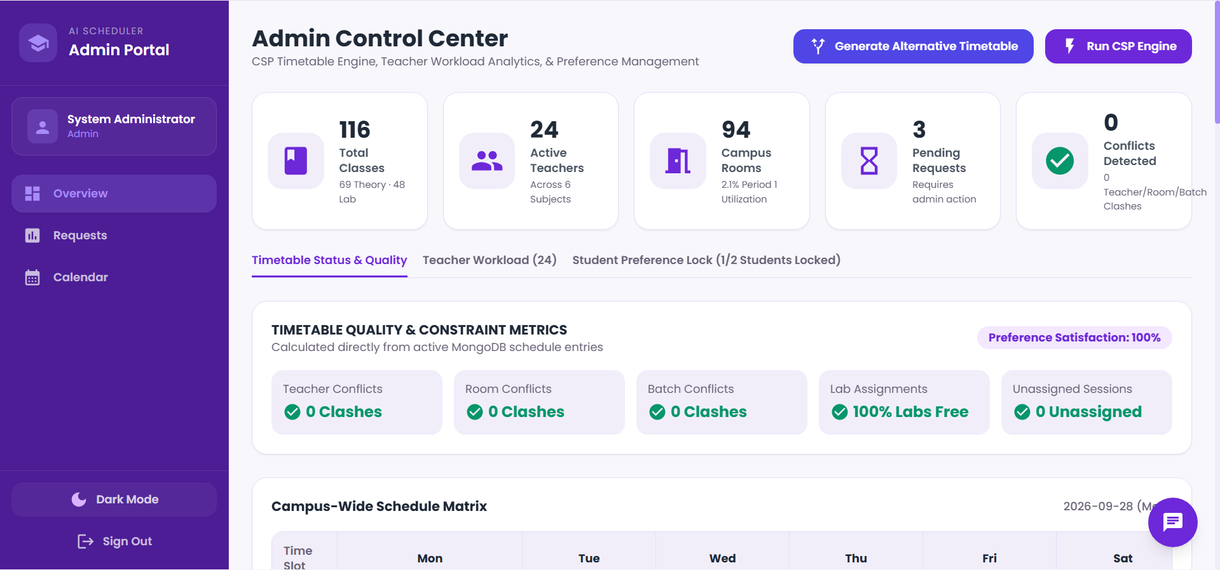
Output 1: Login and Admin Control Center
Secure role-based login
JWT authentication, bcrypt password hashing
One-click demo accounts for Student, Faculty, Admin
Routes and menus change by role
Admin dashboard
Run CSP Engine / Generate Alternative Timetable
116 sessions (69 theory, 48 lab), 94 rooms, 24 teachers
0 teacher, room and batch clashes; 100% preference satisfaction

Slide 8
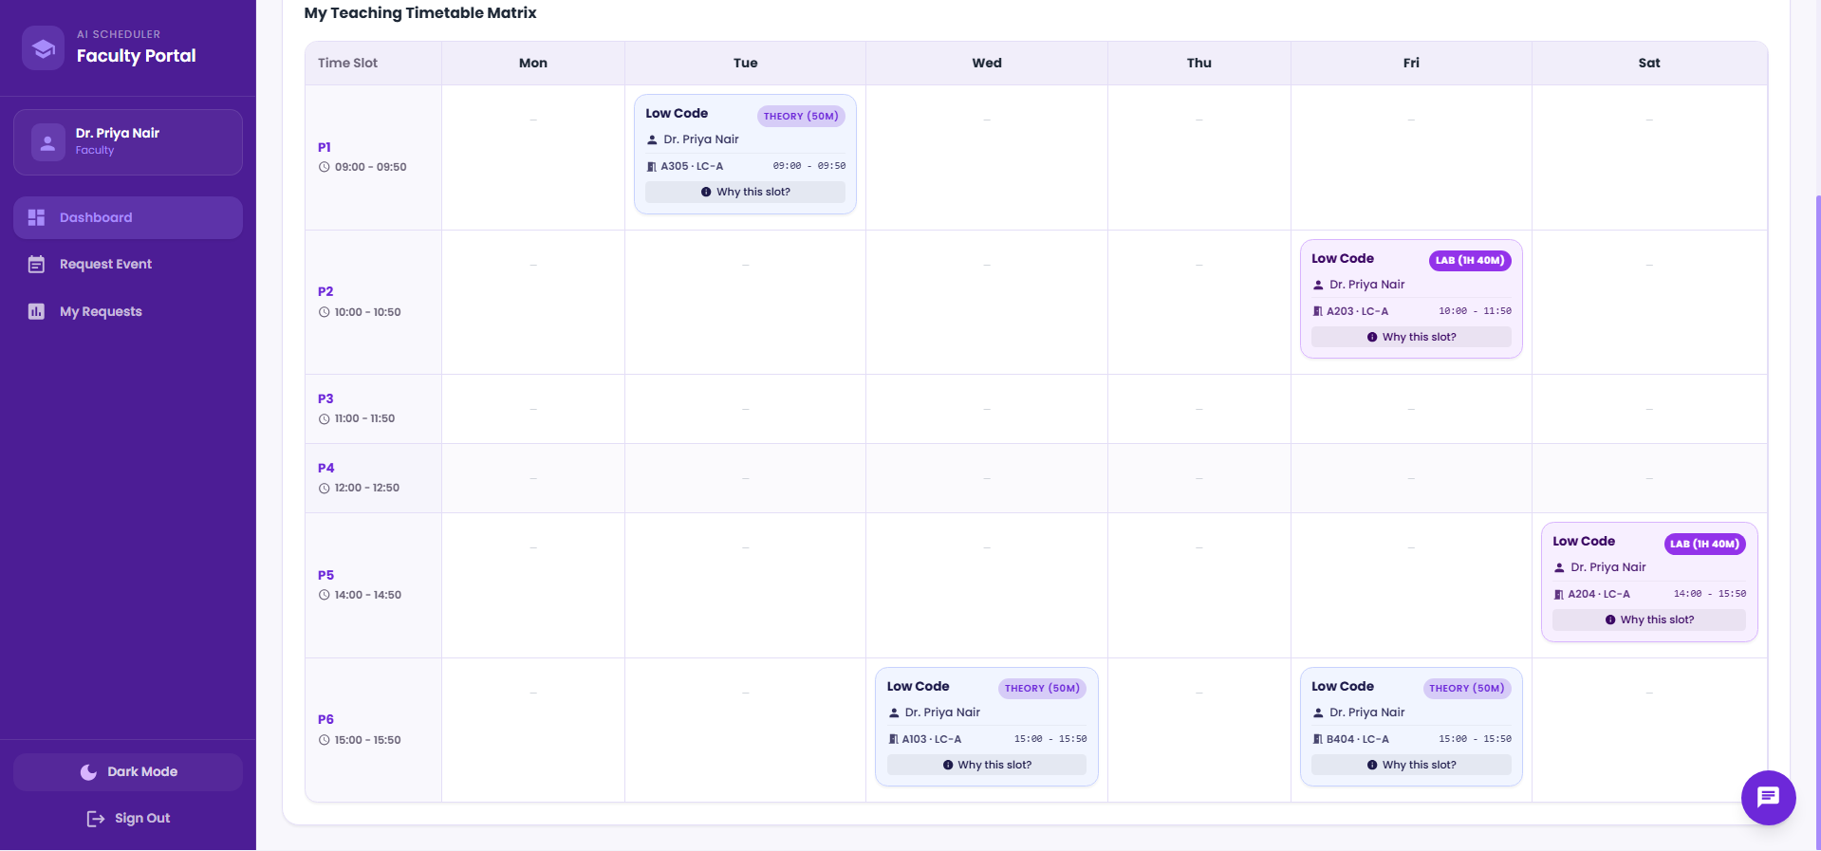
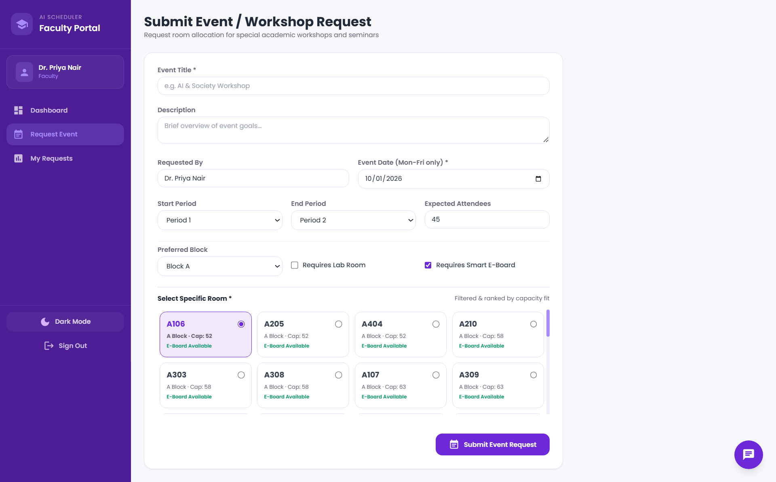
Output 2: Timetable and Event Request
Event / workshop request
Weekdays only; rooms filtered and ranked by capacity fit
Admin re-checks the room on approval
Weekly teaching timetable (Faculty)
Cards show subject, teacher, room and time; theory = 50 min, lab = 1h 40m
"Why this slot?" explains the constraints behind each placement

Slide 9
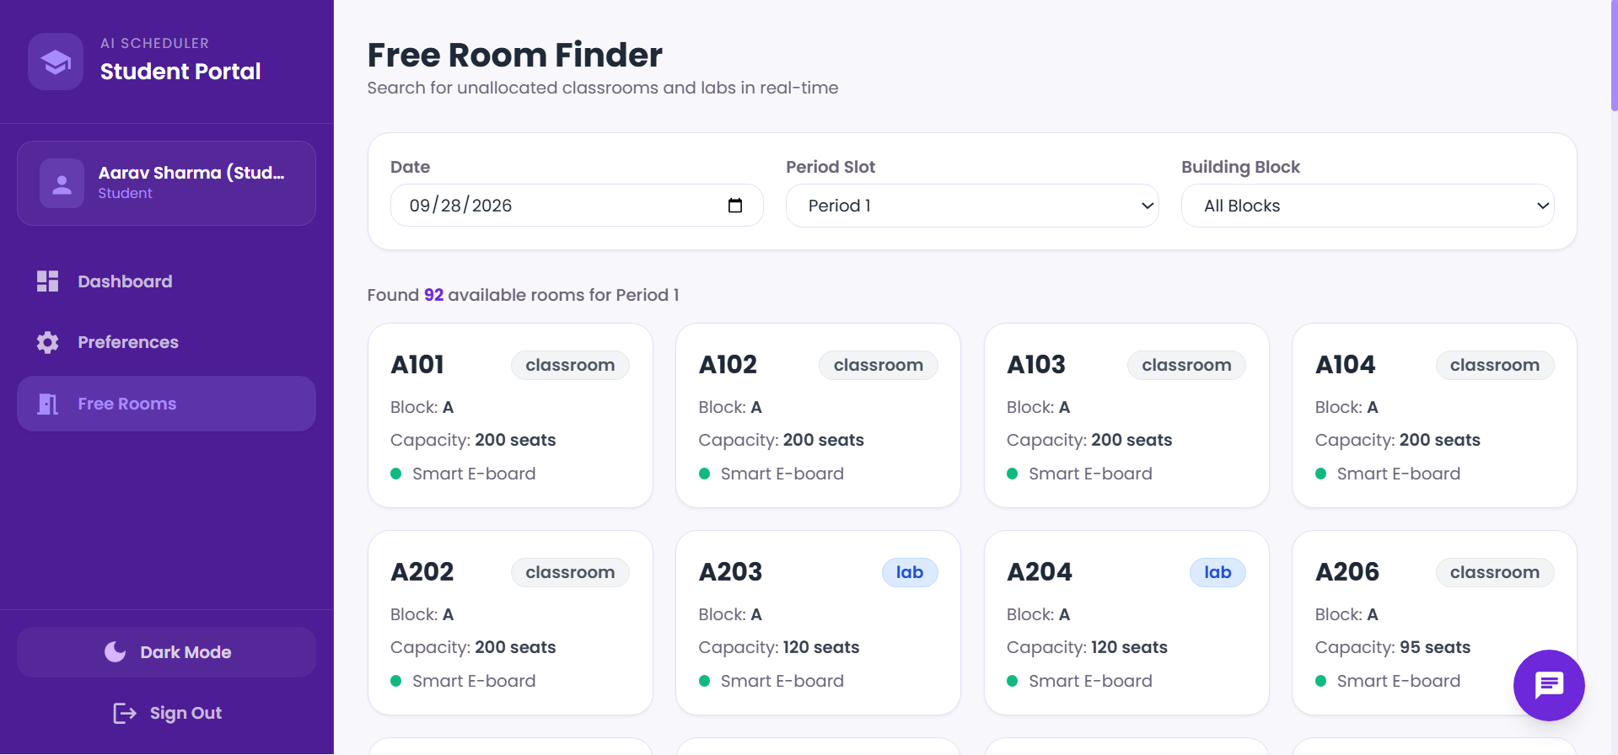
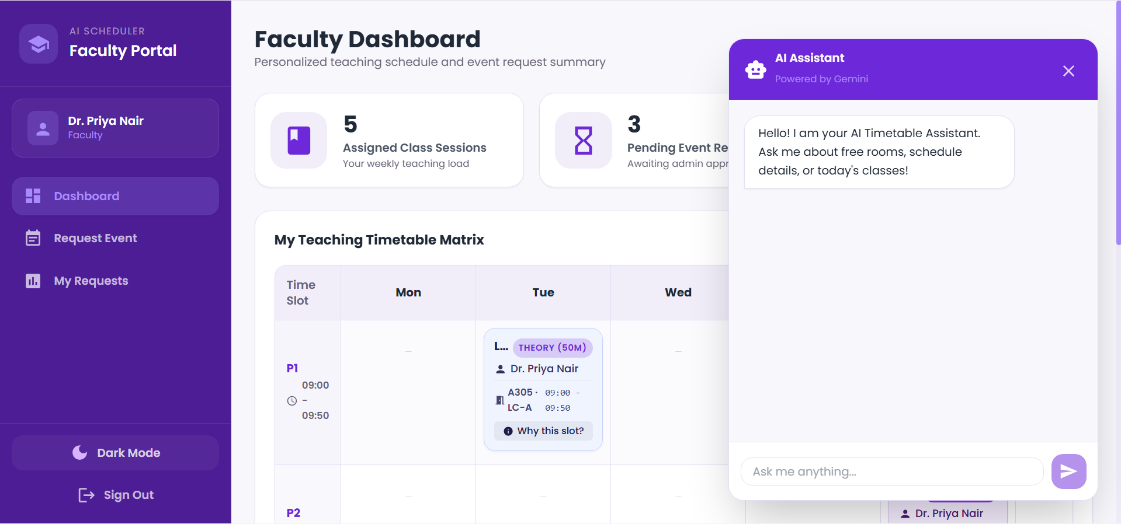
Output 3: Free Rooms and AI Chat
Free Room Finder
Pick date, period and block; 92 rooms free for Period 1 on 28 Sep 2026
Occupied rooms (classes + approved events) are removed, rest ranked by best fit
Gemini chat assistant
Call 1: Gemini extracts intent as JSON
Backend queries real MongoDB data
Call 2: Gemini phrases the answer using only that data

Slide 10
Conclusion & Future Scope
What we achieved
Automatic conflict-free timetable: 0 teacher, room and batch clashes
Labs and classrooms matched, capacity respected, daily break kept
Role-based portals with personalised views and preference locking
Best-fit room finder and event approval that re-checks availability
Grounded chat assistant: Gemini never invents schedule facts
Future scope
Weighted soft constraints with local-search repair
Incremental re-solve when a teacher or room changes
Multiple teachers per batch and elective groups
Email / push notifications for approvals
PDF and calendar (iCal) export
Solver benchmarks on larger datasets
Thank you

