Slide 1
Housing Market Analysis A data analytics journey leveraging python libraries
By: Divya Gunasekaran, Moira O'Reilly, Tanner Santos, Genti Dallvo

Slide 2
Exploring the U.S. Housing Market: Key Analytical Questions
Goal:
To evaluate trends, correlations, and investment performance within the U.S. housing market.
Key Questions:
Regional Home Value Trends
How have home values changed across different regions since 2000?
What are the forecasts through 2030?
Affordability vs. Home Size
Is there a correlation between housing affordability and home size?
Are homes becoming smaller yet more expensive?
Investment Comparison
How does the housing market compare to other investment options, such as the stock market?

Slide 3
Overview of the Python Libraries
For this project we used the following libraries:
Pandas:
a Python library that provides data structures and functions for efficiently working with structured data. It offers tools for data manipulation, analysis, and cleaning
MatPlotLib:
a Python library for creating static, animated, and interactive visualizations. Leveraged the pyplot API a collection of command style functions that make matplotlib work like MATLAB. Each pyplot function makes some change to a figure
StreamLit:
an open-source Python framework for data scientists and AI/ML engineers to deliver interactive data apps – in only a few lines of code.
Seaborn:
a library for creating statistical graphics in Python. It is based on Matplotlib and integrates with Pandas data structures
Statsmodels.tsa.seasonal - seasonal_decompose
The library provides an implementation of the naive, or classical, seasonal decomposition method in a function called seasonal_decompose().

Slide 4
Data – Key Challenges
Datasets Used:
Zillow Home Value Index (ZHVI)
Time span: 2000–2025
Granularity: Metro-level monthly price index for single-family homes and condos
Source: Zillow Research
Zillow Observed Rent Index (ZORI)
Time span: 2015–2025
Metro-level rental cost index trends similar to Zillow Home Value Index dataset
S&P 500 Index from FRED (Federal Reserve Economic Data)
Time span: 2020–2025
Used for comparison with property investment performance
Data Exploration & Processing:
Time normalization was performed across datasets to ensure alignment (especially important when comparing property and stock returns).
Monthly average prices were reshaped to long format (RegionName, Date, HVI)
Derived variables included:
Income needed to afford a home (based on mortgage, taxes, and insurance)
Income needed to afford rent (based on 30% of gross income rule)

Slide 5
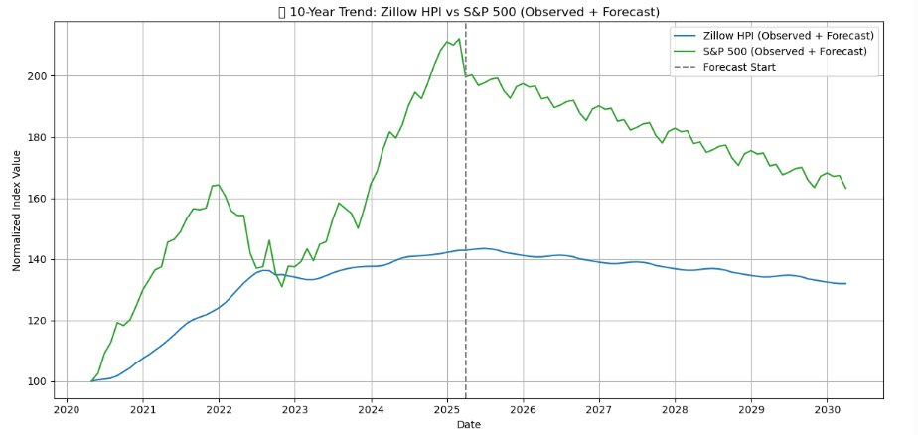
10-year trend of Home Value Index vs S&P 500
Notes:
Y-axis isnt dollars, it's Normalized Index Value, shows that putting money in real estate is much more stable than SP500
Time Series Forecasting (Holt-Winters):
Applied on normalized Zillow HVI and S&P 500 data.
Model components: Level, Trend, Seasonality
Forecast horizon: 60 months (next 5 years)
Insight: Property prices show smoother, long-term appreciation; stocks show greater volatility but higher returns in some periods.

Slide 6
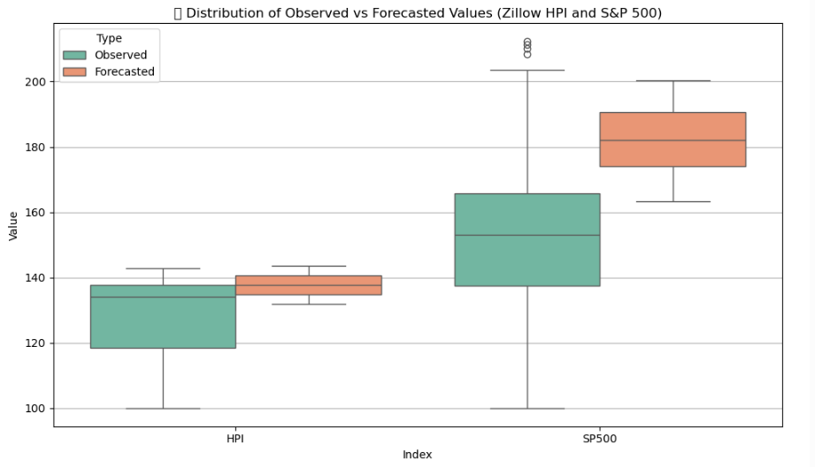
5 - Year Home Value Index vs S&P 500 Comprison
Notes:
Forecasted values have much more narrow range, homes are forecasted to increase a slight amount but SP500 is forecasted to increase much more in the next 5 years

Slide 7
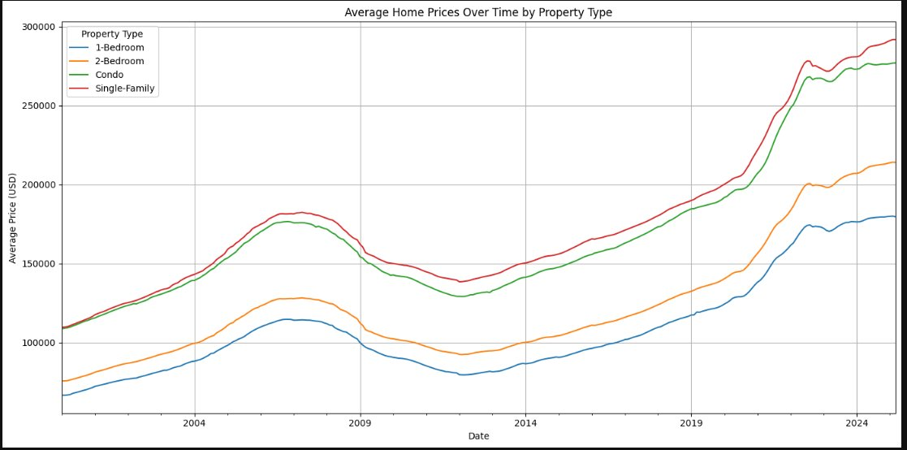
Prices over Time
Shows the overall increase in home prices over time
All home types are increasing in price at about the same rate
Single family homes are the most expensive while 1-bedroom apartments are the least expensive

Slide 8
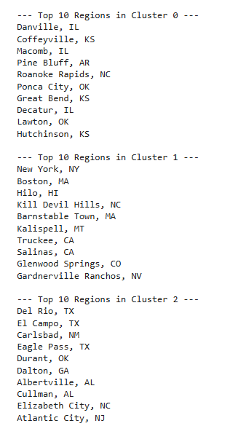
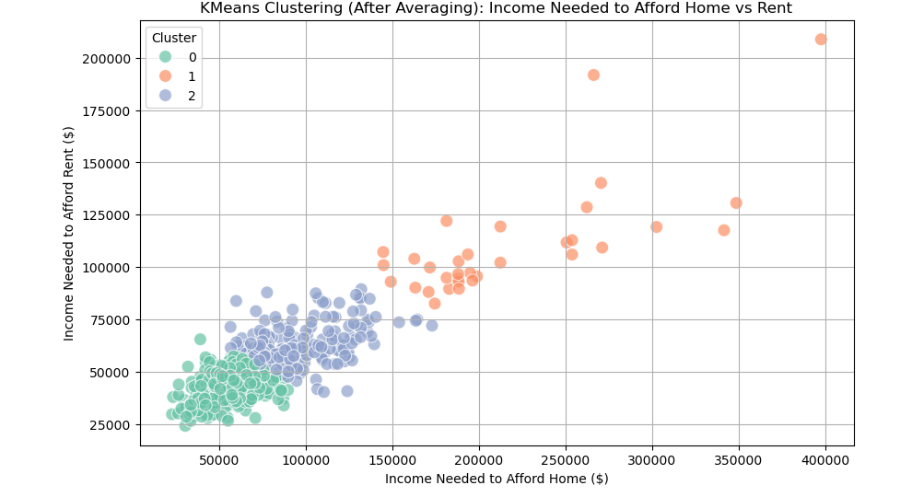
Affordability vs. Income
Notes:
How to Interpret the Scatter Plot:
Each point represents a region (city, metro area).
The X-axis shows the income needed to afford buying a home.
The Y-axis shows the income needed to afford renting.
Clustering (K-Means):
Features: Average income needed to afford rent and buy
Clusters: 3 affordability bands across U.S. metros
Interpretation: Identified tiers of markets, such as low-cost (e.g., Danville, IL), high-cost (e.g., San Jose, CA), and transitional markets
Urban and coastal areas generally form high-income clusters; interior metros offer more affordability.

Slide 9
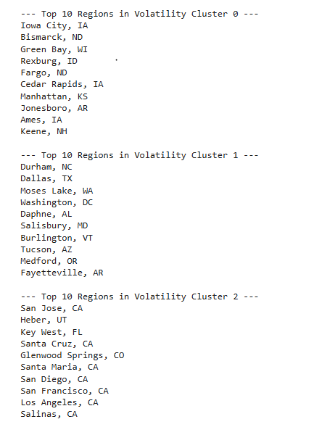
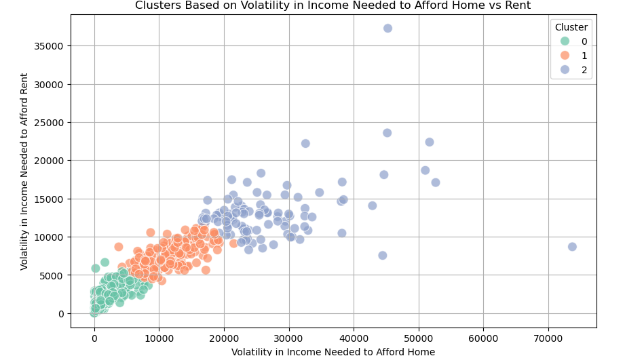
Volatility in Income
Notes:
In this analysis, we clustered regions based on the volatility (time-based fluctuations) of the income needed to afford buying a home and renting a home.
Instead of looking at static affordability values, we calculated the standard deviation over time for each region:
Volatility_Home: How much the income needed to afford a home fluctuated across months.
Volatility_Rent: How much the income needed to afford rent fluctuated across months.
🎯 What the Scatter Plot Means
Each point represents a region (metro or city).
The X-axis shows volatility in income needed to afford buying a home.
The Y-axis shows volatility in income needed to afford renting a home.
Color indicates which cluster a region belongs to based on its volatility pattern.
📋 How to Interpret Clusters
Low Volatility Cluster:
Regions where both buying and renting costs are stable over time.
Typically mature, stable housing markets.
Moderate Volatility Cluster:
Regions where either buying or renting shows moderate fluctuations.
These may be growing or transitioning markets.
High Volatility Cluster:
Regions where both buying and/or renting costs show large swings month-to-month.
Indicates risky or overheated markets, or markets undergoing rapid economic changes.
Key Takeaway
Volatility clustering reveals the hidden stability or instability of regional housing markets, helping us move beyond just current affordability levels and understand risk patterns over time.

Slide 10
Key Insights and Conclusion
Investment Performance:
Both housing and S&P 500 have grown since 2020, but stocks show more volatility.
Housing, though slower, offers stability and long-term wealth building, especially in metro areas
with strong appreciation.
Affordability Trends:
In many U.S. metros, income needed to rent is rising faster than
income needed to buy, indicating shrinking affordability.
Market Clusters:
Urban and coastal areas generally form high-income clusters; interior metros offer more affordability.
Anomalies Reveal Pain Points:
High income gaps between renting and owning signal markets ripe for policy intervention or
investor caution.

Slide 11
Demo

