Slide 1

Seasonal Agriculture Performance Analysis
Divya
Keshav Mahavidyalaya (University of Delhi)
AICTE STU ID : STU688d008a2b2b71754071178

Slide 2

PROBLEM STATEMENT
(Agricultural activities are influenced by seasonal variations in environmental conditions, farming practices, resource availability and market conditions. As a result, agricultural performance may differ from one season to another. However, raw agricultural data does not clearly explain how agricultural performance changes across seasons or what patterns can be observed in different seasonal conditions. The problem is to analyze the given agricultural dataset and investigate seasonal differences in agricultural performance by identifying meaningful patterns, trends, relationships and variations within the available data.

Slide 3
Project Description
This project analyzes agricultural performance data across three Indian cropping seasons – Kharif, Rabi and Zaid – covering 4,000 farm records across 8 states. The dataset spans environmental conditions, resource usage (water, fertilizer, irrigation) and economic outcomes (cost, revenue, profit). After cleaning the data, seasonal patterns in yield, resource efficiency, disease/pest risk and profitability were explored using Python (Pandas, Matplotlib, Seaborn) in a Jupyter Notebook, to derive evidence-based insights and recommendations for seasonal agricultural planning.

Slide 4

WHO ARE THE END USERS?
Farmers and agricultural planners deciding what and when to sow
Agricultural policy makers and government departments
Agri-business and supply chain stakeholders
Researchers and data analysts studying seasonal trends

Slide 5

Technology Used
Python – core programming language for analysis
Pandas & NumPy – data cleaning and manipulation
Matplotlib & Seaborn – data visualization
Jupyter Notebook – documentation and code execution

Slide 6
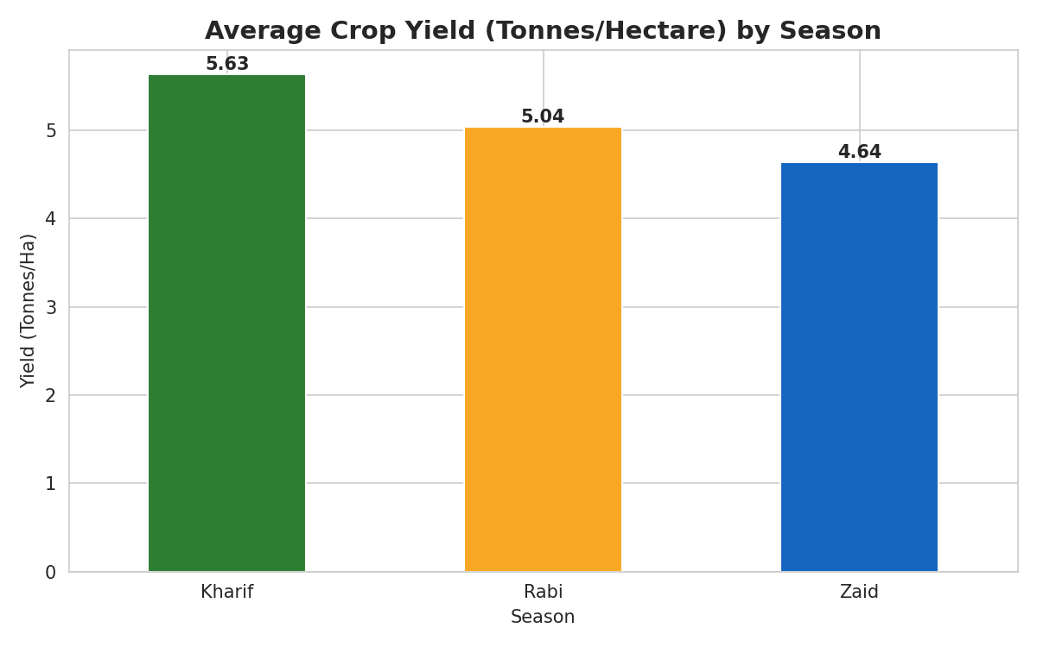
RESULTS – Crop Yield by Season
Kharif yields 5.63 t/ha on average, the highest of the three seasons.

Slide 7
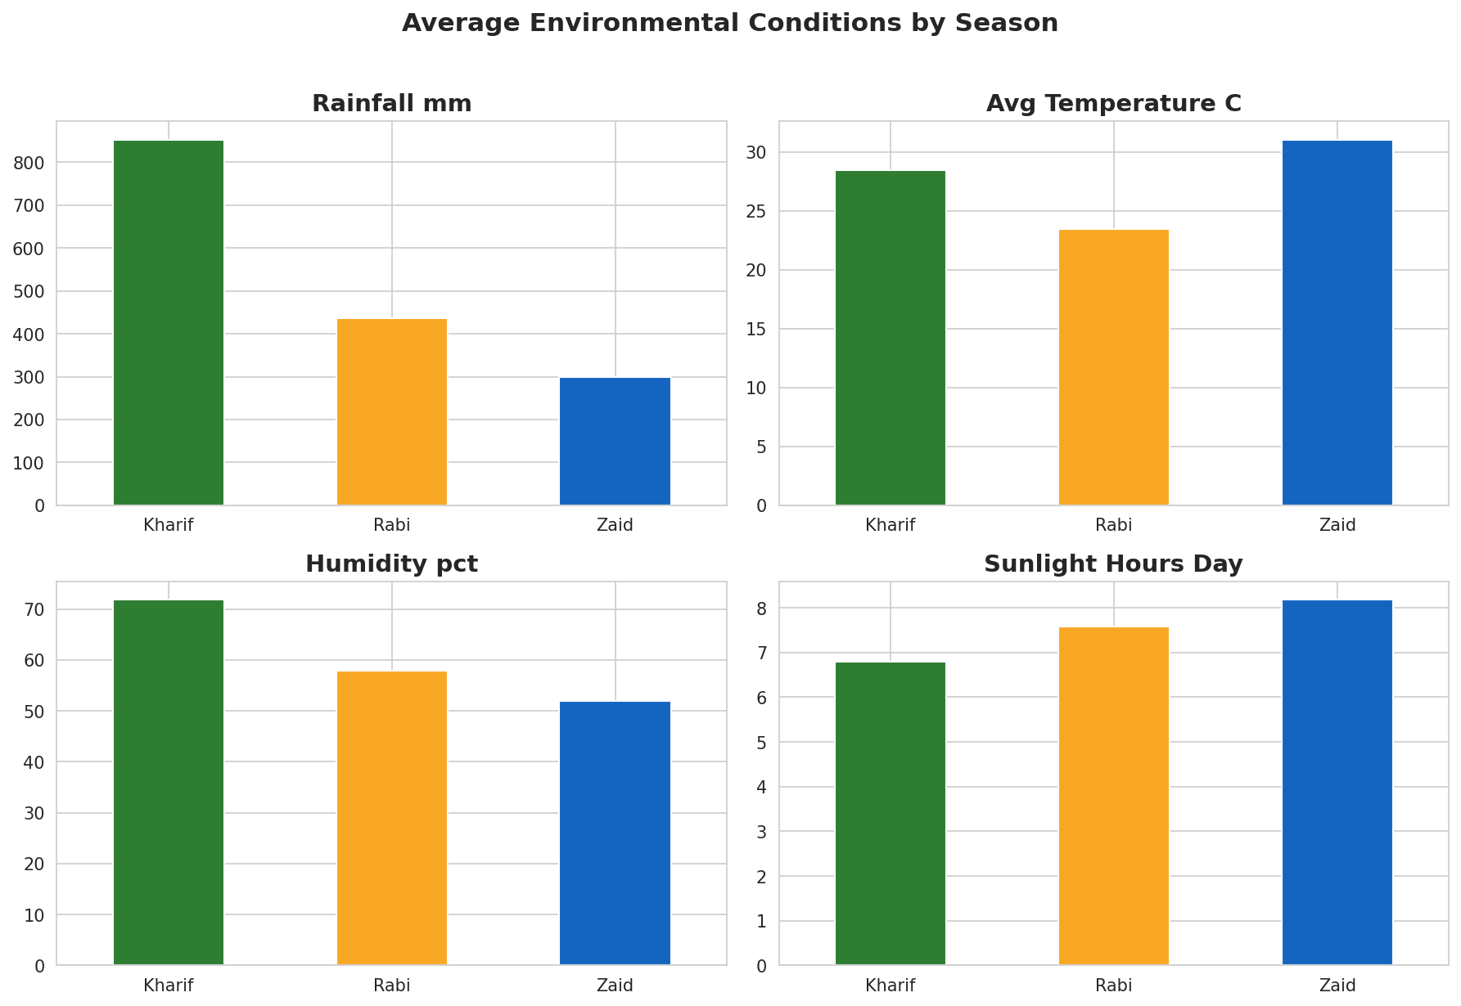
RESULTS – Environmental Conditions
Kharif is the wettest and most humid season
Zaid is the hottest and sunniest.

Slide 8
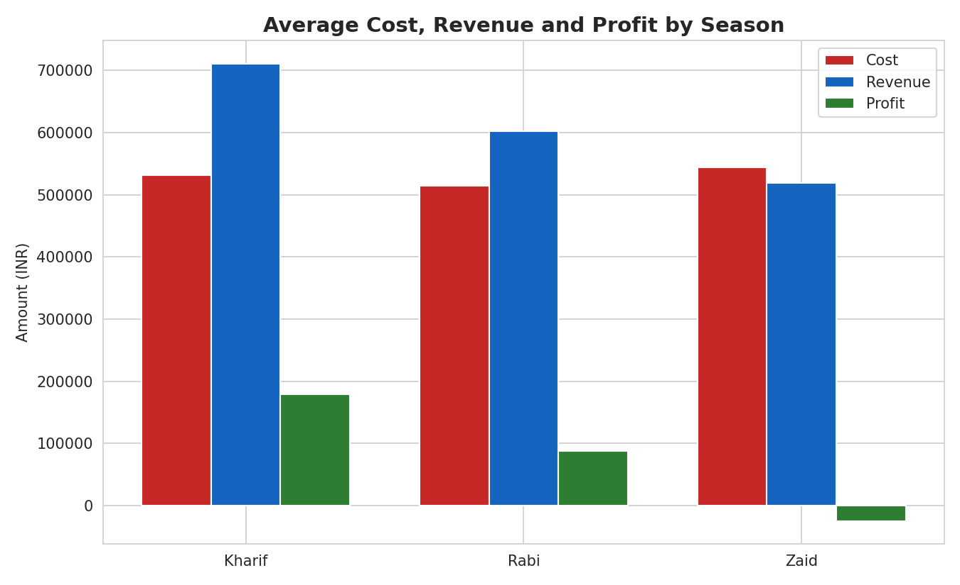
RESULTS – Economic Performance
Kharif delivers the highest revenue and profit; Zaid runs an average loss.

Slide 9
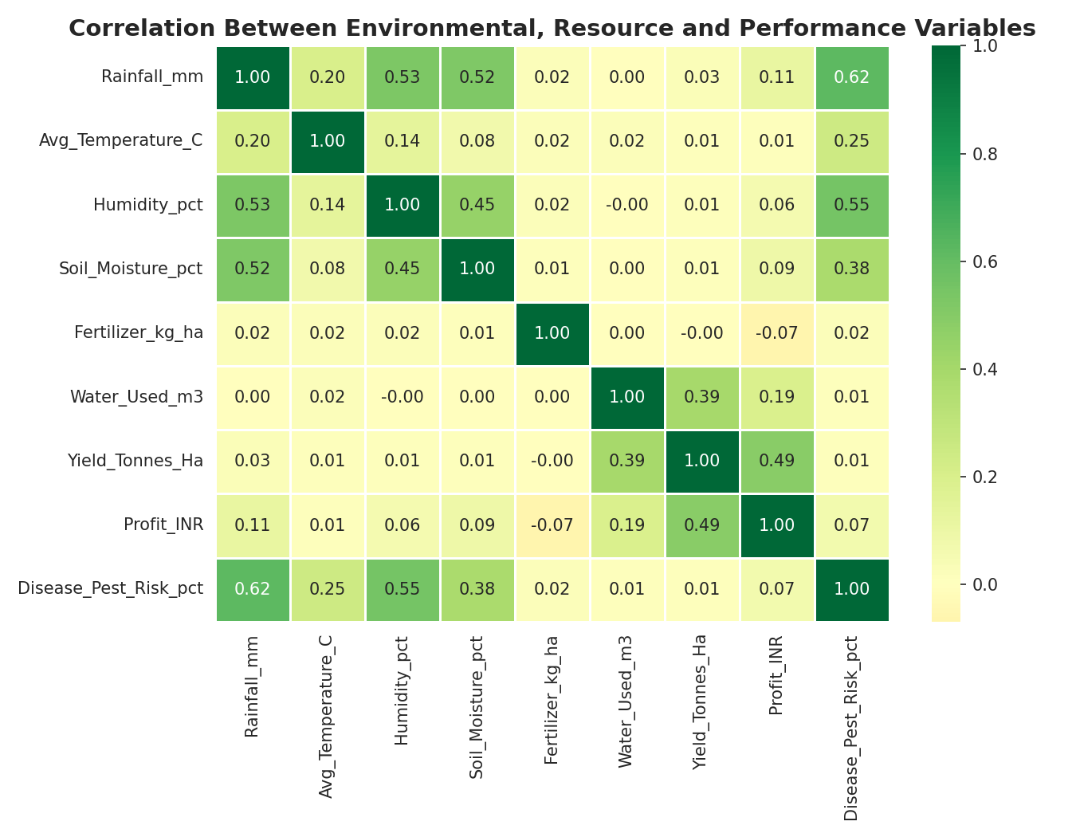
RESULTS – Correlation Analysis
Yield tracks water use (0.39) and drives profit (0.49); rainfall's strongest link is disease/pest risk (0.63).

Slide 10
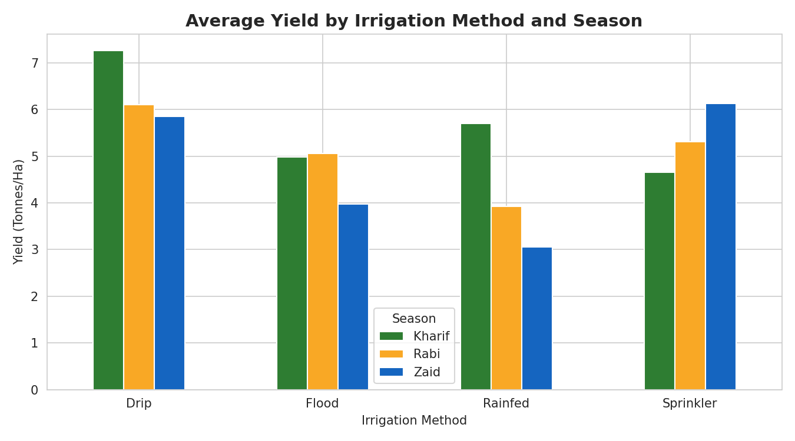
RESULTS – Irrigation Effectiveness
Drip leads in Kharif and Rabi, but Sprinkler edges it out in Zaid (6.17 vs 5.85 t/ha).

Slide 11
Future scope
Incorporate real-time weather and market-price data for live analysis
Apply predictive modeling to forecast yield for upcoming seasons
Build an interactive dashboard for farmers and policy makers
Extend the study to more states and crops for broader generalization

Slide 12
GitHub Link
https://github.com/divyaa2025/VOIS-AICTE-Seasonal-Agriculture-Analysis

Slide 13

VOIS Course completion certificate - Course name- Data Visualization

Slide 14
Thank you
.

