Slide 1
Support Vector Machine [SVM]
Support Vector Machines - Review of finite dimensional vector spaces - Hyper planes - Support Vector Classifier. Kernel methods - Gaussian kernel, Multi class SVM.

Slide 2
Support Vector Machine [SVM]
Support Vector Machine is a Supervised Machine Learning Algorithm which can be used for both classification and regression challenges.
However, it is mostly used in classification problem.
In this algorithm, we plot each data item as a point in n dimensional space( where n is the number of features you have) with the value of each feature being the value of a particular coordinate.
Then we perform classification by finding the hyper-plane that differentiate the two classes very well.

Slide 3
Support Vector Machine [SVM]
How does it work?
Rule of thumb to identify correct hyperplane
Select the hyperplane which segregates the two classes better.
Maximizing the distance between the nearest data point (either class) and hyperplane. This distance is called as Margin.

Slide 4
Support Vector Machine [SVM]
A Support Vector Machine (SVM) can be imagined as a surface that creates a boundary between points of data plotted in multidimensional that represent examples and their feature values.
The goal of a SVM is to create a flat boundary called a hyperplane, which divides the space to create fairly homogeneous partitions on either side.
SVM learning combines aspects of both
instance-based nearest neighbor learning
linear regression modeling described
The combination is extremely powerful, allowing SVMs to model highly complex relationships.

Slide 5
Support Vector Machine [SVM]
SVM can be used for
Classification
Numeric Prediction
Pattern Recognition

Slide 6
Support Vector Machine [SVM]- Application
Classification of microarray gene expression data in the field of bioinformatics to identify cancer or other genetic diseases
Text categorization such as identification of the language used in a document or the classification of documents by subject matter
The detection of rare yet important events like combustion engine failure, security breaches, or earthquakes

Slide 7
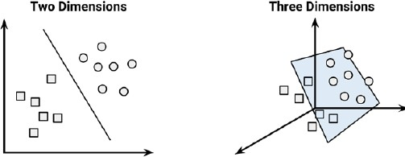
Classification with hyperplanes
Hyper plane- A boundary which partitions the data into groups of similar class values.
SVMs use a boundary called a hyperplane to partition data into groups of similar class values.
For example, the following figure depicts hyperplanes that separate groups of circles and squares in two and three dimensions.
circles and squares can be separated perfectly by the straight line or flat surface, they are said to be linearly separable.

Slide 8
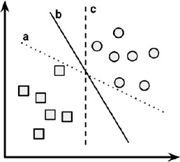
Classification with hyperplanes
In two dimensions, the task of the SVM algorithm is to identify a line that separates the two classes.
In the following figure, there is more than one choice of dividing line between the groups of circles and squares.
Three such possibilities are labeled a, b, and c.
How does the algorithm choose?-It choose Maximum Margin Hyperplane (MMH) that creates the greatest separation between the two classes. Ie, b.

Slide 9
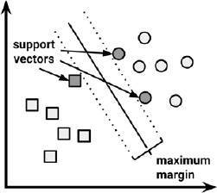
Classification with hyperplanes
Support Vectors
Examples closest to the hyperplane are support vectors.
The support vectors (indicated by arrows in the figure that follows) are the point from each class that are the closest to the MMH;
Each class must have at least one support vector, but it is possible to have more than one.
Using the support vectors alone, it is possible to define the MMH -> This is a key feature of SVMs

Slide 10
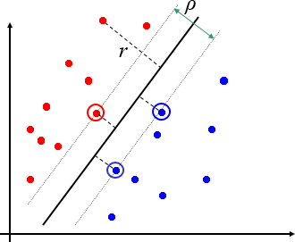
Classification with hyperplanes
Margin ρ of the separator is the distance between support vectors.

Slide 11
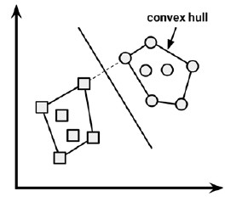
How to find the maximum margin for linearly separable data
Method1
Outer boundaries of the two groups of data points are known as the convex hull.
The MMH is then the perpendicular bisector of the shortest line between the two convex hulls.
Sophisticated computer algorithms that use a technique known as quadratic optimization are capable of finding the maximum margin in this way.

Slide 12
How to find the maximum margin for linearly separable data
Method2
An alternative (but equivalent) approach involves a search through the space of every possible hyperplane in order to find a set of two parallel planes that divide the points into homogeneous groups yet themselves are as far apart as possible.

Slide 13
How to find the maximum margin for linearly separable data
In n-dimensional space, the equation of hyper plane is
Arrows above the letters indicate that they are vectors rather than single numbers.
Eg:- w is a vector of n weights, that is, {w₁, w₂, ..., w_{n}},
b is a single number known as bias.
Bias is conceptually equivalent to the intercept term in the slope- intercept form.

Slide 14

How to find the maximum margin for linearly separable data
Using this formula, the goal of the process is to find a set of weights that specify two hyperplanes, as follows:
these hyperplanes are specified such that all the points of one class fall above the first hyperplane and
all the points of the other class fall beneath the second hyperplane.
This is possible so long as the data are linearly separable.

Slide 15

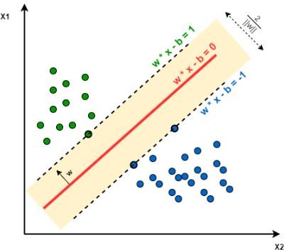
How to find the maximum margin for linearly separable data
Vector geometry defines the distance between these two planes as:
Here, ||w|| indicates the Euclidean norm
(the distance from the origin to vector w).
Because ||w|| is in the denominator, to
maximize distance, we need to minimize
||w||.

Slide 16

How to find the maximum margin for linearly separable data
The task is typically re expressed as a set of constraints, as follows:
first line implies that we need to minimize the Euclidean norm (squared and divided by two to make the calculation easier).
The second line notes that this is subject to (s.t.), the condition that each of the yi data points is correctly classified.
Note that y indicates the class value (transformed to either +1 or -1) and the upside down "A" is shorthand for "for all."

Slide 17
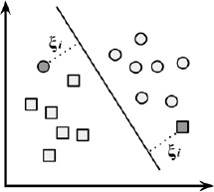
How to find the maximum margin for non- linearly separable data
Method 1: Use a slack variable
The solution to this problem is the use of a slack variable, which creates a soft margin that allows some points to fall on the incorrect side of the margin.
Slack variables ξi can be added to allow misclassification of difficult or noisy examples, resulting margin called soft.
The figure that follows illustrates two points falling on the wrong side of the line with the corresponding slack terms (denoted with the Greek letter Xi):

Slide 18
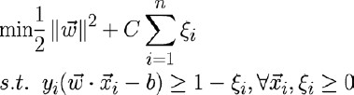
How to find the maximum margin for non- linearly separable data
Method 1: Use a slack variable
A cost value (denoted as C) is applied to all points that violate the constraints, and rather than finding the maximum margin, the algorithm attempts to minimize the total cost.
We can therefore revise the optimization problem to:

Slide 19
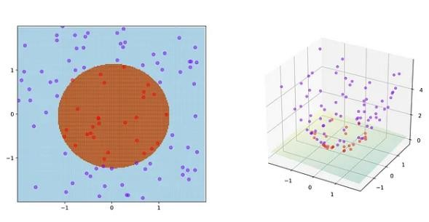
How to find the maximum margin for non- linearly separable data
Method 2: Kernal Trick
In many real-world applications, the relationships between variables are nonlinear.
A key feature of SVMs is their ability to map the problem into a higher dimension space using a process known as the kernel trick.
In doing so, a nonlinear relationship may suddenly appear to be quite linear.

Slide 20
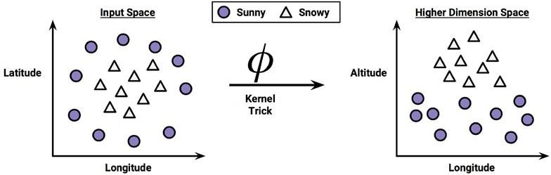
Method 2: Kernal Trick [example]
Scatterplot depicts a nonlinear relationship between a weather class or snowy) and two features: latitude and longitude.
(sunny
The points at the center of the plot are members of the snowy class, while the points at the margins are all sunny.
Such data could have been generated from a set of weather reports, some of which were obtained from stations near the top of a mountain, while others were obtained from stations around the base of the mountain.

Slide 21
Method 2: Kernal Trick [example]
The altitude feature can be expressed mathematically as an interaction between latitude
and longitude:
The closer the point is to the center of Each of these scales, the greater the altitude.
With the addition of this feature, the classes are now perfectly linearly separable.
This is possible because we have obtained a new perspective on the data.
This allows SVM to learn concepts that were not explicitly measured in the original
data.
SVMs with nonlinear kernels, add additional dimensions to the data in order to create
separation.

Slide 22
Method 2: Kernal Trick [example]
The kernel trick involves a process of constructing new features that express mathematical relationships between measured characteristics.
For instance, the altitude feature can be expressed mathematically as an interaction between latitude and longitude—the closer the point is to the center of each of these scales, the greater the altitude.
This allows SVM to learn concepts that were not explicitly measured in the original data.

Slide 23
Method 2: Kernal Trick [example]
In machine learning, a “kernel” is usually used to refer to the kernel trick, a method of using a linear classifier to solve a non-linear problem.
It entails transforming linearly inseparable data like to linearly separable ones.
The kernel function is applied on each data instance to map the original non- linear observations into a higher-dimensional space in which they become separable.

Slide 24
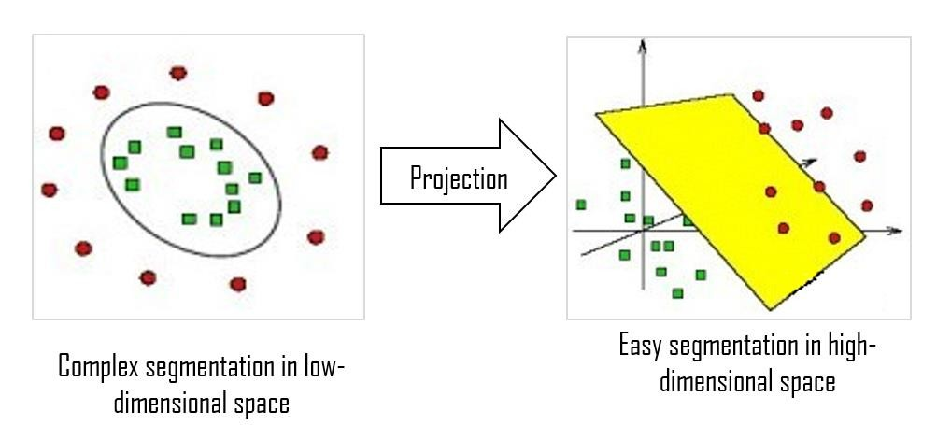
How to find the maximum margin for non- linearly separable data
Kernal functions- General form
Mathematical definition: K(x, y) = <f(x), f(y)>. Here K is the kernel function, x, y are n dimensional inputs. f is a map from n-dimension to m-dimension space.
< x,y> denotes the dot product. usually m is much larger than n.

Slide 25

How to find the maximum margin for non- linearly separable data
Kernal functions- General form
The function denoted by the Greek letter phi, that is, ϕ(x), is a mapping of the data into another space.
Therefore, the general kernel function applies some transformation to the feature vectors xi and xj and combines them using the dot product, which takes two vectors and returns a single number.

Slide 26
How to find the maximum margin for non- linearly separable data
Most Commonly Used Kernel Functions
Linear kernel
Polynomial kernel
Sigmoid kernel
Gaussian RBF kernel
Almost all SVM software packages will include these kernels.

Slide 27
Kernel Functions
1. Linear kernel
The linear kernel does not transform the data at all.
Therefore, it can be expressed simply as the dot product of the features:

Slide 28

Kernel Functions
2. Polynomial kernel
The polynomial kernel of degree d adds a simple nonlinear transformation of the data:
d → degree of polynomial

Slide 29
Kernel Functions
3. Sigmoid kernel
The sigmoid kernel results in a SVM model somewhat analogous to a neural network using a sigmoid activation function.
The Greek letters kappa and delta are used as kernel parameters:
"tanh” → hyperbolic tangent function

Slide 30

Kernel Functions
4. Gaussian RBF kernel
The Gaussian RBF kernel is similar to a RBF neural network.
It is used to perform transformation when there is no prior knowledge about data.
The RBF kernel performs well on many types of data and is thought to be a reasonable starting poi
nt for many learning tasks:
Sigma →adjustable parameter (plays a major role in the performance of the kernel)
30

Slide 31
Kernel Functions- How to choose kernel?
No reliable rule to match a kernel to a particular learning task.
The fit depends on:
The concept to be learned
The amount of training data and
The relationships among the features.
trial and error is required by training and evaluating several SVMs on a validation dataset.
Choice of kernel is arbitrary
Performance may vary slightly.
31

Slide 32
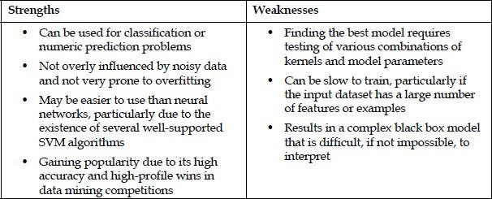
SVM- Non linear Kernal
32

Slide 33
Multi Class SVM
Multiclass Classification
In this type, the machine should classify an instance as only one of three classes or more.
The following are examples of multiclass classification:
Classifying a text as positive, negative, or neutral
Determining the dog breed in an image
Categorizing a news article to sports, politics, economics, or social
33

Slide 34
Multi Class SVM
In its most simple type SVM are applied on binary classification, dividing data points either in 1 or 0.
For multiclass classification, the same principle is utilized.
The multiclass problem is broken down to multiple binary classification 2 Approaches:
One-to-One approach
One-to-Rest
34

Slide 35
Multi Class SVM
This is called a One-to-One approach, which breaks down the multiclass problem into multiple binary classification problems.
A binary classifier per each pair of classes.
Another approach one can use is One-to-Rest.
In that approach, the breakdown is set to a binary classifier per each class.
In the One-to-Rest approach, the classifier can use {m} SVMs. Each SVM would predict membership in one of the {m} classes.
In the One-to-One approach, the classifier can use m (m-1)/ 2 SVMs.
35

Slide 36
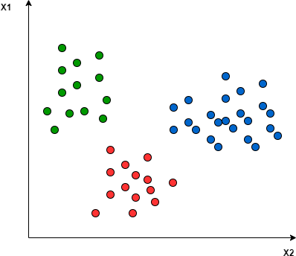
Multi Class SVM
36

Slide 37
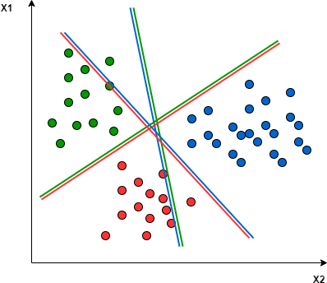
Multi Class SVM
In the One-to-One approach, we need a hyperplane to separate between every two classes, neglecting the points of the third class.
This means the separation takes into account only the
points of the two classes in the current split.
For example, the red-blue line tries to maximize the
separation only between blue and red points.
It has nothing to do with green points:
37

Slide 38
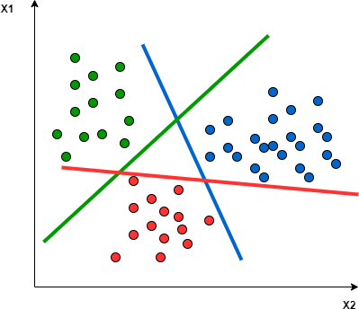
Multi Class SVM
In the One-to-Rest approach, we need a hyperplane to separate between a class and all others at once.
This means the separation takes all points into account, dividing them into two groups;
a group for the class points and a group for all other points.
For example, the green line tries to maximize the separation between green points and all other points at once:
One of the most common real-world problems for multiclass classification using SVM is text classification. For example, classifying news articles, tweets, or scientific papers.
38

Slide 39


What is meant by a Support Vector?
How machine learning using Support Vector Machines possible. ?
What are the applications of SVM.
How Classification using hyperplanes is possible?
What is meant by Maximum Margin Hyperplane?
What do you meant by a kernel function? Explain the strengths and weaknesses of classification using kernel.
What are the different types of kernel functions.
Explain in detail about Multiclass SVM.
39

Slide 40
https://www.baeldung.com/cs/svm-multiclass-classification
40

Slide 41
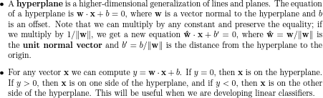
Support Vector Machine [SVM]
41

