Slide 1

MSNAKE
Presented By:
Praneeth Paruchuri
Divya Battu
Mounika karampudi
Giresh Babu.
Instructor: Dr.Yugyung Lee
TA: Feichen Shen

Slide 2
INTRODUCTION
The existing Game is Touch Based and there is no user activity monitoring.
We have implemented Gesture Recognition into the Age Old Touch Based Snake Game.

Slide 3
Existing Game
Aim
Touch Based

Slide 4
Proposed Game!
Motivation
Enhancements

Slide 5
Sensor Tag
Inbuilt Sensors
Accelerometer Sensor

Slide 6
Activity Recognition
HMM
K-means

Slide 7
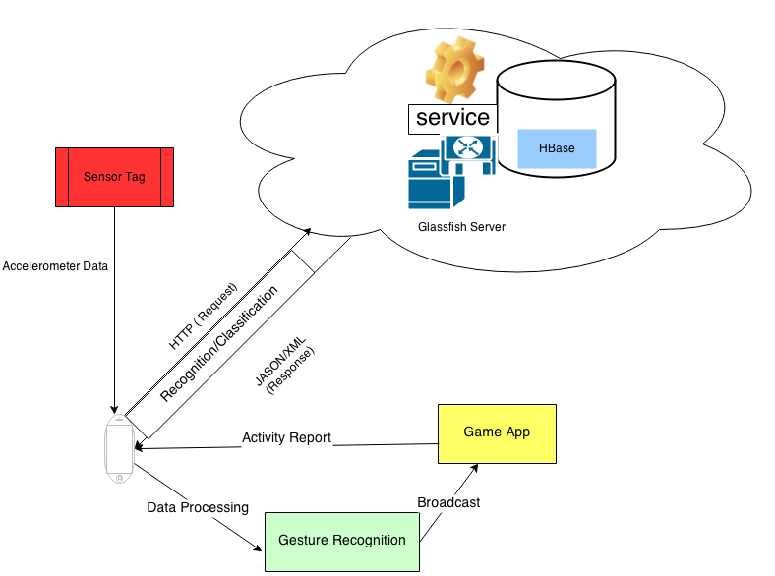
Architecture Diagram

Slide 8
HOW TO PLAY?
Gestures Used
Right
Downward direction
Left
Upward Direction
Pause

Slide 9
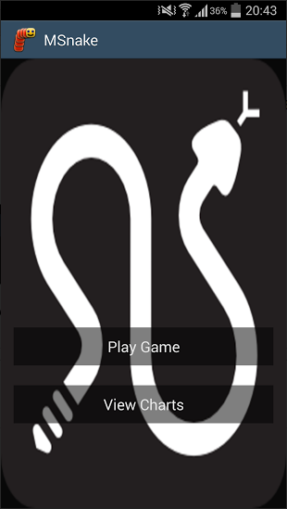
HOME SCREEN

Slide 10
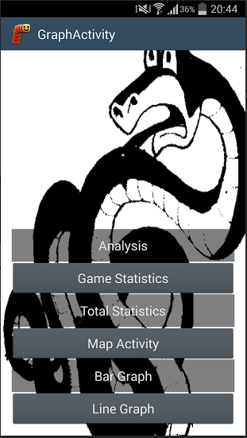
ACTIVITY

Slide 11
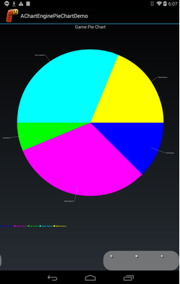
Pie chart- Most recent game

Slide 12
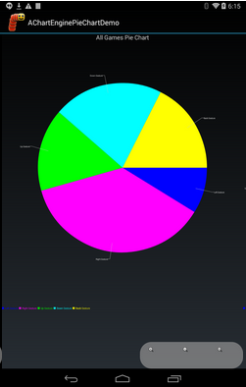
Pie chart – Total games

Slide 13
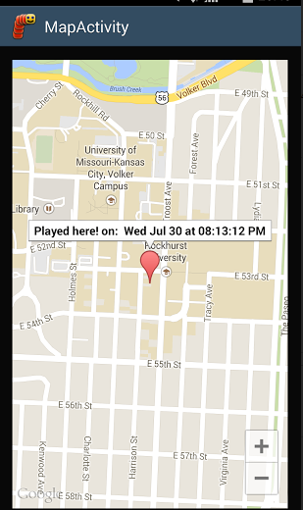
MAP ACTIVITY

Slide 14
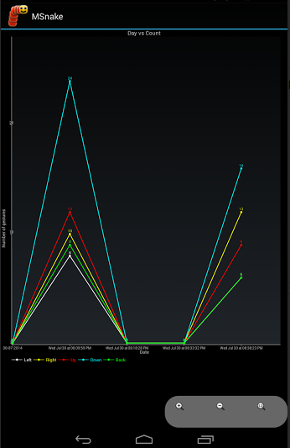
LINE CHART

Slide 15
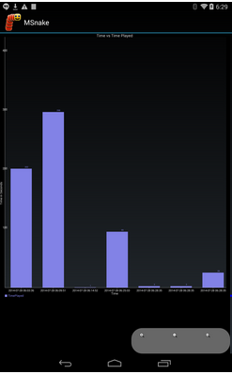
Bar graph

Slide 16
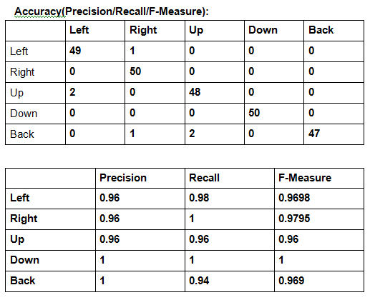
CONFUSION MATRIX

Slide 17
QUESTIONS?
Thank You!!!

