Slide 1

ITC 6000 Database Management Systems Final Project Presentation 2024 Winter 03 Music Recommendation App
Divya Bomaraboina
bomaraboina.d@northeastern.edu

Slide 2
Overview
Project Overview
User Persona’s
Business Rules
ER Diagram
Solution Architecture and HA
Major SQL examples
Metrics
Security & Privacy Concerns
Next steps / Lessons learned

Slide 3


Project Overview
This app will use algorithms to recommend personalized music playlists to users according to their preferences.
It is a freemium model and has offline availability , Platform Independent.
Location , Language preference.
Collabs with other apps.

Slide 4
Personas
This business model has three user personas.
Listener
Collector
Admin

Slide 5

Persona
Listener:
Potentially millions of Listeners
As a User, I want to:
Listen and enjoy music without any limitations.
Discover songs ,playlists that align with my preferences.

Slide 6
Persona
.
Collectors:
Potentially thousands of collectors.
As a User on Music Recommendation App, I want to:
Create and collect playlist and share with others
Playlists are created based on Activity and genres

Slide 7

Persona
Administrators:
-Perhaps few Admins(1,2)
-As an Admin I want to manage the platform
-Maintain data Accuracy, data consistency
-Handle user Feedback
-Store user activity for generating preferences

Slide 8
Business Rules
A USER can have multiple PLAYLISTS.
A PLAYLIST can contain multiple SONGS.
Each SONG has an ARTIST associated with it.
A USER can FOLLOW other USERS.
A USER can LIKE or DISLIKE a SONG.
A SONG can belong to multiple GENRES.
A USER can RATE a SONG.
An ARTIST can release multiple ALBUMS.
A SONG can belong to only one ALBUM.
A USER can CREATE custom PLAYLISTS.

Slide 9
Business Rules
A USER can SHARE their PLAYLISTS with other USERS.
A USER can Download SONGS if they are PREMIUM USERS
USER belongs to COUNTRY, COUNTRY has Regional SONGS and PLAYLISTS
A USER can like one or more GENRES.
A USER can receive recommendations based on their listening history.
An ALBUM can contain multiple SONGS.
A SONG can belong to multiple PLAYLISTS.
ADMIN can manage ARTISTS, SONGS

Slide 10
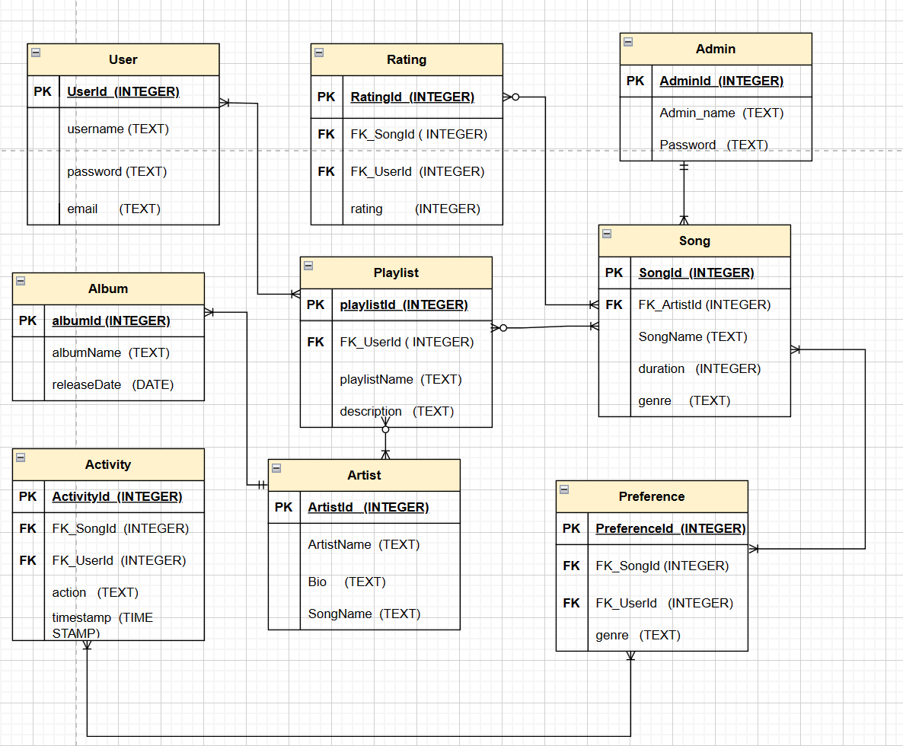
ER Diagram

Slide 11
Architecture Requirements and solution
Uses Client/server architecture.
Cloud-based hosting is the preferred solution due to its scalability, reliability, and accessibility
A combination of relational and NoSQL databases will be employed to manage different types of data efficiently
Storage requirements will depend on factors such as the size of the music catalog, user-generated content, and metadata

Slide 12
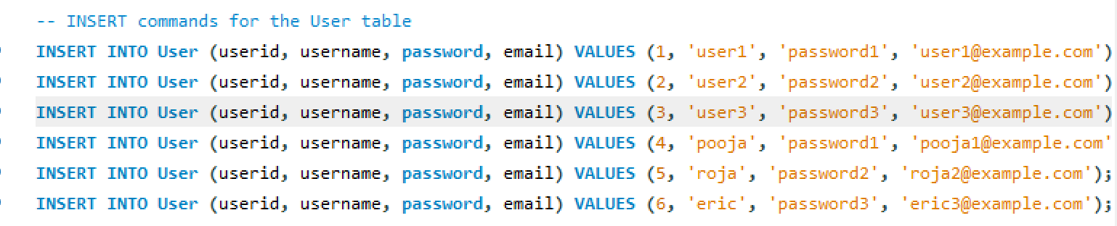
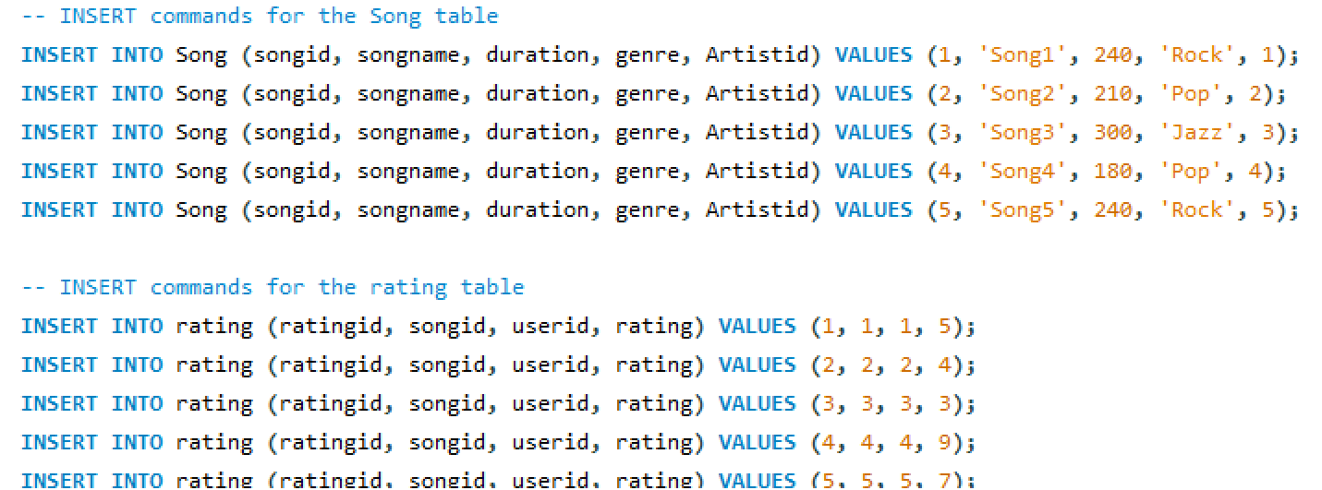
SQL Examples
Inserting statements: After creating tables, we need to insert the data.
Example:

Slide 13
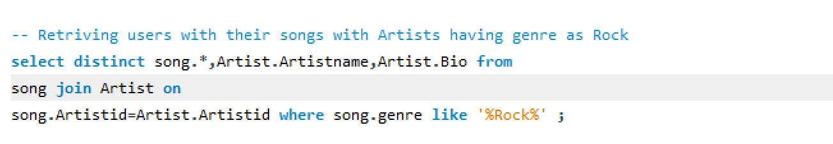
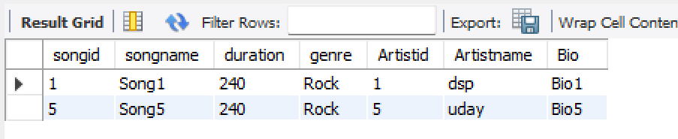
SQL Examples
Query 1.
How can I retrieve users along with the songs they have listened to, where the songs' artists belong to the genre "Rock"?
Output:

Slide 14
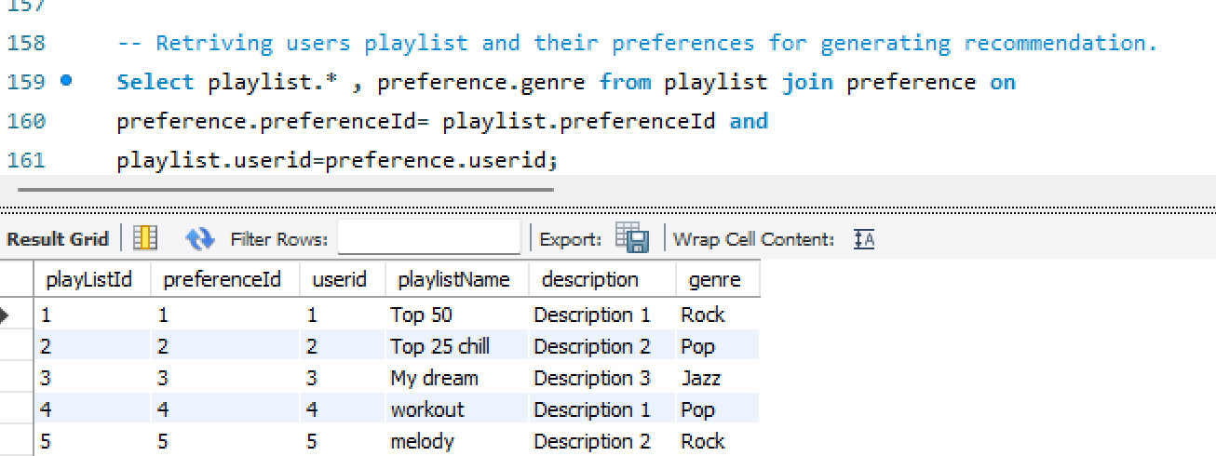
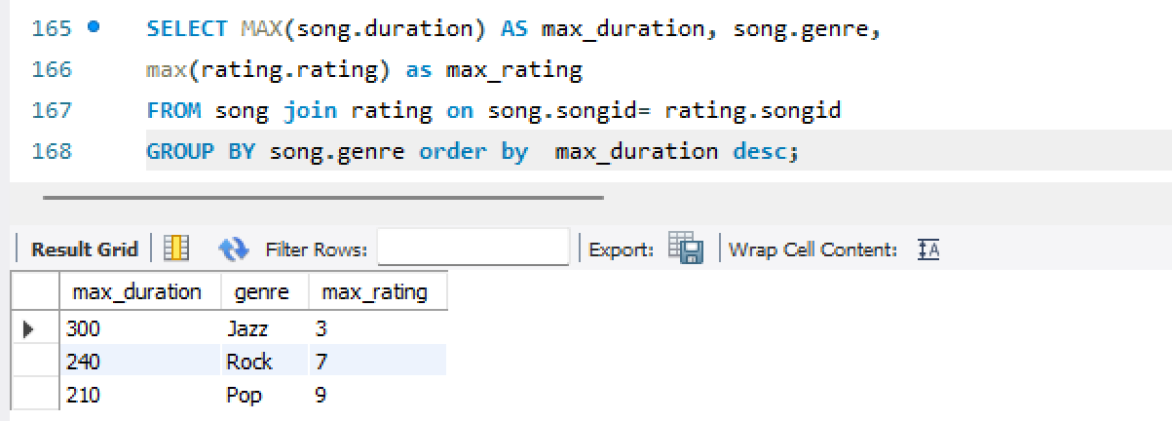
SQL Examples
Query2. How can we efficiently retrieve user playlists and their corresponding preferences from the database in to generate personalized music recommendations?
Query3. How can we retrieve the average duration of songs, the maximum duration of songs, and the highest rating for each genre in the music database?"

Slide 15
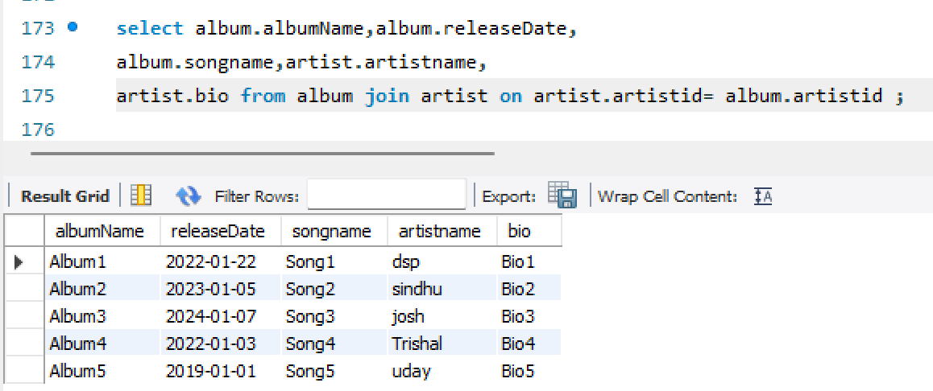
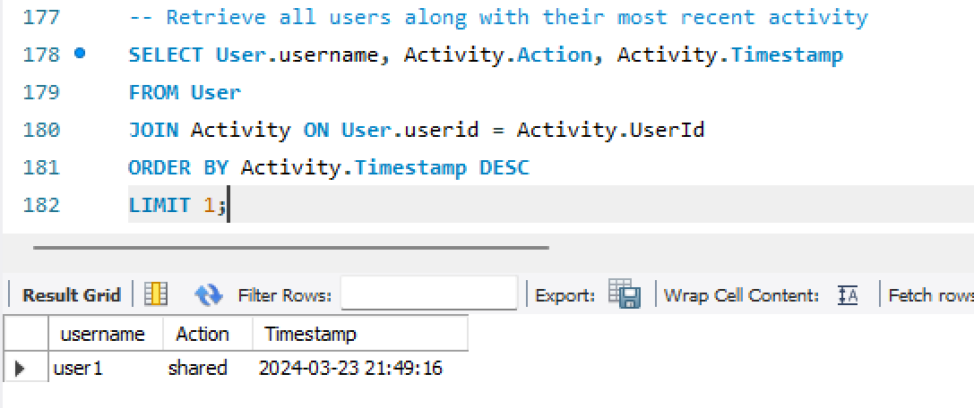
SQL Examples
Query4: How can we retrieve the albums associated with specific artists from the database?
Query5: How can we retrieve all users from the database along with their most recent activity?"

Slide 16
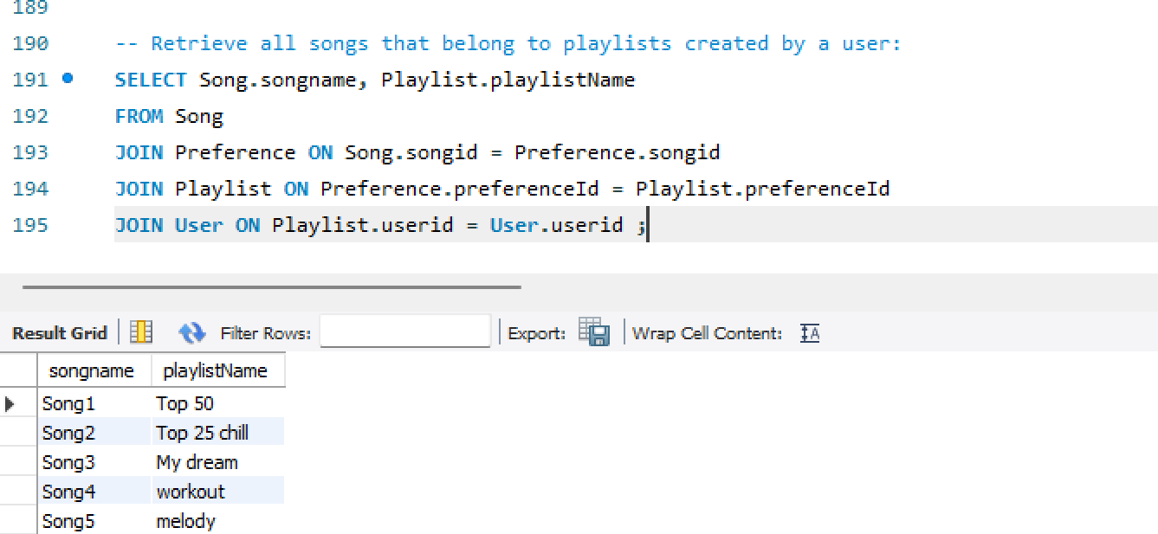
SQL Examples
Query6: How can we retrieve all songs that belong to playlists created by a specific user from the database?"

Slide 17
Metrics and Analytics
User Engagement:
- Monthly Active Users (MAU)
- Daily Active Users (DAU)
- Session Duration
Retention Rate
Content Consumption:
- Track Plays
- Playlist Engagement
- Genre Preference
User Feedback and Satisfaction:
- Ratings and Reviews
- Rating , Likes
Recommendations Effectiveness:
Click-Through Rate (CTR)
Personalization Effectiveness

Slide 18
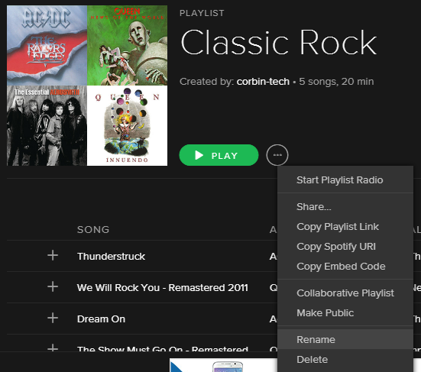
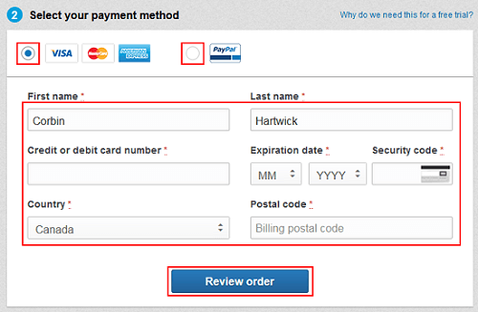
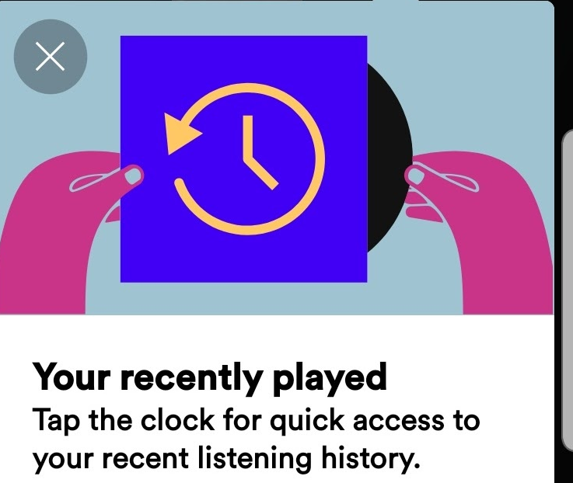

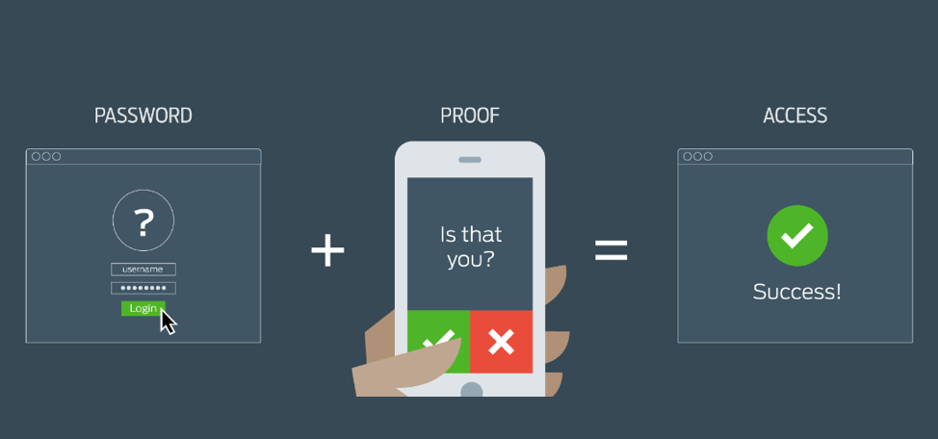
Security and Privacy
App stores data :Listening history,payment details, playlists
Should Implement : Encryption, Multi-factor Authentication

Slide 19
Next steps / Lessons Learned
Key Takeaways
- Data Modeling
- Scalability
- Surveys, User Interactions
- Security
What do I do differently next time:
-User research ,Iterative development.
-Collaboration Tools

Slide 20
THANK YOU

