Slide 1
Superstore Sales Analytics
End-to-End Data Analytics Project (Python + Power BI) | [Tumhara naam] | Week 6 Final Project

Slide 2
Problem Statement and Dataset
Which categories, regions and segments drive sales and profit?
Where are discounts and pricing hurting profit?
Dataset: Sample Superstore, 9,994 rows, 21 columns
Tools: Python, Google Colab, Power BI, Git and GitHub

Slide 3
Data Cleaning
Checked missing values and duplicates
Fixed data types (dates, postal code)
Standardized text, renamed Sub-Category
Added Order Year, Order Month, Profit Margin
Removed unnecessary Row ID column

Slide 4
Exploratory Data Analysis
Sales vs Profit correlation: 0.48
Discount vs Profit correlation: -0.22
Outliers: 11.7% in Sales, 18.8% in Profit
Loss-making: Tables (-17,725), Bookcases (-3,473), Supplies (-1,189)

Slide 5
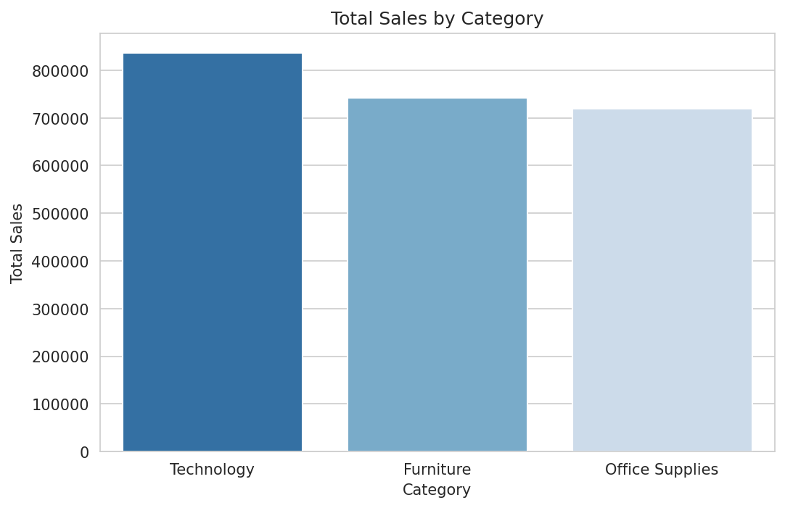
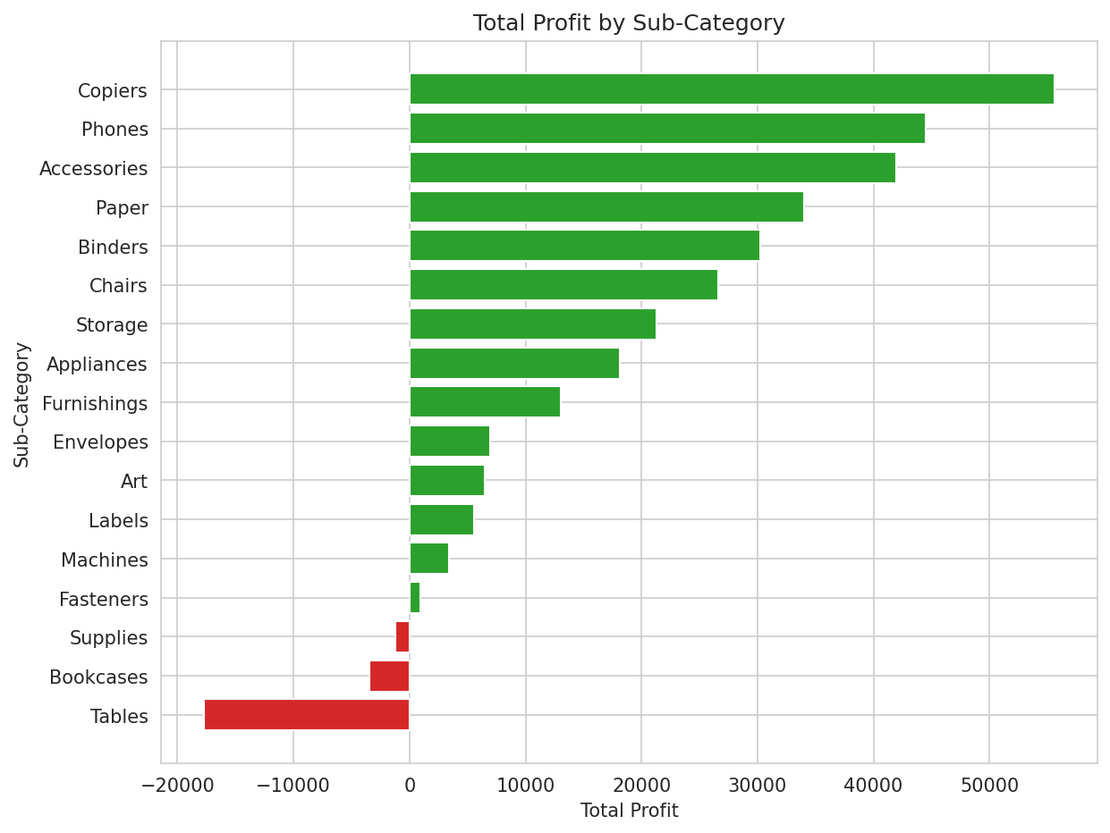
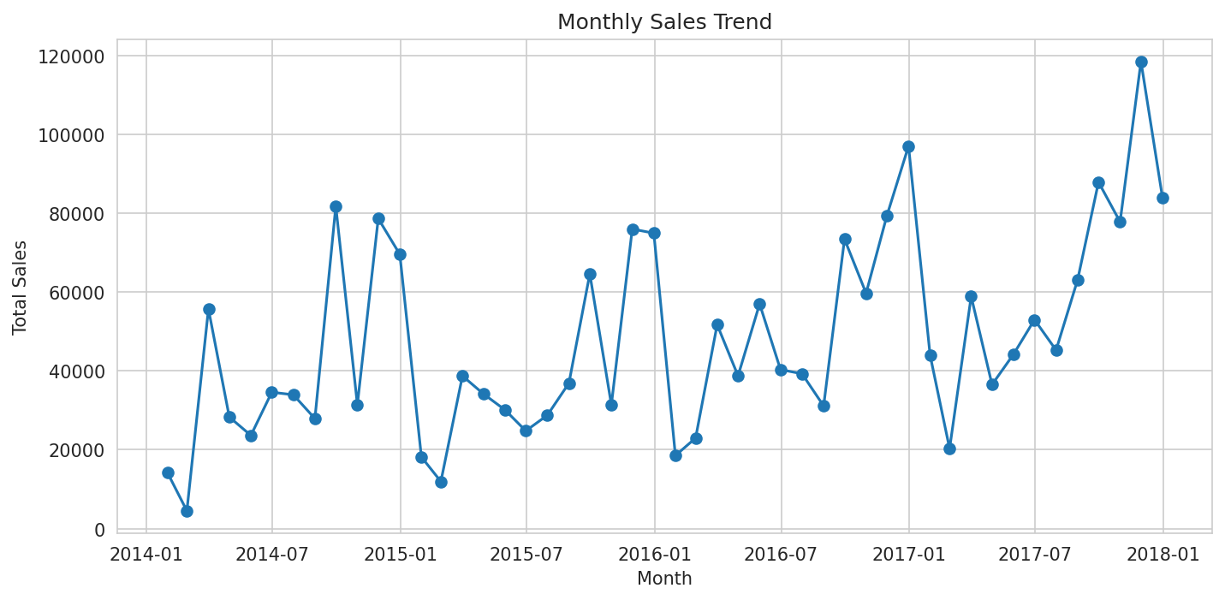
Key Visualizations

Slide 6
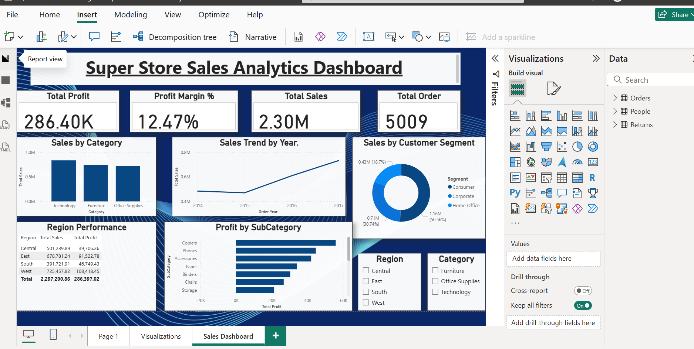
Power BI Dashboard

Slide 7
Insights and Recommendations
Sales 2.30M, Profit 286.40K, Margin 12.47%
West is best, Central is weakest in profit
Recommendation 1: Cap discounts, especially on Tables and Bookcases
Recommendation 2: Improve pricing in Central region
Recommendation 3: Push Copiers and Phones, grow Home Office segment

