Slide 1

PREDICTION OF YEARLY AMOUNT SPENT ON ECOMMERS CLOTHING COMPANY
Presentation by Group 6

Slide 2
Team
1
2
3
4
5
6
PRAGATI SHINDE
VARSHA YALAL
ABHIRAMI S
SYED ADNAN
PRAThYUSHA BANDARU
KALYANI DESHMUKH

Slide 3
TABLE OF CONTENTS
01
02
03
04
05
06
INRODUCTION
OBJECTIVES
DATA & EDA
FEATURE SELECTION
MODEL BUILDING & DEPLOYMENT
CONCLUSION

Slide 4

01
OBJECTIVES
OF THE PROJECT

Slide 5
OBJECTIVES
OUR AIM
THE GOAL
To provide suggestions to the Ecommerce company where to focus their efforts. On Mobile or Website
To find the suitable model for prediction of yearly amount spent
on Ecommerce clothing company.

Slide 6
02
INTRODUCTION

Slide 7
INTRODUCTION
In the ever-evolving landscape of ecommerce, the intersection between digital
platforms and personalized in-store experiences has become paramount for success.
As consumers seek convenience and personalized attention, ecommerce companies are faced with
the challenge of optimizing their online channels while maintaining the allure of in-person interactions
In this project, we embark on a journey to unravel the complexities of ecommerce revenue generation.
Through comprehensive data analysis and predictive modelling , we seek to elucidate the factors driving
annual income prediction and offer actionable recommendations to guide our client's strategic roadmap.
Let us delve into the depths of data science to illuminate the path towards ecommerce excellence.

Slide 8
03
DATA AND EDA

Slide 9
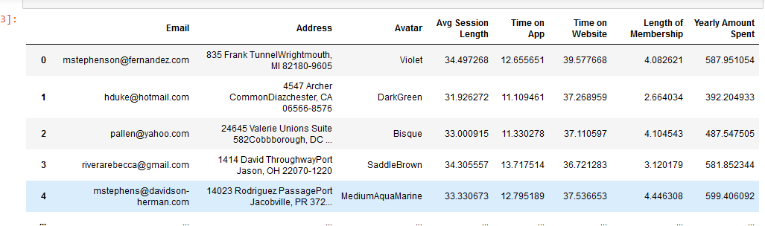
DATA
We worked with Ecommerce Customers data provided by the company.
It has following information.
The data has total 500 observations and 8 features.

Slide 10
EXPLORATORY DATA ANALYSIS (EDA)
DUpLICATE
NULL VALUE
UNWANTED COLUMNS
DATA do not contain any duplicate values.
DATA do not contain any null value.
Removed unwanted columns from the data.
Columns such as 1. Email
2. Avatar, 3.Address
OUTLIER
OUTLIER TREATMENT
AUTO EDA
Yes data has outliers.
Outliers are treated with the help of Flooring and Capping method.
AUTO EDA is done with using
Sweetviz library.
Auto EDA

Slide 11
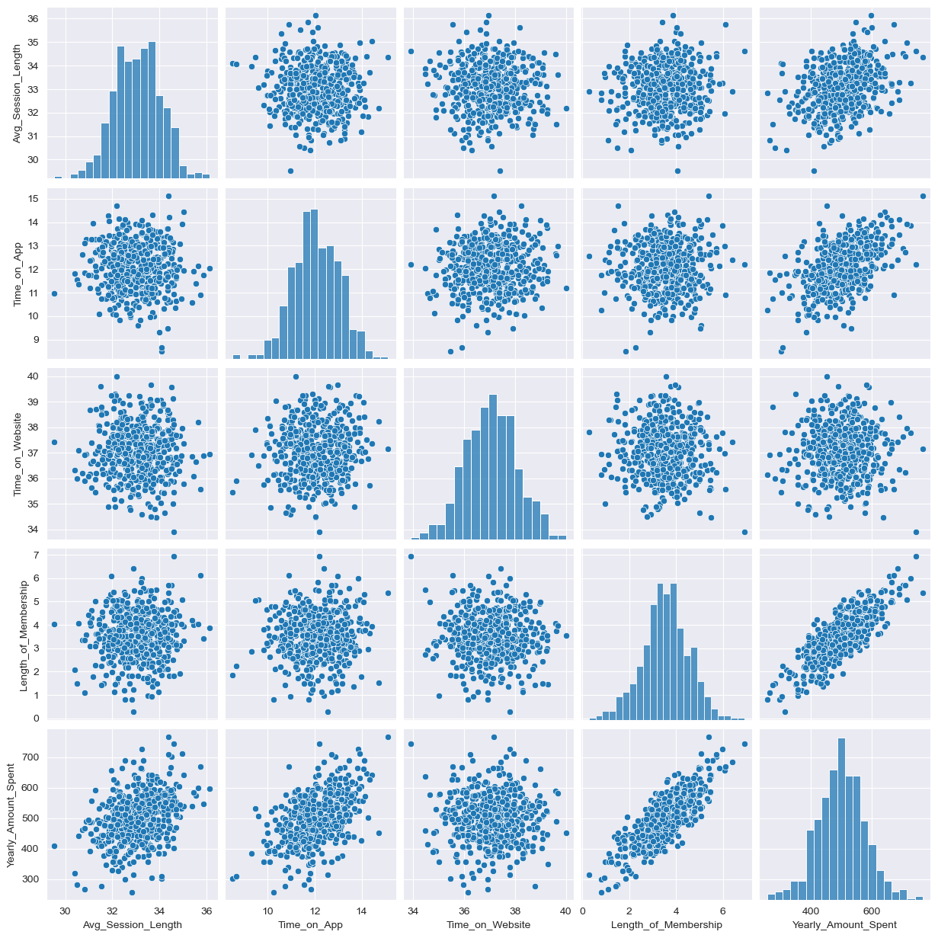
DATA VISUALIZATION
1. PAIR PLOT

Slide 12
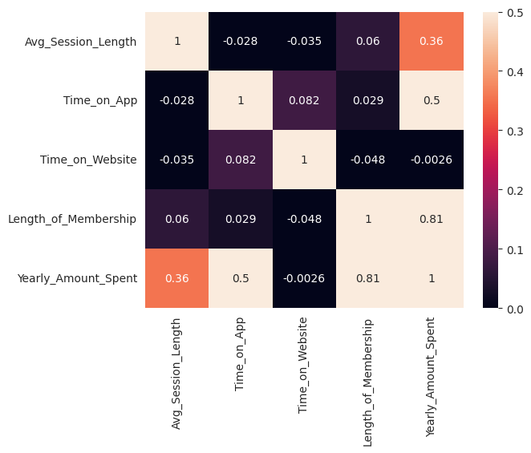
DATA VISUALIZATION CONTINUE…
1. HEAT MAP

Slide 13
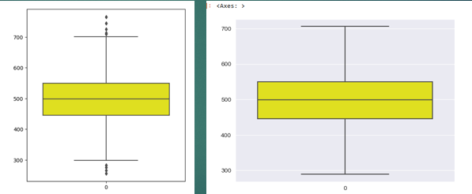
DATA VISUALIZATION CONTINUE…
1. BOX PLOT

Slide 14
03
FEAtURE SELECTION

Slide 15
FEATURE ENGINEERING
Feature engineering is a crucial step in the process of building predictive models , as it
involves transforming raw data into meaningful features that can improve the model’s
performance and accuracy .
Sr. No | Features
1 | Average Session Length
2 | Time on Application
3 | Time on Website
4 | Length of Membership

Slide 16
FEATURE ENGINEERING CONTINUE…
Univariate Feature Selection :
This method works by selecting the best features based on univariate statistical
tests.
Recursive Feature Elimination:
Given an external estimators that assigns weight to the features,
the goal of recursive feature elimination (REE) is to select feature by recursively
considering smaller and smaller sets of features.
Decision Tree Regressor:
Decision tree regressors determine the importance of features based on their contribution to reducing the variance in the target variable..

Slide 17
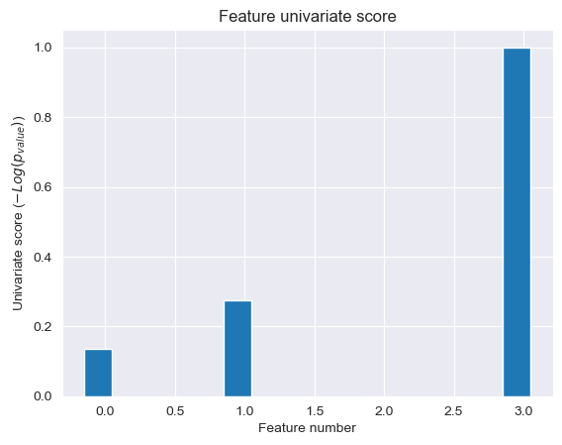
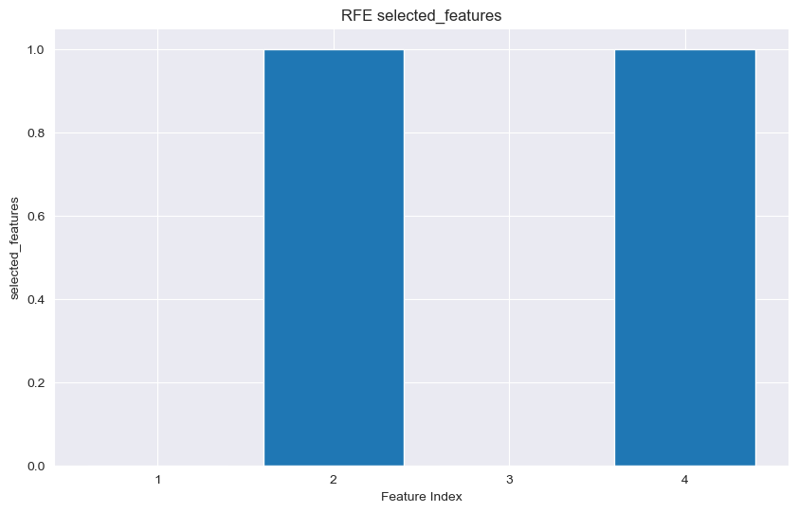
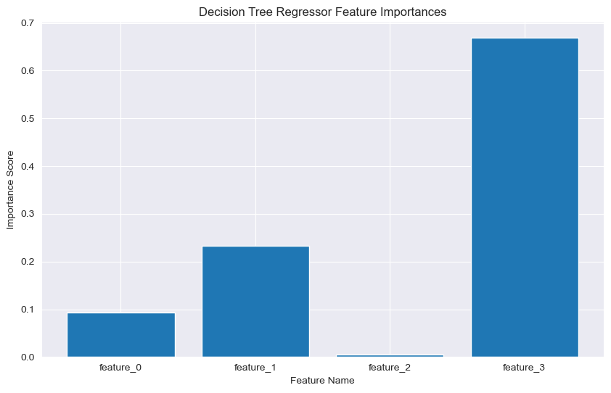
FEATURE ENGINEERING CONTINUE…

Slide 18
05
MODEL BUILDING & DEPLOYMENT

Slide 19
MODEL BUILDING
We explored a variety of models with varying architectures
to best capture the resulting feature matrices and outcomes.
The models used for the prediction are showed on next slide.

Slide 20
Sr. No | Model Name | Use
1 | Linear Regression | Linear regression analysis is used to predict the value of a variable based on the value of another variable.
2 | Decision Tree Regressor | Decision tree regression observes features of an object and trains a model in the structure of a tree to predict data in the future to produce meaningful continuous output.
3 | K -Fold | The model is trained and evaluated k times, using a different fold as the validation set each time. Performance metrics from each fold are averaged to estimate the model's generalization performance.
4 | Random Forest Regressor | Random Forest Regression is a supervised learning algorithm that uses an ensemble learning method for regression.
5 | KNN Regressor | It’s a simple and intuitive algorithm that makes predictions by finding the K nearest data points to a given input and averaging their target values.
6 | SVR | SVR is a supervised machine learning model SVR for working with continuous values.
7 | XGB Regressor | The XGB Regressor is the regression-specific implementation of XGBoost and is used for regression problems where the intent is to predict continuous numerical values.
8 | ANN Regressor | Regression ANNs predict an output variable as a function of the inputs.

Slide 21
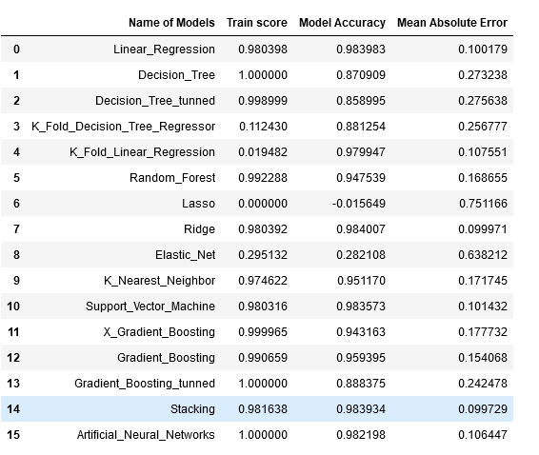
MODEL BUILDING CONTINUE…
Result

Slide 22
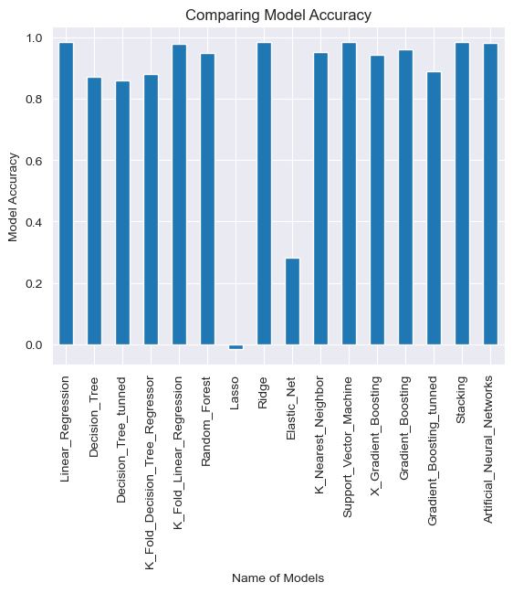
MODEL BUILDING CONTINUE…
Visualizing Best Model
Based on Accuracy

Slide 23
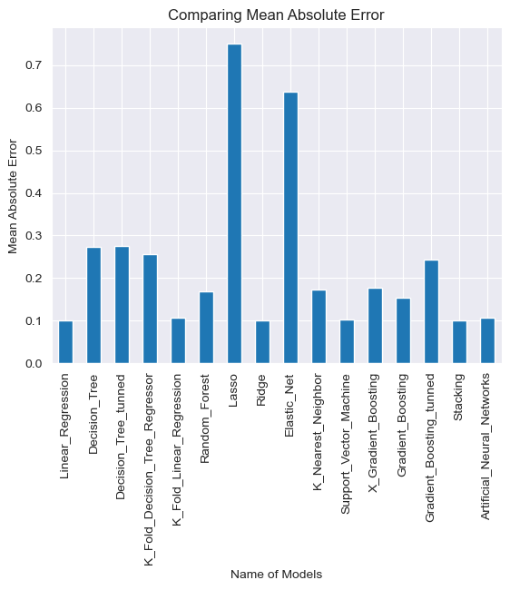
MODEL BUILDING CONTINUE…
Visualizing Best Model
Based on MAE

Slide 24
MODEL DEPLOYMENT
Deployment is the method by which you integrate a machine learning model into an existing production environment to make practical business decisions based on data..
We used streamlit to deploy our model.

Slide 25
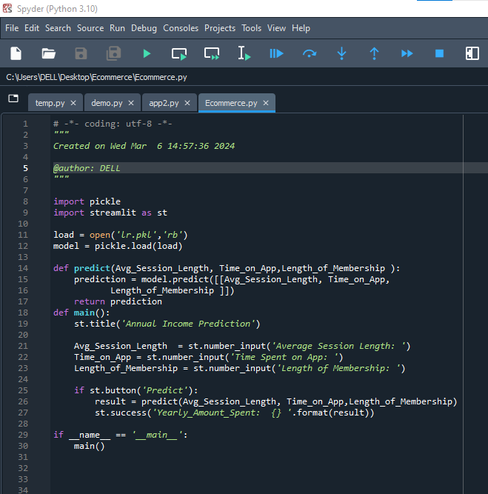
MODEL DEPLOYMENT CONTINUE…
CODE:

Slide 26
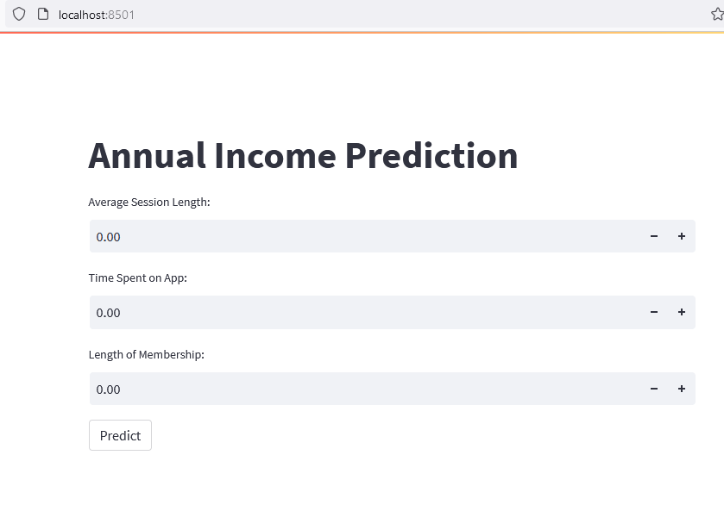
MODEL DEPLOYMENT CONTINUE…
RESULT:

Slide 27
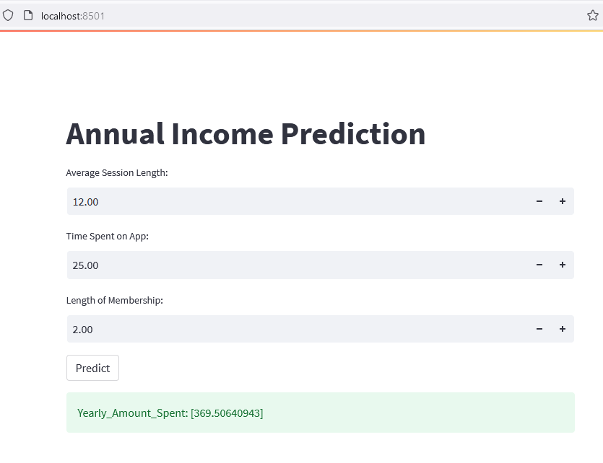
MODEL DEPLOYMENT CONTINUE…
RESULT

Slide 28
06
CONCLUSION & RECOMENDATION

Slide 29
CONCLUSION
1. In this project we wanted to identify key factor which contribute more toward
the business of ecommerce clothing company.
2. And we came to conclusion that “length of membership” that is contributing more,
while “Time of Application” is the 2nd most important factor business.
3. We also found that “Average Session Length” and “Time on Website” are
not contributing much to the business.
4. After trying various models. We came to the conclusion that “Linear Regression Model”
is best for prediction.

Slide 30
RECOMMENDATION
1. We want to recommend company to focus of membership of the customers and companies
Application, because these two are generating most of the revenue.
2. Also company should work on improving their website experience and their session experience
For the customers so that these two sites can generate revenue.
3. Again if company collects information about the gender , age and most sold out products
categories, then it will help company to focus n more reliable factor.

Slide 31
THANK YOU!

