Slide 1
ERP System Data Classification
Presented by Divya Chhipani

Slide 2
Problem Statement

Slide 3
Problem Statement
Dataset
Challenges
Multi-class(10) classification problem
City of Austin, Texas ERP system
Unequal class distribution
Missing values
Majority of features unusable

Slide 4
Process

Slide 5
Exploratory Data Analysis to understand data and the features
Basic pre-processing steps like tokenisation, stopword removal, etc followed by vectorization
Evaluation of model predictions during training and testing phase using various metrics
Data exploration
Data augmentation
Evaluation
Data pre-processing
Model implementation
Creating data samples to solve issues of class imbalance
Implementing the pipeline to select features, choose classifier, and build training and validation pipeline

Slide 6
Dataset

Slide 7
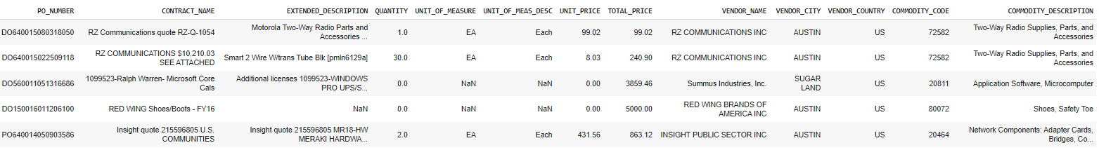
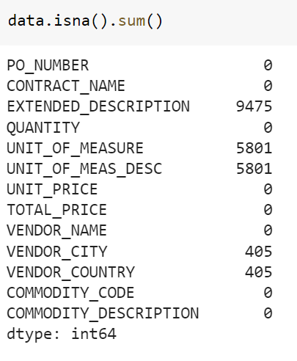
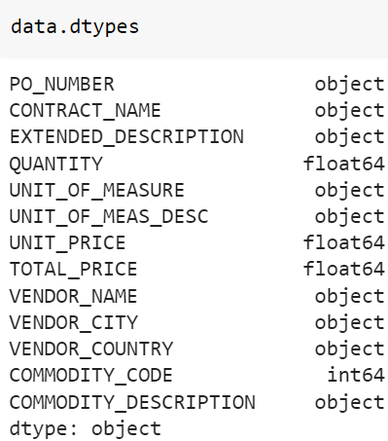
10 classes
28429 original samples
9000+ empty samples
1000+ difference in class size
14500 augmented samples added

Slide 8
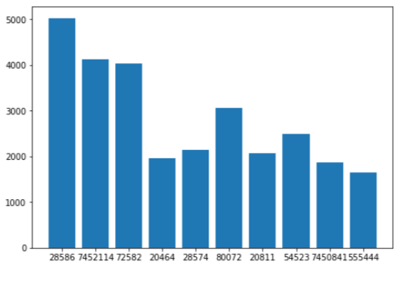
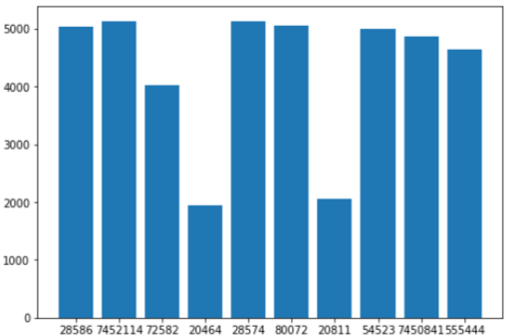
Data distribution per class before augmentation
Data distribution per class after augmentation

Slide 9
Challenges with Dataset
Challenge 1
Challenge 2
Missing Values
Used most frequently occurring words in the description to fill the missing values
Class imbalance
Data augmentation for even distribution of class samples
Class weighing by number of samples used during model training
Decision tree used for classification

Slide 10
Data cleaning

Slide 11
Tokenization
Stopword Removal
Stemming
Lemmatization
Lowercase
Special Char removal
Strip spaces

Slide 12
Data representation

Slide 13
Feature representation
Vector with Inverse term frequency as weights
Label representation
Integer labels from 0-9

Slide 14
Training Pipeline

Slide 15
Feature Selection
Class weighting
Classifiers used – Decision Tree, Logistic Regression, SVM, Multi-layer Perceptron
K-fold cross-validation
Parameter tuning

Slide 16
Evaluation

Slide 17
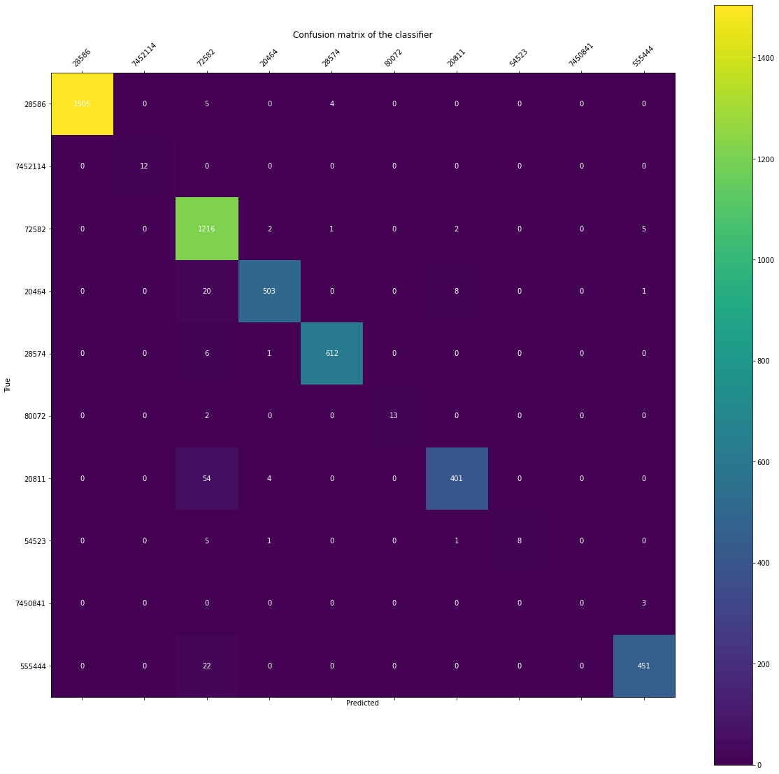
Metrics
Precision
Recall
F1 Score
Confusion Matrix

Slide 18
Logistic Regression (Development)
Model (Phase) | Precision (%) | Recall (%) | F1 Score (%)
Decision Tree (Development) | 91.39 | 91.28 | 90.96
Decision Tree (Testing) | 93.19 | 92.29 | 92.48
Logistic Regression (Development) | 94.81 | 94.39 | 94.35
Logistic Regression (Testing) | 94.64 | 94.30 | 94.24
SVM (Development) | 92.01 | 90.57 | 90.56
SVM (Testing) | 94.29 | 93.07 | 93.08
MLP (Development) | 96.82 | 96.54 | 96.55
MLP (Testing) | 97.06 | 96.98 | 96.92

Slide 19
Thank You

