Slide 1


ISOM 825
ERP Simulation Game Strategy Analysis
Presented By: Divya Chowdary Koripalli
Notes:
Hi everyone. My name is Merelyn, and I’m here with my team members Divya and Vina. We are Team C and we’ll be presenting our ERP simulation game strategy.

Slide 2




Roles & Responsibilities
Market price analysis → Adjusted price lists dynamically.
Forecasting & MRP runs → Production orders.
Financial statements & valuation (Fiori).
Converted planned orders → Production.
Loan repayment tracking.
Inventory reports & purchase order monitoring.

Slide 3

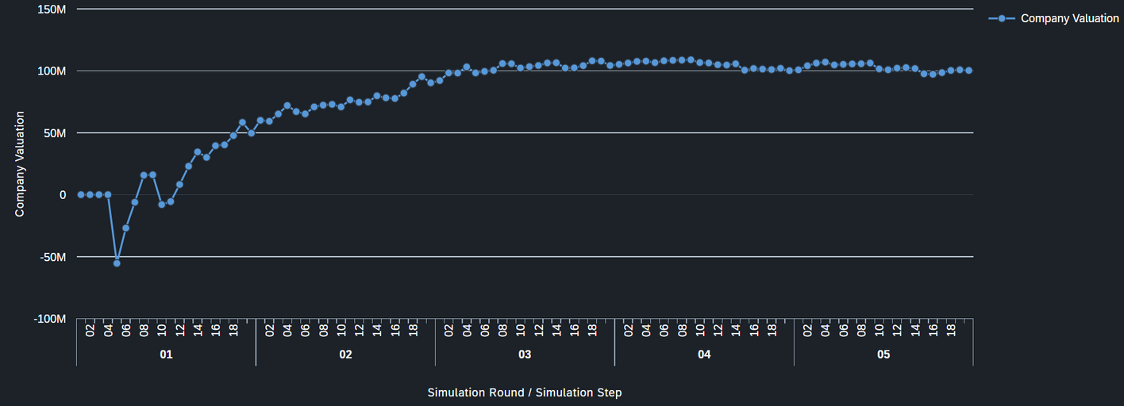
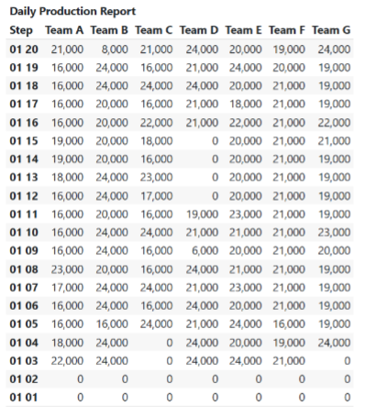

Company Valuation
R1 €49M → R5 €100M
Peak - €107M
R1
Notes:
Alright, so here's how our company valuation changed throughout the game.
At the very beginning, we took a hit — you can see that sharp drop early on, where our value actually went negative. That was mostly because of our upfront investments and maybe some early decisions that didn’t play out right away.
But we bounced back pretty quickly. Within a few steps, we recovered and started building momentum.
From there, things got better fast. Through Rounds 1 and 2, we kept growing steadily — thanks to better coordination between our planning, production, and pricing decisions. We were making smarter moves and learning from our mistakes.
By Round 3, we hit our peak — just over 100 million in company valuation. That’s when everything started to click.
After that, the valuation leveled out. We stayed pretty consistent, which isn’t a bad thing — it means we were stable and profitable. We weren’t taking big risks, but we were holding strong.
Toward the end, there’s a small dip — nothing too major. It might’ve been due to market shifts or increased competition, but overall, we ended the game in a really solid position.
So yeah, from a rough start to a strong finish — this shows how we adapted, worked as a team, and made decisions that paid off.

Slide 4
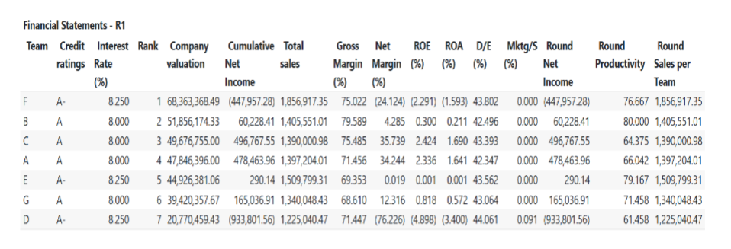

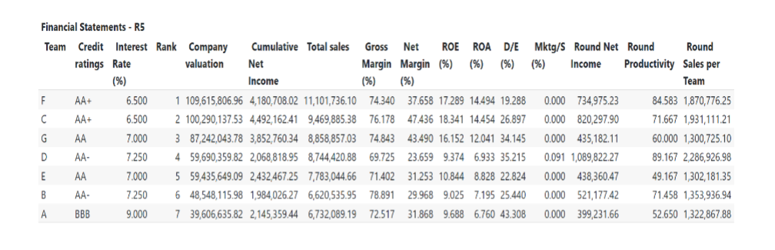
Financial Performance
1. Profitability Growth
Net Profit Margin: R1: 35.74% → R5: 47.44%
Gross Margin: Improved from 75.49% (R1) to 76.18% (R5).
2. Revenue & Ranking
Total Sales: R1: €1.39M→R5: €9.47M (6.8x growth).
3. Loan & Credit Rating Impact
Interest Rate: Reduced from 8.0% (R1) to 6.5% (R5) due to AA+ credit rating.
Savings: Lower interest expenses contributed to higher net margins.
Debt-to-Equity (D/E): Decreased from 43.39% (R1) to 26.90% (R5).
Paid bank loans from €8M to €6M by R5.
Notes:
Here’s a quick breakdown of how our financial performance improved over the course of the game.
First — Profitability Growth.
We started with a net profit margin of 35.74% by the end of Round 1 and ended at 47.44% by Round 5 — that’s a solid 11.7% improvement.
Our gross margin also went up slightly from 75.49% to 76.18%, which shows better cost control and pricing strategy.
Next — Revenue and Ranking.
Our total sales grew from 1.39 million in Round 1 to 9.47 million in Round 5 — that’s about 6.8 times growth.
This helped push us up the rankings significantly, landing us in the second spot by the final round.
And finally — Loan & Credit Rating Impact.
We started with an interest rate of 8%, but by Round 5 we brought it down to 6.5% thanks to improving our credit rating from A to AA+.
That lower rate helped us save on interest expenses, which fed directly into better net margins.
Our debt-to-equity ratio also dropped — from 43.39% to just 26.90% — showing we were managing our finances more efficiently and relying less on borrowing.
So overall, we made smart moves that paid off — strong profits, healthy growth, and a much better financial position by the end.”

Slide 5
Financial Performance
4. Operational Efficiency
ROE: Improved from 2.42% (R1) to 18.34% (R5).
ROA: Jumped from 1.69% (R1) to 14.45% (R5).
5. Key Strengths
Highest Net Margin: 47.44%
Consistent Profitability: Positive net income in all rounds.
Creditworthiness: AA+ rating
6. Areas for Improvement
Sales Volume: Lagged behind Team F (€9.47Mvs.€11.1M).
Productivity: 71.67% (R5) vs. Team D’s 89.17%.
Notes:
Continuing with our financial performance…
First — Operational Efficiency.
We made big strides here.
Our Return on Equity jumped from just 2.42% in Round 1 to 18.34% in Round 5 — that means we were using our shareholders’ equity a lot more effectively.
Return on Assets also improved — from 1.69% to 14.45% — showing we were making better use of our resources overall.
Now for Key Strengths.
We had the highest net margin of all teams at 47.44%, which means we were not just selling — we were selling smart and keeping our costs in check.
Even better — we stayed profitable in every single round. No losses, no surprises.
And our credit rating improved to AA+, which gave us better loan terms and helped reduce financial pressure.
Of course, there’s always room to improve.
We lagged behind Team F in total sales volume — they hit 11.1 million, while we ended with 9.47 million.
And our productivity, while solid at 71.67%, still trailed behind Team D, who reached 89.17%. So that’s definitely something we’d want to tighten up — maybe by optimizing operations or workforce allocation.
Overall though, we’re proud of the balance we struck — strong margins, solid returns, and stable growth.”

Slide 6
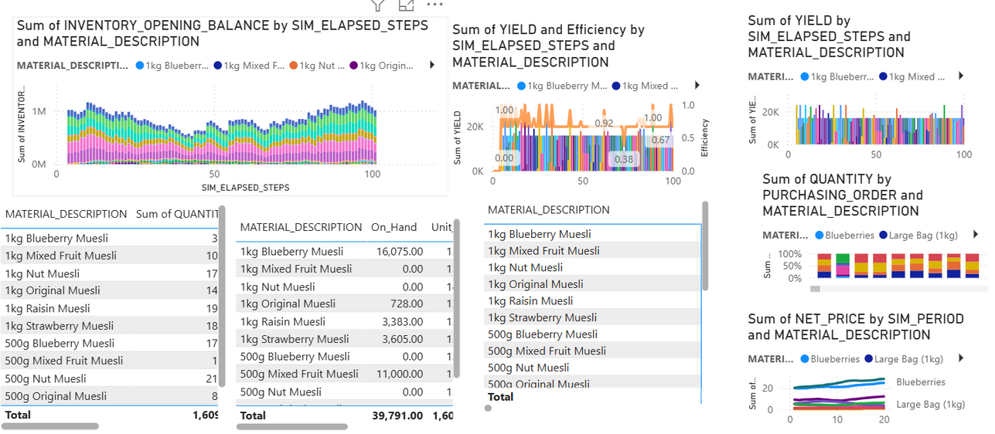
PRODUCTION
Production Strategy
Focused on high-demand SKUs like:
500g Nut (214k units), 1kg Raisin (194k units), 1kg Strawberry Muesli (183k units)
Balanced mix of 500g and 1kg packs to match market preferences.
Smart procurement with different purchasing orders (Blueberries vs. Large Bags) to optimize raw material usage.
Maintained steady inventory levels to avoid stockouts or excess stock.
Production Capacity & Output
Total Production: 1.6M+ units
Ending Inventory: ~39.8K units → strong sell-through rate.
On-hand stock concentrated in top sellers (e.g., 500g Muesli lines).
Efficiency & Yield Insights
Efficiency improved steadily, stabilizing at 0.9–1.0 after mid-sim.
High and stable yield across SKUs reflects minimal waste and good production planning.
Notes:
Total Yield Across All SKUs: 1.649M units (ST) produced overall.
Top-Performing Products by Yield:
500g Strawberry Muesli: 220K ST
500g Nut Muesli: 214K ST
1kg Raisin Muesli: 194K ST
1kg vs. 500g Products:
500g SKUs generally yielded higher total output, indicating a possible focus on smaller-size production — likely to match demand patterns or due to faster cycle times.
By Simulation Round (top-right chart):
Yield peaked in Round 02 (347K) and gradually declined toward Round 01 (309K), reflecting potential capacity strain, machine utilization limits, or shift in production strategy.
Balanced SKU Output: Production focused across multiple SKUs, including both 500g and 1kg variants — especially: 500g Blueberry Muesli, 500g Mixed Fruit Muesli, 1kg Nut Muesli (high quantities produced).
Flexibility in Response to Demand: Steady adjustments in yield and inventory reflect responsiveness to market consumption patterns.
🔹 Inventory Planning:
Inventory levels (left chart) show consistent stock availability with minor dips, meaning:
“We maintained a well-managed buffer stock to prevent stockouts while avoiding overproduction.”
🔹 Raw Material Utilization:
Product yield lines (top right) show relatively even output across SKUs.
Use of different purchasing orders for 1kg and 500g bags suggests strategic procurement to optimize packaging based on demand.
⚙️ Slide Title: Production Capacity & Efficiency
🔹 Production Capacity:
Peak total production = ~1.6M units (bottom left).
Final on-hand inventory = ~39,791 units, indicating good sell-through rate.
High producers:
500g Mixed Fruit Muesli (210k units)
500g Nut Muesli (201k units)
🔹 Efficiency Performance:
Efficiency bar (top center) fluctuates but stabilizes near 0.9 – 1.0 after Step 40:
“Production efficiency improved over time, reaching optimal levels (~1.0) toward the end of the simulation.”
🔹 Yield and Waste:
No major yield drop suggests minimal waste.
Yield graph shows consistent productivity across time, indicating good line balancing and raw material planning.

Slide 7
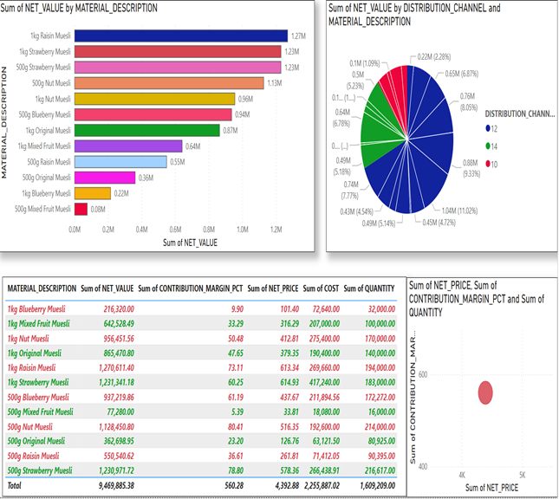

PRODUCT & PRICING STRATEGY
1. NET VALUE by Material Description
1kg Raisin and Strawberry Muesli & 500g Strawberry and Nut Muesli drove the highest sales.
1kg variants significantly outperformed 500g packs in revenue contribution.
2. NET VALUE by Distribution Channel & Product
Channel 12 contributed the most to NET VALUE across products.
Diverse spread shows effective multi-channel distribution.
Indicates potential for scaling profitable channels further.
3. Product-Wise Performance
Key pricing insights:
High-margin products: 1kg Raisin (73%), 500g Blueberry (61%)
Low-margin concern: 1kg Blueberry (9.9%) → possibly overpriced or underutilized.
Cost, price, and quantity alignment visible per SKU.
4. Contribution Margin vs. Net Price
Visual correlation between price and profitability.
Supports strategic pricing decisions based on: ➤ High margin, moderate price = optimal ➤ Products with low margin at high prices need review.

Slide 8
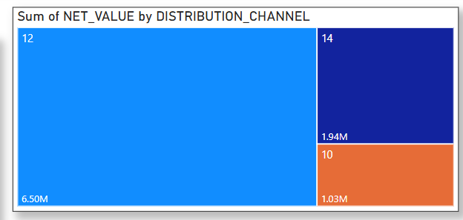

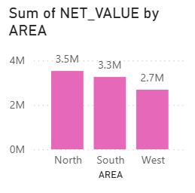
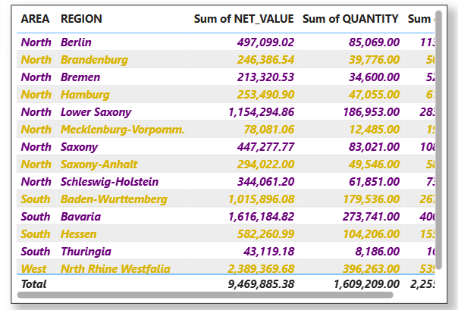

Sales by Region and Distribution Channel
Top Channel
Channel 12 dominated sales with €6.5M (approx. 69% of total sales)
Channel 14 contributed €1.94M
Channel 10 underperformed with only €1.03M
Top-Performing Area
North Germany led sales with €3.53 M.
South Germany followed closely with €3.25M.
West Germany generated €2.68M.

Slide 9
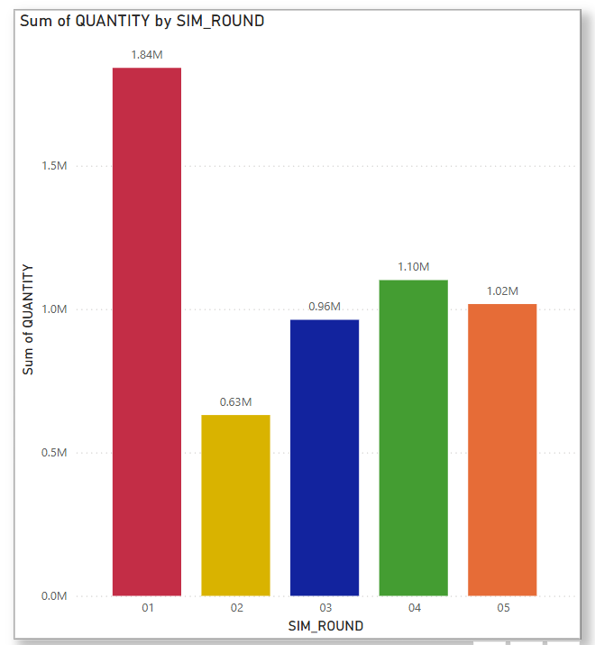
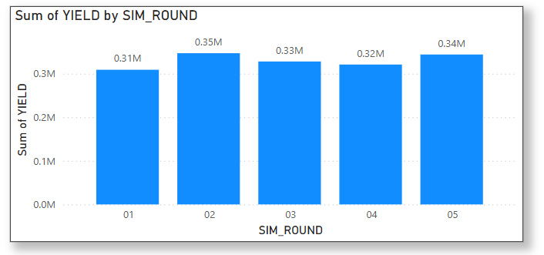
Decision Impact Timeline
Yield remained relatively stable between Rounds 01 and 05 — but slightly decreased over time (R4) - pressure on operational efficiency.
Quantity was highest in Round 01, then decreased each round — a shift from aggressive production to more strategic control - early overproduction strained resources and inventory, impacting later rounds.
Gradual stabilization indicates that we learned and adapted through better coordination and planning.

Slide 10

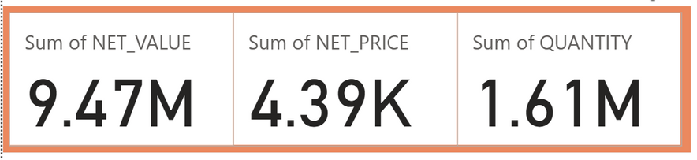
LESSONS LEARNED
01.
What We Learned:
Right Product/Channel Mix Drives Performance
Timing of Decisions Shapes Market Share
Pricing & Inventory Optimization Are Critical
KPI Monitoring Is Non-Negotiable
Cross-Functional Alignment is Key
Market-Driven Pricing Wins
Product Mix Matters
What We’d Do Differently:
Track Competitor Behavior Closely
Use Forecasting Tools Proactively
Invest More Strategically
Be More Agile With Pricing
02.

Slide 11

Thank you!

