Slide 1


Govt Polytechnic Sorab
Department of Computer Science and Engineering
PROJECT PHASE SEMINAR ON:
“Wine Quality Prediction”
Presentation by:
1.Bhoomika
2.Divya S C
3.Sanjana
4.Sinchana
5.Tanuja D H

Slide 2
Introduction
This project focuses on predicting wine quality based on various chemical features.
The goal is to classify wine samples into quality categories using ML models.

Slide 3
Dataset Description
Dataset Source: Kaggle - Wine Quality Dataset
Features: Fixed acidity, Volatile acidity, Citric acid, Residual sugar, Chlorides, Free sulfur dioxide, Total sulfur dioxide, Density, pH, Sulphates, Alcohol
Target: Wine Quality (score 0–10)

Slide 4
fixed acidity - Non-volatile acids present in wine(6-8 g/dm3)(e.g., tartaric acid).
volatile acidity - Amount of acetic acid (<0.5 g/dm3)(too much gives a vinegar taste).
citric acid - Adds freshness and flavor; acts as a preservative(0.2-0.4 g/dm3).
residual sugar - Natural sugar left after fermentation (1-3 g/dm3)(sweetness of wine).
Chlorides - Salt content in wine(<0.08 g/dm3).
free sulfur dioxide - Free SO₂ that prevents microbial growth and oxidation(20-40 mg/dm3).
total sulfur dioxide - Combined free + bound SO₂ (100-150mg/dm3) (too much gives pungent smell).
Density - Density of wine (0.994-0.996 g/cm3)(depends on sugar and alcohol).
PH - Acidity level of wine (3.2-3.5)(scale of 0–14).
Sulphates - Sulfur dioxide derivatives that improve stability and flavor (0.5-0.7 g/dm3).
Alcohol - Alcohol percentage by volume(10-12%)
Quality - Quality score of the wine (6-8 good wines)(usually rated between 0–10).

Slide 5
Data Preprocessing
1. Handled missing values
2. Converted categorical values if any
3. Handled outerliers values
4. Created new labels (Low, Medium, High) based on quality score

Slide 6
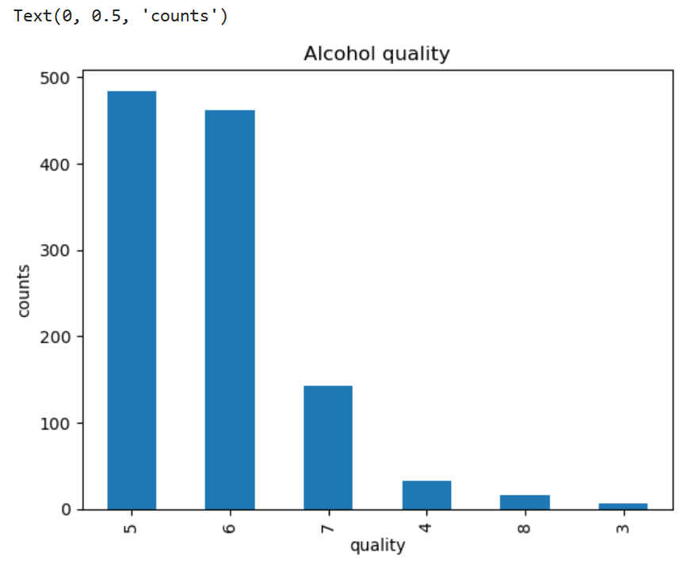
Exploratory Data Analysis

Slide 7
Linear Regression Results
Evaluation metrics:
Mean Squared Error (MSE): 0.150

Slide 8
Results
• Logistic Regression: 65% accuracy
• Decision Tree: 70% accuracy
• Random Forest: 75% accuracy
• SVM: 72% accuracy
Best Model: Random Forest

Slide 9
Conclusion
Wine quality can be predicted using chemical properties
Cleaned and preprocessed dataset is ready for modeling.
Visualizations show that alcohol, sulphates, and citric acid improve wine quality, while volatile acidity and chlorides reduce it.
After splitting and training, the model can predict wine quality with good accuracy.
This dataset is useful to understand chemical properties of wine and their effect on taste/quality.

Slide 10
Thank You

