Slide 1


Govt Polytechnic Sorab
Department of Computer Science and Engineering
PROJECT PHASE SEMINAR ON
“Wine Quality Prediction”
Presentation by:
1.Bhoomika
2.Divya S C
3.Sanjana
4.Sinchana
5.Tanuja D H

Slide 2
Columns meaning
fixed acidity - Non-volatile acids present in wine(6-8 g/dm3)(e.g., tartaric acid).
volatile acidity - Amount of acetic acid (<0.5 g/dm3)(too much gives a vinegar taste).
citric acid - Adds freshness and flavor; acts as a preservative(0.2-0.4 g/dm3).
residual sugar - Natural sugar left after fermentation (1-3 g/dm3)(sweetness of wine).
Chlorides - Salt content in wine(<0.08 g/dm3).
free sulfur dioxide - Free SO₂ that prevents microbial growth and oxidation(20-40 mg/dm3).
total sulfur dioxide - Combined free + bound SO₂ (100-150mg/dm3) (too much gives pungent smell).
Density - Density of wine (0.994-0.996 g/cm3)(depends on sugar and alcohol).
PH - Acidity level of wine (3.2-3.5)(scale of 0–14).
Sulphates - Sulfur dioxide derivatives that improve stability and flavor (0.5-0.7 g/dm3).
Alcohol - Alcohol percentage by volume(10-12%)
Quality - Quality score of the wine (6-8 good wines)(usually rated between 0–10).

Slide 3
1.Data collection:
Import Libraries and Load DataSet
import pandas as pd
import numpy as np
import matplotlib.pyplot as plt
np.float=float
from sklearn.model_selection import train_test_split
from sklearn.linear_model import LinearRegression
from sklearn.metrics import mean_squared_error,r2_score
df=pd.read_csv('C:/Users/user/Downloads/kaggle/WineQT.csv')
df.head(10)

Slide 4
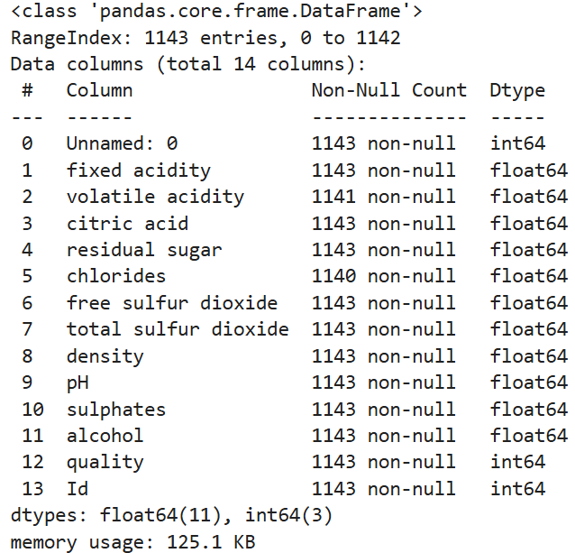
2.Data Analysis
df.info()

Slide 5
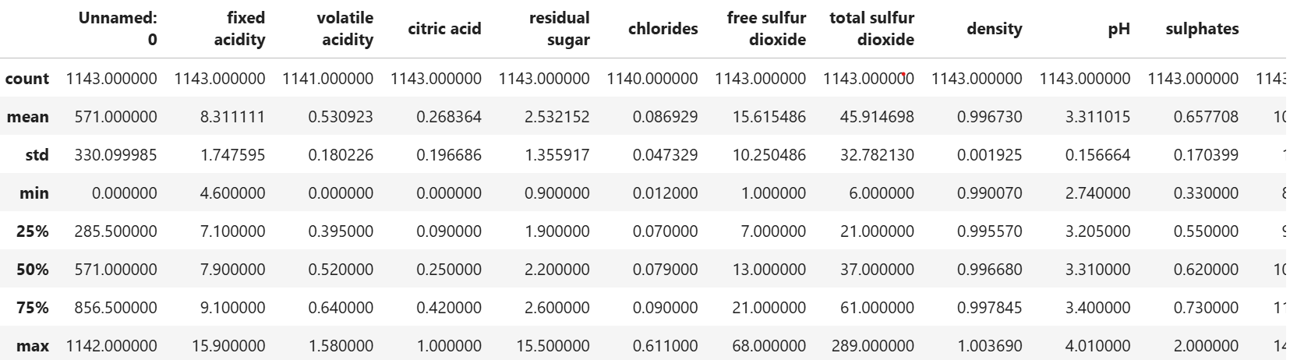
df.describe()
df.describe()

Slide 6
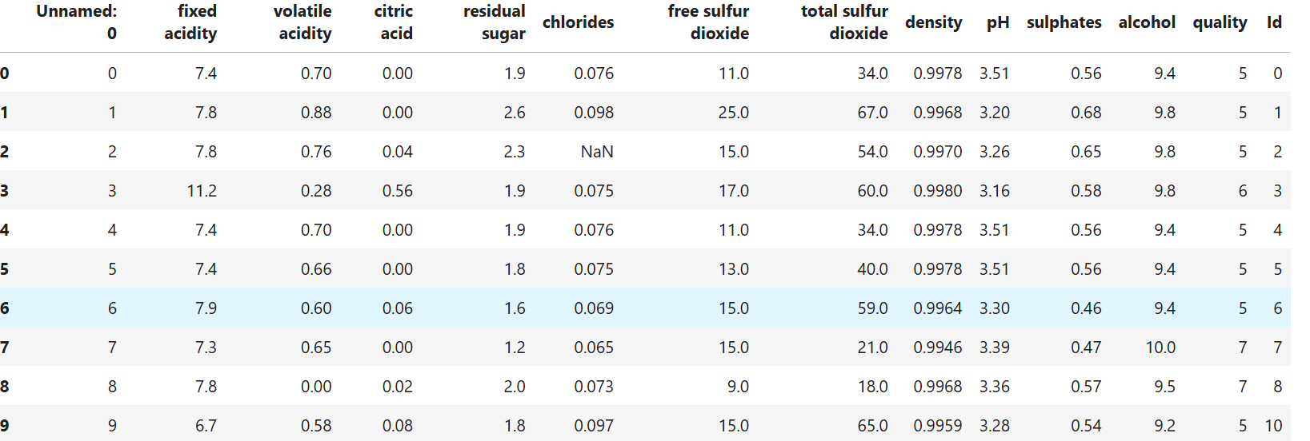
df.head(10)

Slide 7
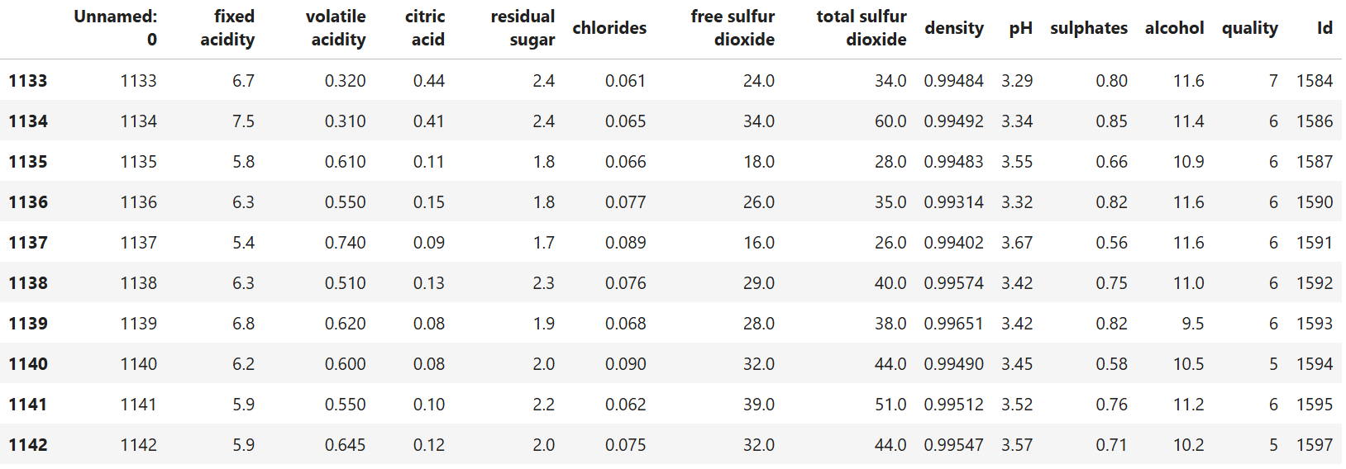
df.tail(10)

Slide 8
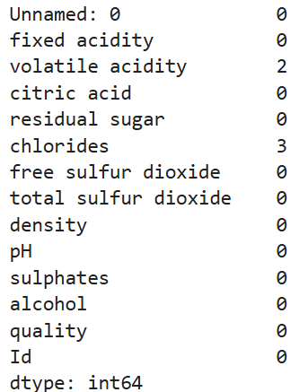
df.shape
(1143, 14)
df.isnull().sum()

Slide 9
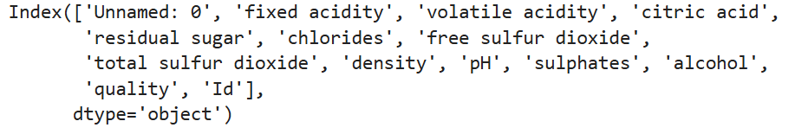
df.columns

Slide 10
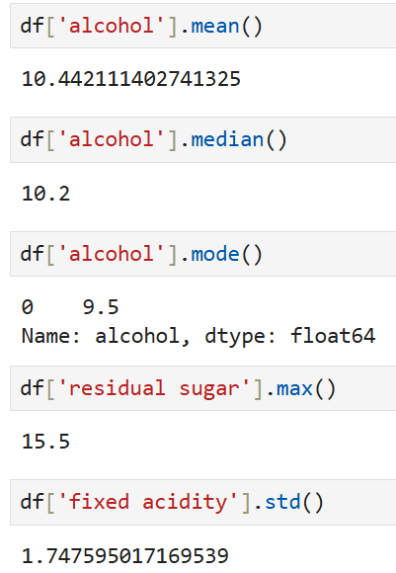
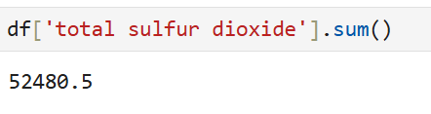
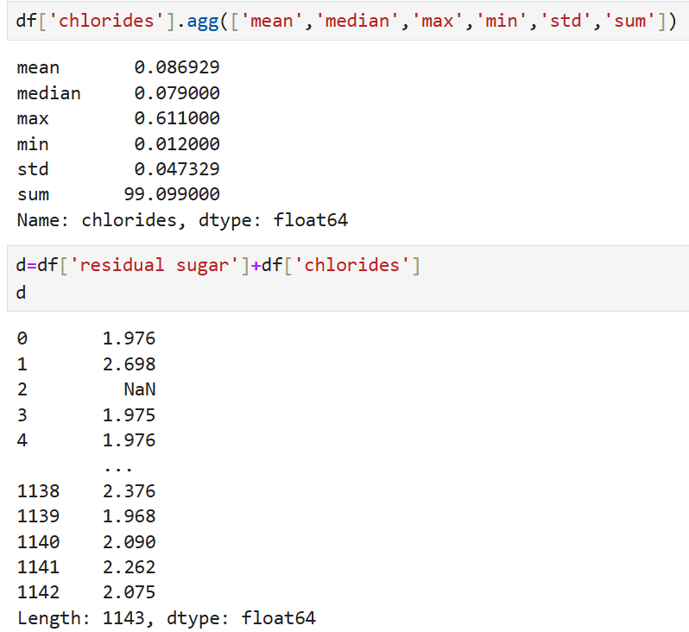
Aggregation functions

Slide 11
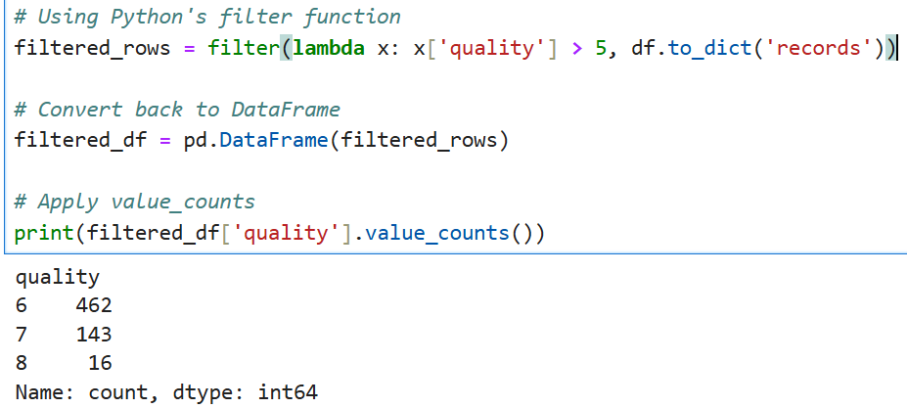

Slide 12
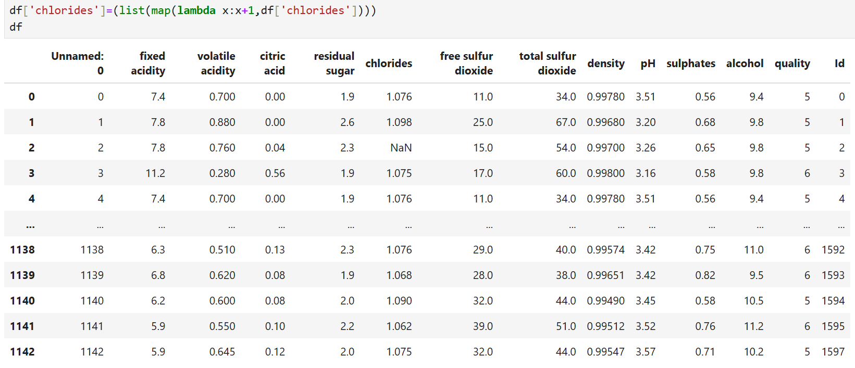
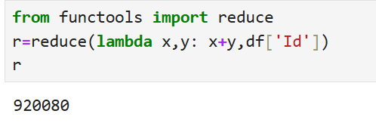

Slide 13
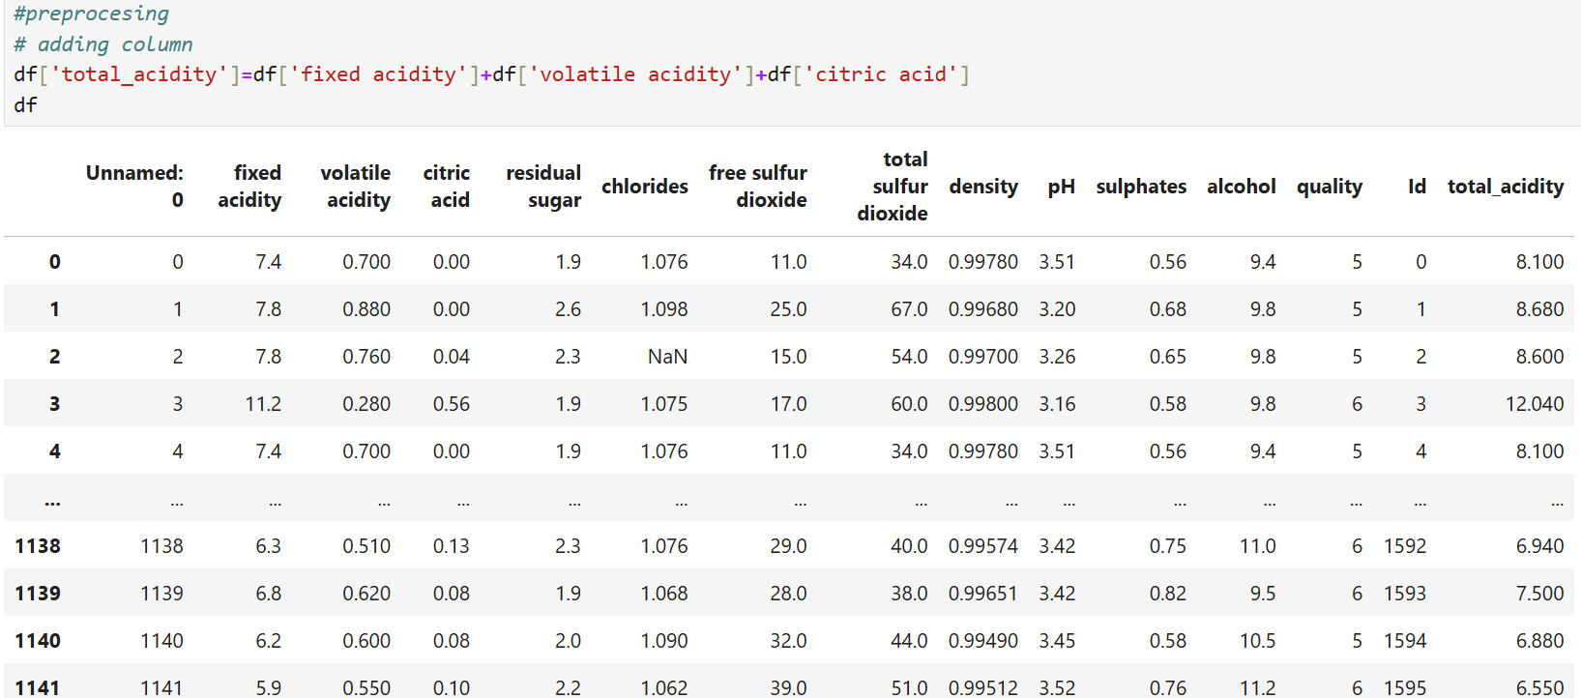
3.Data Preprocesing and cleaning

Slide 14
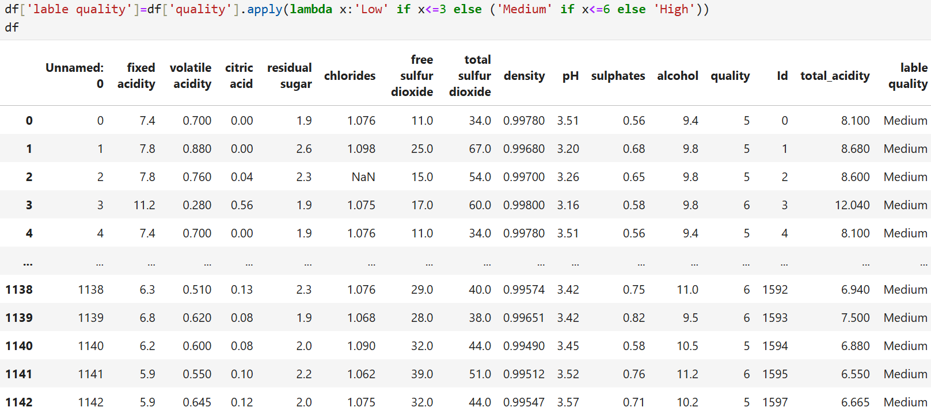

Slide 15
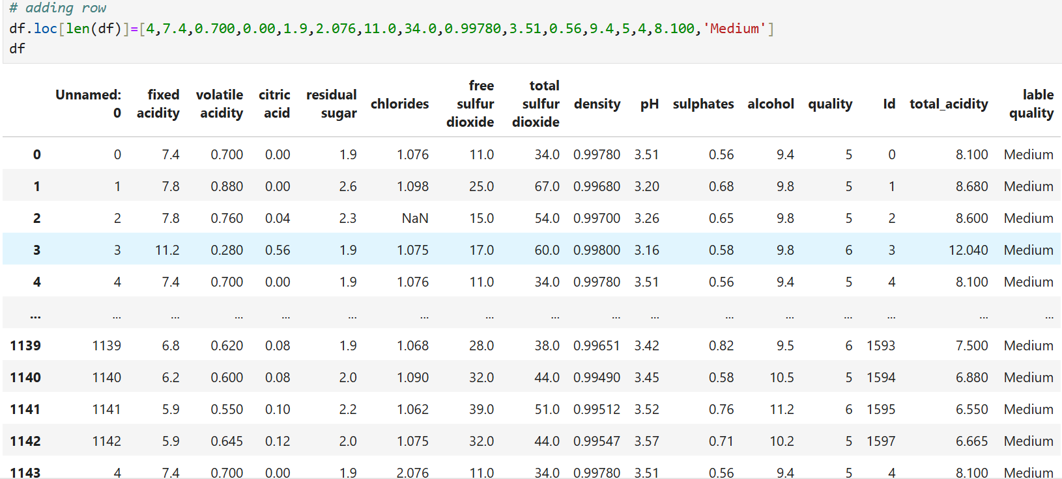

Slide 18
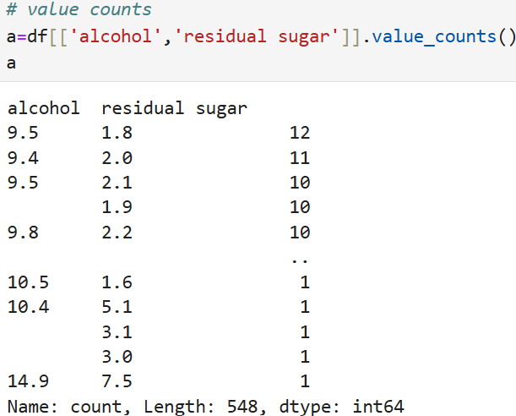
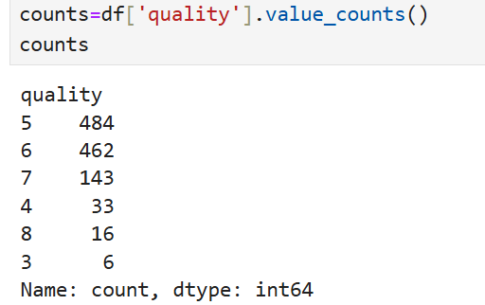

Slide 19
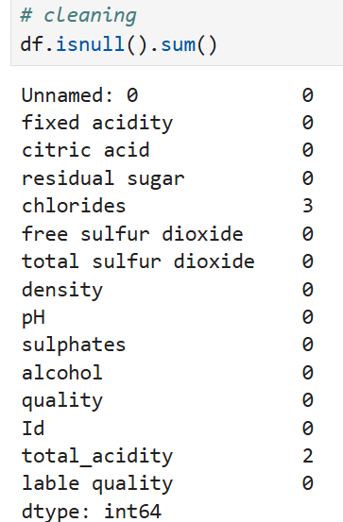

Slide 20
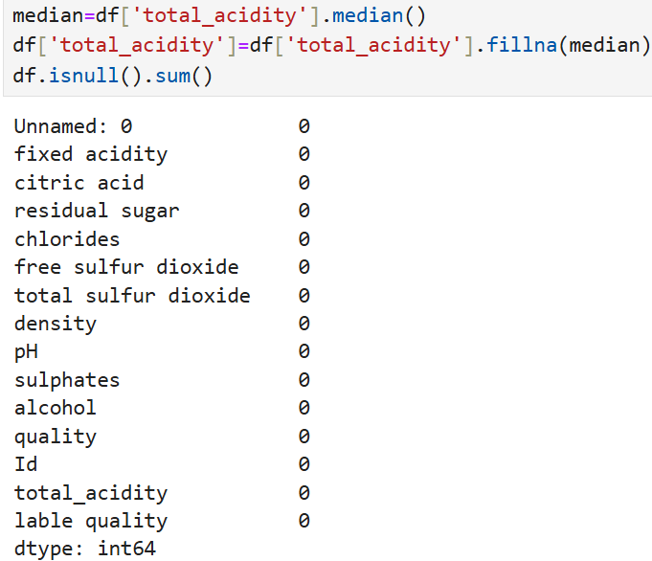
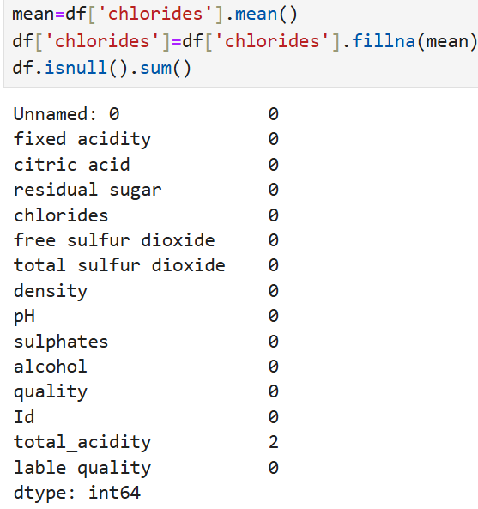

Slide 21

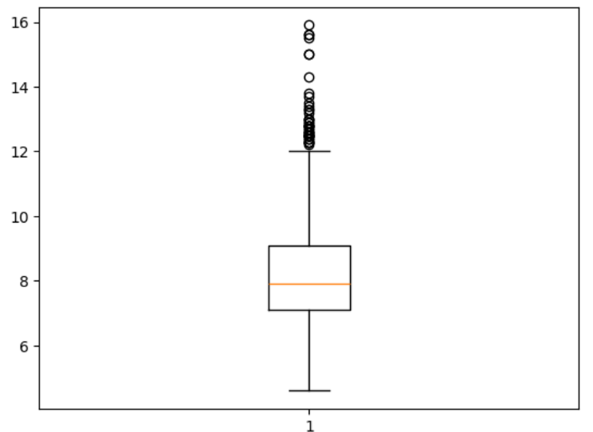

Slide 22
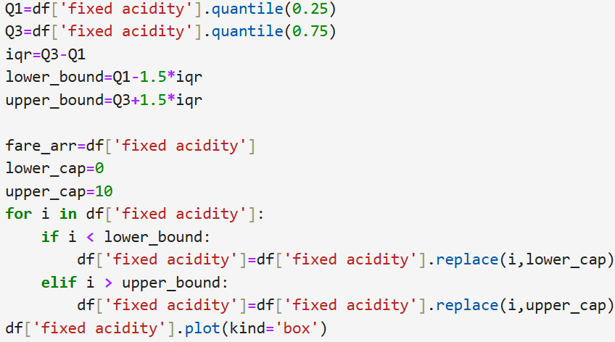
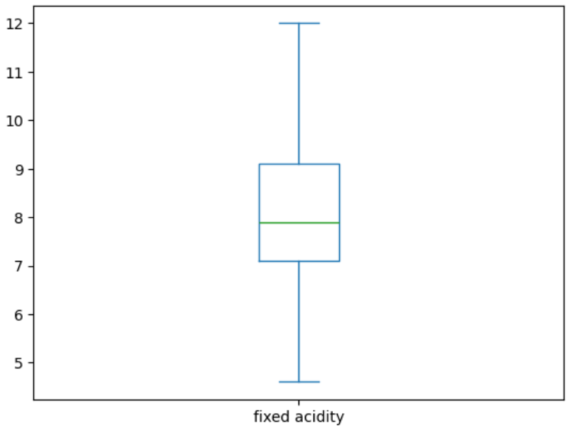

Slide 23
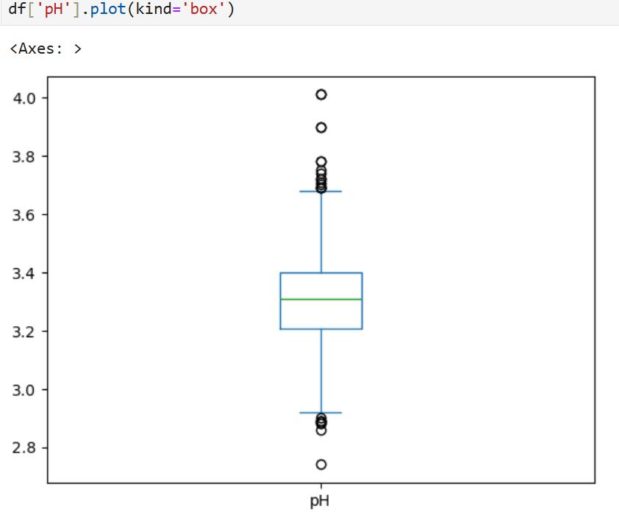

Slide 24
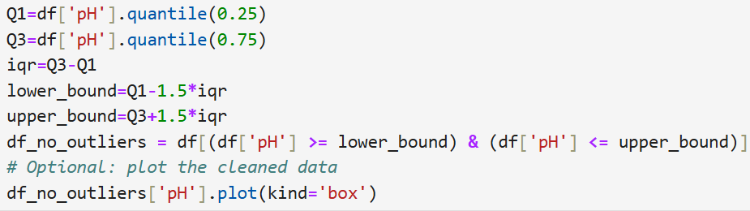
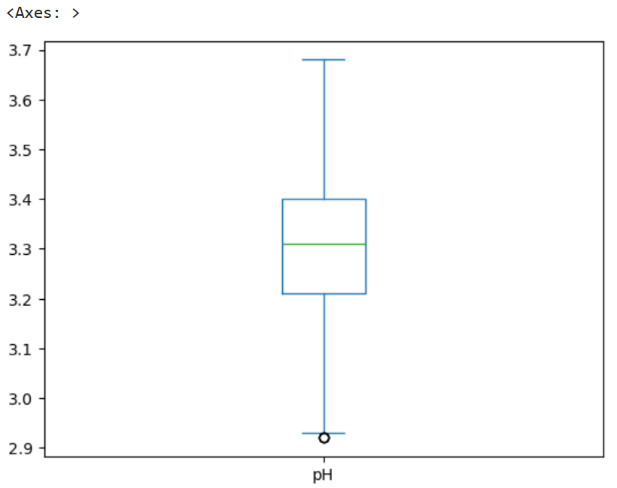

Slide 25
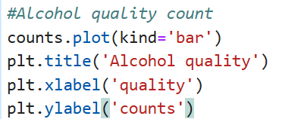
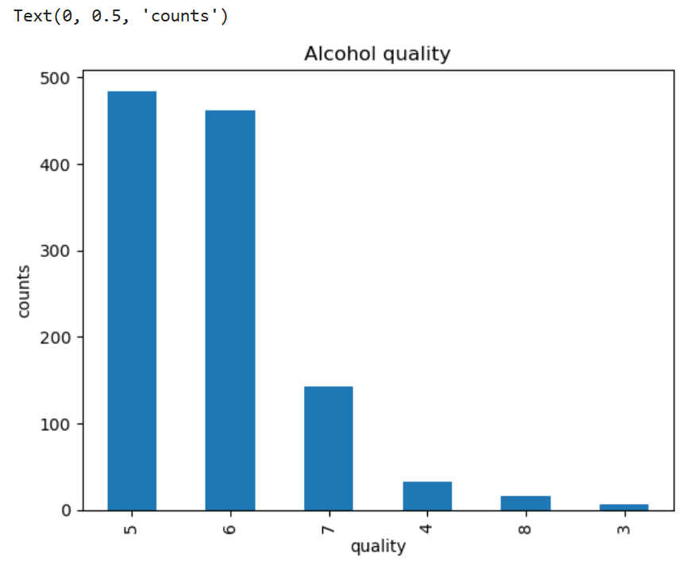
4.Data visuvalization

Slide 26
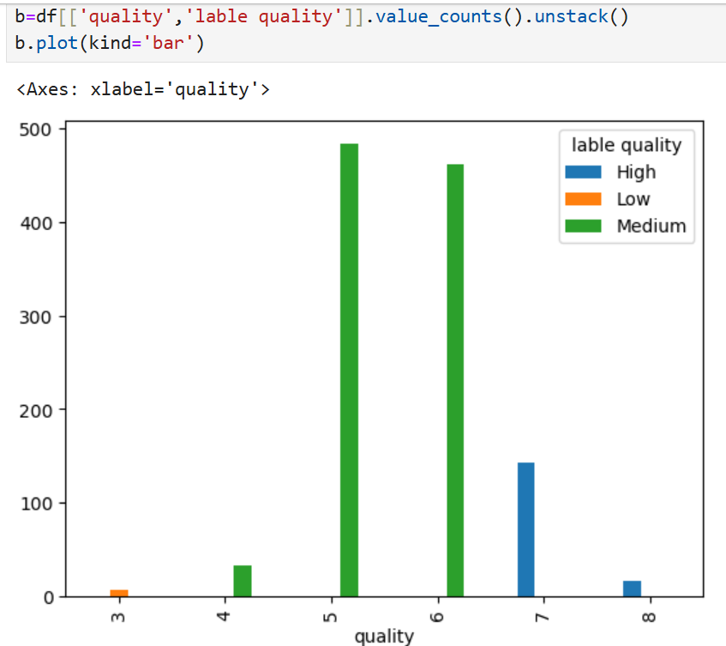

Slide 27
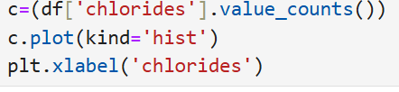
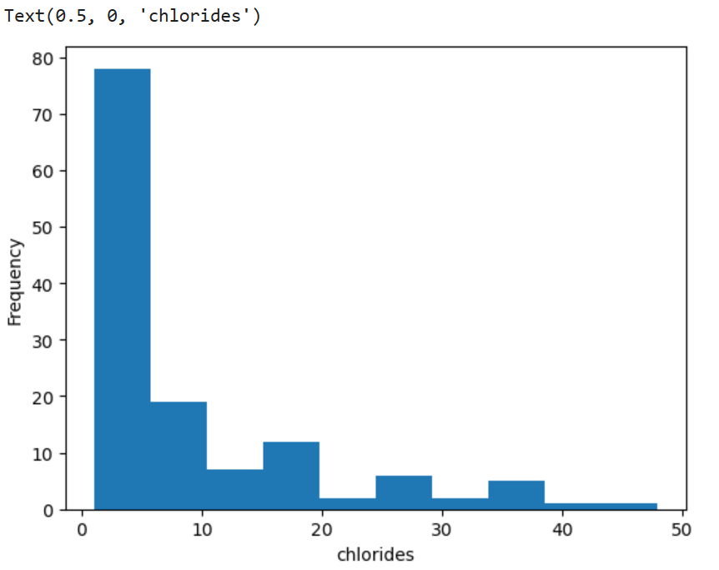

Slide 28
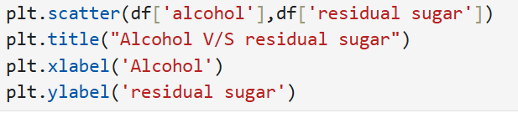
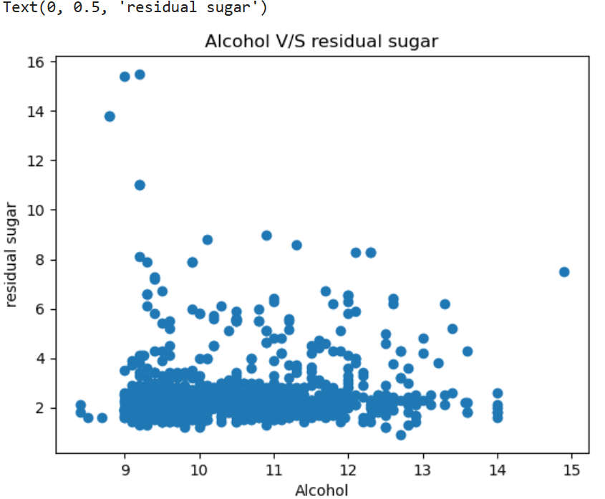

Slide 29
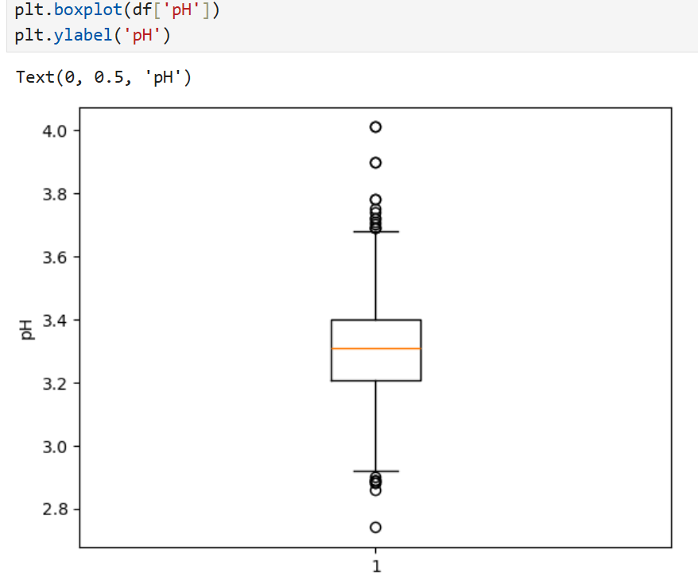

Slide 30
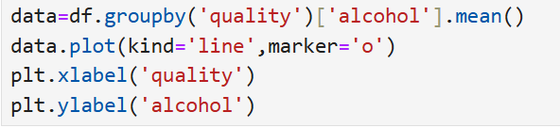
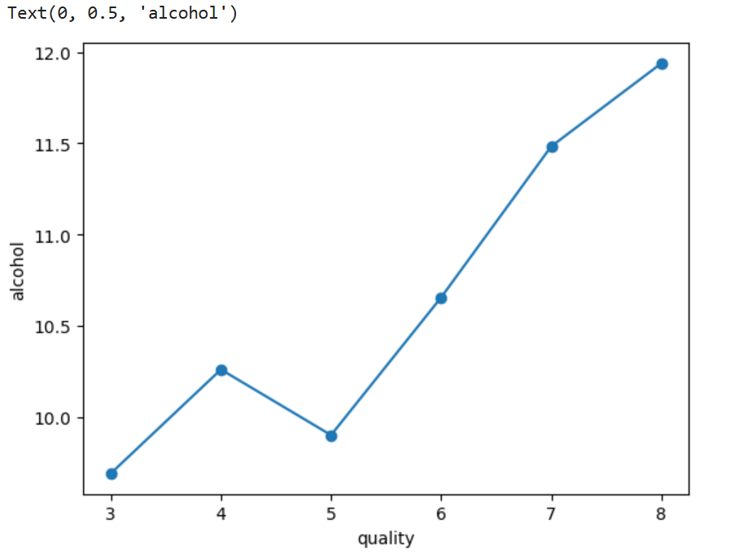

Slide 31
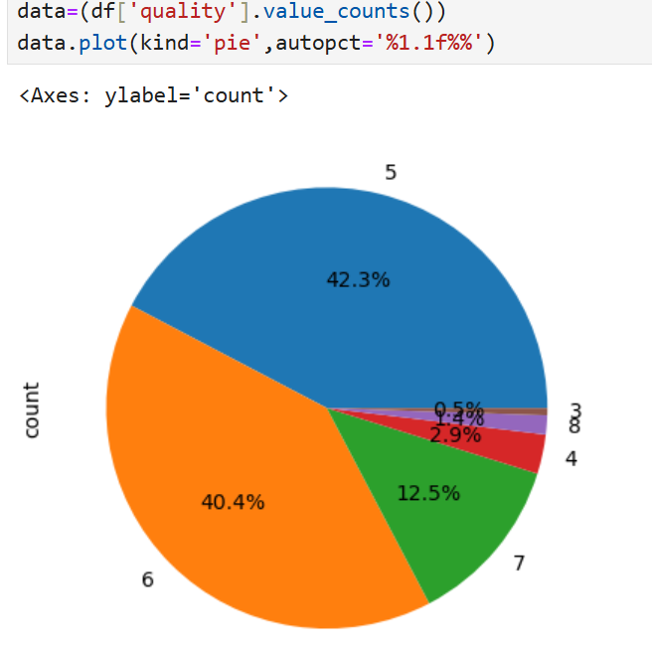

Slide 32

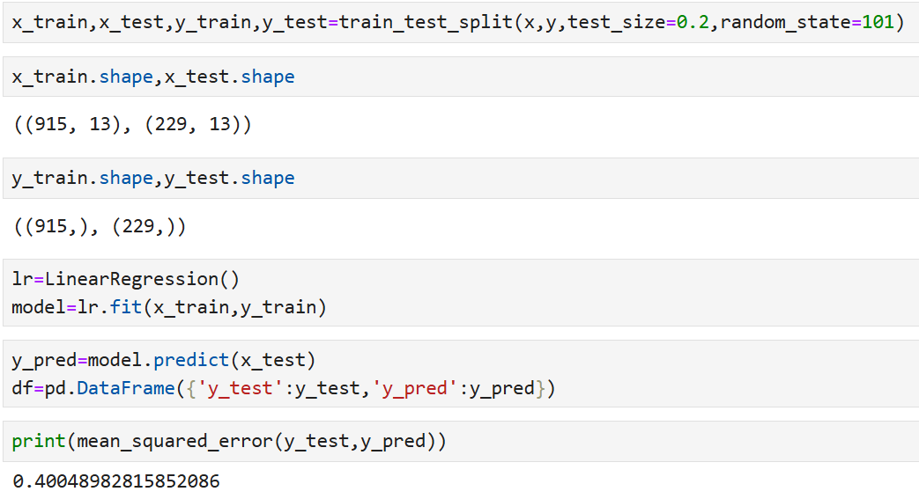
5.Data Training and Testing

Slide 33
THANK YOU

