Slide 1
Opening new Grocery Store in Singapore

Slide 2
Business Problem
Location of grocery store is the most important decisions that will determine the store will be hit or not.
Objective: To explore and select the best place for the new grocery store to open.

Slide 3
Data
List of neighborhoods in Singapore
List of latitude and longitude values
Venue data and information related to other grocery stores near by.
Geocoder package for lat and long values
Foursqaure API for venue data

Slide 4
Methodology
Web scrapping
Getting lat and long values
Foursqaure API for venue info
Grouping data, filtering data based on neighborhood and venue data
Using Kmeans and showing clusters

Slide 5
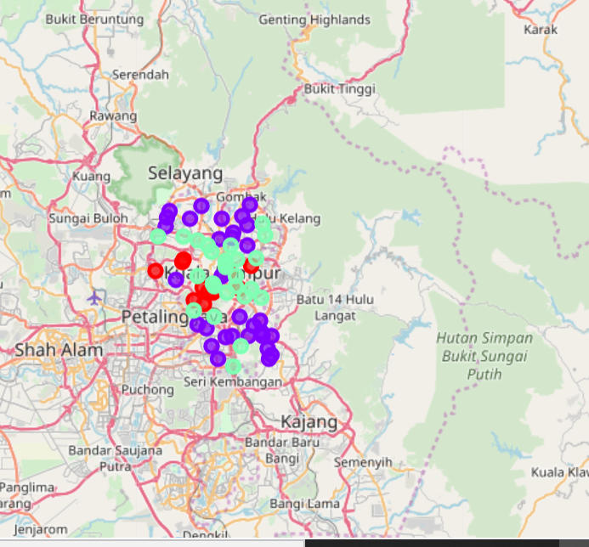
Results
we got 3 clusters
Cluster 1 : Neighborhoods
with moderate number of stores
Cluster 2 : Neighborhoods with
low to no existence number of stores
Cluster 3 : Neighborhoods with
high number of stores

Slide 6
Conclusion
Cluster 1 are the most preferred location to open a new grocery store.
This will provide better understanding to stakeholders to decide.

