Slide 1

Rajiv Gandhi University of Knowledge Technologies ,IIIT Srikakulam (Department of Computer Science & Engineering)
Review 1 of Major Project
for E-4 (2021-2022)
Title: “Crypto-currency Simulation”
Under the supervision of
Ms. Roopa Musidi
Department of Computer Science and Engineering, Rajiv Gandhi University of Knowledge Technologies,
Srikakulam – 532402

Slide 2
Team members
S.No | Name | ID No | Class
1. | A.Sruthi | S160933 | CSE-4E
2. | D.Divya | S160842 | CSE-4E
3. | V.J.Pushpa | S160492 | CSE-4E
4. | K.Mounika | S160055 | CSE-4A

Slide 3
Abstract
Commerce on the Internet has come to rely almost exclusively on financial institutions such as banks, serving as trusted third parties to process electronic payments. While the system works well enough for most transactions, it still suffers from the inherent weaknesses of the trust-based model. What is needed is an electronic payment system based on cryptographic proof instead of trust, allowing any two willing parties to transact directly with each other without the need for a trusted third party and it can be done by using block-chain. The system consists of two types of users as in the real-time use case: Users and Miners. Anyone can add a message to the block-chain, so using Asymmetric cryptography we can solve this problem by generating a pair of keys: a public key and a private key. Block-chains are un-hackable, so it makes perfect sense why cryptography makes use of this technology. The model is developed in Java, we intend to develop a generic cryptocurrency model simulation, which makes it easy to understand how a decentralized cryptocurrency model works.
Keywords: Block-chains, Cryptocurrency, Asymmetric cryptography, Miners.

Slide 4
Introduction
Crypto-currency is a digital currency in which encryption techniques are used to regulate the generation of units of currency and verify the transfer of funds, operating independently of a central bank. The main strength of crypto-currencies comes from being decentralized. The decentralized nature of crypto-currencies comes from the underlying paradigm, Block-chain. Block-chain was invented by a person (or group of people) using the name Satoshi in 2008 to serve as the public transaction ledger of the Page 6 crypto-currency bit-coin. The identity of Satoshi remains unknown to date. The invention of the block-chain for bit-coin made it the first digital currency to solve the double-spending problem without the need for a trusted authority or central server.

Slide 5
Problem Statement
The current state of international payments through banking channels is a hotch- potch,
It is a multistep process that involves a lot of intermediaries, lot of time and also requires a hefty
amount of money. Now, this model is developed in Java, which is intended to develop a generic
Crypto-currency model simulation, which makes it easy to understand how a decentralized
Crypto-currency model works.

Slide 6
Literature Survey
The field of development and application of blockchain simulators has received more attention
from the research community only recently, and requires significantly more consideration. There
is a need for research and study in many areas for entering the world of digital money. Prior to
conducting the necessary research in this area, entering the cryptocurrency market seems
unreasonable. The present study showed that no significant research has been done in this regard.
From the study of published articles in the field of cryptocurrency, it has been concluded that
much research has not been carried out on many related topics.

Slide 7
Existing System
i)Banking system:
More specifically, banks offer deposit accounts that are secure places for people to keep their money. Banks use the money in deposit accounts to make loans to other people or businesses. In return, the bank receives interest payments on those loans from borrowers.
Drawbacks of banking system:
Operating expenses.
Slow processes.
Going to bank whenever we want money.
Poor maintenance and technology.
Time consuming

Slide 8
ii)UPI System:
Unified Payments Interface (UPI) is a system that powers multiple bank accounts into a single mobile application (of any participating bank), merging several banking features, seamless fund routing & merchant payments into one hood.
Drawbacks:
UPI is a deal for smaller fund transfers, when an amount is high then other modes of online transfer are preferable.
Another issue with UPI is that it is difficult to persuade customers to download the bank application to their smartphone for a single payment interface because they are concerned about online fraud.
Do not tell your personal information such as the date of birth, The UPI pin, and other information to any other person, so that your account will be safe.
It doesn’t work on the slow internet.
You must know that you have to transfer money from the unified payment interface pin is also known as the UPI pin, and it is a very small digit, 4 to 6 digit while having a small digit, it is not safe, so make your payment carefully and its information does not let anyone else know

Slide 9
Proposed System
Cryptocurrencies are developed to decrease the cost of mediation and overcomes the weaknesses
of the traditional banking systems by building trust, and as of now, there exists over 1,800+
cryptocurrency specifications. Even with all the work done in the field, it is very difficult to
understand how cryptocurrencies actually work. We intend to develop a generic cryptocurrency
model simulation, which makes it easy to understand how a decentralized cryptocurrency model
works.

Slide 10
Technology used
Block-Chain:
A block-chain is a growing list of records, called blocks, that are linked using
cryptographic techniques. Each block contains a cryptographic hash of the
previous block, a timestamp, and transaction data. By design, a block-chain is
resistant to modification of the data. It is an open, decentralized ledger that can
record transactions between two parties efficiently and in a verifiable and
permanent manner.
A block-chain is typically managed by a peer-to-peer network collectively
adhering to a protocol for inter-node communication and validating new blocks.
Once recorded, the data in any given block cannot be altered retroactively
without the alteration of all subsequent blocks, which requires consensus of the
network majority.

Slide 11
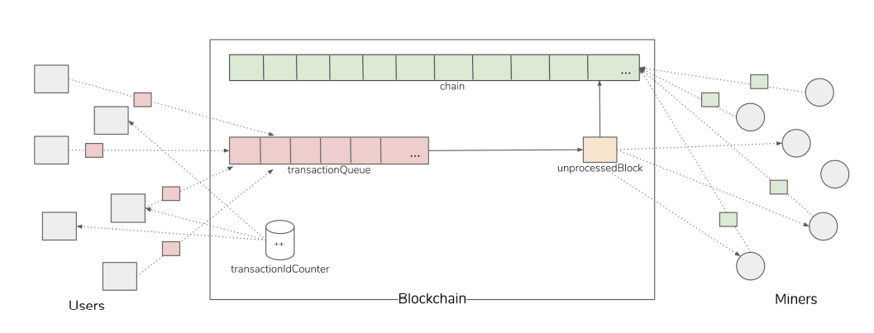
Simulation model

Slide 12
Advantages
Protection from inflation: Inflation has caused many currencies to urge their value to decline with time.
Self-governed and managed.
Decentralized.
Cost-effective mode of transaction.
Currency exchanges finish smoothly.
Secure and private.
Easy transfer of funds.

Slide 13
Conclusion
We have used Java Security and Concurrency APIs. The resulting simulation
model helped a few of my peers understand crypto-currencies and block-chain in a
more friendly way, for which we are proud of.

Slide 14
Thankyou

