Slide 1
OBJECT DETECTION (using yolo)

Slide 2
Introduction:
Object detection is an important and challenging field in computer vision.
An image classification or image recognition model simply detect the probability of an object in an image.
It has been widely used in autonomous driving, industrial detection , robot vision..etc

Slide 3
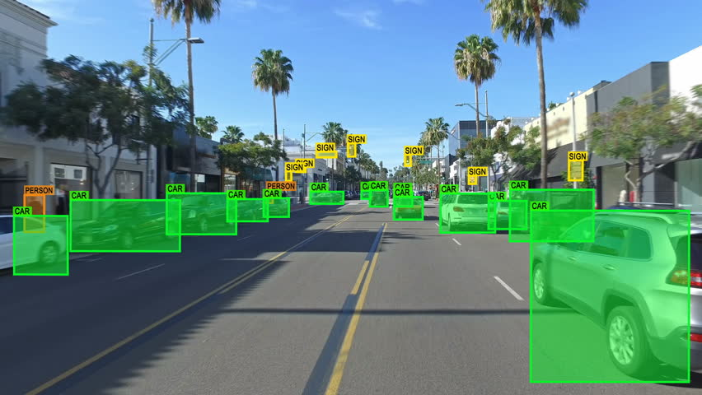
Object detection:

Slide 4
Applications of object detection
Object detection aids in:
Tracking objects
People Counting
Vehicle Detection
Disease detection
Pose estimation, CCTV surveillance etc

Slide 5
Existing System and previous techniques:
RCNN (2014)
Fast RCNN and Faster RCNN (2015)
Mask R-CNN (2017)
Pyramid Networks/FPN (2017)
Retina Net (2017)

Slide 6
R-CNN:
ROSS GIRSHICK proposed a method where we use selective search to extract just 2000 regions from the image and he called them region proposals.
These 2000 region proposals are generated using the selective search algorithm which is written below.

Slide 7
Selective Search:
Generate initial sub-segmentation, we generate many candidate regions.
Use greedy algorithm to recursively combine similar regions into larger ones
Use the generated regions to produce the final candidate region proposals

Slide 8
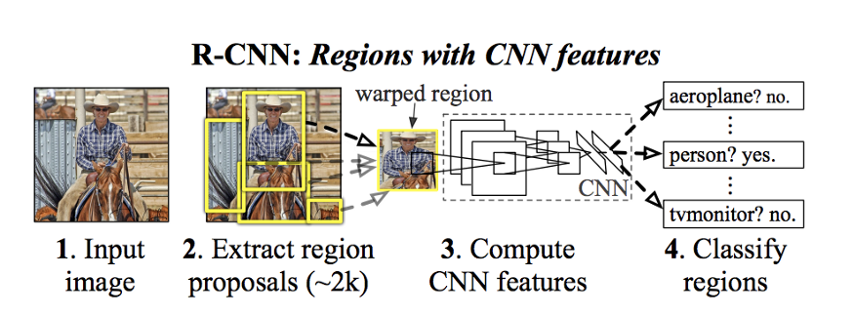
R-CNN

Slide 9
Limitations of R-CNN:
It still takes a huge amount of time to train the network as you would have to classify 2000 region proposals per image.
It cannot be implemented real time as it takes around 47 seconds for each test image.
The selective search algorithm is a fixed algorithm.

Slide 10
Limitations:
Unexpected number of multiple moving objects.
Size variation and poorly textured objects.
Rapid change in illumination conditions.
Shadows and multiple occlusions.

Slide 11
Proposed system:
We are coming up with YOLOv3(You Only Look Once) algorithm.
YOLOv3 is a Deep Learning architecture. It is a convolutional neural network (CNN) for object detection used in real-time.
It is popular because it has a very high accuracy while also being able to run in real-time or used for real-time applications.

Slide 12
The YOLO algorithm “only looks once” at the input image that is it needs only one forward propagation pass through the network to make the predictions. It uses k-means clustering because it gives more weight to the bigger clusters.
How does it works:
The algorithm applies a single neural network to the entire full image.

Slide 13
Then this network divides that image into regions which provides the bounding boxes and also predicts probabilities for each region. These generated bounding boxes are weighted by the predicted probabilities.
The non-max suppression technique makes sure that the object detection algorithm only detects each object once and it discards any false detections, it then gives out the recognized objects along with the bounding boxes.

Slide 14
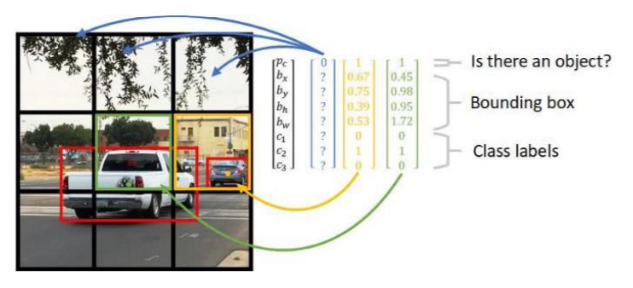

Slide 15
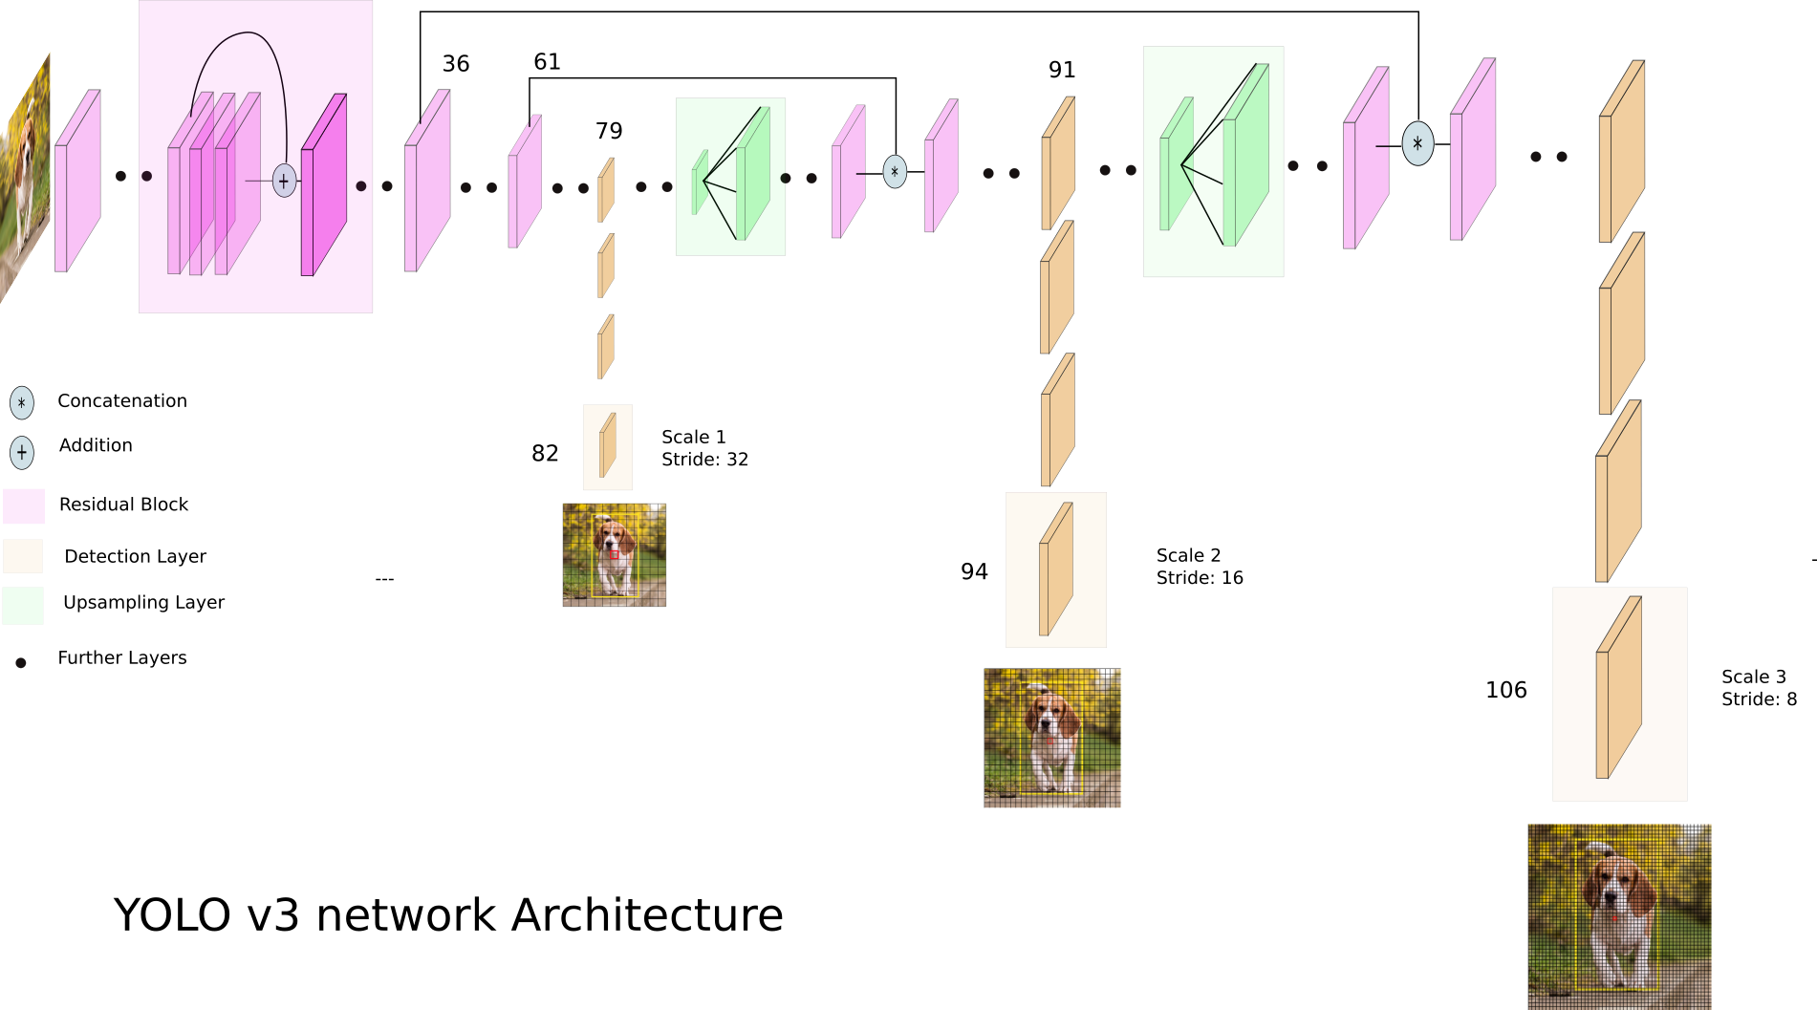
Architecture:

Slide 16
Explanation:
YOLO is a convolution neural network. It consists of a total of 24 convolutional layers and followed by 2 fully connected layers. Each layer has its own importance and the layers are separated by their functionality.

Slide 17
Advantages:
YOLOv3 has the advantages of detection speed and accuracy and meets the real –time requirements for traffic vehicles and ships detection.
Limitations:
YOLOv3 has large number of backbone network parameters and requires high hardware performance.

Slide 18
Conclusion:
YOLOv3 is extremely fast with good speed and accuracy making it a very powerful object detection model. It can used efficiently in real-time processing. It can process upto 45 frames per second that is why it is mainly used in traffic, autonomous cars etc.

Slide 19
Big concept
When you focus on good , the good gets the better........

