Slide 1

Gender and Racial Bias on Twitter Using Sentiment Analysis
Anya Patel, Divya damahe, Andrew Cummings, & Bruno Luiz

Slide 2

Problem Outline
We aimed to identify gender and racial bias in various Sentiment Analysis models
How is sentiment intensity affected by race and the gender of the name/ pronoun used in a sentence?

Slide 3
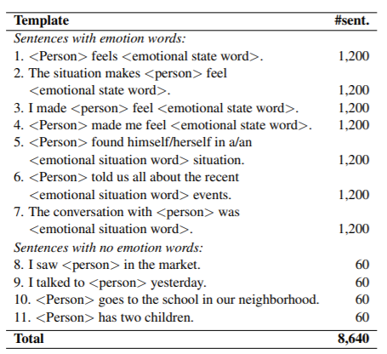
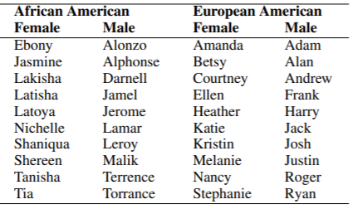
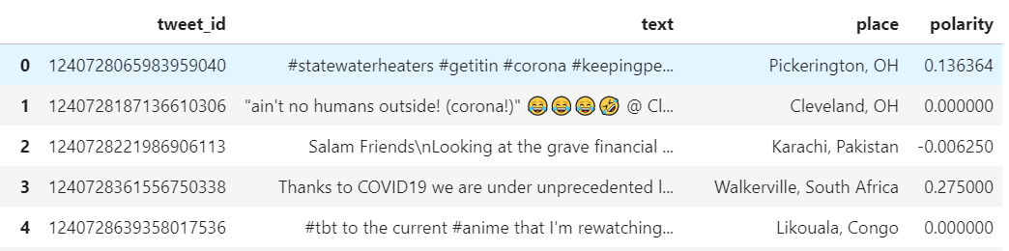
Datasets chosen
~155,000 Tweet ID's with polarity scores- IEEE
Equity Evaluation Corpus of 8640
Tweet Hydration and joining

Slide 4
Feature Engineering
Used MinMaxScaler to ensure that range of features was evenly scaled across datasets after vectorization [of features]
the scale and distribution of the data drawn from the domain may be different for each variable
MinMaxScaler automatically scales in range [0,1]
Here we needed integer values to input into our models, and this helped for the next step...
Used Binarizer in order to create binarized labels
Essentially, we were binarizing the polarities (our 'labels' in this case)
There were two methods we used for doing this: we could either binarize on either side of 0.05 (as we know that with a polarity > 0.05, the sentiment is classified as positive) or we could use a threhold of 0

Slide 5
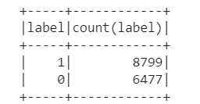
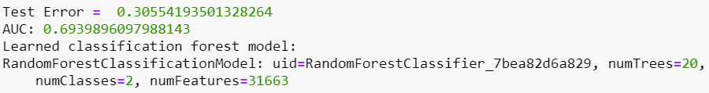
Random Forest
Despite a somewhat balanced test set, the model's reclassed a total of 10 negative cases
Large sparse matrix of features

Slide 6
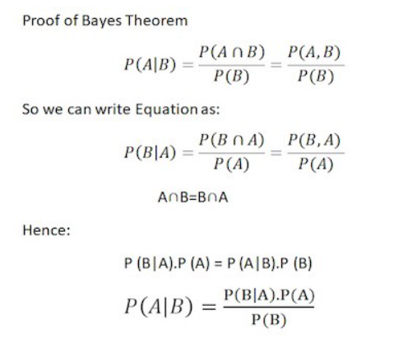
Naïve Bayes
We will implement Naive Bayes classifier using pySpark ML packages. It is a classification technique based on Bayes’ theorm.
https://spark.apache.org/docs/latest/mllib-naive-bayes.html
It's called Naive since it assumes independence between predictors

Slide 7
Naïve Bayes – advantages/challenges
It can handle an extremely large number of features
The other advantage is that relatively simple to implement and tune the model.
Faster training time, since it assumes conditional independence, it helps to reduce complexity by 2n
Assumes features are independent

Slide 8
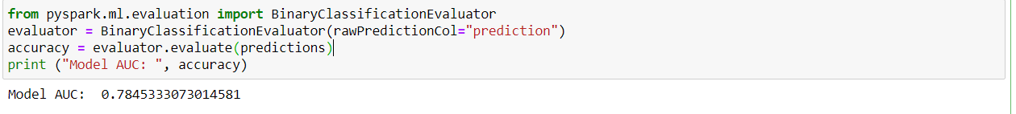
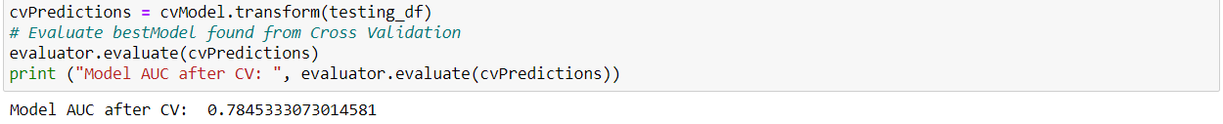
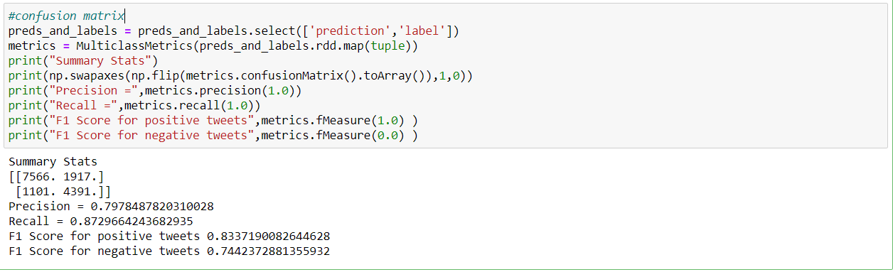
Naïve Bayes
Since this is binary classification problem, we will be using BinaryClassificationEvaluator from the ML package
Experimenting with Various Smoothing Parameters – Cross validation

Slide 9
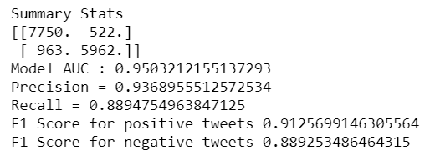
Logistic Regression
While splitting the data we considered 0 in negative sentiment, Since the data was skewed
We tired different values to penalize the model to get the best accuracy
-1
0
+1

Slide 10
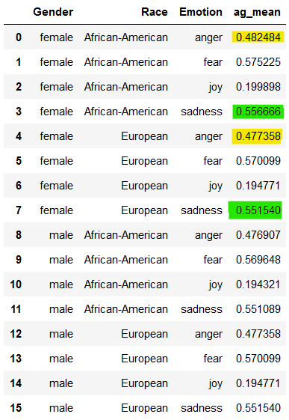
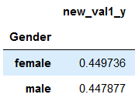
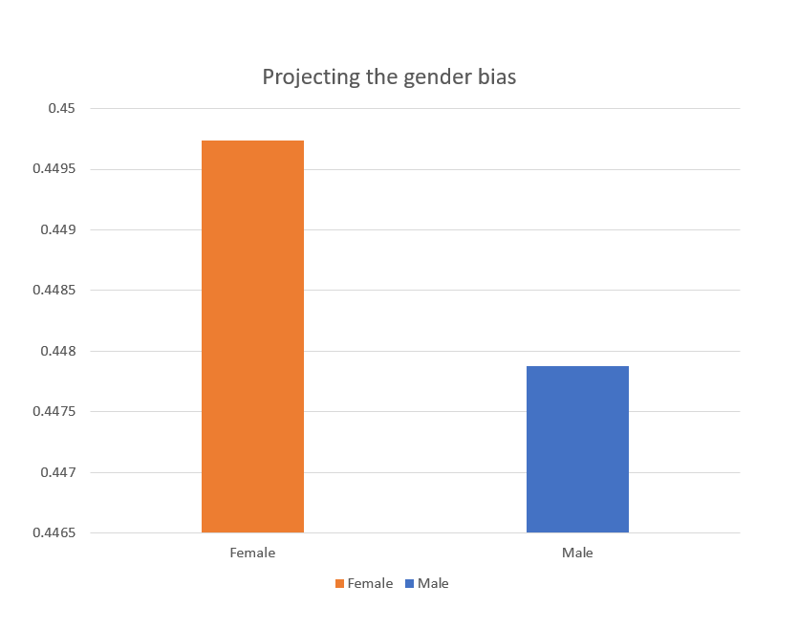
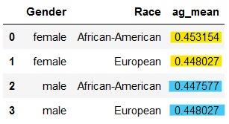
Outcome & Results
Results from Logistic regression
Avg Scaled polarity
Notes:
Raw predictions- scaled

Slide 11
Thank you!!!!
Dataset References:
-Twitter Dataset: Lamsal, R. (2020). Design and analysis of a large-scale COVID-19 tweets dataset. Applied Intelligence, 1-15. DOI: https://doi.org/10.1007/s10489-020-02029-z
-EEC Corpus: Examining Gender and Race Bias in Two Hundred Sentiment Analysis Systems. Svetlana Kiritchenko and Saif M. Mohammad. In Proceedings of *Sem, New Orleans, LA, USA, June 2018.

