Slide 1

COVID – 19 Data modeling, analysis and death prediction.
Divya Devadas
MSDS692
Data Science Practicum
Regis University

Slide 2
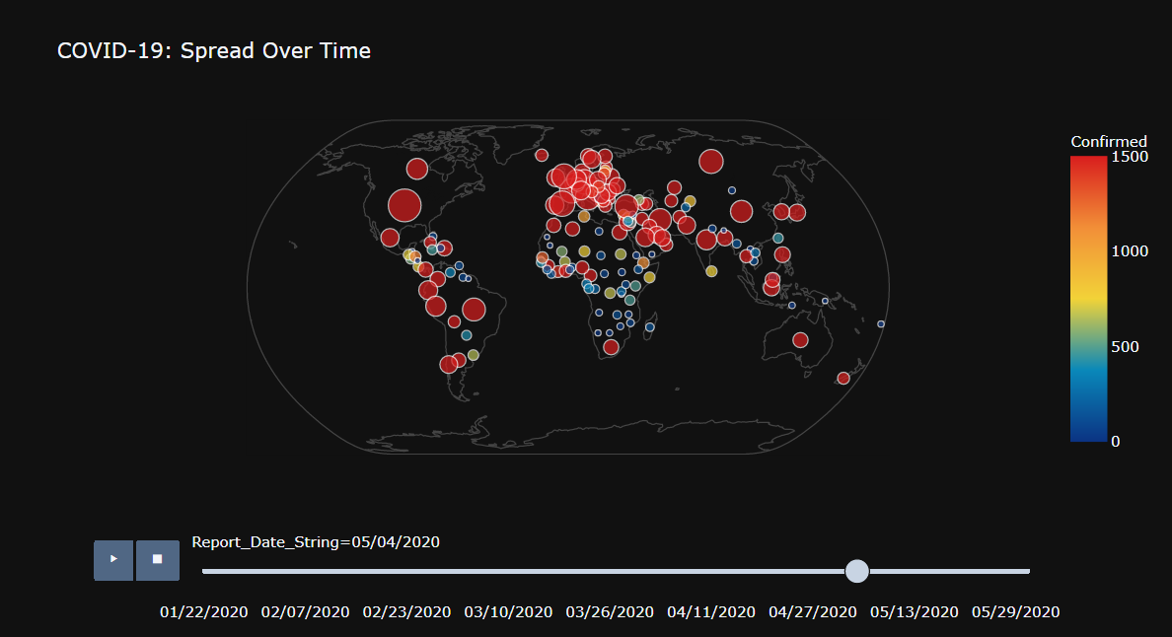
OVERVIEW
The objective of the project is to use the COVID-19 data from CSSE at Johns Hopkins University and Our World in Data.
Explore and analyze the data using python, create visualizations.
Machine Learning Models: Build Prophet, SIR, and linear regression model for death prediction

Slide 3
DATA CLEANING –Missing Values & NaN
Replace the nan with empty string using fillna(‘’) from Pandas
#Replace the Nan with 0 – fillna(0) - owid_covid_data[ColumnToClean] = owid_covid_data[ColumnToClean].fillna(0)

Slide 4
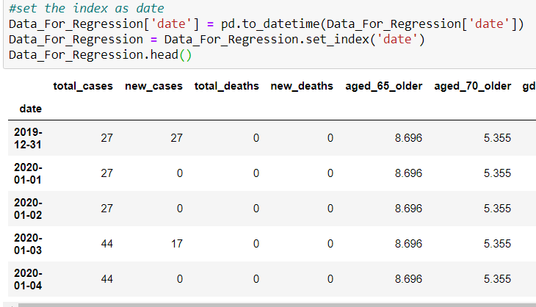
DATA CLEANING – Date column
Linear regression doesn't work on date data. Therefore we need to convert it into index foam for predicting date value in the future.

Slide 5
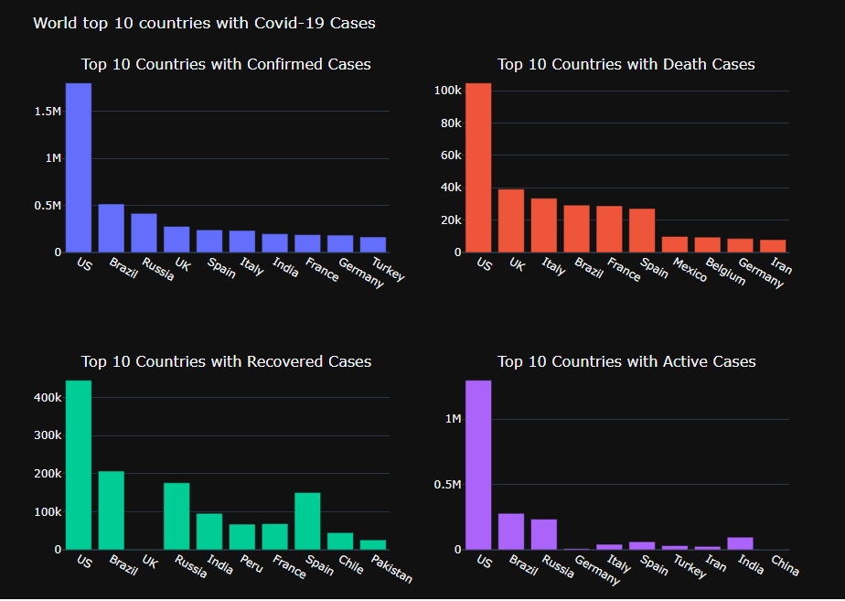
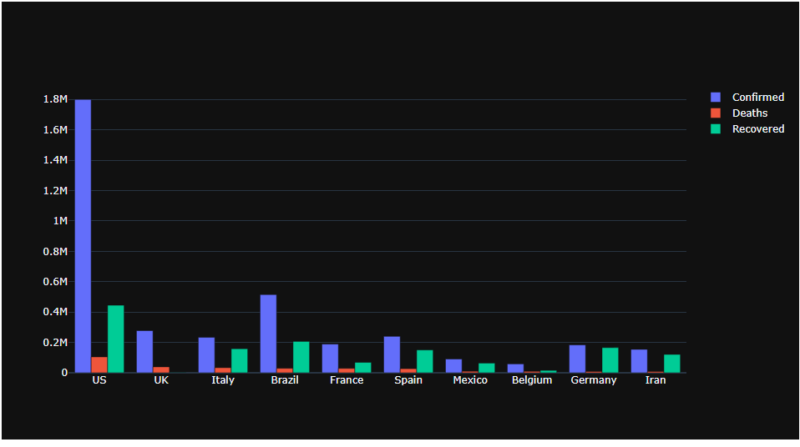
EXPLORITORY DATA ANALYSIS – Bar Charts for comparing Confirmed, Death and Recovered cases
Used Plotly library to create these visuals(from plotly.subplots import make_subplots)
US has the top most number of cases, followed by Brazil and UK.

Slide 6
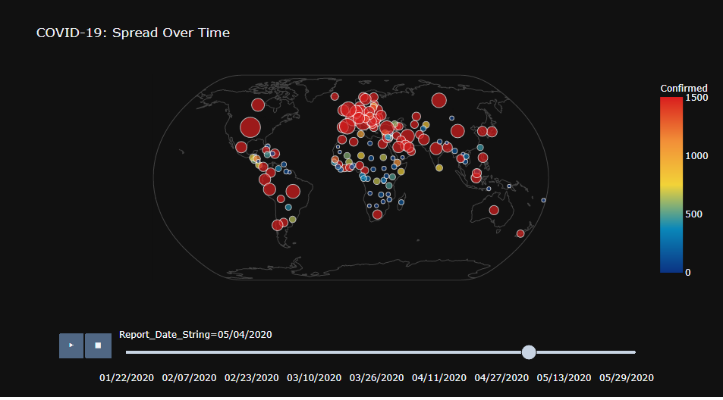
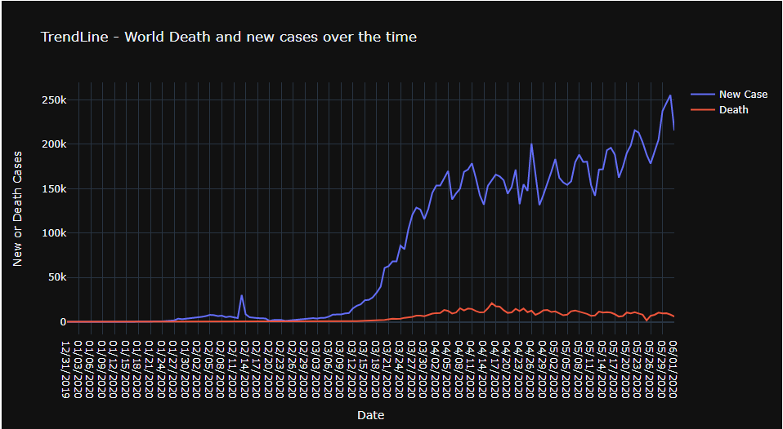
EXPLORITORY DATA ANALYSIS – spread over the Time
TRENDLINE
Here the trend line showing the increase in the number of new cases in the blue line as well as the red line shows the corresponding death rate
GEOGRAPHICAL SCATTER PLOT
Used plotly library(import plotly.express as px)
function used- fig = px.scatter_geo()
The red colored bubbles indicates the comfirmed cases

Slide 7
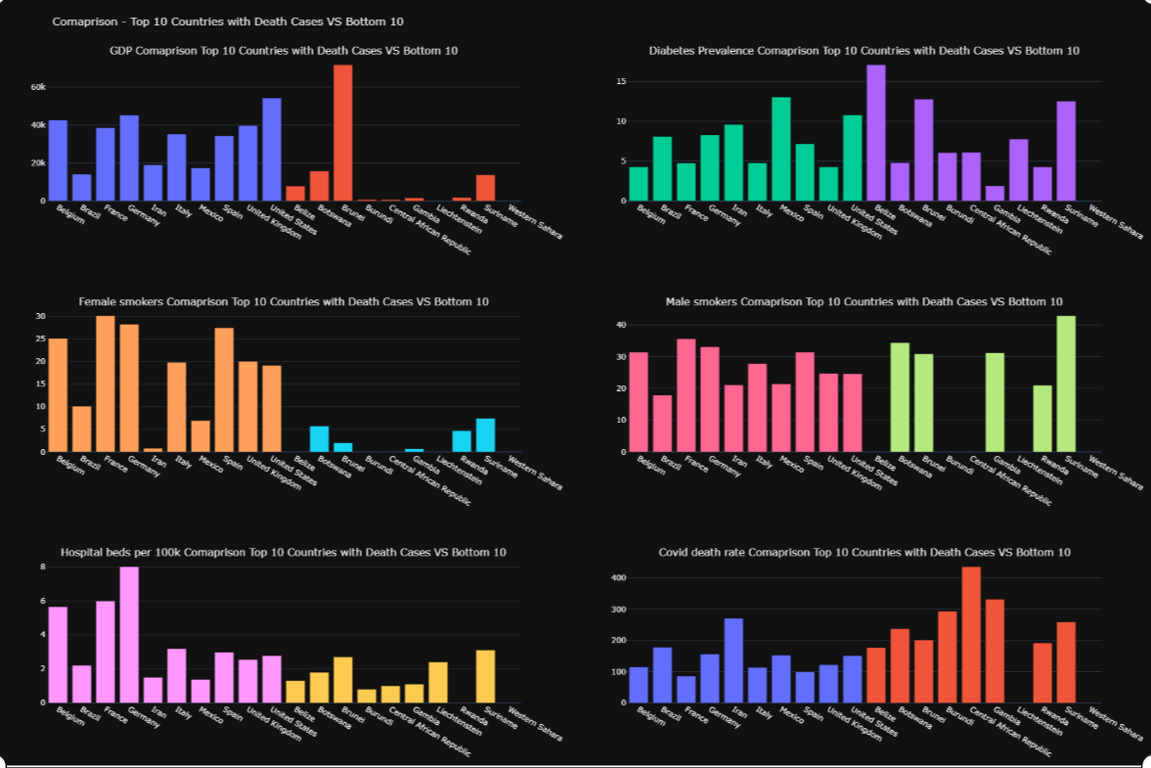
EXPLORITORY DATA ANALYSIS – Top 10 Death cases VS bottom 10 – GDP, Smokers, Diabetic etc

Slide 8
MACHINE LEARNING MODELS
Linear Regression Model: used to predict future values from past values.
Prophet Model: Prophet is a procedure for forecasting time series data based on an additive model where non-linear trends are fit with yearly, weekly, and daily seasonality, plus holiday effects.
SIR Model: SIR model is one of the simplest compartment model consist of three compartments S for the number of susceptible, I for the number of infectious, and R for the number of recovered or deceased.

Slide 9
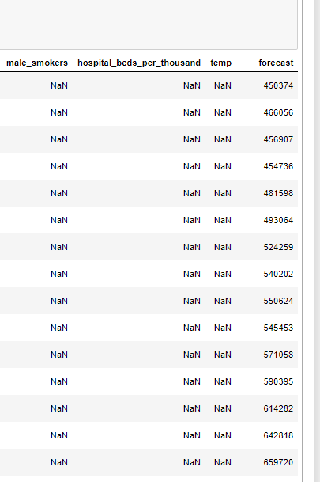
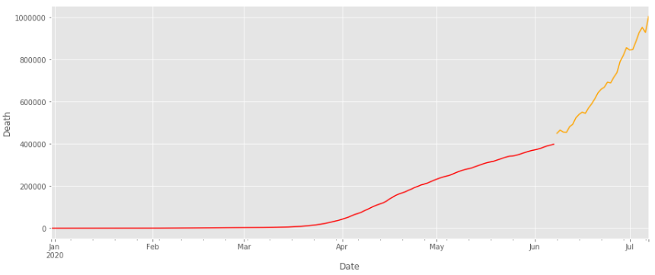
RESUTS- LINEAR REGRESSION
Orange line indicates the future forecast of Death.
Predicted the Death rate for next 30 days in the forecast column

Slide 10
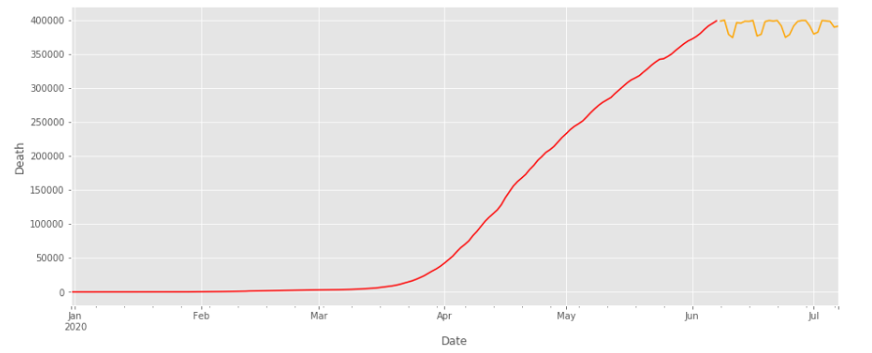
RESULTS- XGBOOST – Comparing The Prediction
Orange line indicates the death prediction

Slide 11
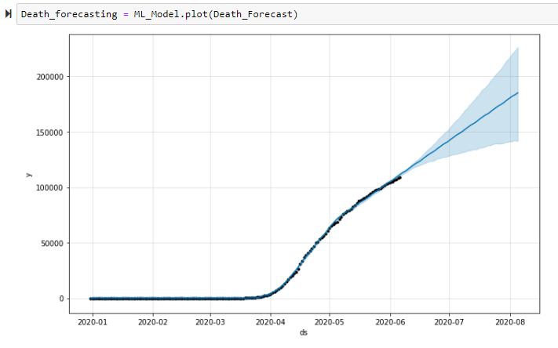
RESULTS- USING PROPHET MACHINE LEARNING MODEL
Prophet expect Dataframe with columns "ds" and "y" with the dates and values respectively, here ‘y’ is total death.
The blue line shows the prediction along with its lower and upper bound of the uncertainty interval
Great for predicting different forecast with time series data like covid19 data.

Slide 12
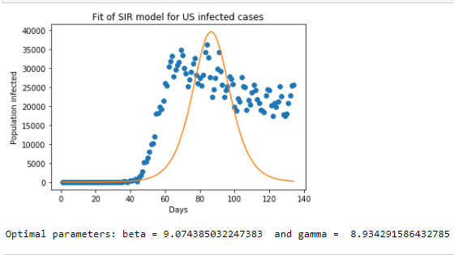
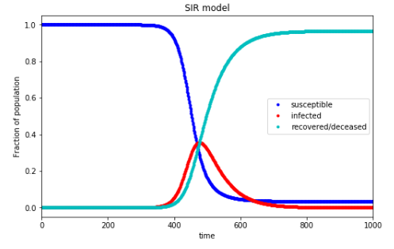
SIR Model
SIR model is one of the simplest compartment model consist of three compartments S for the number of susceptible, I for the number of infectious, and R for the number of recovered or deceased.
Used the US Covid-19 data for the prediction.

Slide 13
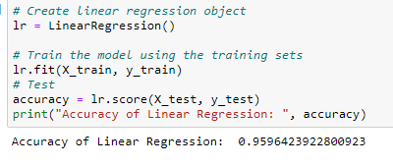
ACCURACY
Accuracy of Linear Regression:

Slide 14
CONCLUSION

