Slide 1


COVID – 19 Data Modeling, Analysis & Death prediction.
Divya Devadas
MSDS692
Data Science Practicum
Regis University

Slide 2

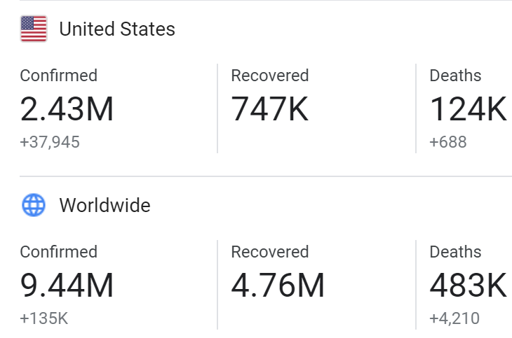
Background
Covid-19 is respiratory illness from the family of MERS-CoV and SARS-CoV
Discovered and started in wuhan china ( December2019)
First death reported on Jan 11 2020
Jan 20 first case reported in united state
Declared as a pandemic by WHO ( March 11 2020)

Slide 3
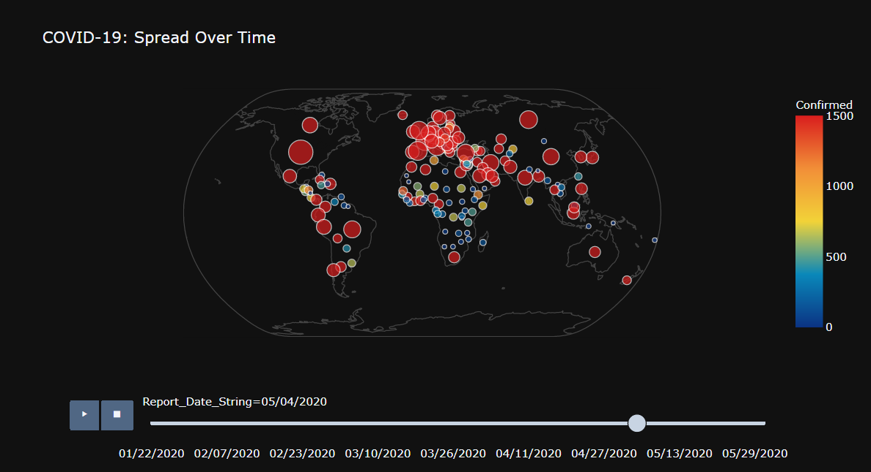
OVERVIEW
The objective of the project is to create a death projection based on COVID-19 data from CSSE at Johns Hopkins University and Our World in Data.
Explore and analyze the data using python with help of panda, sklearn, scipy, xgboost, plotly, matplotlib and also create visualizations.
Machine Learning Models: Prophet, SIR, and linear regression model for death prediction

Slide 4
DATA CLEANING& Preparation
Null Handling
Replace the nan with empty string using fillna(‘’) , Replace the float/int Nan from Pandas
Format
Format columns like date, object to float and also rename columns to redable name etc.
Aggregation
Aggregate Data using group by Date or Country
Concatenation
Concatenate multiple Data frames to get the data from different sources
Append
Append Data frames in order to merge data
Create
Created Empty row for the future prediction with date index

Slide 5
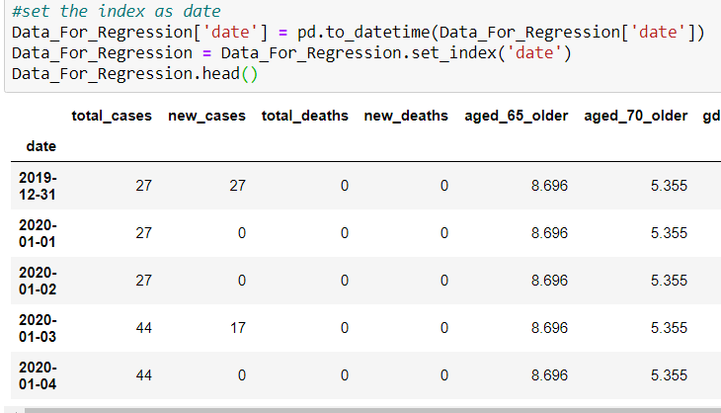
DATA CLEANING – Date column
Linear regression doesn't work on date data. Therefore we need to convert it into index foam for predicting date value in the future.

Slide 6
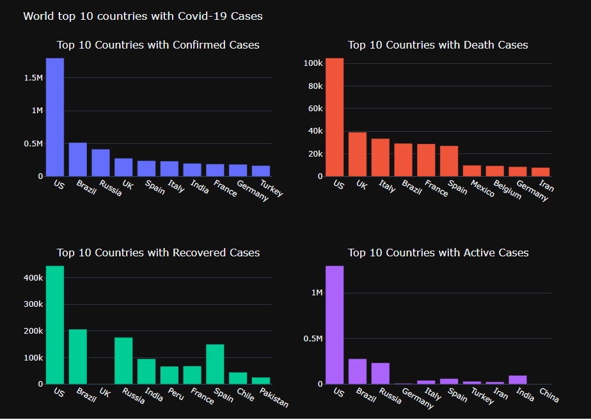
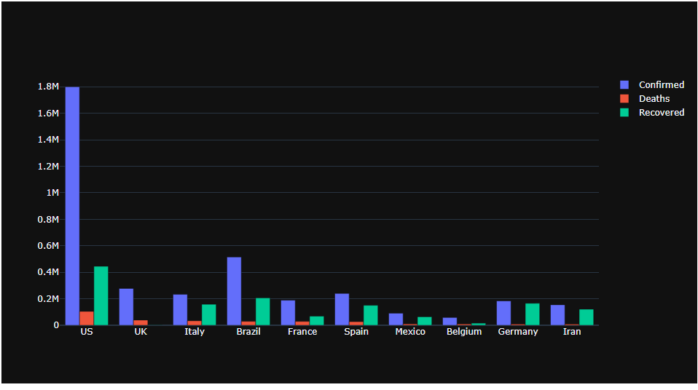
EXPLORITORY DATA ANALYSIS – Bar Charts for comparing Confirmed, Death and Recovered cases
Used Plotly library to create these visuals(from plotly.subplots import make_subplots)
US has the top most number of cases, followed by Brazil and UK.

Slide 7
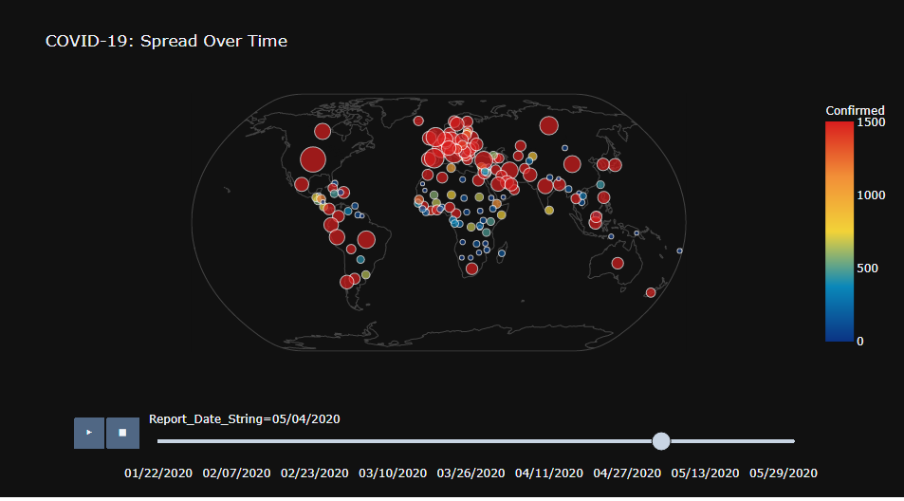
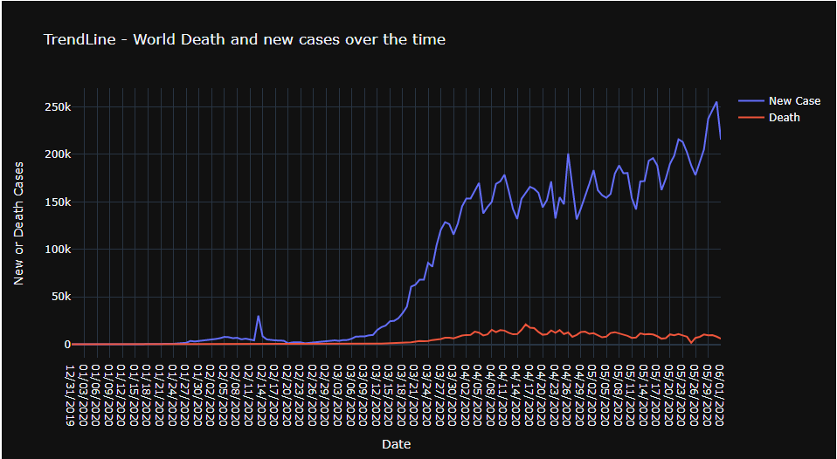
EXPLORITORY DATA ANALYSIS – spread over the Time
GEOGRAPHICAL SCATTER PLOT
Used plotly library(import plotly.express as px)
function used- fig = px.scatter_geo()
The red colored bubbles indicates the comfirmed cases
TRENDLINE
Here the trend line showing the increase in the number of new cases in the blue line as well as the red line shows the corresponding death rate

Slide 8
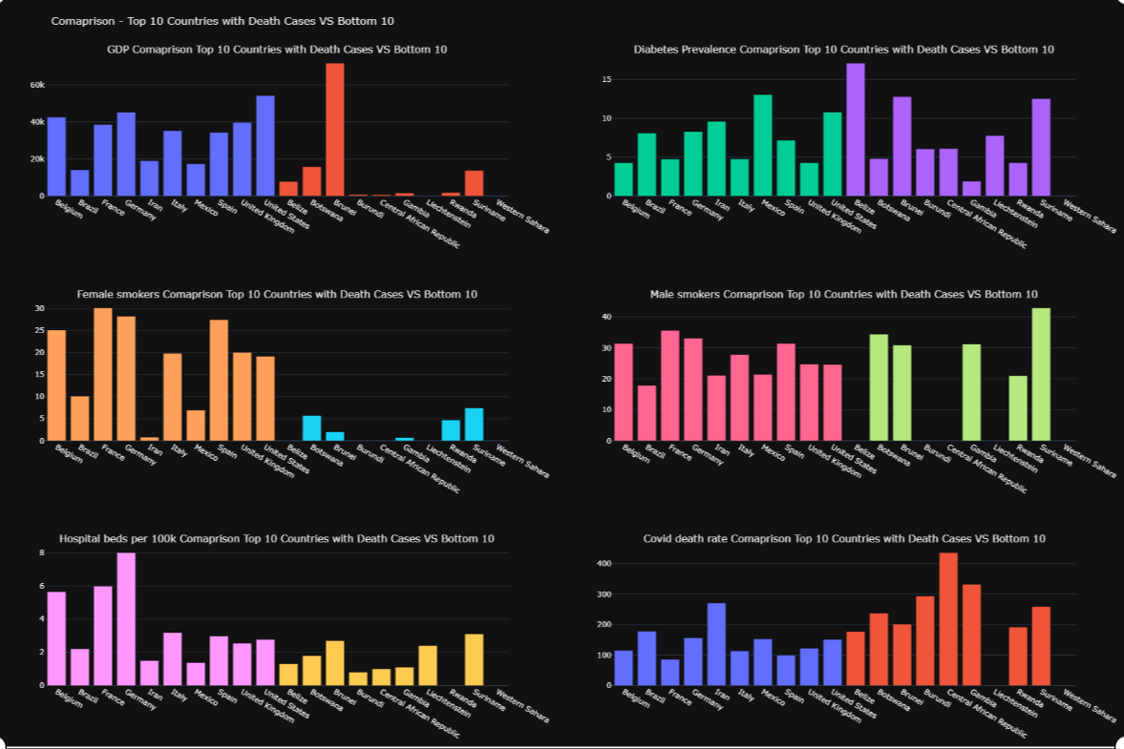
EXPLORITORY DATA ANALYSIS – Top 10 Death cases VS bottom 10 – GDP, Smokers, Diabetic etc

Slide 9
MACHINE LEARNING MODELS
Linear Regression Model: used to predict future values from past values.
Prophet Model: Prophet is a procedure for forecasting time series data based on an additive model where non-linear trends are fit with yearly, weekly, and daily seasonality, plus holiday effects.
SIR Model: SIR model is one of the simplest compartment model consist of three compartments S for the number of susceptible, I for the number of infectious, and R for the number of recovered or deceased.
SIR Extended Model: This model extended SIR with Exposed , Hospitalized and Dead Compartments

Slide 10
LINEAR REGRESSION
# test_size = 0.2 ==> 20% data is test data
X_train, X_test, y_train, y_test = train_test_split(X, y, test_size=0.2, random_state=0)
# Create linear regression object
lr = LinearRegression()
# Train the model using the training sets
lr.fit(X_train, y_train)
# Test
accuracy = lr.score(X_test, y_test)
# Predict using our Model
forecast_prediction = lr.predict(X_forecast_out)
Used OneWorld.org data for modeling.
Predicted the Death rate for next 30 days with independent variable like age, gdp, diabetes, smokers, hospital beds etc.
Split into 80% train and 20% test data.
Linear Regression Fitted with Accuracy of 0.9596
Used sklearn.model_selection for train_test_split
Used sklearn.linear_model for LinearRegression

Slide 11
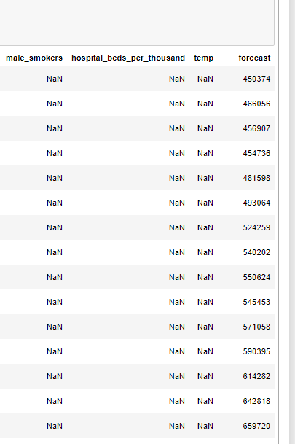
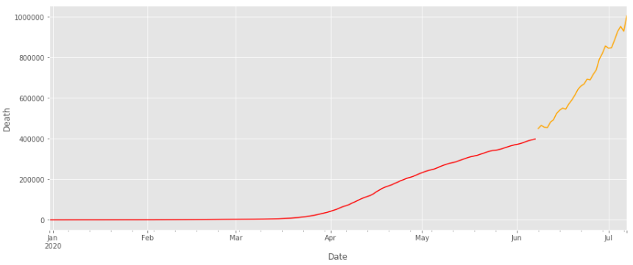
LINEAR REGRESSION
Orange line indicates the future forecast of Death.
Predicted the Death rate for next 30 days in the forecast column

Slide 12
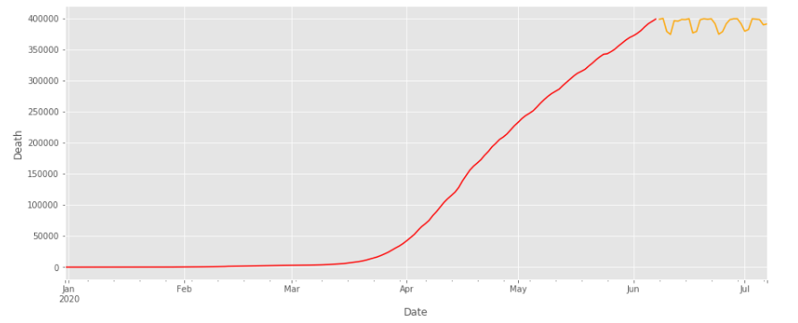
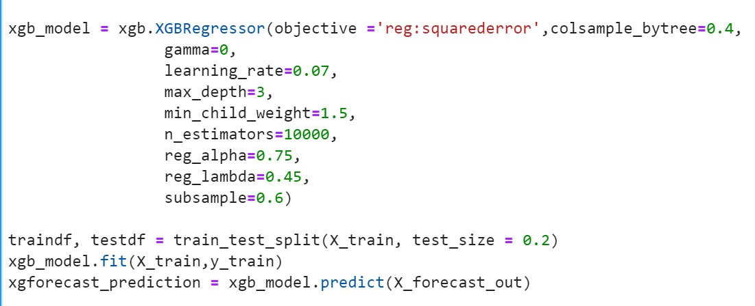
XGBOOST
Used OneWorld.org data for modeling.
XGBoost will generally fit training data much better than linear regression.
Orange line indicates the death prediction.

Slide 13
SIR Model
SIR model is one of the simplest compartment model consist of three compartments S for the number of susceptible, I for the number of infectious, and R for the number of recovered or deceased.
N: total population
S(t): number of people susceptible on day t
I(t): number of people infected on day t
R(t): number of people recovered on day t
β(“beta”): expected amount of people an infected person infects per day
D: number of days an infected person has and can spread the disease
γ(“Gama”): the proportion of infected recovering per day (γ = 1/D)
R₀: the total number of people an infected person infects (R₀ = β / γ
These systems are extremely sensitive to the initial parameters. That’s also why it’s so hard to correctly model an emerging outbreak of a new disease.

Slide 14
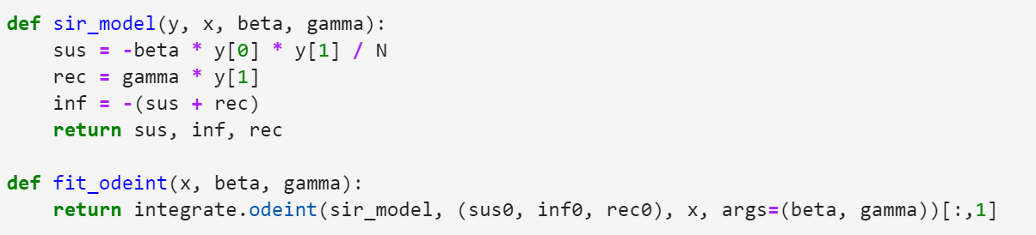
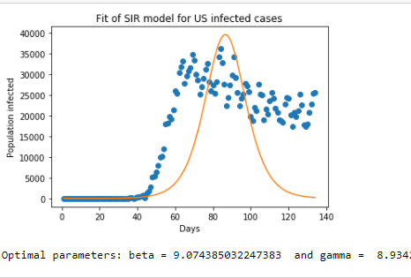
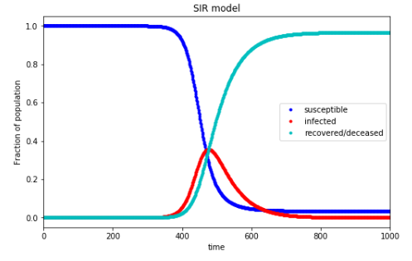
SIR Model

Slide 15
SIR Extended Model (SEIRHD Model)
Extended Compartments
Exposed - First compartment we need to add is exposed compartment. Since people need to be exposed to a infected person then only they will get infected.
Hospitalized - we need to consider the hospitalized compartment since people can recover if they get proper care and ventilator assistance
Dead – Deadly disease model is not complete without dead compartment so we need to add a new compartment into our model.
E(t): number of people exposed on day t
R(t): number of people recovered on day t
D(t): number of people dead on day t
x₀ (parameter in R₀(t))
k (parameter in R₀(t))
s (parameter in Beds(t))
Beds₀ (parameter in R₀(t))
δ: length of incubation period
α: fatality rate
ρ: hospitalization rate

Slide 16
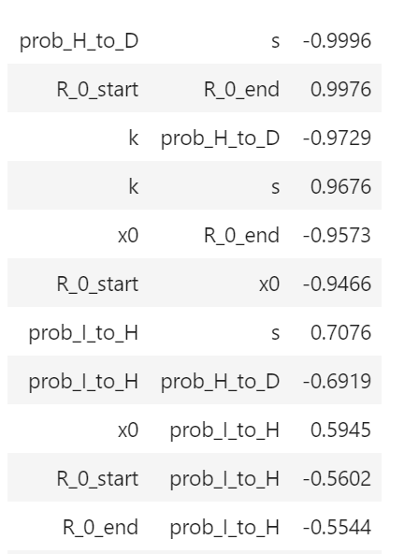
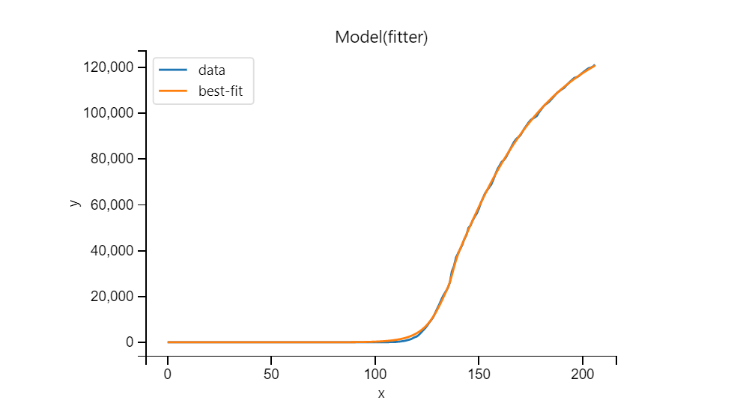
SEIRHD Model

Slide 17
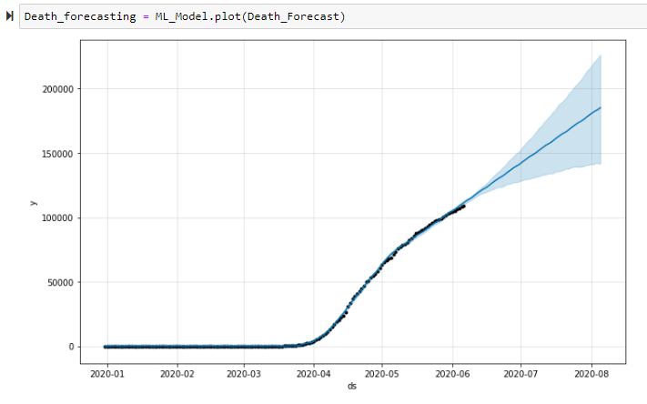
PROPHET MACHINE LEARNING MODEL
Prophet expect Dataframe with columns "ds" and "y" with the dates and values respectively, here ‘y’ is total death.
The blue line shows the prediction along with its lower and upper bound of the uncertainty interval
Great for predicting different forecast with time series data like covid19 data.

Slide 18
CONCLUSIONS
Used data from multiple sources
Performed EDA and visualizations
Create Five Different Machine Learning Models
Predicted the death for the world and US
Fitted the model with real time data from Ourdworldin.org and john Hopkins
Verified Accuracy

Slide 19
References
Data Sources
https://ourworldindata.org/
https://github.com/CSSEGISandData/COVID-19
Project Github
https://github.com/divyaddas/MSDS-Practicum-1-COVID19-Data-modeling-analysis-and-death-prediction
Resource Reference
https://en.wikipedia.org/wiki/Compartmental_models_in_epidemiology
https://www.kaggle.com/saga21/covid-global-forecast-sir-model-ml-regressions#2.-SIR-model-
https://www.lewuathe.com/covid-19-dynamics-with-sir-model.html
https://www.youtube.com/watch?v=NKMHhm2Zbkw

Slide 20
COVID – 19 Data Modeling, Analysis & Death prediction.
Thanks
Divya Devadas
MSDS692
Data Science Practicum
Regis University

