Slide 1
Practicum 2 Title: NLP Disaster Tweets Kaggle Competition: Predict which Tweets are about real disasters and which ones are not
Divya Devadas
Regis University

Slide 2
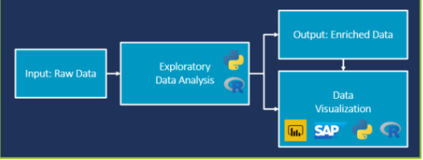
EXPLORATORY DATA ANALYSIS AND VISUALIZATION
understand the data
summarize its characteristics
visualize it.

Slide 3
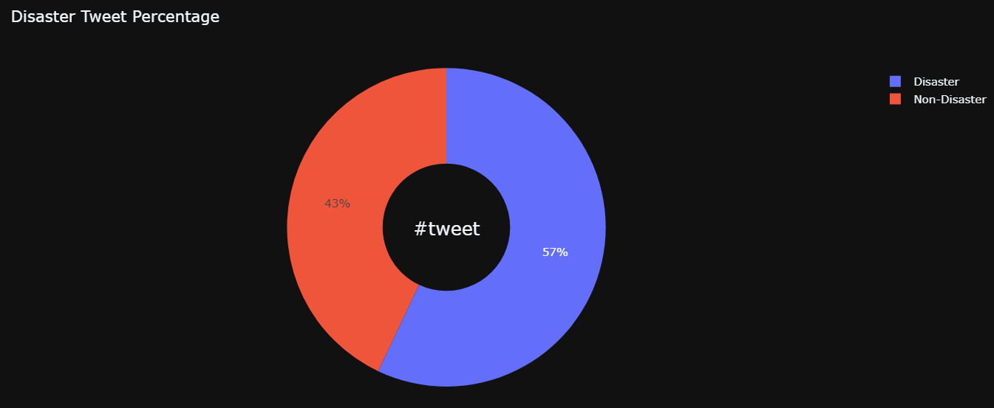
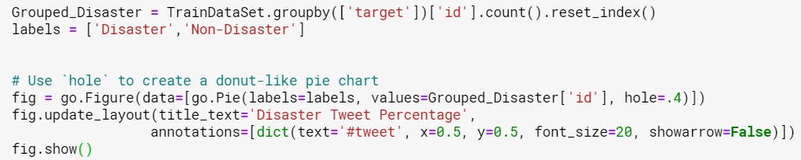
Disaster Tweet Percentage
# plotly library

Slide 4
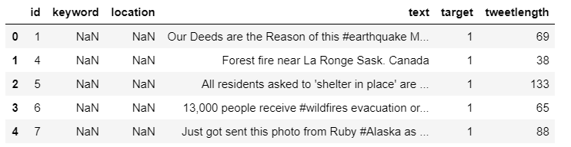
TWEET LENGTH
Checking the number of characters present in tweets.

Slide 5
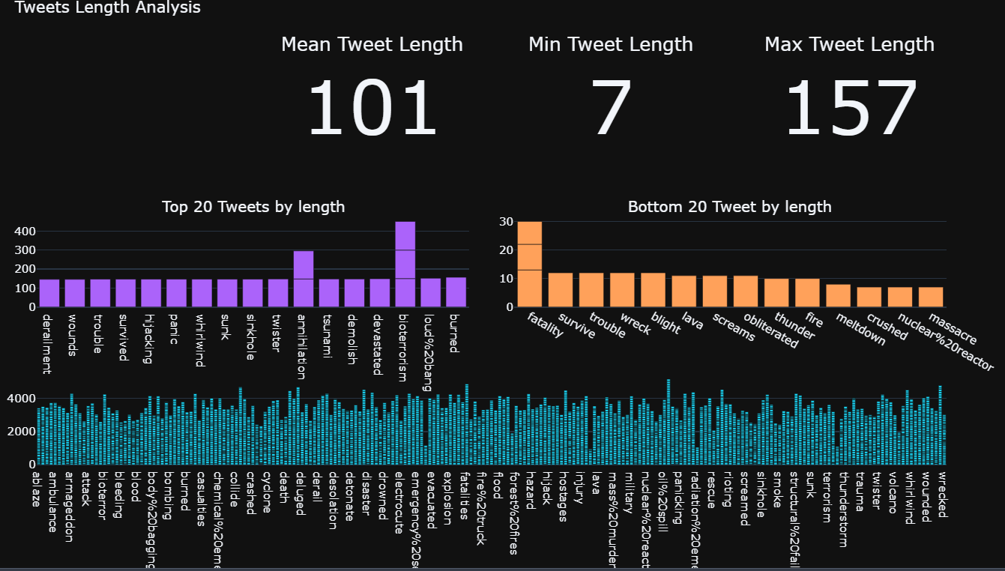
TWEET LENGTH ANALYSIS
# plotly library

Slide 6
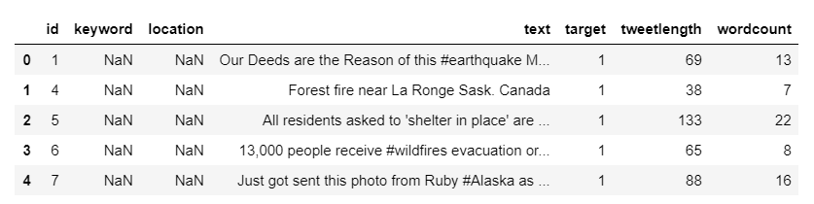
Tweet Word count analysis
Wordcount

Slide 7
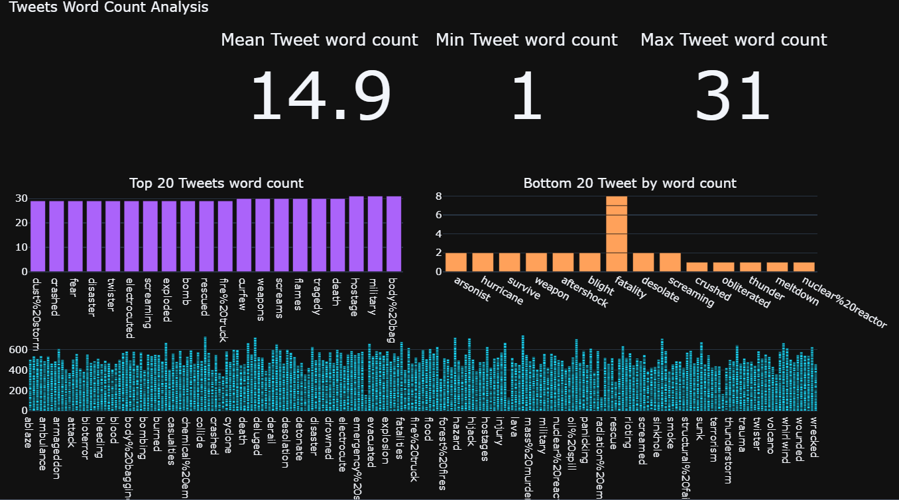
TWEET WORD COUNT ANALYSIS CHART
# plotly library

Slide 8
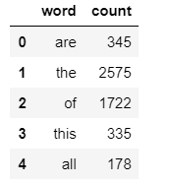
Tweet stop word analysis
Nltk library
import nltk
from nltk.corpus import stopwords

Slide 9
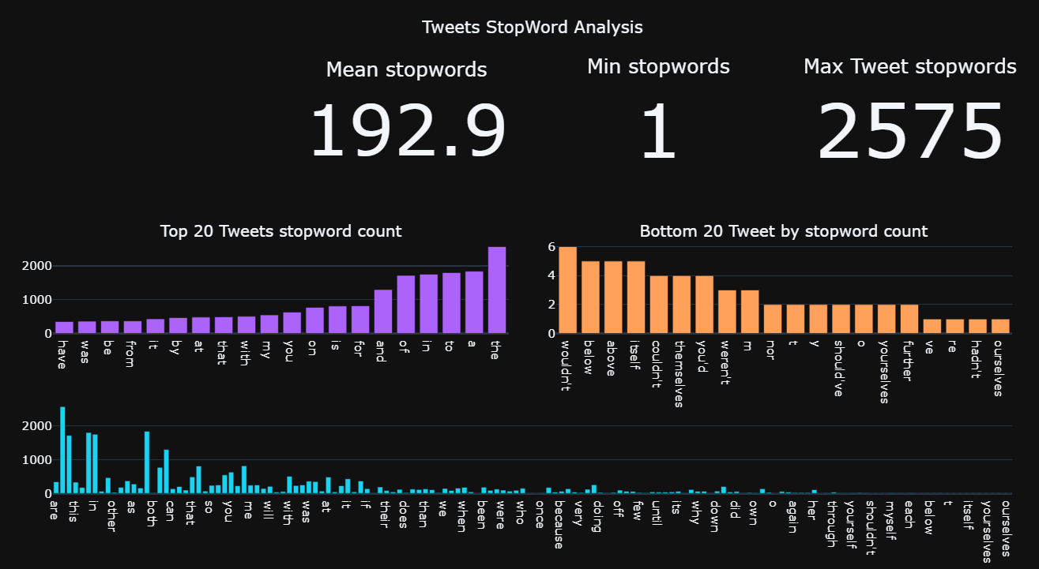
TWEET STOPWORD
# plotly library

Slide 10
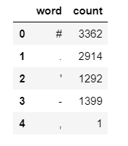
Tweet Punctuation and space word analysis
import spacy
nlp = spacy.load('en')

Slide 11
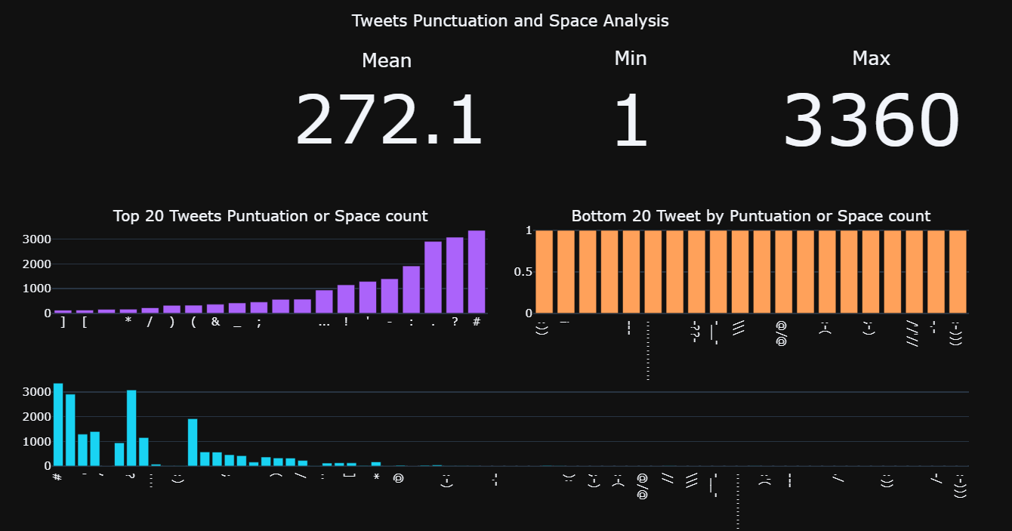
TWEET PUNCTUATION AND SPACE ANALYSIS
# plotly library

Slide 12
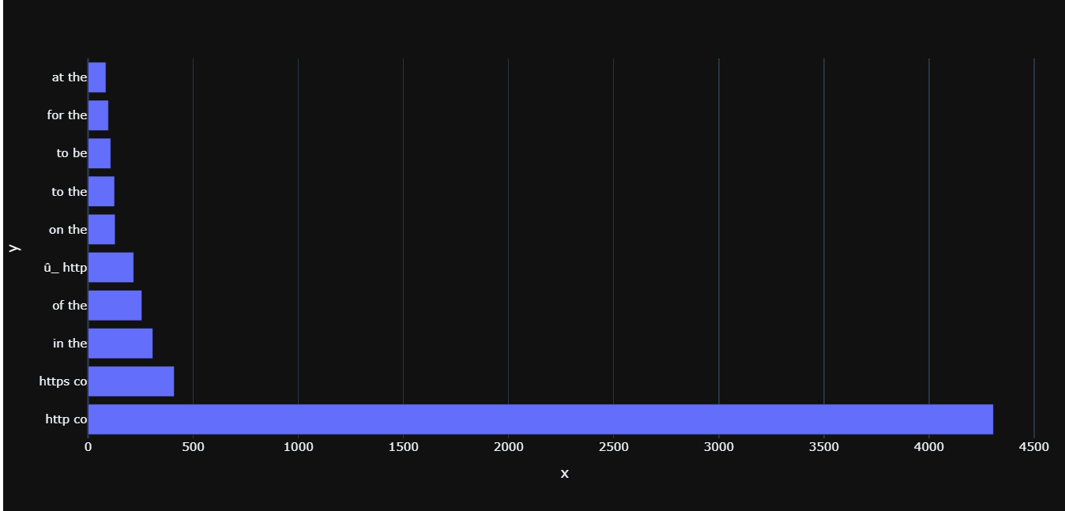
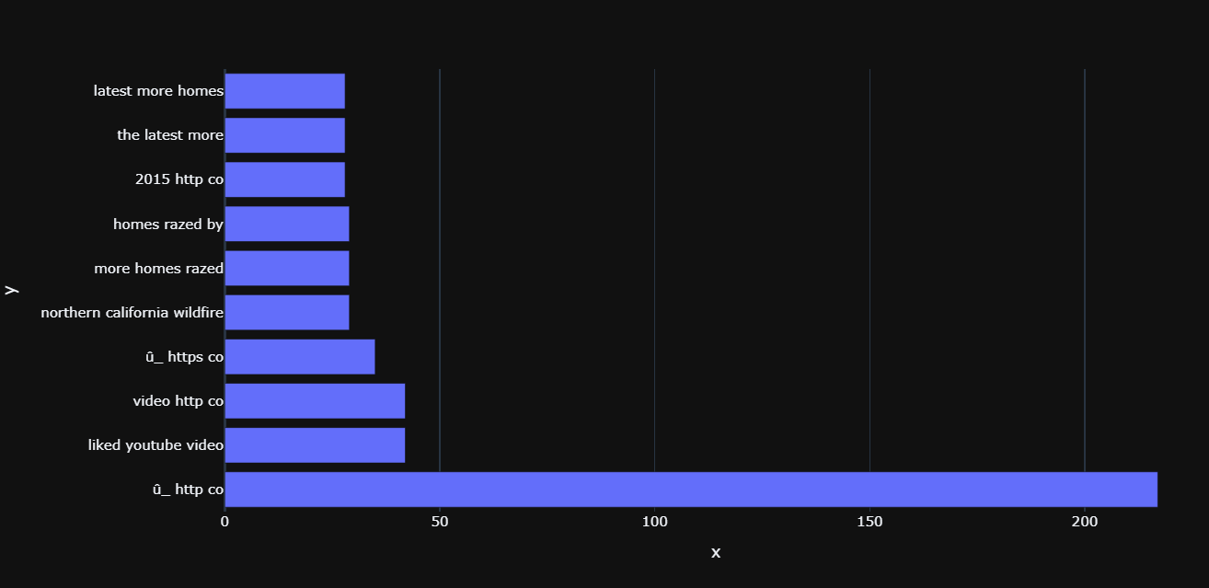
NGRAMS
from nltk.util import ngrams
from sklearn.feature_extraction.text import CountVectorizer
BIGRAMS
TRIGRAMS

Slide 13
Timeline
Week 2: Data collection…..Done
Week 3: Data inspection and cleansing…..Done.
Week 4: EDA/Visualization and selecting appropriate analysis methods….Done
Week 5: Applying machine learning models
Week 6: Analyze findings and attempt to increase model’s accuracy if possible, and Result visualization
Week 7: Create presentation
Week 8: Revise presentation and present project
Github: https://github.com/divyaddas/MSDS-Practicum2-NLP-Disaster-Tweets

Slide 14
references
https://www.analyticsvidhya.com/blog/2019/09/demystifying-bert-groundbreaking-nlp-framework/
https://towardsdatascience.com/natural-language-processing-nlp-top-10-applications-to-know-b2c80bd428cb
https://www.researchgate.net/figure/Example-for-tweet-text-preprocessing_fig2_322713146
https://towardsdatascience.com/effectively-pre-processing-the-text-data-part-1-text-cleaning-9ecae119cb3e
https://blog.camelot-group.com/2019/03/exploratory-data-analysis-an-important-step-in-data-science/
THANK YOU

