Slide 1

Recipe App
RNS INSTITUTE OF TECHNOLOGY
BENGALURU - 98
DEPARTMENT OF INFORMATION SCIENCE & ENGINEERING
Presentation on Internship
Divya Desai
USN: 1RN18IS040
ENMAZ Engineering Services Pvt. Ltd.
Internal Guide
Dr. Suresh L
Associate Professor, Dept of ISE, RNSIT
External Guide
Mrs. Sridevi S
Co-Founder & CEO, ENMAZ, Bangalore

Slide 2
AGENDA
Abstract
About the Company
Introduction
Literature Survey
Requirements
System Design
Detailed Design
Implementation
Testing
Conclusion and Future Enhancements
References
Q & A

Slide 3
ABSTRACT
The use of mobile devices such as, smartphone or tablets have increased significantly in the past decade. All these devices use applications that are created for them. These applications can provide many different services including, social media, music streaming, video streaming, ride sharing, online shopping, and video games. Some of these apps need to be constantly connected to the internet to function properly, while others can work offline.
Who said our smartphones don’t belong in the kitchen? These days, you can use your phone and tablet to pull up a recipe for any dish: Mexican, Italian, Lebanese, or any other cuisine you can dream of. Whether you run iOS or Android, there’s no shortage of freemium and reasonably priced recipe apps.
This presentation discusses a recipe mobile application that allows users to search for and explore various meal recipes based on several categories. Users can browse a collection of recipes, as well as their prep time and type (vegetarian, non-vegetarian, etc.). Each recipe is accompanied by a well-known YouTube video. The app aims to be efficient while maintaining an intuitive and simple design that offers the user with all of the key features.

Slide 4
About the Company
ENMAZ provides end-to-end solutions and development services for Industrial Internet of Things (IoT) requirements. ENMAZ specializes in:
IoT
Industrial IoT
IoT Analytics
Embedded Hardware Development
Embedded Firmware Development
Cloud Support, Big Data Analysis and Reporting
Dashboard UX/UI Design and Development
Model Analysis
ENMAZ has a team of highly passionate industrial designers & professional engineers with strong educational background from the most reputed institutes of India with cumulative industry experience of 50+ years, from various domains.

Slide 5
INTRODUCTION
Recipe Software is a smartphone app that allows users to browse a wide range of cuisine dishes.
Flutter was used to create the user interface.
The API was built using Express, in conjunction with MongoDB.
API Testing in Postman.
Tunneling was used in the development process for sending data from one network to another.
Git was used to manage code changes and coordinate work among team members.

Slide 6
LITERATURE SURVEY
Cross-Platform App Development:
Cross-platform application development is about building a single application that can run on various operating systems, instead of developing different app versions for each platform.
API-First Approach:
API-first development puts APIs at the foundation, instead of pre-built or opinionated software solutions or experiences. API-first development ensures that all of the functionality inside the platform is accessible to you through the API.
NoSQL:
NoSQL databases (aka "not only SQL") are non-tabular databases and store data differently than relational tables. The main types are document, key-value, wide-column, and graph. They provide flexible schemas and scale easily with large amounts of data and high user loads.

Slide 7
Requirements
Software
• Frontend – Flutter
• Flutter Dependencies – cupertino_icons, http, flutter_spinkit, flutter_dotenv, url_launcher
• Backend – JavaScript (Node.js)
• Node.js Dependencies – crypto-js, dotenv, express, mongoose
• Database – MongoDB Atlas
• Tools – Visual Studio Code, Postman
• Version Control – Git
Hardware
• Operating System – Windows 10 Home 64-bit
• Processor – Intel® Core™ i5-10300H CPU @ 2.50GHz
• RAM – 8 GB

Slide 8
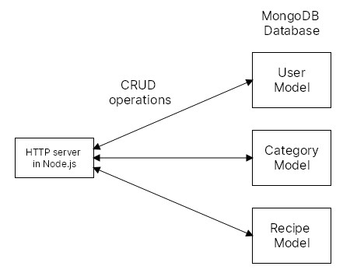
System Design
API Design

Slide 9

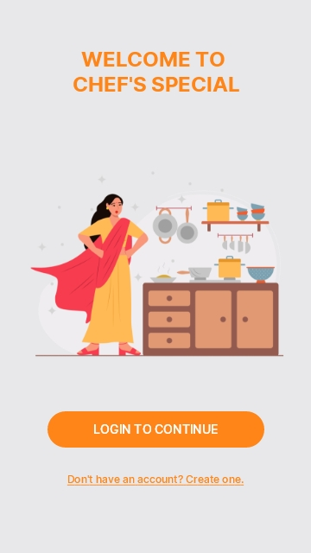
UI UX Designs
Splash Screen and Welcome Screen

Slide 10
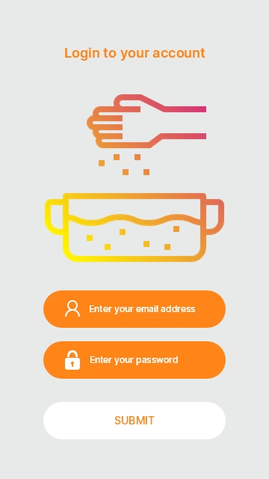
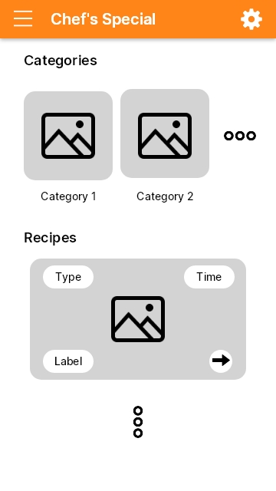
Login Screen and Home Screen

Slide 11
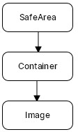
Detailed Design
Widget Tree
Splash Screen

Slide 12
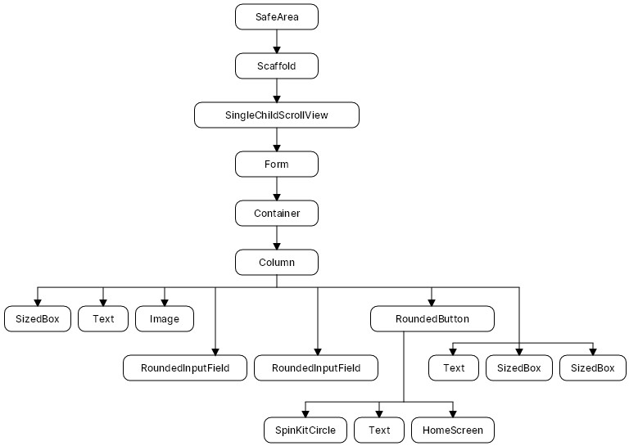
Login Screen

Slide 13
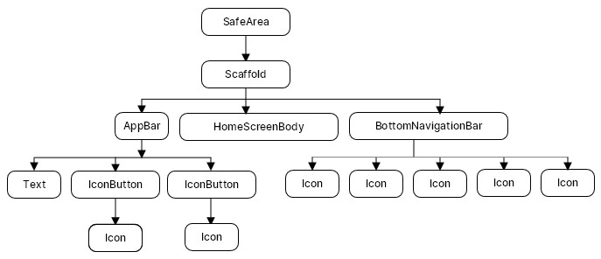
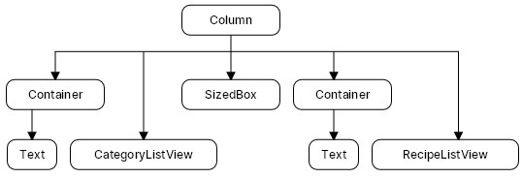
Home Screen
Home Screen Body

Slide 14
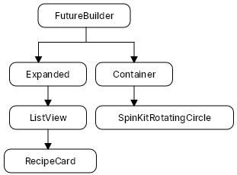
Recipe List View

Slide 15
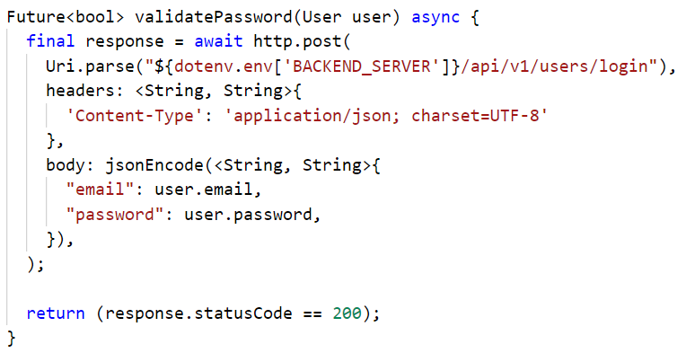
Implementation
Login Functionality
The http.post() method is used to send user credentials data to the backend server.
If the response status code is 200, then the user is successfully logged in.

Slide 16
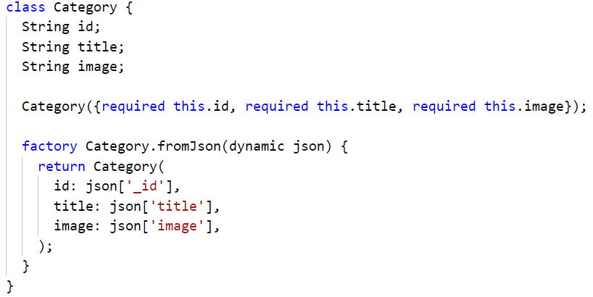
Implementation
Data Binding
The fromJson() method is used to serialize JSON inside model classes.
In the above example, the constructor constructs a new Category instance from a map structure.

Slide 17
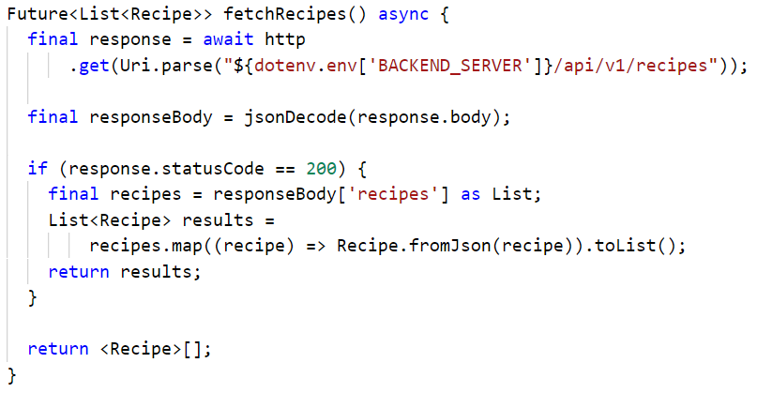
Implementation
Fetch Recipes From Server
The http.get() method is used to send GET requests to the server.
The JSON response from the server is decoded and converted to a list of Recipe instances.

Slide 18
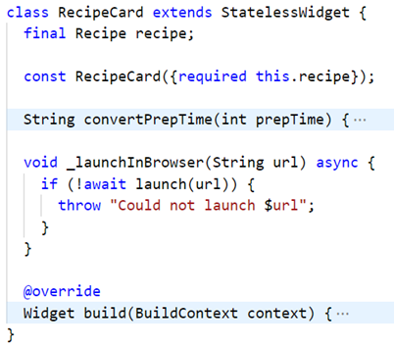
Implementation
Launch Recipe Video
The launch() method parses the specified URL string and delegates handling of it to the underlying platform.
If successful, the video opens in the client’s browser.

Slide 19
TESTING
Case ID | Test Case | Expected Result | Actual Result | Status
1 | Click on “LOGIN TO CONTINUE” button | Display login screen to the user | Displays login screen to the user | Pass
2 | Enter valid user credentials in login form and submit the form | Process form data by sending it to the server | Processes form data by sending it to the server | Pass
3 | Submit empty login form | Display error message “Invalid Credentials” | Displays error message “Invalid Credentials” | Pass
4 | Fetch recipes by sending GET request to the server | Get the list of recipes with response status code | Response status code is 200 Recipe list is returned | Pass
5 | Validate user password by sending POST request to the server | Perform validation check to see if password matches with user in the database | If password matches, respond with status code 200 Otherwise respond with status code 401 | Pass

Slide 20
CONCLUSIONS
This application is extremely handy and useful for cooking variety of recipe with minimum search effort from internet.
It will help people to save their time and energy in finding recipes for daily routine as well as for special occasions.
And since this is a mobile application, users have the luxury to check for recipes wherever they are.
Also, since we have developed the application in a cross-platform framework, the application can be used by a broad range of users.
However, there are also some features that the application is short of such as searching and filtering, categorizing recipes, saving recipes, etc.

Slide 21
Future Enhancements
Additional screen for each recipe, which shows the ingredients and text description of it.
Enhanced interactivity, allowing users to add their own recipes.
Organizing and moderating user-added recipes in a proper way.
Bookmarking recipes.
Personalization feature to let the users customize the app settings for their own experience.
Additional security features such as signing up users and verifying them, two-factor authentication, account backup, and API security features.

Slide 22
REFERENCES
[1] https://docs.flutter.dev/
[2] https://nodejs.org/dist/latest-v16.x/docs/api/
[3] https://expressjs.com/en/5x/api.html
[4] https://docs.atlas.mongodb.com/
[5] https://ngrok.com/docs
[6] https://www.redhat.com/en/topics
[7] https://asperbrothers.com/blog/
[8] https://www.netsolutions.com/insights/
[9] https://www.sitecore.com/da/knowledge-center/blog

Slide 23
Open for Q&A

Slide 24
THANK YOU

