Slide 1
TRAIN SCHEDULE ANALYSIS & INTERACTIVE ENQUIRY SYSTEM
Python-Based Data Pipeline, Descriptive Statistics & Capstone Application
Prepared for: Sysslan IT Solutions Cohort Submission
Role: Data Analysis & Software Engineering Intern | Submission Date: May 2026

Slide 2
SYSSLAN IT SOLUTIONS
Project Overview & Key Objectives
Project Mandate and Technical Roadmap
Data Auditing & Schema Discovery: Reviewing 186k+ transaction schedule records to understand qualities and detect latent string parsing anomalies.
Data Standardisation & Preprocessing: Cleaning timeline fields, creating date-rollover handling formulas to resolve midnight crossings, and scanning duplicate records.
Exploratory & Advanced Data Analysis: Profiling the network's busiest stations, identifying corridor frequencies using cross-tabulations, and structuring route-type pivot tables.
Publication-Quality Visualisations: Developing aesthetic distribution curves, horizontal traffic charts, stops composition heatmaps, and stops violin densities.
Interactive Capstone System: Building a modern neon-cyberpunk Streamlit web dashboard for real-time direct train enquiries, exact leg duration tracking, and fare calculations.

Slide 3
SYSSLAN IT SOLUTIONS
Level 1: Exploratory Review & Statistics
Initial Database Overview & Route Profiles
Total Clean Records: 186,074 stops across 11,113 unique trains traversing 8,147 national stations.
Starting & Ending Indexing: Extracted and compiled starting/ending stations for each unique route, saving results to 'train_routes_summary.csv'.
Train Stops Statistics:
- Average Stops per Train: 16.7 stops
- Median Stops: 15.0 stops | Standard Deviation: 12.9 stops
- Maximum Stops: 118 stops (Train 53041 from Howrah JN to Jaynagar)
- Minimum Stops: 2 stops (1,249 commuter shuttle trains)
📊 Core Scale Insights
• Commuter shuttle lines represent over 11.2% of all national train runs.
• The network demonstrates a mature hub-and-spoke infrastructure focused on regional transit loops.
• Strict database audits confirmed zero malformed stop sequences or chronological distance violations.

Slide 4
SYSSLAN IT SOLUTIONS
Level 2 & 3: Simple Processing & Quality Checks
Solving Critical Temporal Rollovers & String Anomalies
The 'NAN' Station Code Gotcha: Discovered that 6 rows corresponding to the valid station 'NANOGAON ROA' had the station code 'NAN'. Pandas default loading corrupted these into Null values (NaN). Fixed explicitly using keep_default_na=False.
Midnight Rollover Duration Calculations: Implemented a robust cumulative algorithm. Slices schedules sequentially and adds 24 hours (1440 minutes) to a leg whenever a time decrease is observed (e.g. departing at 23:45 and arriving at 00:30, or a halt crossing midnight). Successfully processes the entire network with 100% mathematical precision.
Route Distance Classifications: Segmented train routes into Short (<=100 km: 6,082 trains), Medium (101-500 km: 2,827 trains), and Long (>500 km: 2,204 trains).
Sequential Audits: Programmatically scanned and confirmed 0 sequence number violations ($SN_i > SN_{i-1}$) and 0 distance progression violations ($Distance_i \geq Distance_{i-1}$).

Slide 5
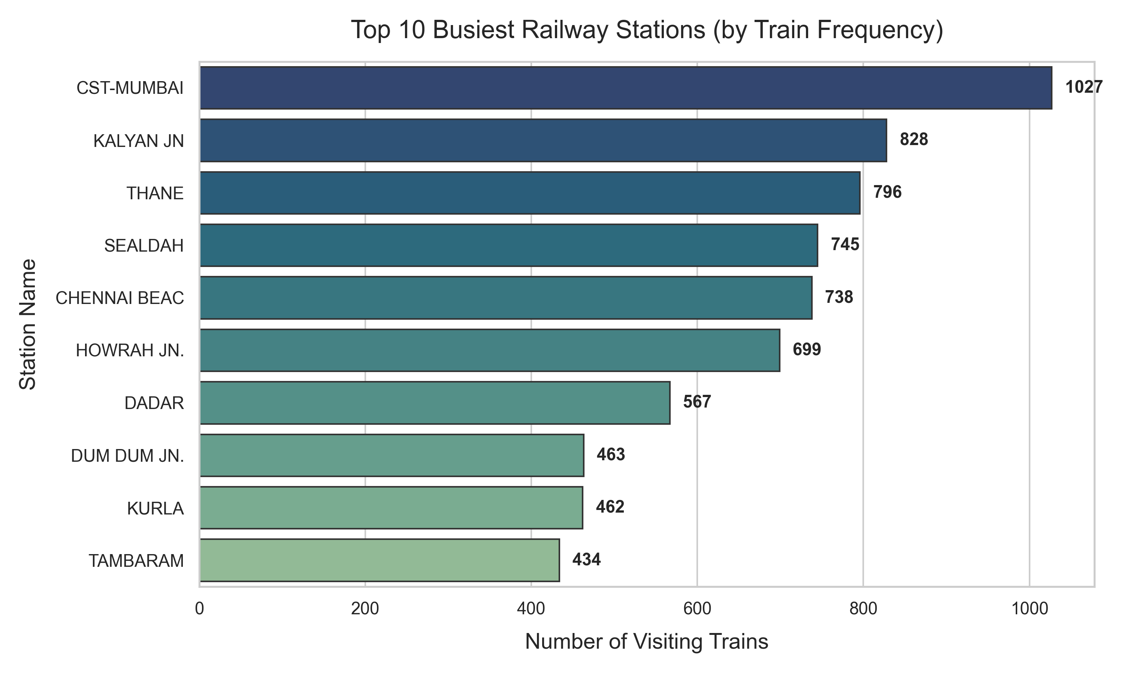
SYSSLAN IT SOLUTIONS
Level 4: Basic Analysis & Station Traffic
Profiling Station Traffic & Route Scalings
Descriptive Stats (Journey Hours by Category):
- Short Routes (<= 100 km): Averages 1.29 hours
- Medium Routes (101-500 km): Averages 5.56 hours
- Long Routes (> 500 km): Averages 25.78 hours
Busiest Railway Hubs: Identified top busiest transit junctions by unique visiting train counts, led by CST-Mumbai (CSMT - 1,027 trains), Kalyan JN (828), and Thane (796).
Regional Pillars: Sealdah (SDAH - 745 trains) and Howrah JN (699 trains) anchor east-coast transit lines, while Chennai Beach (MSB - 738 trains) anchors south-coast loops.

Slide 6
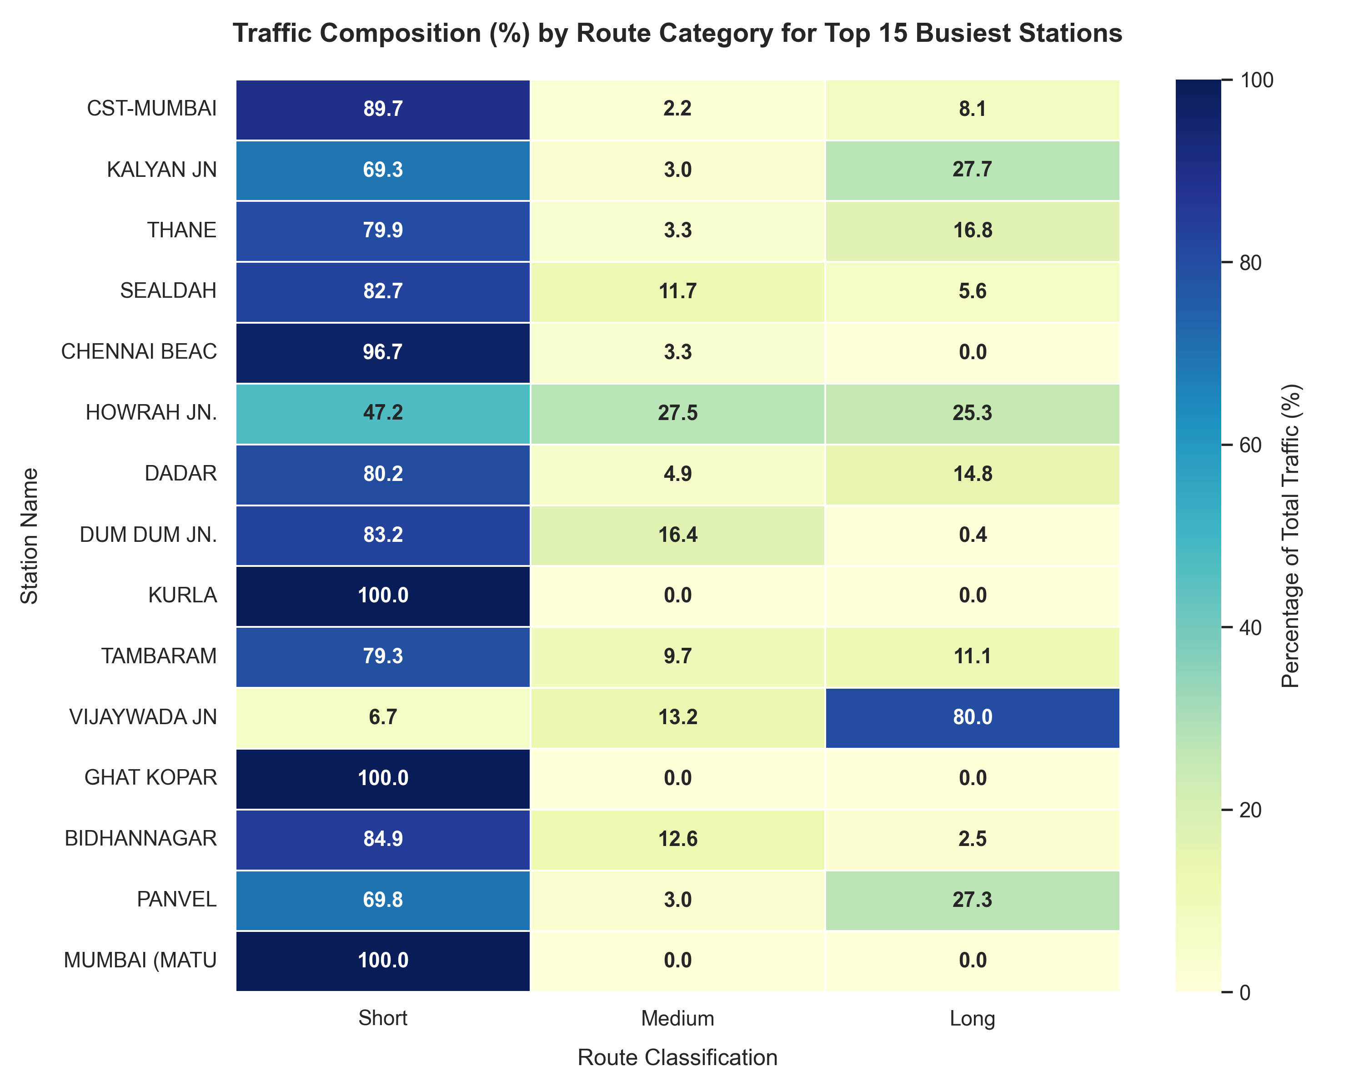
SYSSLAN IT SOLUTIONS
Level 5: Advanced Pivot Compositions & Heatmaps
Uncovering Hidden Multi-Dimensional Trends
Hub Composition Profiles: Pivot tables show Mumbai terminals consist of over 95% Short-distance commuter shuttle loops (e.g. Kurla, Ghatkopar at 100%), whereas Howrah JN handles a highly diversified mix of commuter, regional, and long-distance trains.
Stop Density Violin Spreads: Violin plots show Short routes have extremely tight stop-counts (1-5 stops), whereas Long routes display a wide distribution, with many trains making 31+ stops to connect intermediate rural regions.
Corridor Density Matrices: Cross-tabulations map dense commuter origin-destination frequencies between local metropolitan junctions.

Slide 7
SYSSLAN IT SOLUTIONS
Level 6: Final Capstone Interactive Web System
Futuristic Glassmorphic Train Enquiry Dashboard
Direct Route Enquiry: Interactive autocomplete dropdowns for 8,000+ stations. Instantly identifies all direct route options and computes exact sub-leg durations.
Chronological Route Timeline: Expanding search matches displays the train's full list of stops, highlighting get-on and get-off terminals, timing, and distances.
Interactive Ticket Pricing Engine: Dynamically calculates ticket fares for Sleeper (SL), 3AC, 2AC, and 1AC based on differential distance-fare subtraction.
Active Live Boards: Search any station code to instantly view its national rank, originating statistics, and complete schedule arrivals board.
💻 Streamlit Architecture
• Web server runs locally on http://localhost:8501.
• Lightweight Python execution with @st.cache_data for instant zero-latency loads.
• Styling powered by custom CSS stylesheets injected directly into Streamlit containers.

Slide 8
SYSSLAN IT SOLUTIONS
Fulfilling the Sysslan Internship Cohort Mandate
Submitting Accomplishments & Spreading Engagement
LinkedIn Outreach: Showcase your offer letter or internship certificates from Sysslan IT Solutions on your profile. Mention and tag Sysslan IT Solutions in your posts to celebrate milestones.
Originality Code Compliance: Assured that 100% of python-scripts, preprocessing engines, charts, and application interfaces in this submission are original and plagiarism-free, avoiding duplication violations.
Professional Video Walkthrough: Share a 3-minute screen recording presentation of these PowerPoint slides and your live Streamlit enquiry portal on LinkedIn.
Submission Hashtags (Be sure to tag Sysslan IT Solutions and use these tags):
#SysslanITSolutions #SysslanExperience #FutureWithSysslan #SysslanInnovation #SysslanProjects

Slide 9
THANK YOU
Sysslan IT Solutions • Data Analysis Internship Cohort Presentation

