Slide 1
ASSIGNMENT 1: DATA PRE-PROCESSING CSIT558 - DATA MINING, Summer 2020 DR. APARNA VARDE Montclair State University
By: Andleeb Chaudhri, Bansari Patel, Divya Karthikeyan

Slide 2

Dataset
Attribute Information
1) age
2) sex
3) chest pain type (4 values)
4) resting blood pressure
5) serum cholesterol in mg/dl
6) fasting blood sugar > 120 mg/dl
7) resting electrocardiographic results (values 0,1,2)
8) maximum heart rate achieved
9) exercise induced angina
10) oldpeak = ST depression induced by exercise relative to rest
11) the slope of the peak exercise ST segment
12) number of major vessels (0-3) colored by fluoroscopy
13) thal: 0 = normal; 1 = fixed defect; 2 = reversable defect
14) target: 0= less chance of heart attack 1= more chance of heart attack

Slide 3
Objective for dataset
The objective for this dataset is to detect factors that play a part in women getting a heart attack
In order to utilize this dataset to it’s full potential, there is a need to pre-process it using different operations
Given that different individuals will use the data in a different manner and for different purposes, we need to clean and manipulate the dataset in a way that will be specific to solving our problem

Slide 4


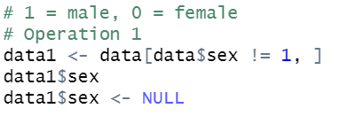
operation #1: subsetting data
Before operation:
After operation:
Since we are only detecting heart attack possibility in women and the given data includes possibilities for both men and women, we will delete all the rows with male values
After this, we will delete the entire column since after the first operation, we know that the data will only contain female values
After deleting column:

Slide 5
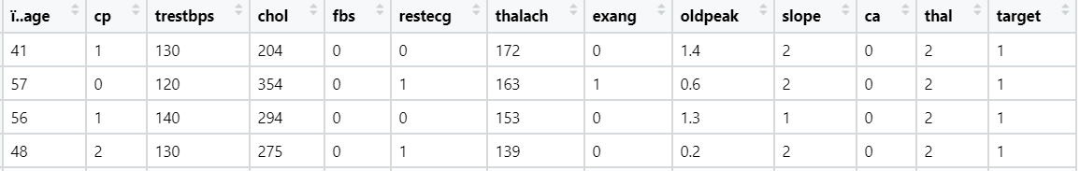
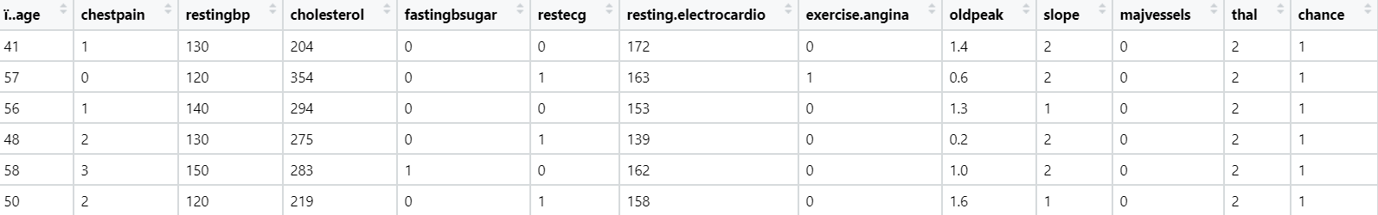
Operation #2: Renaming the columns
Before operation:
The columns of this dataset are not descriptive at all, making them hard to understand and work with
After renaming them, in the after picture we can see that the columns are considerably easier to decipher
After operation:

Slide 6
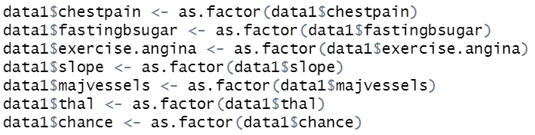
Operation #3: Converting numeric values to categorical
By using the as.factor function, we converted relevant numerical values to categorical
For example, chest pain is spilt into 4 factors ranging from 0-3, using this column as a numeric column would not make sense as the chest pain is split into 4 different categories not numeric values
Before operation:
After operation:

Slide 7
Sources
https://www.kaggle.com/nareshbhat/health-care-data-set-on-heart-attack-possibility
https://rstudio.com/

