Slide 1

ASSIGNMENT 2: Descriptive Data Mining CSIT558 - DATA MINING DR. APARNA VARDE
By: Andleeb Chaudhri
Bansari Patel
Divya Karthikeyan

Slide 2

Dataset: Contact Lenses
Attributes
Age
Spectacle-prescription
Astigmatism
Tear Production Rate
Contact-lenses
Our purpose is to determine factors that lead to a patient receiving or not receiving a contact lens prescription.

Slide 3
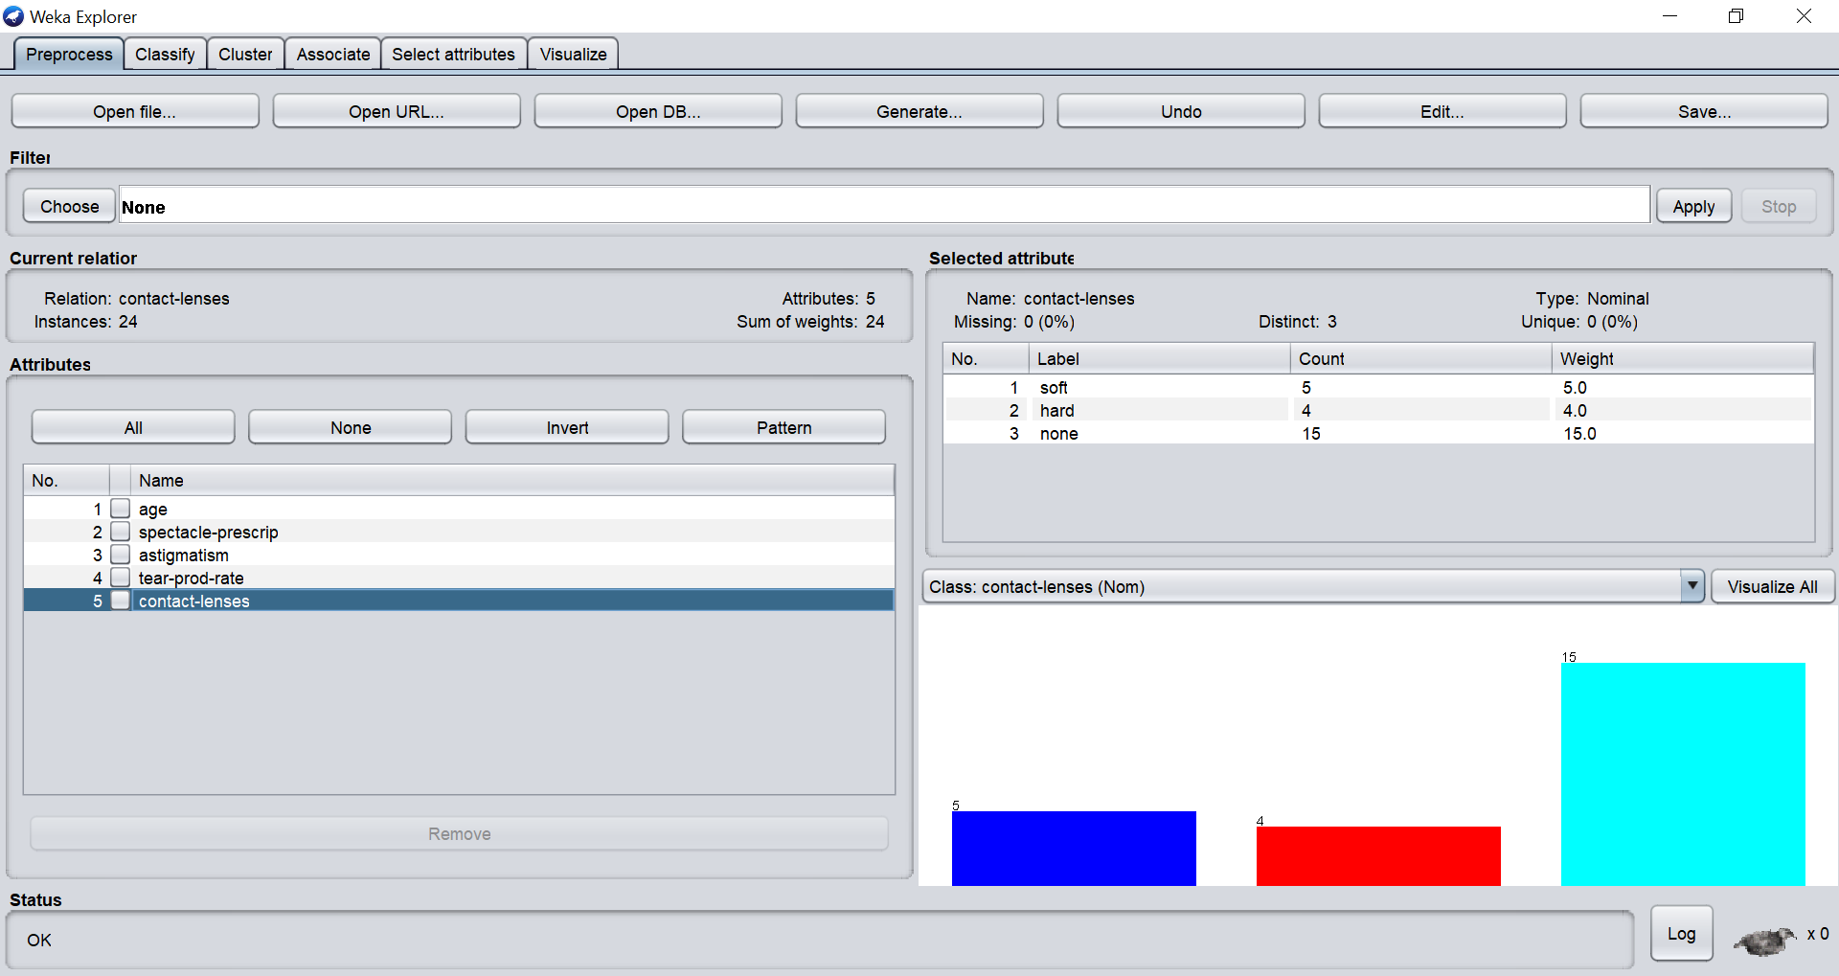
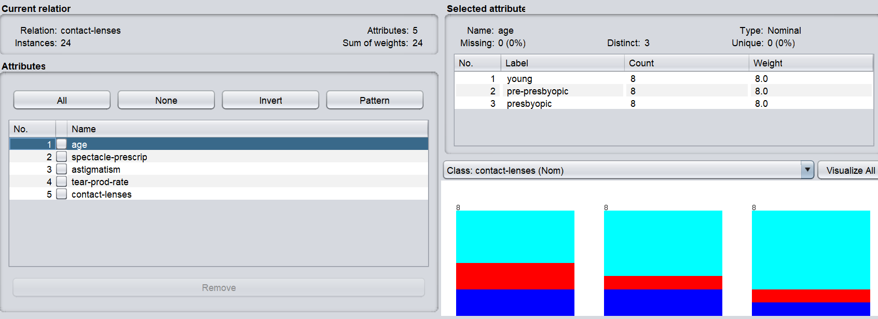
Attribute Information
There are 3 Classes for contact-lenses:
The patient should be fitted with hard contact lenses
The patient should be fitted with soft contact lenses
The patient should not be fitted with contact lenses
Age of the patient :
Young
Pre-presbyopic
Presbyopic

Slide 4
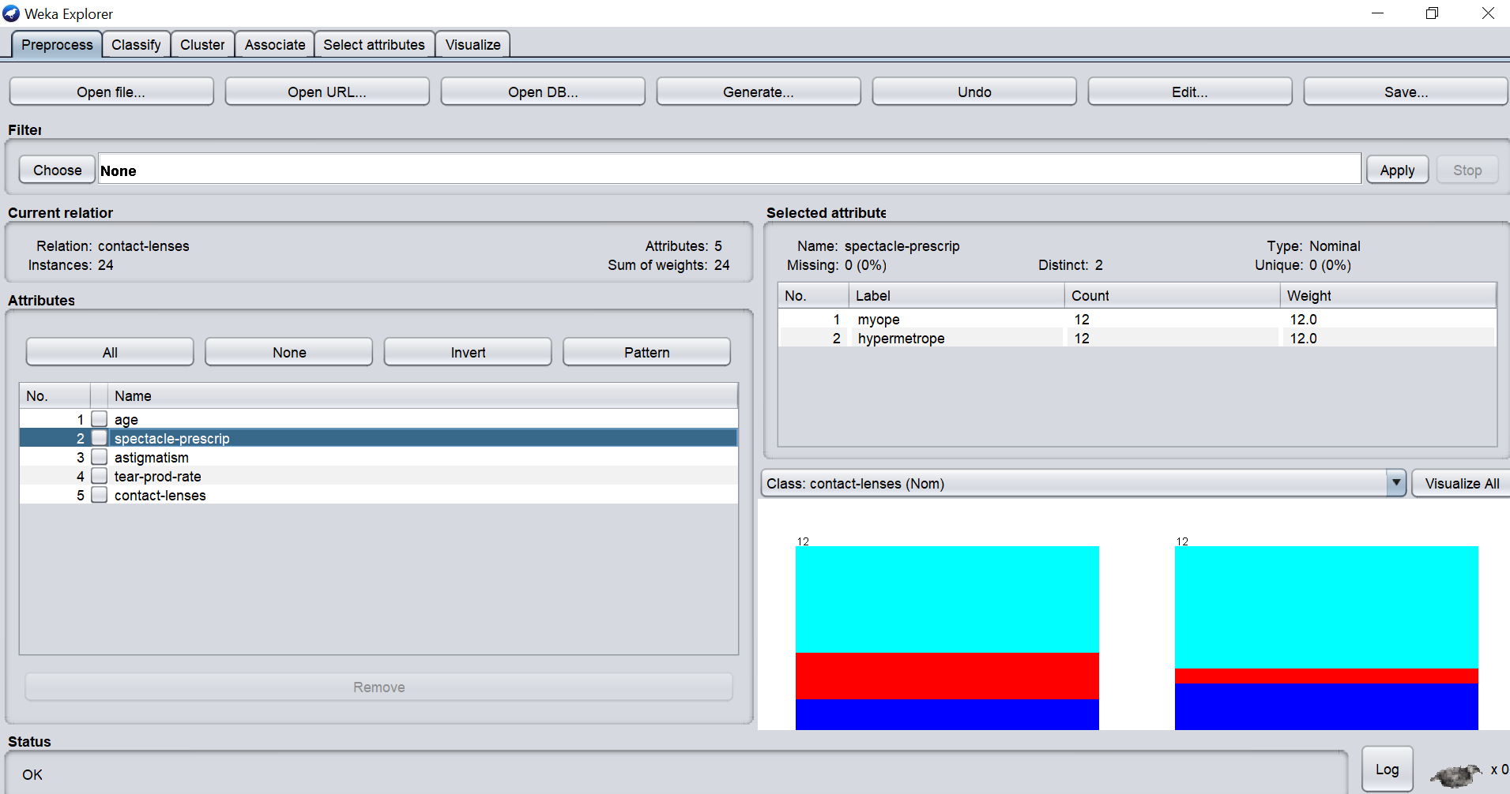
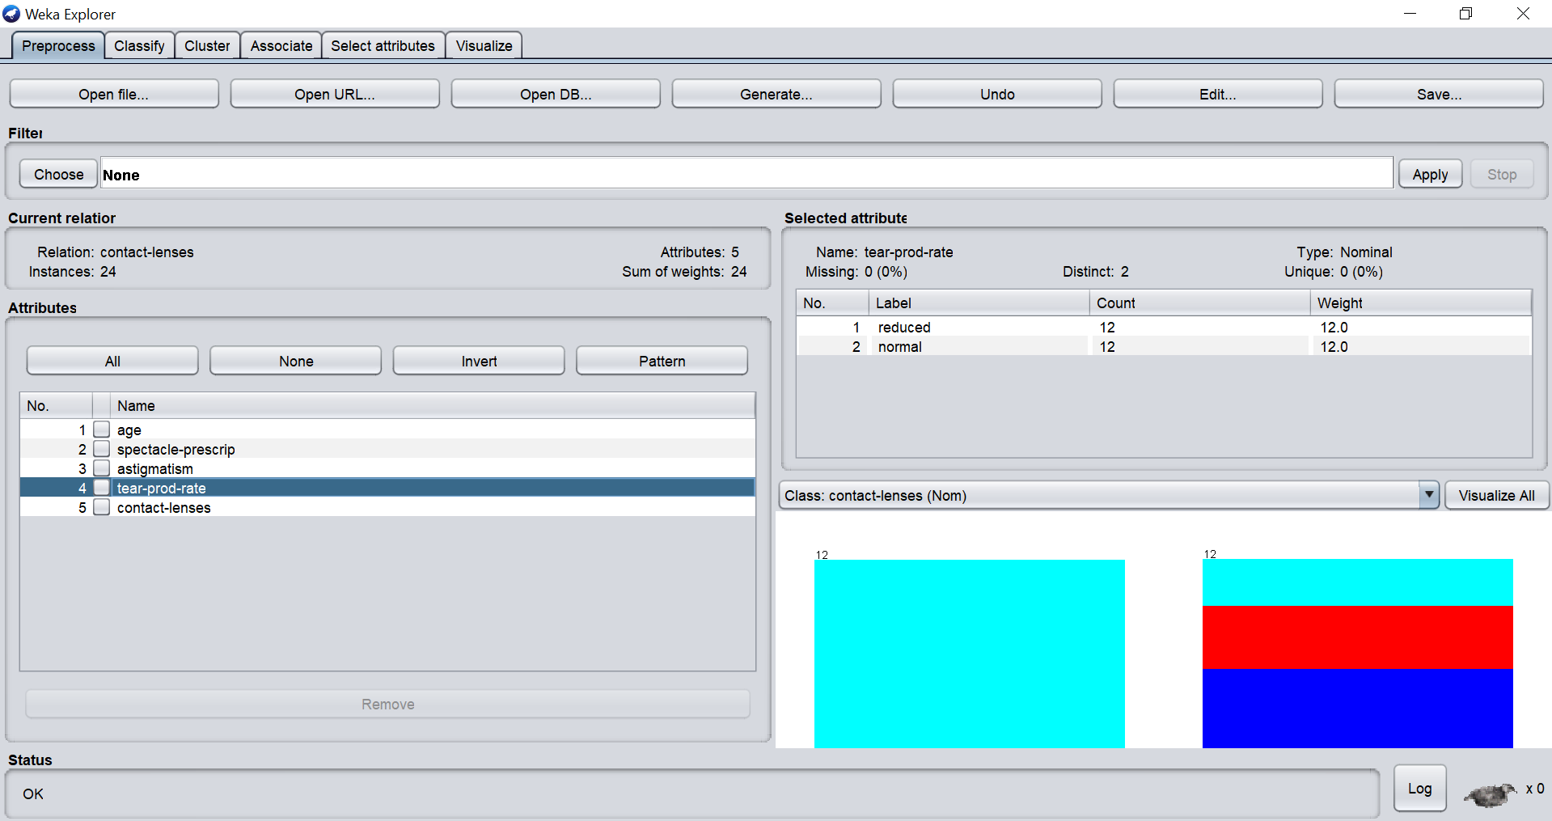
Spectacle Prescription :
Myope
Hypermetrope
Astigmatic :
Yes
No
Tear Production rate:
Reduced
Normal

Slide 5
Apriori Algorithm
Apriori is a simple algorithm which is applied to discover patterns in the dataset and to find frequent item sets and association between various item sets.
The Apriori algorithm reaches good performance by decreasing the size of candidate sets.
Apriori Algorithm has a two-stage operation:
All item sets will have a support factor greater than or equal to the user-specified minimum support.
All rules will have a confidence factor more significant than or similar to the user-specified minimum confidence.
By applying this algorithm, we can find associations between different attributes in the dataset.

Slide 6
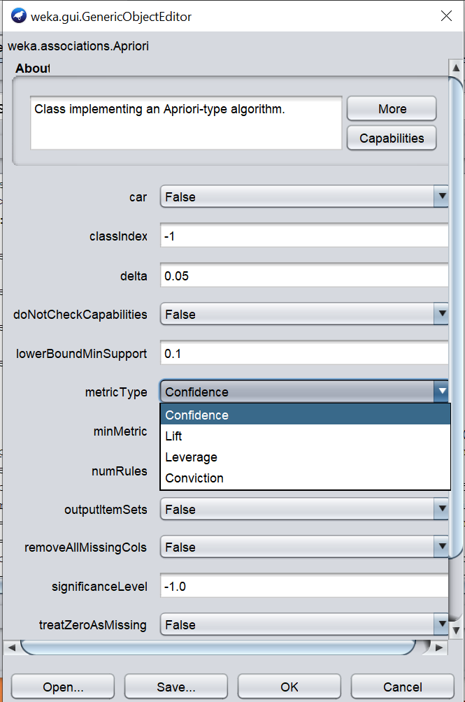
EXECUTION
We utilized the confidence metric type which ranked our association rules from greatest to lowest. Confidence is the most commonly used metric and the higher the confidence the better the association is ranked.

Slide 7
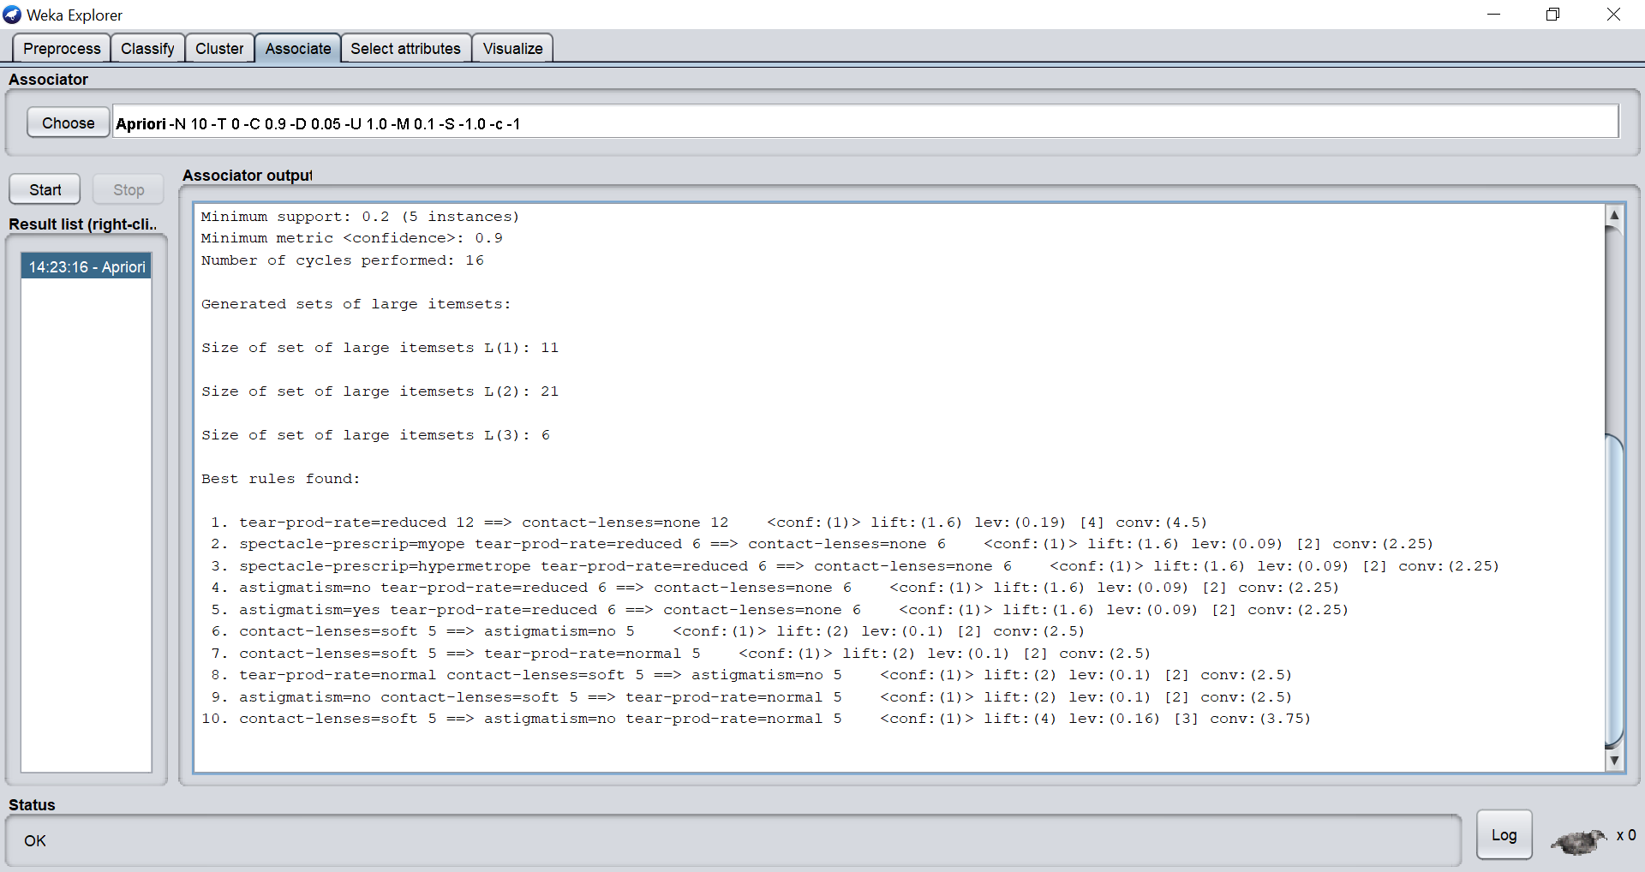
Output

Slide 8
Three inferences
The top ranked association found that the attribute tear production rate was reduced when no contact lenses were prescribed. The confidence level given for this association was 1.
The second highest ranked association was between myope spectacle prescription and a reduced tear production rate leading to 6 cases where no contact lenses were prescribed if the patient was myope with a reduced tear production rate.
Lastly, being hypermyope and having a reduced tear production rate were also associated with no contact lens prescription.

Slide 9
Conclusion
With some of the inferences described in the previous slide, we can conclude that a patient is less likely to receive a contact lens prescription if:
Their tear production rate was reduced
If they have a myope prescription (are near-sighted) in conjunction with a reduced tear production rate
If they are hypermetropic (have great difficulty seeing close objects as opposed to objects that are distant) also in conjunction with a reduced tear production rate.

Slide 10
Resources
https://www.cs.waikato.ac.nz/ml/weka/
https://storm.cis.fordham.edu/~gweiss/data-mining/datasets.html
www.tandfonline.com › doi › full
https://www.geeksforgeeks.org/apriori-algorithm/

