Slide 1

INTRODUCTION TO PROGRAMMING
IN MATLAB
SUBMITTED BY:
DIVYA GUPTA
B.TECH-CSE

Slide 2
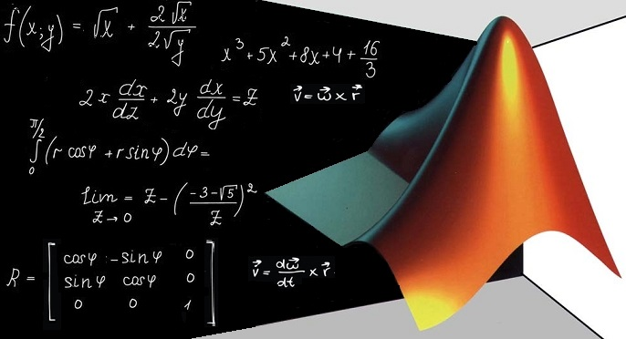
MATLAB IS A FOURTH GENERATION PROGRAMMING LANGUAGE DEVELOPED BY MATHWORKS.

Slide 3
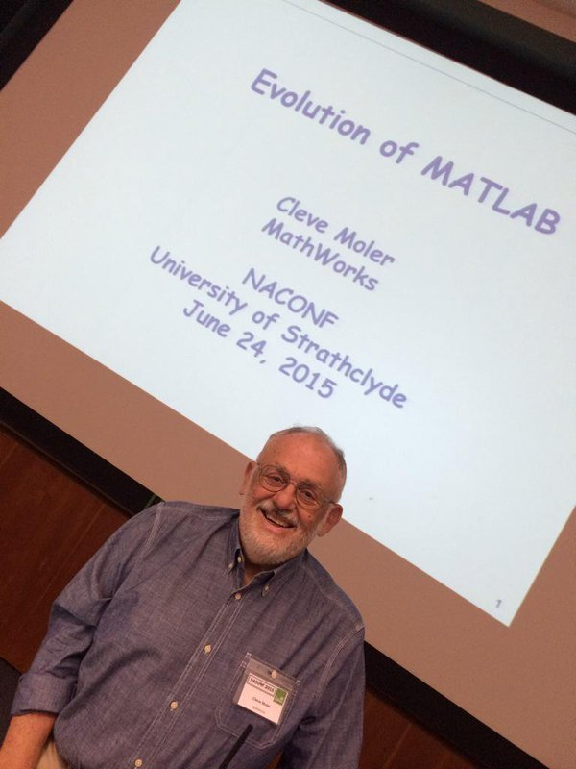
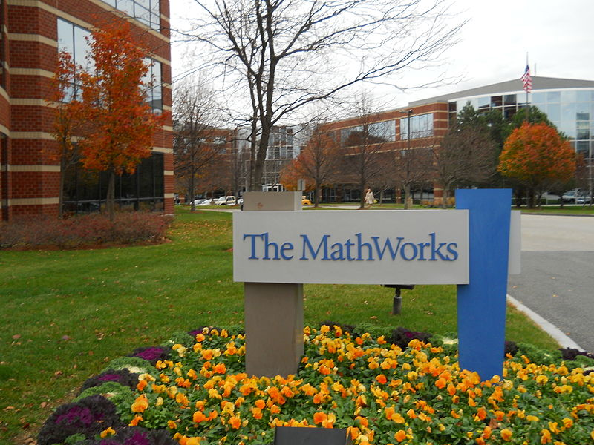
HISTORY Cleve Moller,the chairman of the computer science department at the University of New Mexico,started developing Matlab in late 1970s.

Slide 4
KEY FEATURES
Interactive environment for iterative exploration, design, and problem solving
Mathematical functions for linear algebra, statistics, Fourier analysis, filtering, optimization, numerical integration, and solving ordinary differential equations
Built-in graphics for visualizing data and tools for creating custom plots
Development tools for improving code quality and maintainability and maximizing performance
Tools for building applications with custom graphical interfaces
Functions for integrating MATLAB based algorithms with external applications and languages such as C, Java, .NET, and Microsoft Excel.

Slide 5
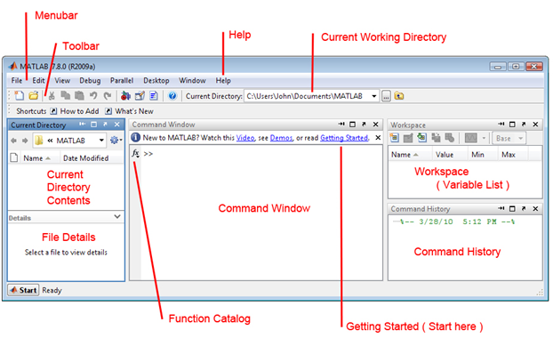
MATLAB WORK ENVIRONMENT

Slide 6
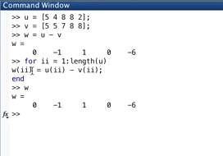
IN MATRIX CALCULATIONS THERE ARE LOOPS WORKING BEHIND. MATLAB DOES IT ITSELF.

Slide 7
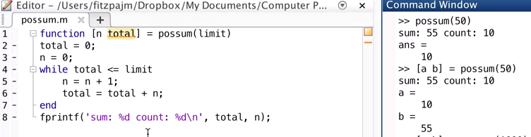
FUNCTIONS & Use of fuction returning argument

Slide 8
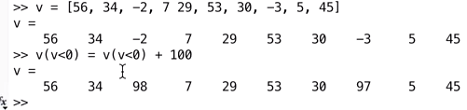
Matlab follows the concept of Logical Indexing.
Logical indexing finds out the values less than zero and updates them.
Example of logical indexing shown:

Slide 9
The precedence rules for MATLAB operators are shown in this list, ordered from highest precedence level to lowest precedence level:
Parentheses ()
Transpose (.'), power (.^), complex conjugate transpose ('), matrix power (^)
Unary plus (+), unary minus (-), logical negation (~)
Multiplication (.*), right division (./), left division (.\), matrix multiplication (*), matrix right division (/), matrix left division (\)
Addition (+), subtraction (-)
Colon operator (:)
Less than (<), less than or equal to (<=), greater than (>), greater than or equal to (>=), equal to (==), not equal to (~=)
Element-wise AND (&)
Element-wise OR (|)
Short-circuit AND (&&)
Short-circuit OR (||)

Slide 10
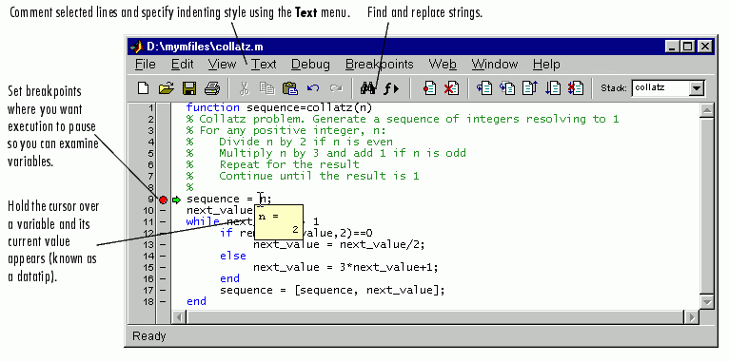
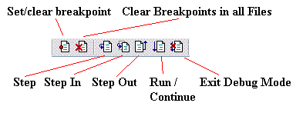
MATLAB TEXT EDITOR AS A DEBUGGER

Slide 11
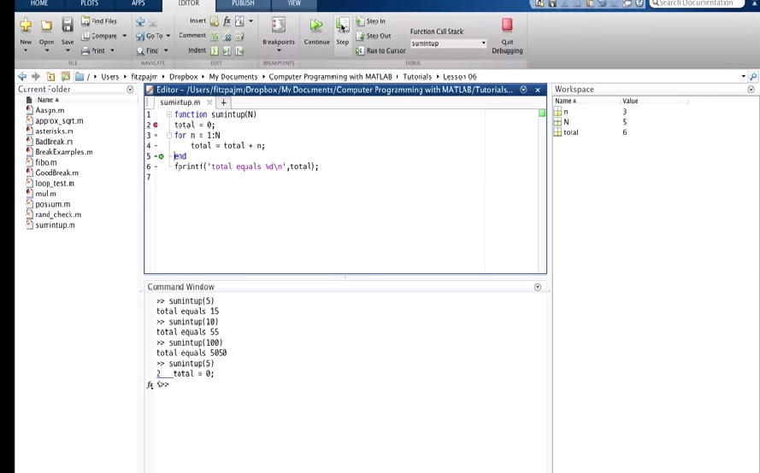
This shows how the debugger works. By clicking the step button ,you can see the for loop working step by step

Slide 12
FILE INPUT/OUTPUT
IN MATLAB

Slide 13
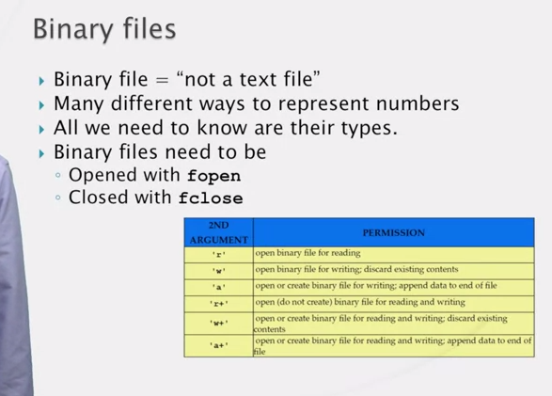

Slide 14
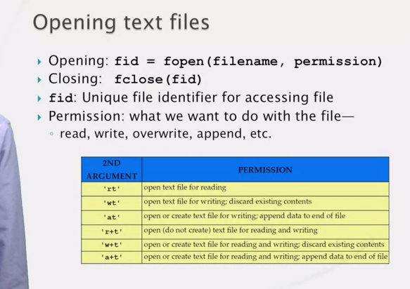

Slide 15
WHY MATLAB ?
EASY TO USE.
RAPID DEBUGGING OF CODES.
EFFICIENT MATRIX AND VECTOR CALCULATIONS.
OBJECT ORIENTED PROGRAMMING.
EASY CREATION OF SCIENTIFIC AND ENGINEERING GRAPHICS.
EXTENSIBILITY(TOOLBOXES).
STRING PROCESSING.
FILE I/O OPERATIONS.

Slide 16
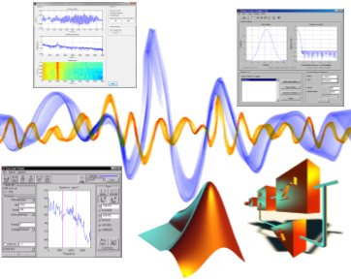
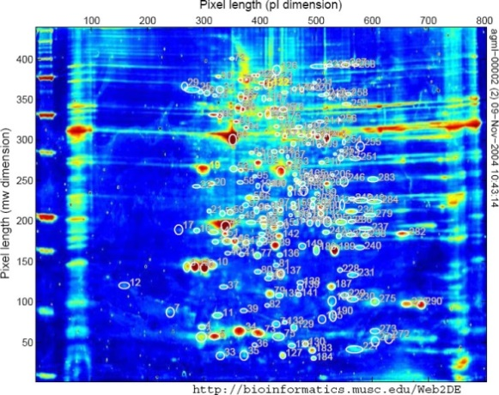
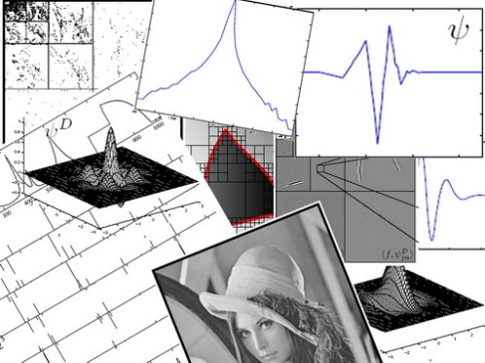
USES
MATLAB IS WIDELY USED AS A COMPUTATIONAL TOOL IN SCIENCE AND ENGINEERING ENCOMPASSING THE FIELDS OF PHYSICS,CHEMISTRY,MATH.IT IS USED IN THE RANGE OF APPLICATIONS INCLUDING:
Signal processing and communication.
Image and video processing.
Control system.
Test and Management.
Computational Finance.
Computational Biology.

Slide 17
DISADVANTAGES
It uses a large amount of memory and on slow computers it is very hard to use.
It sits “on top” of Windows, getting as much CPU time as Windows allows it to have. This makes real-time applications very complicated.

Slide 18
MY VIEW
According to me, I felt it somewhat similar like shell programming in unix/linux in various ways:
* It has a command window just as we have our shell prompt in linux/unix.
* It has an editor to type functions or to make files as we have in VI editor.
*It has many commands like pwd,cd somewhat similar to shell programming in linux/unix.

Slide 19
Thank you

