Slide 1
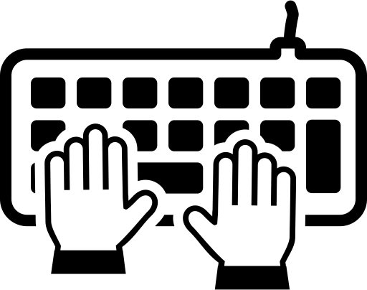
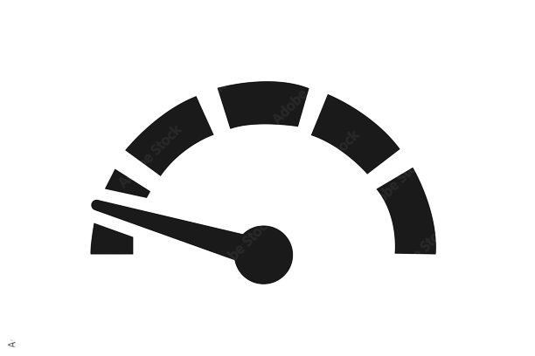
PYTHON PROJECT
PROJECT NAME : LETS CHECK YOUR TYPING SPEED.
BY : DIVYA JAIN
UID: 21MCA2399

Slide 2
Index:
Overview of the project
Why should you have fast typing speed with good accuracy.
How typing speed and accuracy is calculated.
Tips to improve typing speed and accuracy.
Glimpse of the project.

Slide 3
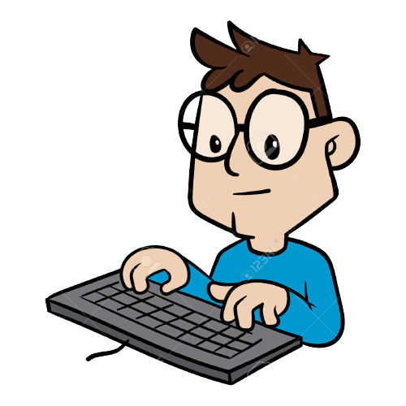
Overview :
Have you ever checked your typing speed? Well, It’s very beneficial to track your typing speed and enhance it with regular practice. Here I created a Speed Typing Test Python Project which will check your typing speed.
With typing speed this project will also tell you the time you took to
type the text and also the accuracy with which the text is typed.
If you want to check your typing speed again , this project also
contains a reset button, so you can reset the text
and type again.

Slide 4


Why should you have fast typing speed with good accuracy????

Slide 5

Becoming a fast typer is really important these days, almost every office job includes typing documents on your computer and you should be a really good typer to do your work effectively.
Also as a student, you will need to type many essays and assignments, academic papers, articles, term papers, dissertations, etc. so it can save your lots of time.
Another benefit of learning to type faster is that you will not have to look at the keyboard and think about where your fingers are going. Once you are typing fast, you will be able to look directly at the screen, and your fingers will type without you even thinking about the movements.
This means that you will be able to improve your focus.
.
And if you are an employee, you could learn how to increase your typing speed to impress your boss, or you can simply give yourself more time to spend on other things.

Slide 6
How typing speed and accuracy is calculated :
The time starts when the user clicks on the input box and when the user hits return key “Enter” then we perform the difference and calculate time in seconds.
To calculate accuracy, we did a little bit of math. We counted the correct typed characters by comparing input text with the display text which the user had to type.
The formula for accuracy is:
(correct characters)x100/ (total characters in sentence)
The WPM is the words per minute. A typical word consists of around 5 characters, so we calculate the words per minute by dividing the total number of words with five and then the result is again divided that with the total time it took in minutes.
Since our total time was in seconds, we had to convert it into minutes by dividing total time with 60.
Formula becomes: total words/5 x total time (for seconds)
And total words x 60/5 x total time (for minutes)

Slide 7

Lets have a look on my project

Slide 8
Libraries used in the project:
Pygame -- help you make games and other multimedia applications
Sys -- provides access to the variables and functions
Time -- to handle time-related tasks
Random -- used to generate random numbers
String -- allows you to create and customize your own string formatting

Slide 9
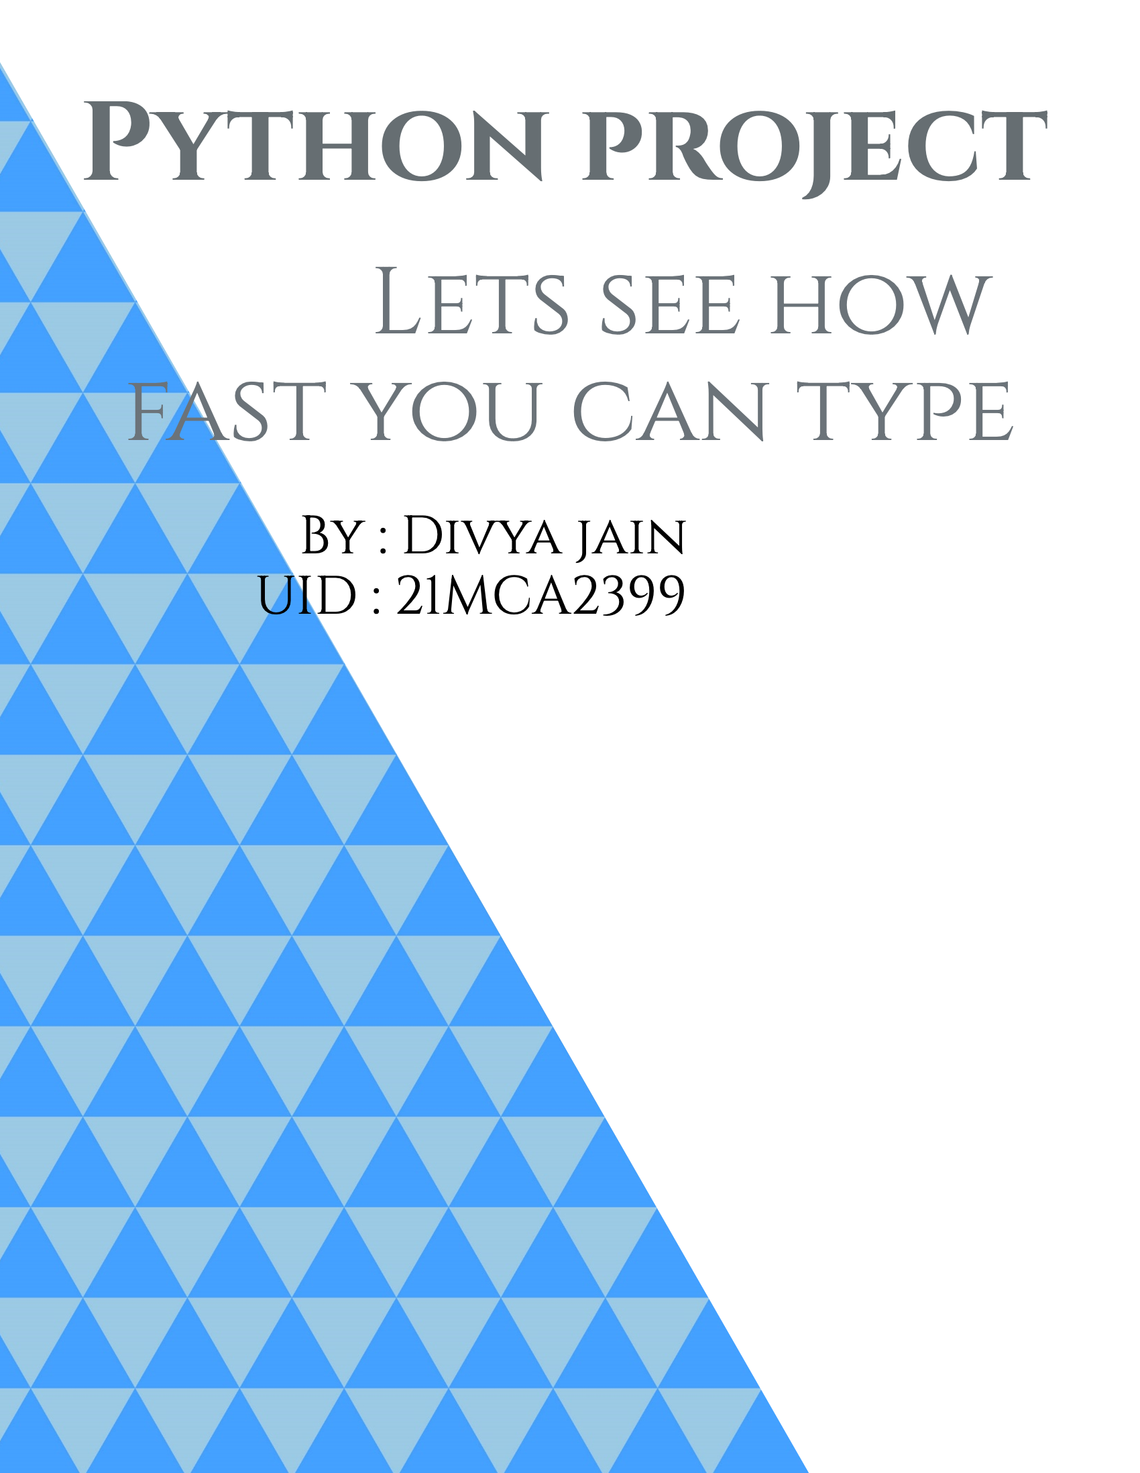
The project starts here

Slide 10
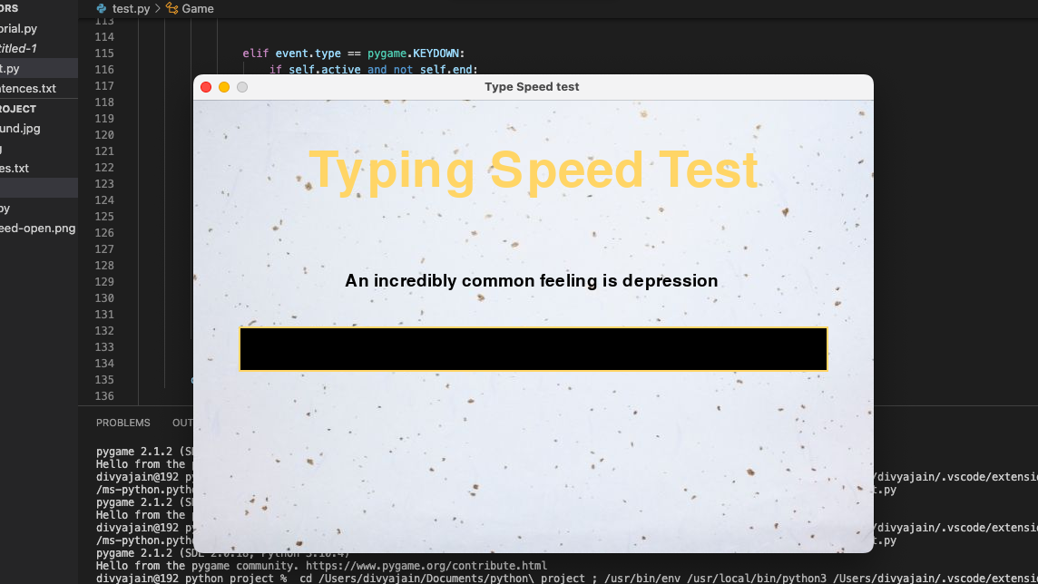


Slide 11
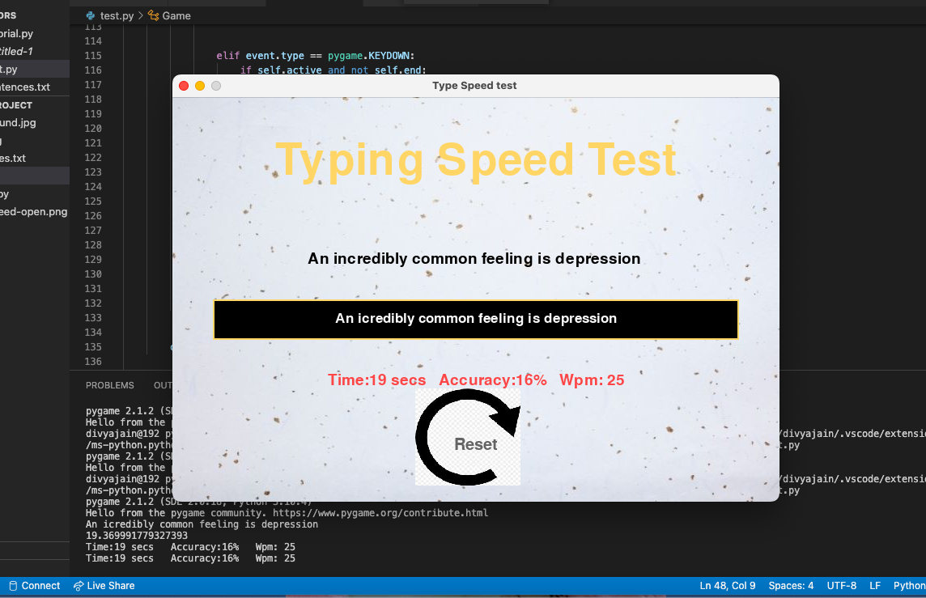

Slide 12

Tips for Improving Your Typing Speed & Accuracy

Slide 13

The most important tip that everyone knows is to not look to on the keyboard while typing.
When you look at the keyboard your speed reduces and you will make more errors as you won't see what is appearing on the screen and will waste more time on correcting mistakes

Slide 14

Before you start typing you should sit straight with your spine not leaning forward towards your table.
A correct straight position helps to increase the level of your concentration and will make you more focused to be able to type faster
A correct straight position helps to increase the level of your concentration and will make you more focused to be able to type faster

Slide 15

Also, the right position of your wrists and elbows is also important to type faster. Do not bend your arms up or down.

Slide 16


