Slide 1
Titanic Dataset: Report of Findings
Visual Analysis & Insights

Slide 2
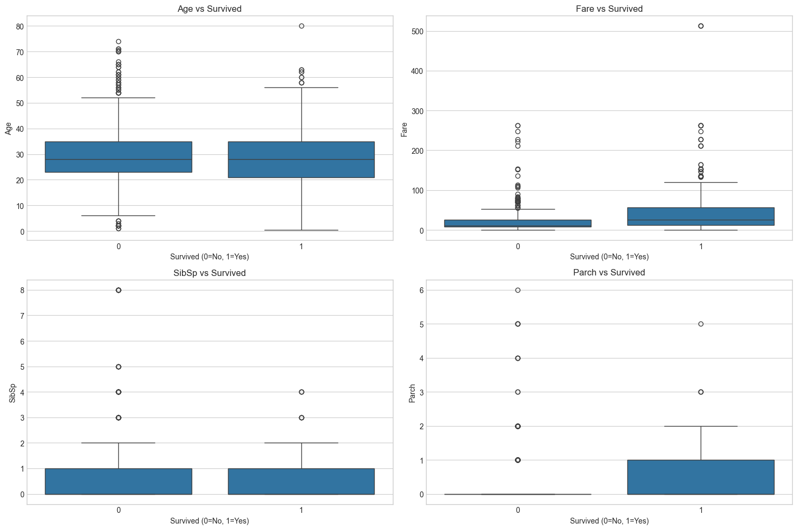
Box Plot - Numerical Features
• Fare shows significant outliers. • Age distribution is wide. • SibSp and Parch are right-skewed.

Slide 3
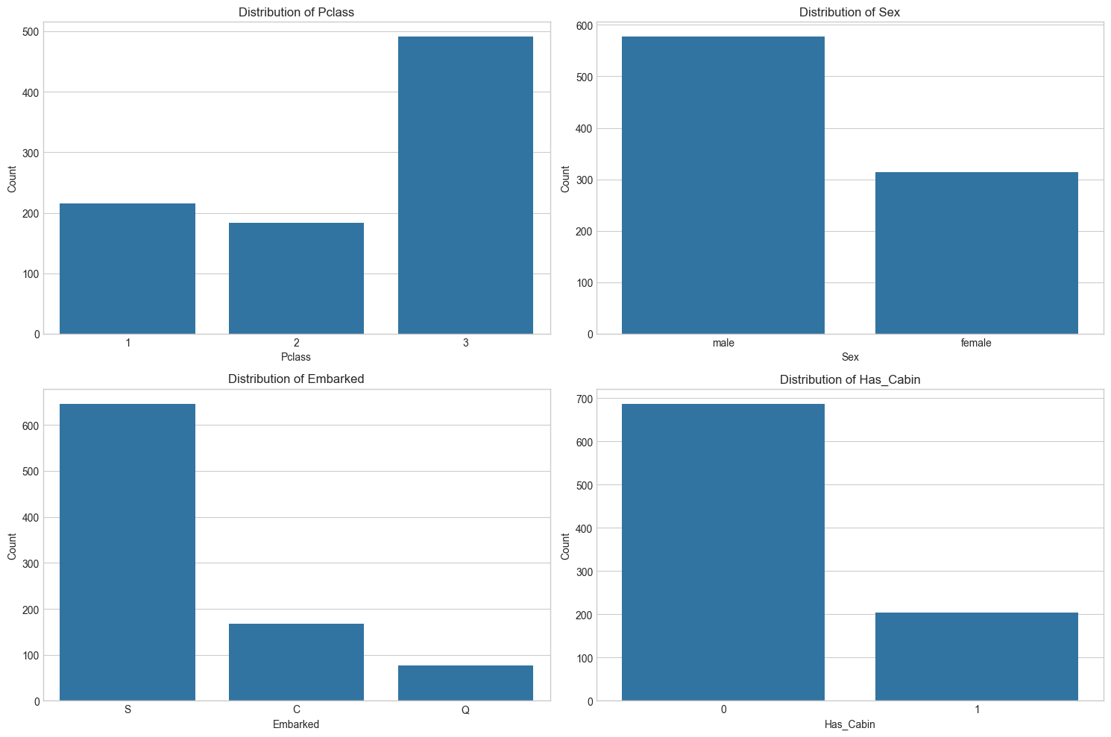
Count Plot - Categorical Features
• Most passengers were in 3rd class. • Majority of travelers were male.
• Embarkation mostly at port 'S'. • Many passengers lacked cabin data.

Slide 4
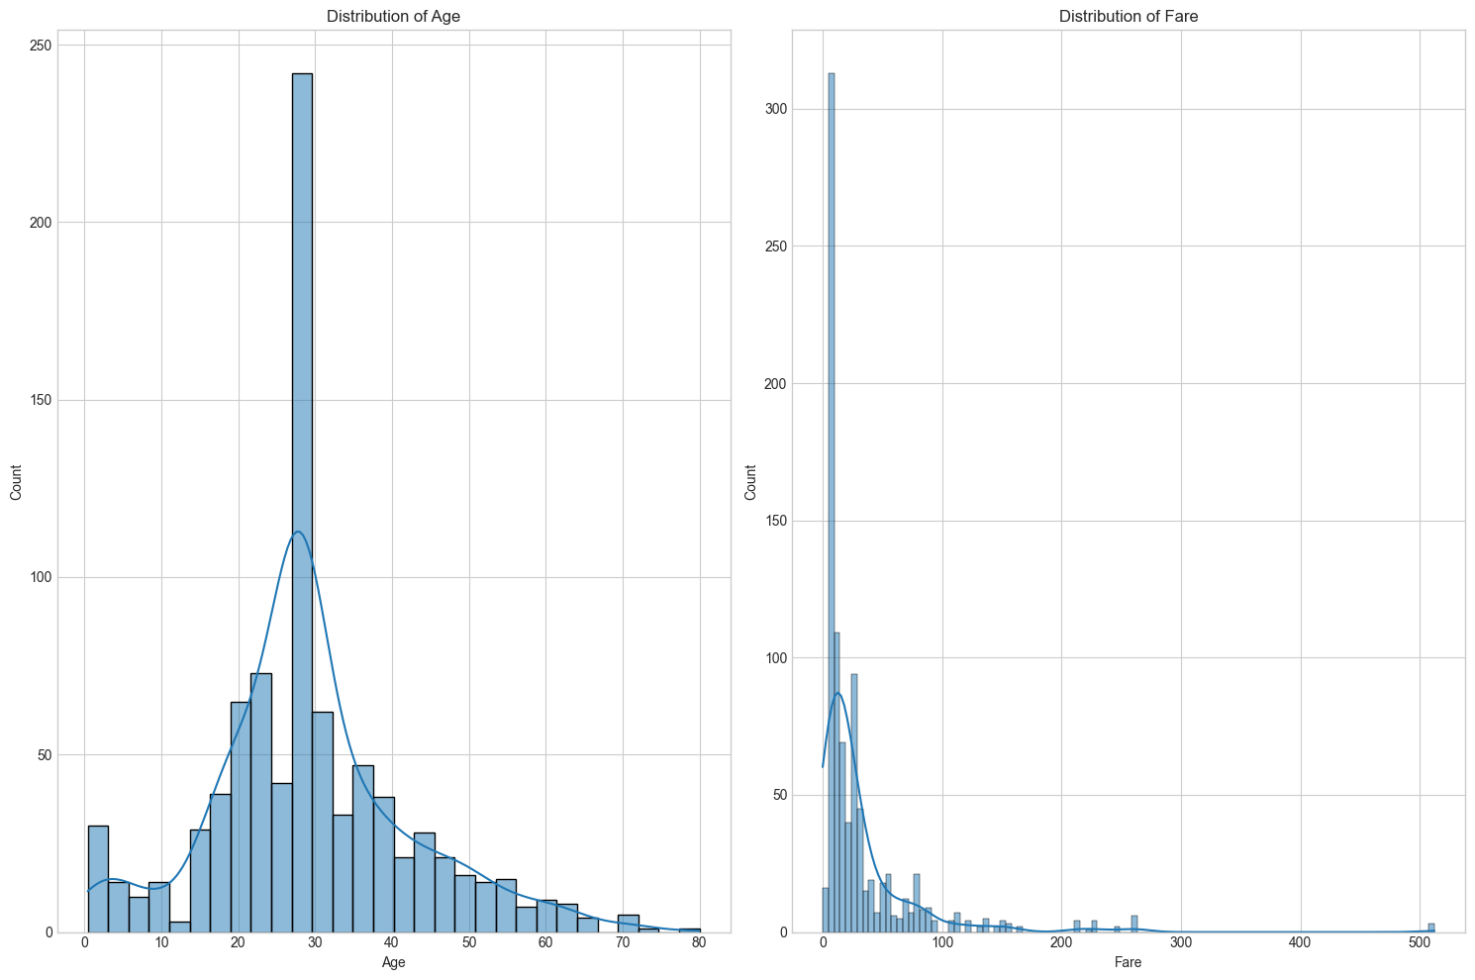
Histogram - Numerical Features
• Age is roughly normally distributed. • Fare is right-skewed with few high values.

Slide 5
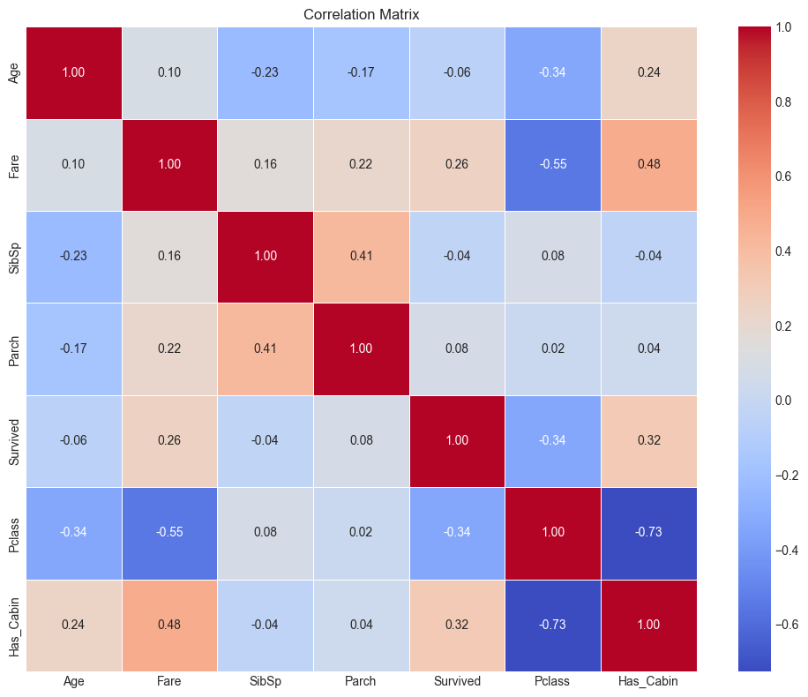
Correlation Matrix
• Positive correlation between SibSp and Parch suggests families traveled together. • Fare and Pclass show a negative correlation: higher classes paid more.

Slide 6
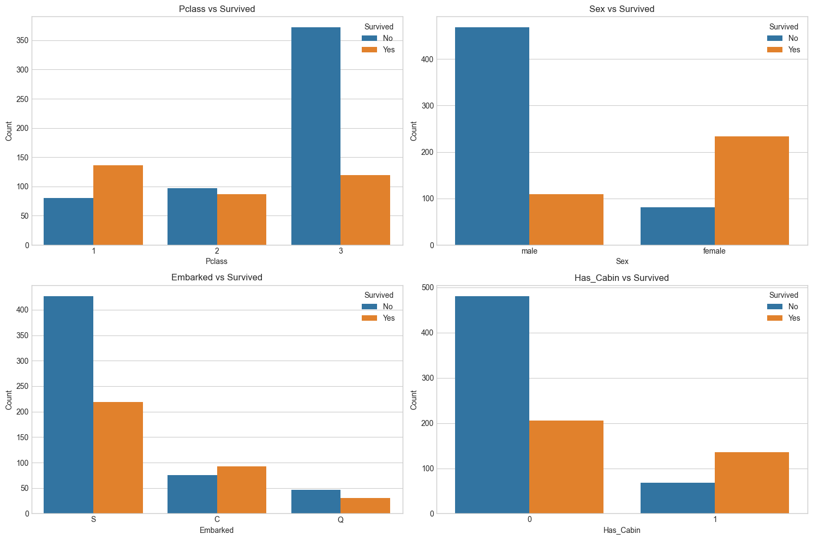
Survival by Categorical Features
• Survival higher among females and 1st class passengers. • Known cabin info linked to better survival chances.

Slide 7
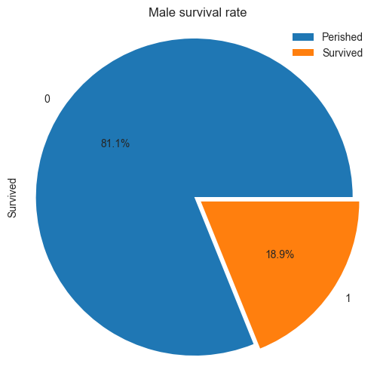
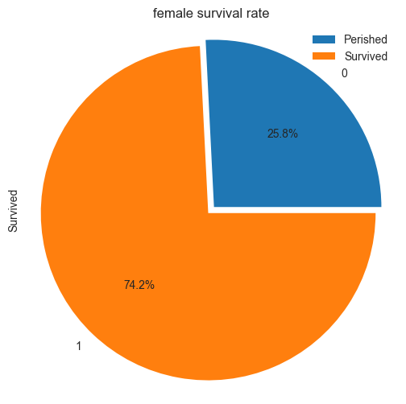
Pie Chart - Survival Rate by Gender
• Females had a notably higher survival rate. • Male survival was significantly lower.

Slide 8
Conclusion
Gender and class significantly influenced survival chances.
Socioeconomic factors (e.g., fare paid) correlate with survival.
Insights from this data can inform future safety protocols and fairness in emergency responses.

