Slide 1
A Decentralized PKI to issue, verify and revoke certificates over Blockchain

Slide 2
Team Members
Rohitangsu Das
Jayson Cena
Maddi Kamal Divya
Hu Hui

Slide 3
Content
Introduction
Certificate (and its structure)
Signing
Revocation
Future Works

Slide 4
INTRODUCTION

Slide 5
INTRODUCTION
Although a CA (Certificate Authority) is defined as trusted, we’ve seen many cases a CA is compromised
Symantec, Google, etc.
Weakness in current PKI system
TLS and SSL (X.509, predecessor) use chain-of-trust
Single entity trust entity leads to monopoly
CAs are prone to compromise and operational errors (impersonating and MiTM attack)
What we propose
Decentralized PKI to issue, verify and revoke certificates over Blockchain

Slide 6
RELATED WORKS
IKP (Instant Karma PKI)
Key problem to address
A better way to incentivize CAs to improve security and report misbehaviour
To automate the process to report unauthorized certificate
Solution
Smart contract platform – Ethereum (IKP Authority - maintain CA’s information; Detector - report suspicious certificate)
Reaction Policy to automate reaction against unauthorized certificate
CertCoin/NameCoin
CertCoin is built upon NameCoin: behave like decentralized DNS, and used as a permanent ledger to store CertCoin information.
CertCoin
Key issue addressed
Offer guarantee of identity retention
Solution
Cryptographic primitives
cryptographic accumulators
distributed hash tables
Both only address partial

Slide 7
Every CA is considered as an Entity in the model.
Entities will have nodes to verify, validate and revoke certificates.
Every entity should have at least a fixed number of minimum nodes to participate and it cannot exceed the maximum nodes.
A new node can be added after verification of new node done by the existing nodes. Requester submits a certificate to the blockchain to verify and it is put on the current, open block.
Once the block is closed, it will be visible to all nodes in the blockchain network.
A browser/client will initiate the request and it will receive response with similar details as the original TLS specification along with updated certificate information after validation done by nodes and the transaction IDs on the blockchain where the certificate was signed.
A browser/client can decide to accept or reject the certificate based on the number of signatures done by the validating nodes.

Slide 8
CERTIFICATE AND ITS STRUCTURE

Slide 9
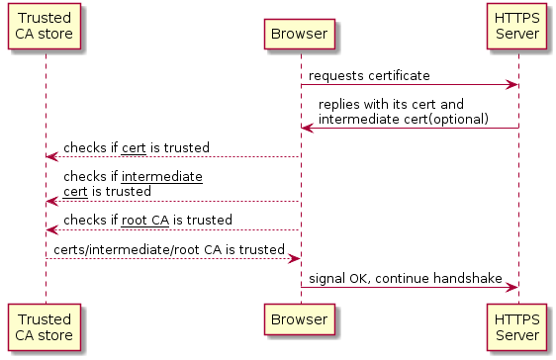
How browser authenticates x.509 certs

Slide 10
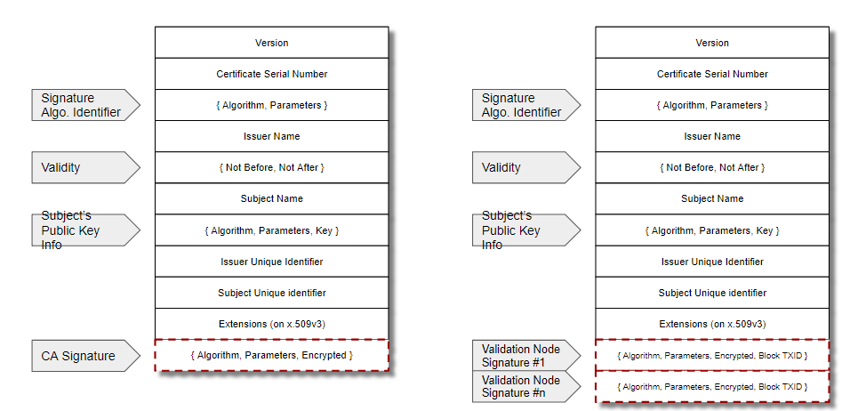
Standard x.509 Cert vs Decentralized PKI Cert

Slide 11
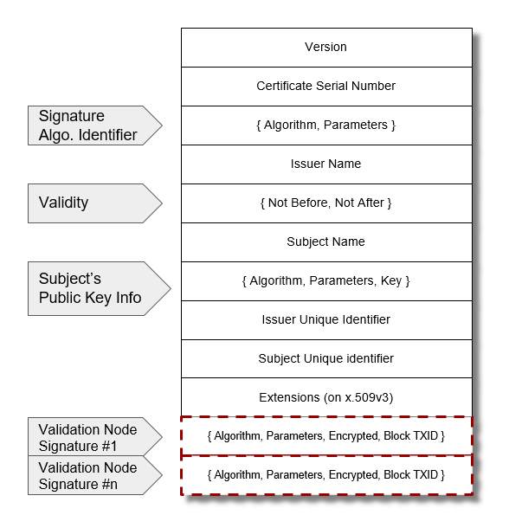
Standard x.509 Cert vs Decentralized PKI Cert
Certificates are signed by multiple CA certificates which also includes the transaction ID where the certificate signature was done on the blockchain

Slide 12
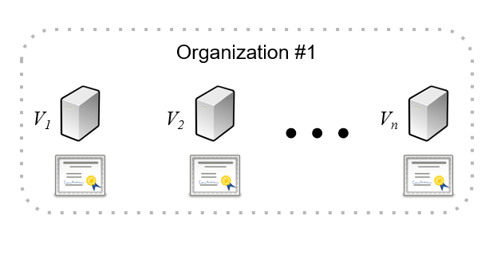
Trust Model on CA Network
Multiple CA nodes for every member entity
Every organization or entity will have an equal number of validating nodes distributed on different locations

Slide 13
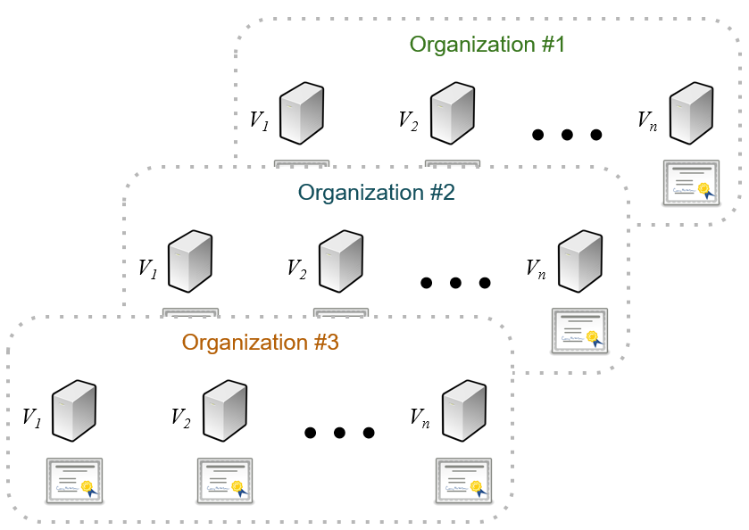
Trust Model on CA Network
Multiple entities form a consortium
There are multiple organizations that are a member of the consortium. They are also maintaining their own number of validating nodes

Slide 14


Trust Model on CA Network

Slide 15
Trust Model on CA Network
Cross-certification between certs
Each Validating Node’s CA certificate should be signed and trusted by the verifier. In this case, V₁ signed and trusts V₂ before they can establish connection

Slide 16
But before that … Design Restrictions
This will be done on a private blockchain network with only few selected members which each members represents a single node. The reason for this that validations are done by adding a custom DNS record and/or adding a file containing a hash and served over HTTP. We don’t want 100,000 nodes verifying which can cause a DDoS attack
Good uptime is needed to ensure that all member nodes can sign all certs. That’s why we’re going to assign on members to an organization who has a capability to maintain the required infrastructure uptime.
This is going to be a private network so only selected, trusted nodes can join the network. Each selected organization should have an equal node on the network. This is to prevent a certificate signed by rogue nodes. 1 bogus, signed certificate might cause an issue

Slide 17
Certificate Issuance and Validation

Slide 18
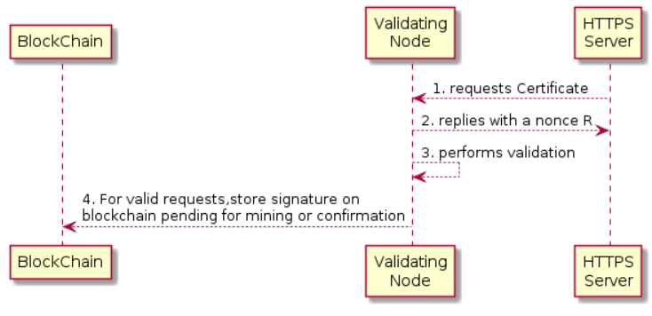
Certificate Request
Notes:
@startuml
participant "BlockChain"
participant "Validating\nNode"
participant "HTTPS\nServer"
"HTTPS\nServer" --> "Validating\nNode": 1. requests Certificate
"Validating\nNode" --> "HTTPS\nServer": 2. replies with a nonce R
"Validating\nNode" --> "Validating\nNode" : 3. performs validation
"Validating\nNode" --> "BlockChain": 4. For valid requests,store signature on\nblockchain pending for mining or confirmation
@enduml

Slide 19
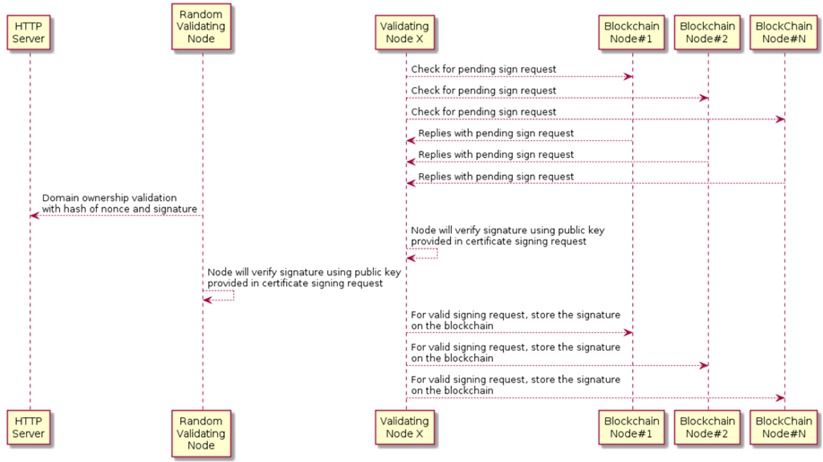
Certificate Validation
Notes:
@startuml
participant "HTTP\nServer"
participant "Random\nValidating\nNode"
participant "Validating\nNode X"
participant "Blockchain\nNode#1"
participant "Blockchain\nNode#2"
participant "BlockChain\nNode#N"
"Validating\nNode X" --> "Blockchain\nNode#1": Check for pending sign request
"Validating\nNode X" --> "Blockchain\nNode#2": Check for pending sign request
"Validating\nNode X" --> "BlockChain\nNode#N": Check for pending sign request
"Blockchain\nNode#1" --> "Validating\nNode X": Replies with pending sign request
"Blockchain\nNode#2" --> "Validating\nNode X": Replies with pending sign request
"BlockChain\nNode#N" --> "Validating\nNode X": Replies with pending sign request
"Random\nValidating\nNode" --> "HTTP\nServer": Domain ownership validation \nwith hash of nonce and signature
"Validating\nNode X" --> "Validating\nNode X": Node will verify signature using public key\nprovided in certificate signing request
"Random\nValidating\nNode" --> "Random\nValidating\nNode": Node will verify signature using public key\nprovided in certificate signing request
"Validating\nNode X" --> "Blockchain\nNode#1": For valid signing request, store the signature\non the blockchain
"Validating\nNode X" --> "Blockchain\nNode#2": For valid signing request, store the signature\non the blockchain
"Validating\nNode X" --> "BlockChain\nNode#N": For valid signing request, store the signature\non the blockchain
@enduml
@enduml

Slide 20
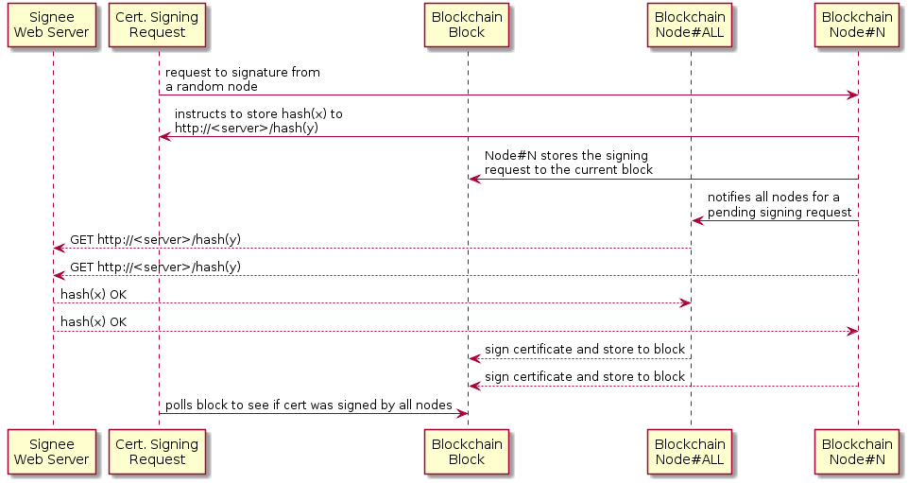
Issuance of signed cert
Notes:
@startuml
participant "Signee\nWeb Server"
participant "Cert. Signing\nRequest"
participant "Blockchain\nBlock"
participant "Blockchain\nNode#ALL"
"Cert. Signing\nRequest" -> "Blockchain\nNode#N": request to signature from\na random node
"Cert. Signing\nRequest" <- "Blockchain\nNode#N": instructs to store hash(x) to\nhttp://<server>/hash(y)
"Blockchain\nNode#N" -> "Blockchain\nBlock": Node#N stores the signing\nrequest to the current block
"Blockchain\nNode#N" -> "Blockchain\nNode#ALL": notifies all nodes for a\npending signing request
"Blockchain\nNode#ALL" --> "Signee\nWeb Server": GET http://<server>/hash(y)
"Blockchain\nNode#N" --> "Signee\nWeb Server": GET http://<server>/hash(y)
"Blockchain\nNode#ALL" <-- "Signee\nWeb Server": hash(x) OK
"Blockchain\nNode#N" <-- "Signee\nWeb Server": hash(x) OK
"Blockchain\nNode#ALL" --> "Blockchain\nBlock": sign certificate and store to block
"Blockchain\nNode#N" --> "Blockchain\nBlock": sign certificate and store to block
"Cert. Signing\nRequest" -> "Blockchain\nBlock": polls block to see if cert was signed by all nodes
@enduml

Slide 21
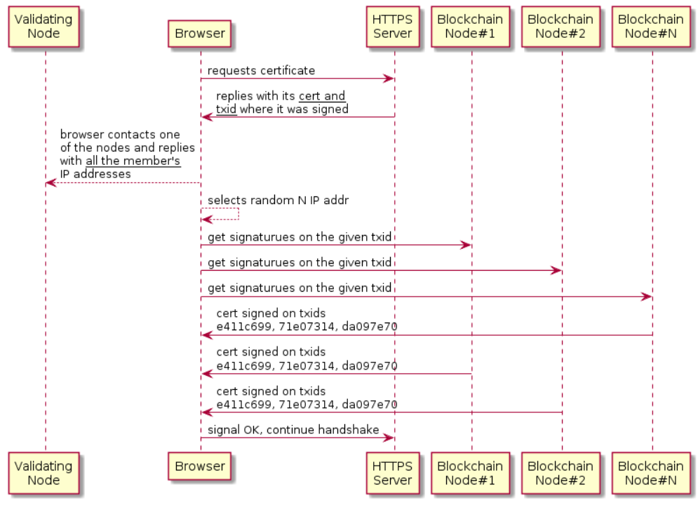
How Browser Authenticate Certs from a Decentralized CA
Notes:
@startuml
participant "Validating\nNode"
participant Browser
participant "HTTPS\nServer"
participant "Blockchain\nNode#1"
participant "Blockchain\nNode#2"
participant "Blockchain\nNode#N"
Browser -> "HTTPS\nServer": requests certificate
"HTTPS\nServer" -> Browser: replies with its __cert and__\n__txid__ where it was signed
Browser --> "Validating\nNode": browser contacts one of the\n nodes and replies with\n__all the available validating nodes addresses__
Browser --> Browser: selects random N IP addr
Browser -> "Blockchain\nNode#1": get signaturues on the given txid
Browser -> "Blockchain\nNode#2": get signaturues on the given txid
Browser -> "Blockchain\nNode#N": get signaturues on the given txid
Browser <- "Blockchain\nNode#N": cert signed on txids\ne411c699, 71e07314, da097e70
Browser <- "Blockchain\nNode#1": cert signed on txids\ne411c699, 71e07314, da097e70
Browser <- "Blockchain\nNode#2": cert signed on txids\ne411c699, 71e07314, da097e70
Browser -> "HTTPS\nServer": signal OK, continue handshake
@enduml

Slide 22
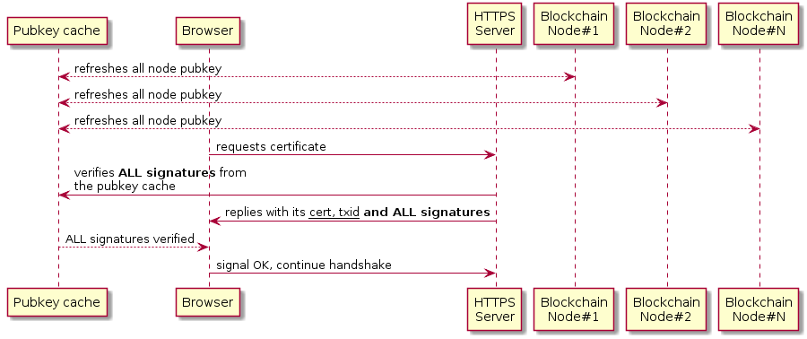
How browser authenticates certs from a Decentralized CA (signature stored on cert)
Notes:
@startuml
participant "Pubkey cache"
participant Browser
participant "HTTPS\nServer"
"Pubkey cache" <--> "Blockchain\nNode#1": refreshes all node pubkey
"Pubkey cache" <--> "Blockchain\nNode#2": refreshes all node pubkey
"Pubkey cache" <--> "Blockchain\nNode#N": refreshes all node pubkey
Browser -> "HTTPS\nServer": requests certificate
"HTTPS\nServer" -> "Pubkey cache": verifies **ALL signatures** from\nthe pubkey cache
"HTTPS\nServer" -> Browser: replies with its __cert, txid__ **and ALL signatures**
"Pubkey cache" --> Browser: ALL signatures verified
Browser -> "HTTPS\nServer": signal OK, continue handshake
@enduml

Slide 23
Certificate Revocation

Slide 24
Revocation
1. Nodes on the blockchain can vote to revoke their signature from a certificate and then revocation are added to a separate, “revocation” blockchain store.
2. When the browser tries to verify the cert, “revocation” blockchain store will be queried first to see if the cert was revoked before doing an authentication

Slide 25
Current Revocation Mechanism
The Certificate Authority maintains a Certificate Revocation List(CRL), which it periodically updates. As the name suggests, it is a storehouse of all the revoked certificates.
Revocation is necessary to prevent invalid certificates from being circulated.
Revocation is triggered upon the following conditions: if a CA improperly issued a certificate, or if a private-key has been compromised, or any domain did not adhere to the policies of a valid certificate issuance.

Slide 26
Current Revocation Mechanism(Contd)
A browser connecting to a remote server over https, receives the certificate of the remote server.
A validation step requiring the non-occupancy of the certificate in the current CRL is important before trusting the certificate. To ensure this, the browser needs to connect to the updated CRL and get the validation result.
This process is often a costly mechanism, requiring considerable bandwidth. Negates the purpose of PKI, certificates should be self validating.
Faster protocol such as OCSP, works better.

Slide 27
Modelling the CRL
There are many ways to implement CRL.
Distributed secure hash tables such as Kademlia, can address the availability and scalability of maintaining the revoked certificates.
Constant expected lookup time is indeed a motivation.
However, additional burden in maintaining dht together with our blockchain.
Important to note, distributed systems are inherently more complex.
Another approach, to model a revoked certificates as a transaction.
However, this approach might increase the lookup time as entire blockchain needs traversing.

Slide 28
Cryptographic Accumulators
A tool for compact set membership representation and secure set membership proof, was first introduced by Benaloh and Demare.
When an element is added to a set by means of an accumulator, a membership witness is generated.
Different types of accumulators: RSA, Bilinear, Merkle Hash root
Maintaining of witnesses can be cumbersome because with each addition of an element into the accumulator, need to update the witnesses for already added elements. Need a centralized accumulator manager, bringing in the notion of single point of failure.
Therefore, we will formalize the notion of a strong accumulator.

Slide 29
Properties
Correctness: A strong accumulator is correct if an up-to-date witness wx corresponding to value x can always be used to verify the membership of x in an up-to-date accumulator a.
Soundness: A strong accumulator is sound (or secure) if it is hard to fabricate a witness w for a value x that has not been added to the accumulator.
Asynchronicity: An accumulator is asynchronous if the accumulator value and the membership witnesses can be out of sync, and veriﬁcation still works.
Finally, we will impose further restriction on the accumulator, it has to have a low-update frequency and should be old-accumulator compatible.

Slide 30
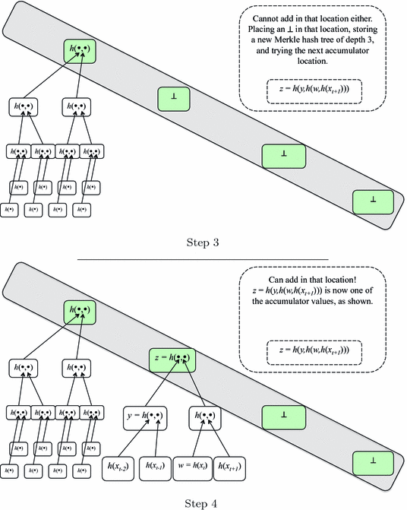
Merkle Tree Accumulator

Slide 31
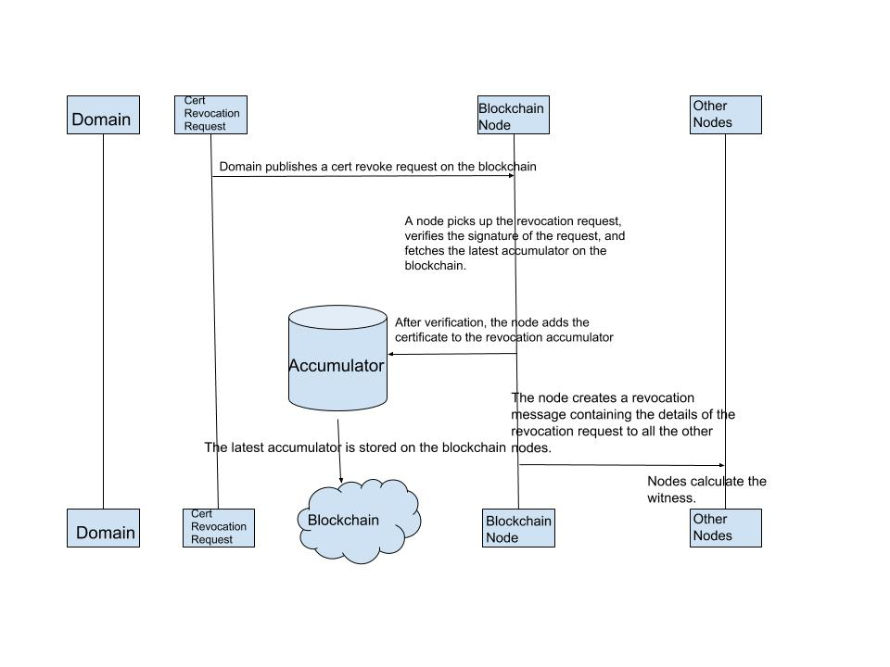
Revocation

Slide 32
Uncertainties
How does a member node signs the unsigned certificate or CSR
No one from the team has an idea how ethereum VM/scripting works (oraclize.it helped solidity to support HTTP requests)
Can we index specific fields in a data in a blockchain i.e. a JSON file stored on the blockchain and specific fields are indexed for fast querying
Can you do multiple signing of a certificate from multiple nodes in a single transaction?
Inefficiency - need to verify cert from multiple nodes (majority? Select random X nodes?)
How to verify if a node is a member of the correct blockchain network?
How do we know that the signature that we’re querying are on the correct blockchain and not on the fork?

Slide 33
Future Work
Implementation and benchmarking
Design monetization logic on the network
Handle partition on validating nodes

Slide 34
Thank You

