Slide 1
DOSCM
Group Work 4 & 5
ABC vs XYZ Analysis
Group 7
Arushi - 440554
Bhargav Sridhar - 441060
Divya Khanolkar - 443123
Mohammad Tayyab - 442237
Shreya Umre - 443641

Slide 2
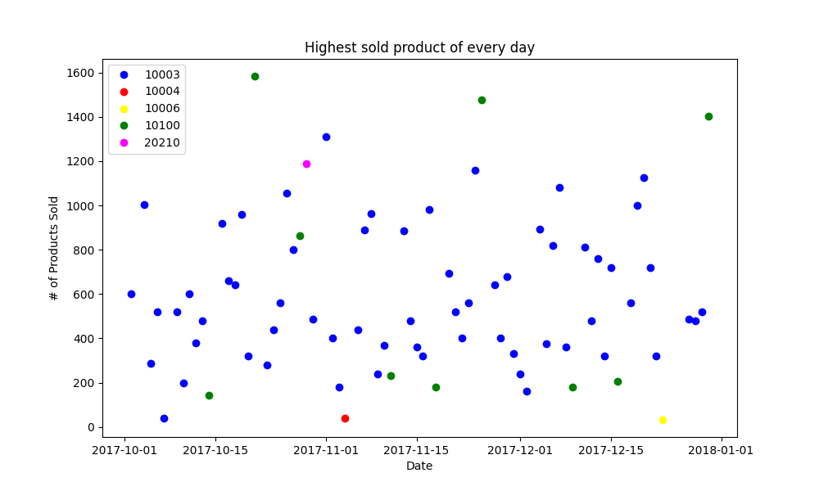
Observations
Number of Unique Customers: 640
Number of Unique Articles: 176
Most Sold Product: 10408
Avg. Products Sold per Day: ~71
Total Sales till Date: 10080326
Product sold the most number of units/day: 10003
Product sold the maximum number of units for a single day: 10100
However, the product sold most in the quarter, i.e., 10408, was never the highest sold product on any single day!

Slide 3
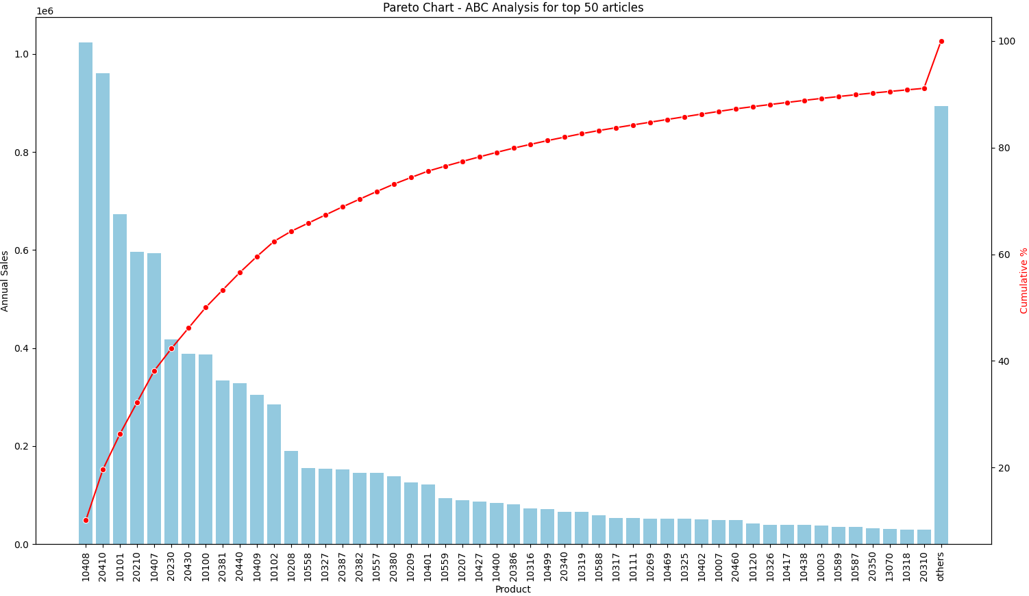
ABC Analysis for Top 50 Articles
Number of Unique Customers: 640
Number of Unique Articles: 176
Most Sold Product: 10408
Avg. Products Sold per Day: ~71
Total Sales till Date: 10080326
Product sold the most number of units/day: 10003
Product sold the maximum number of units for a single day: 10100
However, the product sold most in the quarter, i.e., 10408, was never the highest sold product on any single day!

Slide 4
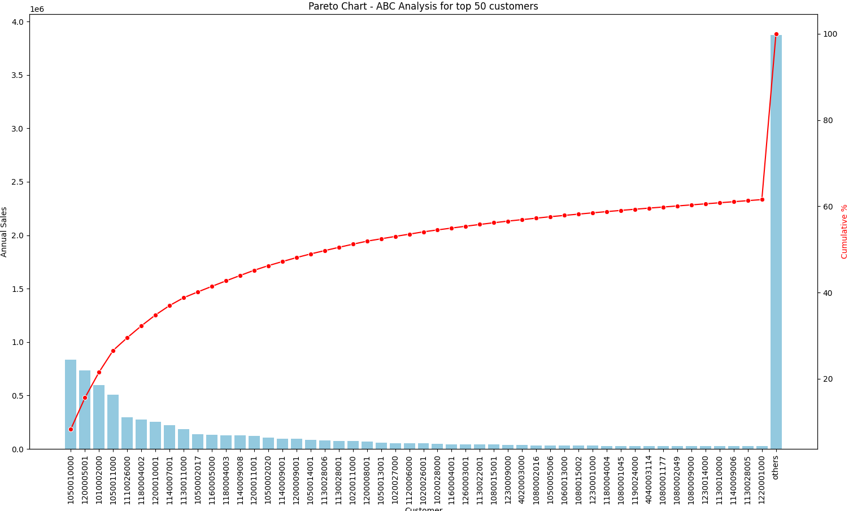
ABC Analysis for Top 50 Customers
Number of Unique Customers: 640
Number of Unique Articles: 176
Most Sold Product: 10408
Avg. Products Sold per Day: ~71
Total Sales till Date: 10080326
Product sold the most number of units/day: 10003
Product sold the maximum number of units for a single day: 10100
However, the product sold most in the quarter, i.e., 10408, was never the highest sold product on any single day!

Slide 5
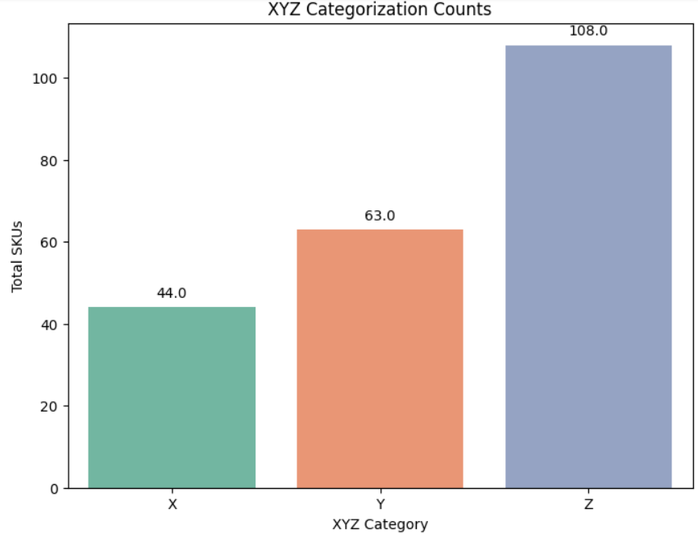
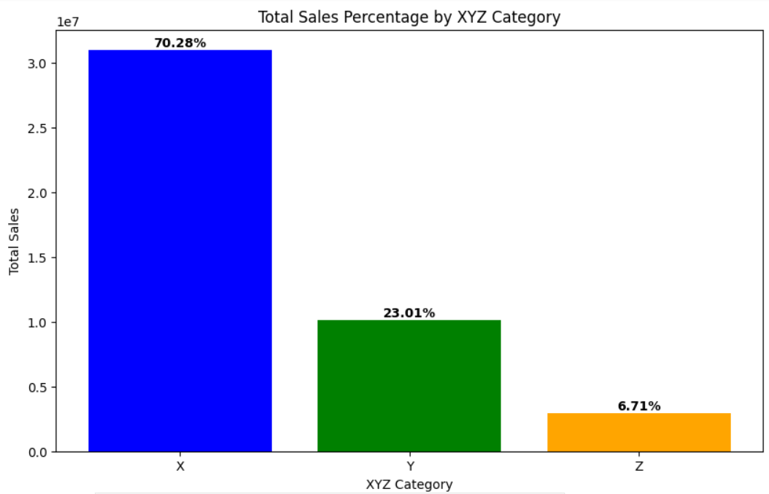
XYZ Analysis
Category X has 44% articles providing 70.28% of total sales.

Slide 6
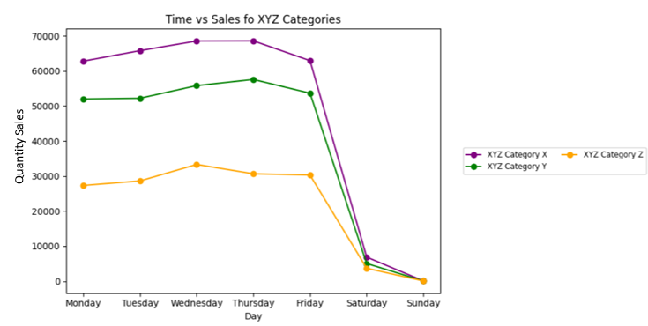
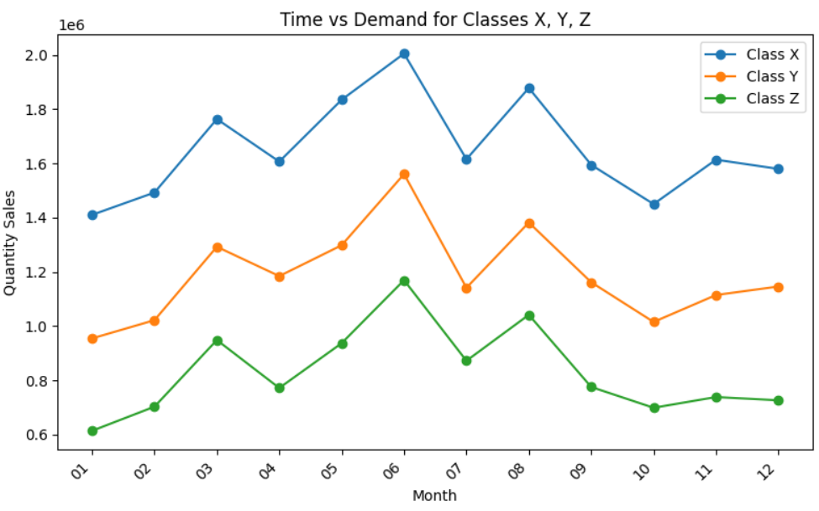
Time vs Sales
Monthly trend across classes is similar, and the highest sales is seen in May, June and August (Quarter 2).
Sales on week days is comparatively higher than the weekends.

Slide 7
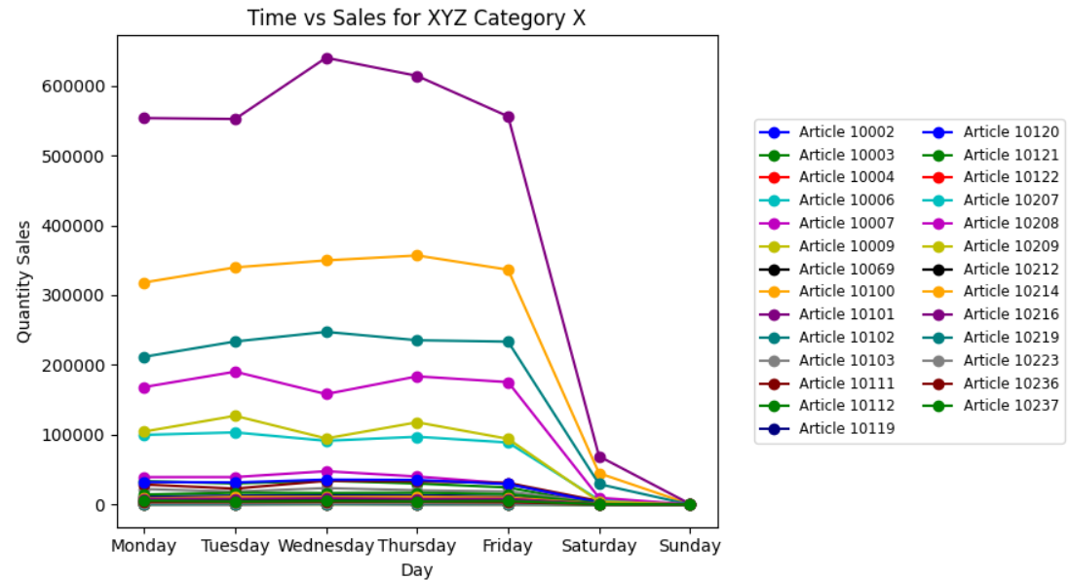
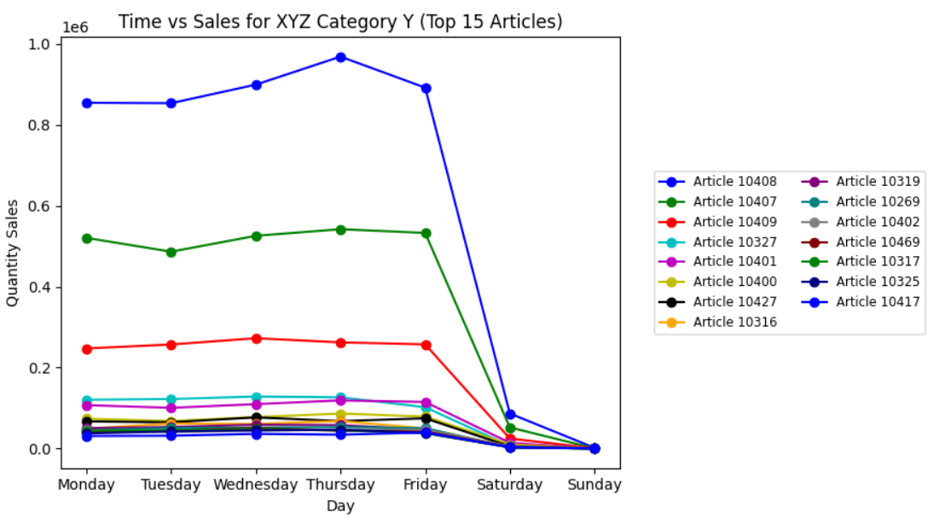
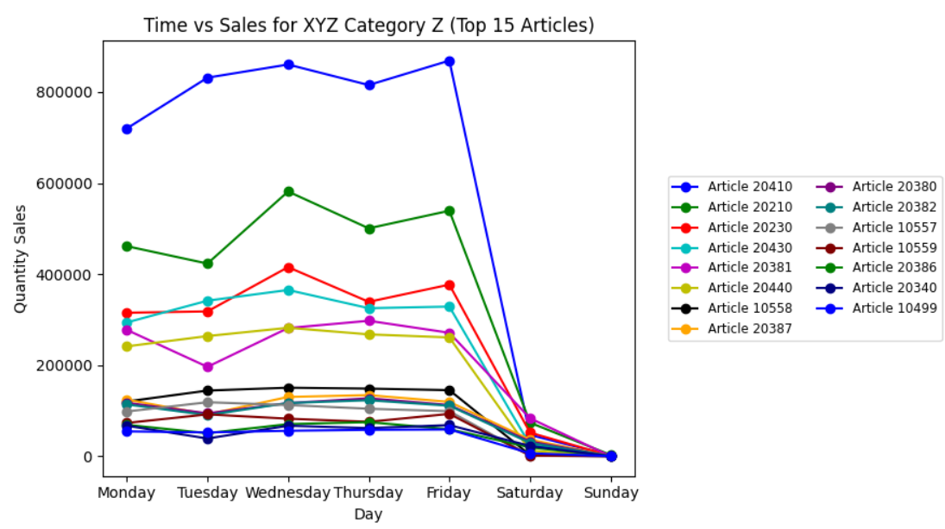
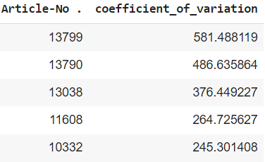
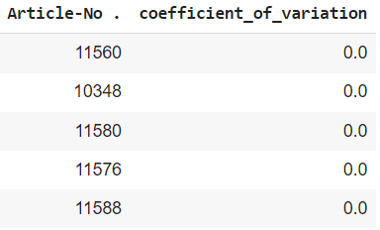
Time vs Sales
5 most variable articles
5 least variable articles

Slide 8
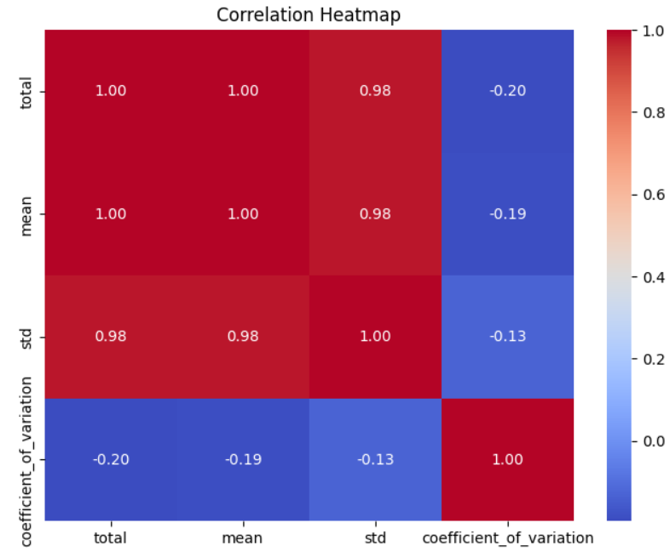
Product portfolio and the demand characteristics
Product Portfolio
Product portfolio with diverse range of products and varied demand variability
An increase in total sales may result from a mix of products with diverse sales patterns
Level of sales volatility might be associated with the overall sales volume
Demand Characteristics
Seasonal Variability: STD captures fluctuations, indicating possibility of seasonality in demand
Seasonal variations contribute to both higher total sales and increased variability in individual item sales
Assumptions on the type of products and industry
Seasonal or Trend-Driven Products:
Industry or products are subject to fluctuations, possibly due to seasonality or trends. For e.g. fashion-industry, electronic gadgets
Stable Core Products:
While there is variability in sales, the core or staple products within this industry might have relatively stable sales proportions even when total sales increase.
Consumer Goods with Price Variability:
Products in which pricing strategies influence both sales volume and variability. For instance, if there are regular sales promotions or discounts, total sales might fluctuate, but the relative variability could decrease during high-sales periods.

Slide 9
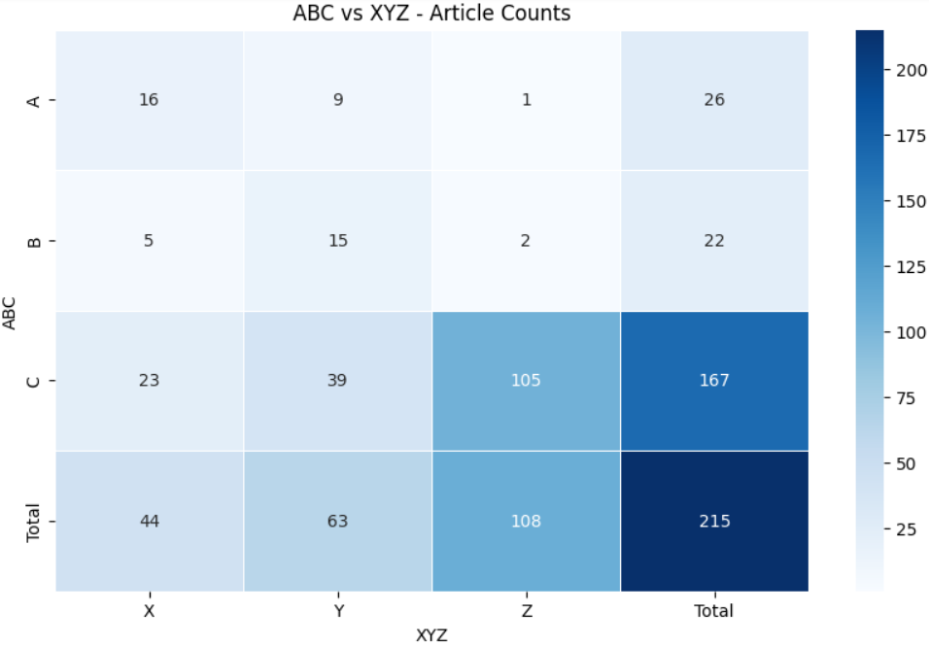
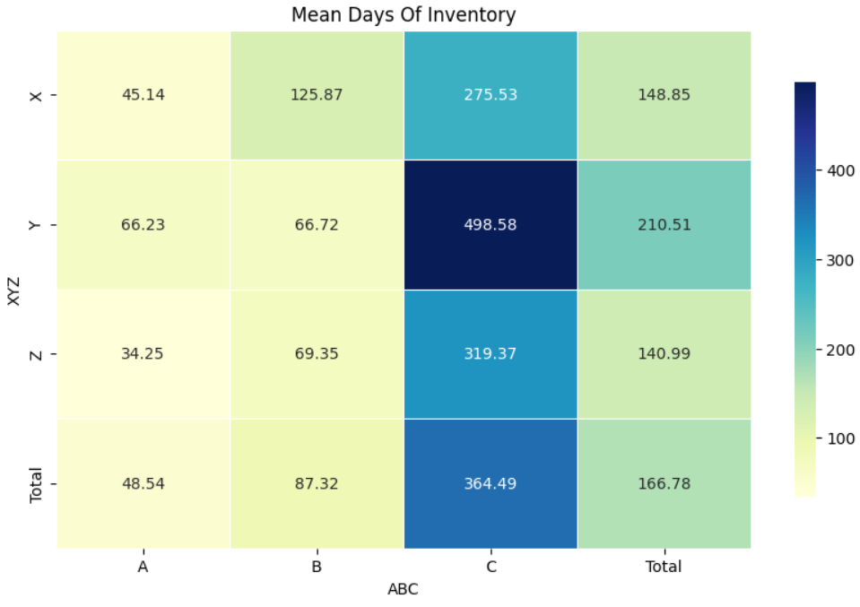
Delivery Concept and Readiness
Production Synchronous Delivery /JIT
Stock Holding
at customer
Hold at both
Delivery Concept
Stock Holding
at supplier
Single Sourcing on Demand
Delivery Readiness Based on Stock Levels:
Stock Holding
Safety Stocks
Real-time Inventory Monitoring
Recommendations:
Forecasting models: Better prediction accuracy
Optimize production schedules: Preventing stockouts
Feedback Loops: Sales, Inventory and Logistics

