Slide 1
Textile and Clothing Industry
Presented By:
Arushi - 440554
Bhargav Sridhar - 441060
Divya Khanolkar - 443123
Mohammad Tayyab - 442237
Shreya Umre - 443641
Production Network

Slide 2
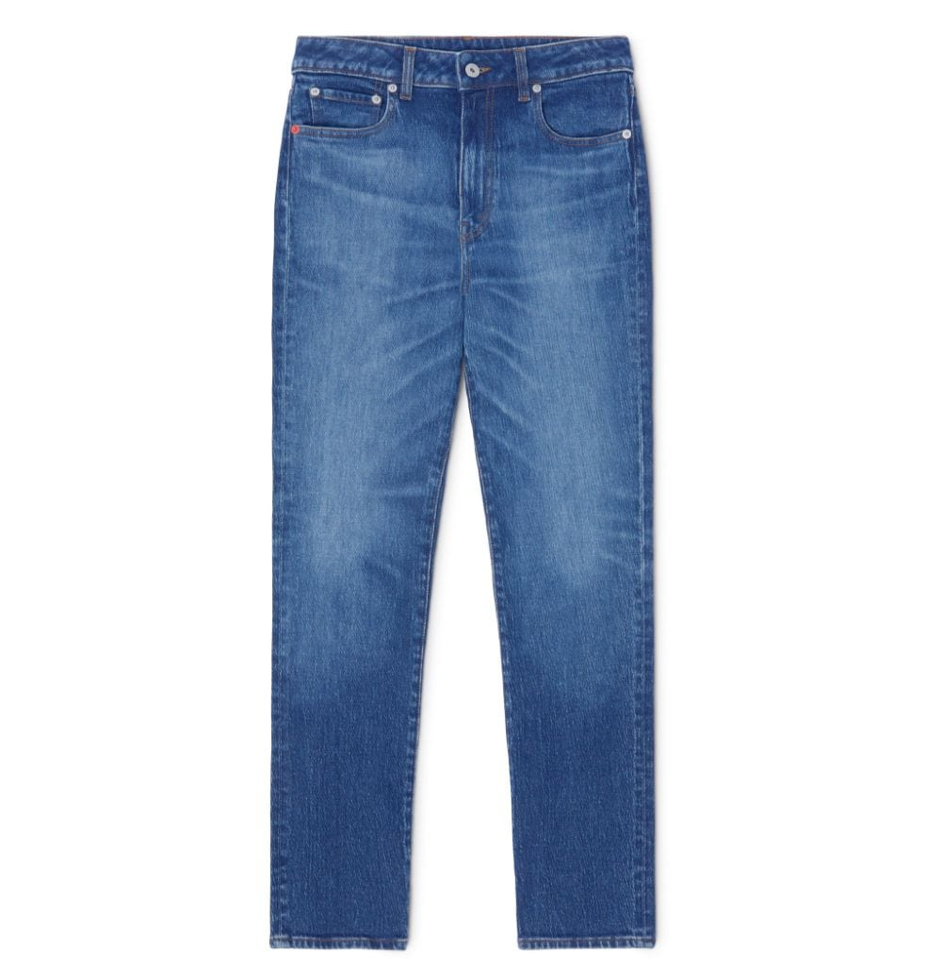
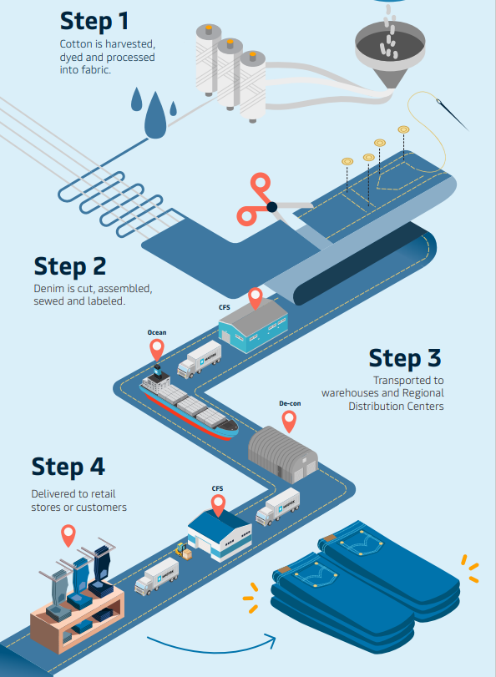
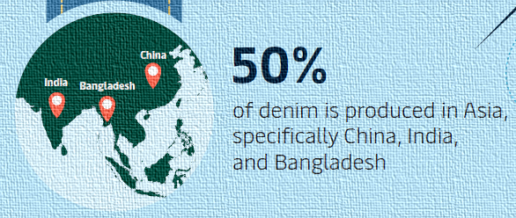
Production Network Design
DENIM JEANS
PRODUCT
Production network Phenotype: World Factory
Location / geographical position
Large-scale production capabilities
Favorable government policies
Low-labor costs
CHALLENGES
Adapting to fast fashion
Over-production
Supply Chain Management
Quality Control
Environmental Sustainability
Packaging and Logistics
PRODUCTION OF
DENIM
Source
Source: Google

